Slide 1
Children’s Health in
Northern Ireland
Summary
2023/24
April 2025

Slide 2
COVID-19
Note that some data within this presentation will be
impacted by the COVID-19 pandemic
and should be interpreted with a degree of caution.

Slide 3







Mothers – Summary
Highest live birth rate (10.4) in United Kingdom, 2023
2.1% of births are to teenage mums, 2023/24
2010/11: 15.5%
Women who smoke (at antenatal booking)
4.8% of births are to older mums (40+), 2023/24
2023/24: 9.5%
2023/24: 12.4%
Highest fertility rate across UK (1.64, 2023)
Women with diabetes
Over 1 in 4 women obese at antenatal booking (28.6%), 2023/24
2010/11: 1.8%
Note: 2023/24 data for smoking status, diabetes, and obesity have been uplifted to reflect missing data for South Eastern Health and Social Care Trust for births 9 November 2023 - 31 March 2024 (see page 4 of main report for further information).
Graphics downloaded from: thenounproject.com

Slide 4





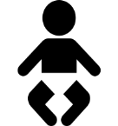

Children – Summary
40.1% of infants born by Caesarean Section, 2023/24
(22.7% elective, 17.4% emergency)
5.8% of singleton infants born pre-term (<37 weeks gestation), 2023/24
3.0% of infants born as a multiple, 2023/24
6.2% low birth weight (<2,500g, live infants), 2023/24
53.7% of infants breastfed
(partial or total), 2023/24
12.2% high birth weight (≥4,000g, live infants), 2023/24
Overweight or obese (IOTF), 2023/24:
26% of Primary 1 girls
17% of Primary 1 boys
Note: 2023/24 data for delivery method has been uplifted to reflect missing data for South Eastern Health and Social Care Trust for births 9 November 2023 - 31 March 2024 (see page 4 of main report for further information).
Graphics downloaded from: thenounproject.com

Slide 5
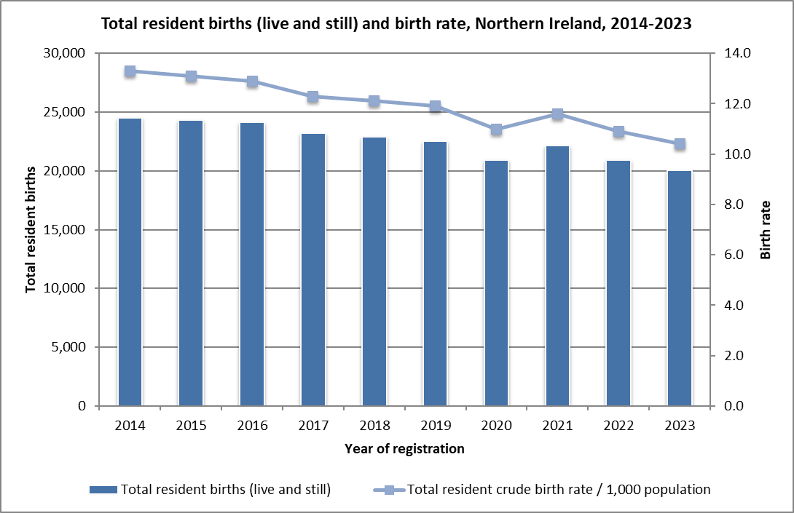
Trends in births
2023:
20,029 registered births to NI residents (total births).
Birth rate of 10.4 per 1,000 population (total births).
Live birth rate (10.4) is the highest across the four UK countries.
67 registered stillbirths.
19.0% of live births to mothers whose country of birth was not NI.
Data tables 1.1 and 1.2
Source: Northern Ireland Statistics and Research Agency, Office for National Statistics (other UK) and Central Statistics Office (RoI)
https://www.nisra.gov.uk/statistics/births-deaths-and-marriages/births
https://www.ons.gov.uk/peoplepopulationandcommunity/populationandmigration/populationestimates/datasets/vitalstatisticspopulationandhealthreferencetables
https://data.cso.ie/

Slide 6
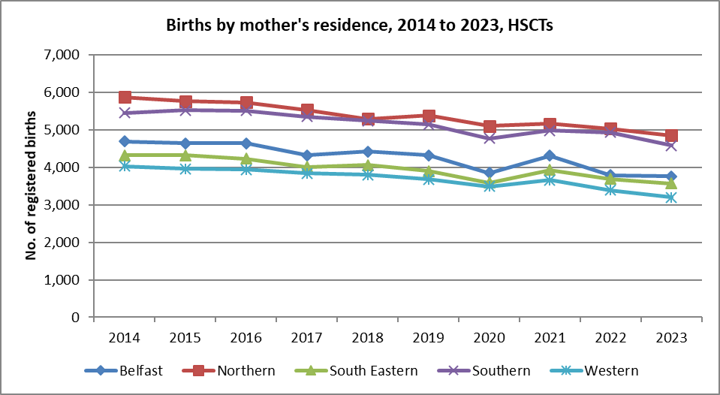
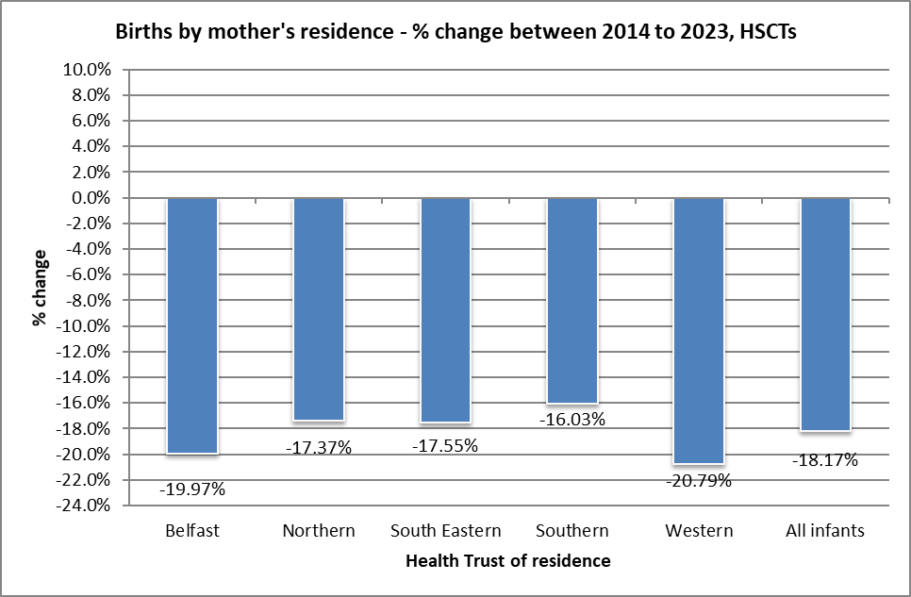
Trends in births – Health Trusts
2023:
Largest number of registered births(live) recorded to NHSCT residents (4,858), with the lowest number in the WHSCT (3,196).
Percentage share of live births by Health Trust:
  BHSCT = 18.8%
  NHSCT = 24.3%
  SEHSCT = 17.9%
  SHSCT = 23.0%
  WHSCT = 16.0%
Data table 1.2
Source: Northern Ireland Statistics and Research Agency https://www.nisra.gov.uk/statistics/births-deaths-and-marriages/births

Slide 7
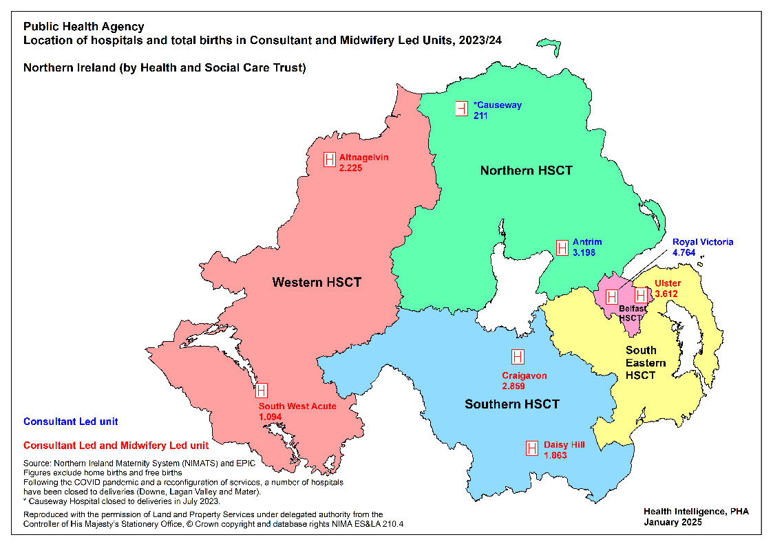
Location of Hospitals/Total births

Slide 8
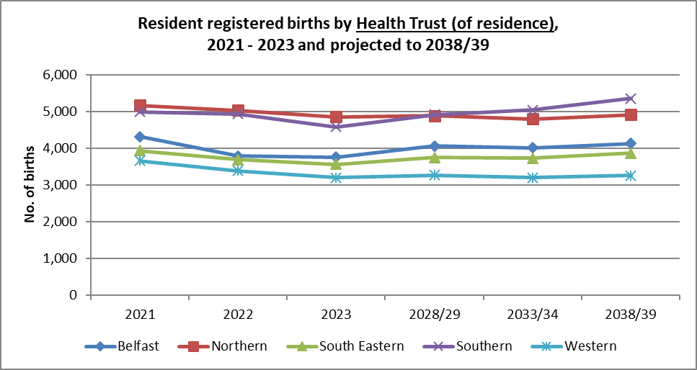
Trends - Projected Births
In the next 15 years (2023 to 2038), the number of births is projected to increase in all Health and Social Care Trust areas in Northern Ireland: Southern (16.9%), Belfast (9.9%), South Eastern (8.3%), Western (2.0%), and Northern (1.1%). Across NI, the number of births is projected to increase by 7.8%.
Data table 1.3
Source: Northern Ireland Statistics and Research Agency
https://www.nisra.gov.uk/statistics/births-deaths-and-marriages/births
https://www.nisra.gov.uk/publications/2018-based-population-projections-areas-within-northern-ireland

Slide 9
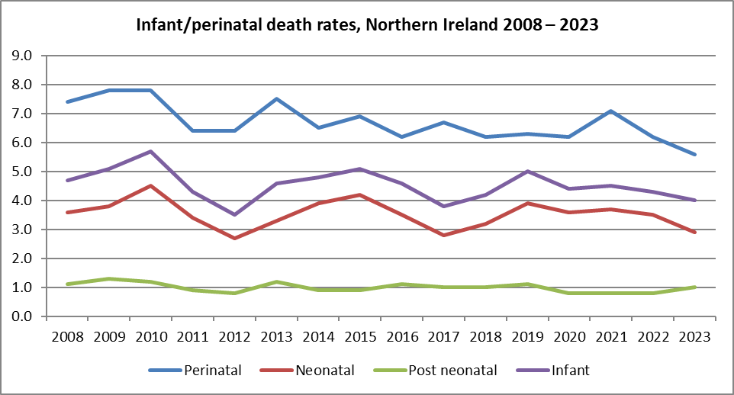
Trends - Infant Mortality
Infant mortality is considered a key indicator of the health of a population. Risk factors for infant mortality include younger mothers, smoking during pregnancy and not breastfeeding.
Perinatal deaths continue to have the highest rate of death in children aged less than one year, although this figure continues to fall (184 deaths in 2013, 113 deaths in 2023).
Data table 1.6
Source: Northern Ireland Statistics and Research Agency
https://www.nisra.gov.uk/statistics/births-deaths-and-marriages
Perinatal mortality rate: Number of stillbirths and deaths in the first week of life per 1,000 live and stillbirths per annum.
Neonatal mortality rate: Number of deaths in the first four weeks of life per 1,000 live births per annum.
Post neonatal mortality rate: Number of deaths after the first four weeks but before the end of the first year per 1,000 live births per annum.
Infant mortality rate: Number of deaths in the first year of life per 1,000 live births per annum.
Rates include non Northern Ireland residents.

Slide 10
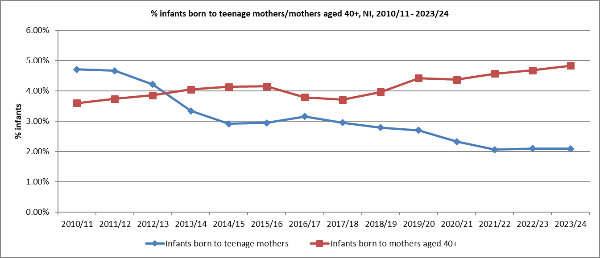
Age of mother
2023/24
Teenage mothers (<20 years):
Number of infants born to teenage mothers in 2023/24 = 417
2.1% of all infants born were to teenage mothers.
4.2% of infants born to mothers living in the most deprived areas of NI, 1.0% in the least deprived areas (NIMDM 2017).
Older mothers (aged 40+):
Overall % births increasing since 2018/19 (% infants born to mothers aged 40+ in 2023/24 = 4.8%).
3.6% in the most deprived areas, 6.2% in the least deprived areas (NIMDM 2017).
Data tables 3.1 and 3.2
Source: Child Health System
Source: Northern Ireland Statistics and Research Agency, NI Multiple Deprivation Measure 2017
https://www.nisra.gov.uk/statistics/deprivation/northern-ireland-multiple-deprivation-measure-2017-nimdm2017

Slide 11
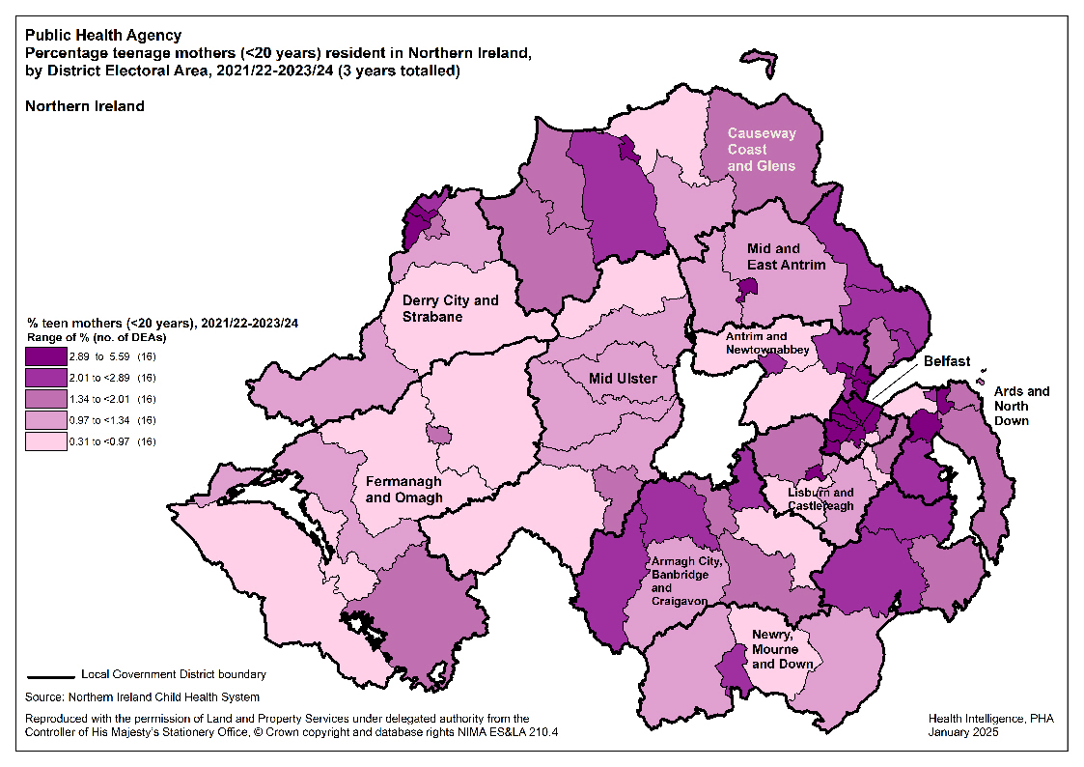
Teenage mothers

Slide 12
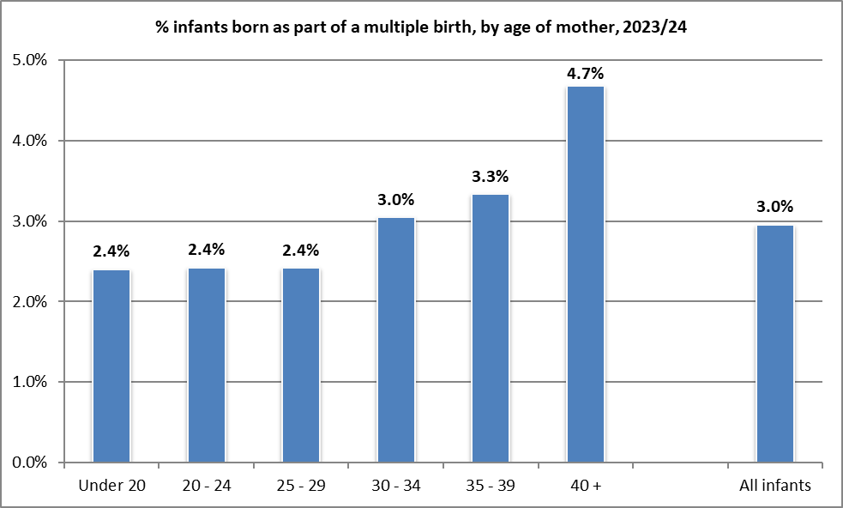
Multiple Births
2023/24:
The proportion of infants born as part of a multiple birth pregnancy increased in general with mother’s age (2.4% of those aged under 20 years who gave birth in 2023/24, compared to 4.7% of those aged 40+ years)
There was little difference in the proportion of infants born as a multiple when considering ethnic group of mother, Trust of residence of mother or deprivation status (NIMDM 2017).
Data table 4.2
Source: Child Health System
Source: Northern Ireland Statistics and Research Agency, NI Multiple Deprivation Measure 2017 https://www.nisra.gov.uk/statistics/deprivation/northern-ireland-multiple-deprivation-measure-2017-nimdm2017

Slide 13
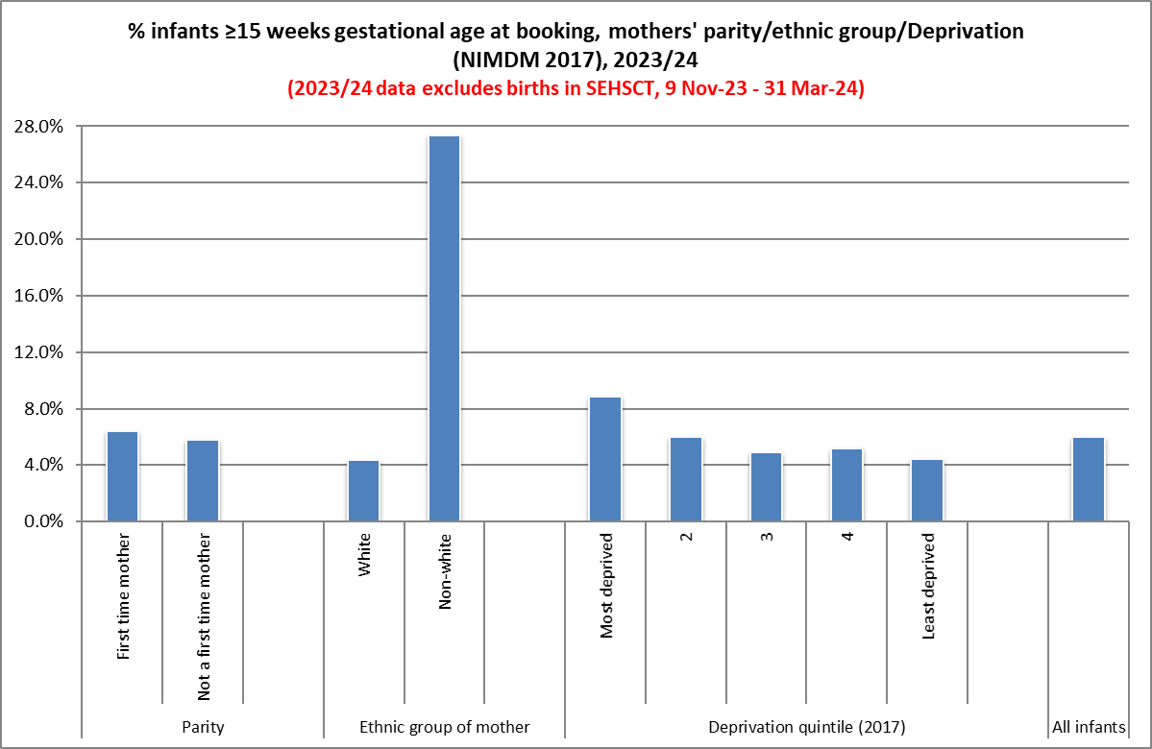
Infant Gestation - Booking
2023/24:
There are substantial differences in the timescales of when mothers book by ethnic group.
More likely that women living in more deprived areas will book for antenatal care later in their pregnancy.
Data table 5.2
Source: NI Maternity System
Source: Northern Ireland Statistics and Research Agency, NI Multiple Deprivation Measure 2017
https://www.nisra.gov.uk/statistics/deprivation/northern-ireland-multiple-deprivation-measure-2017-nimdm2017

Slide 14
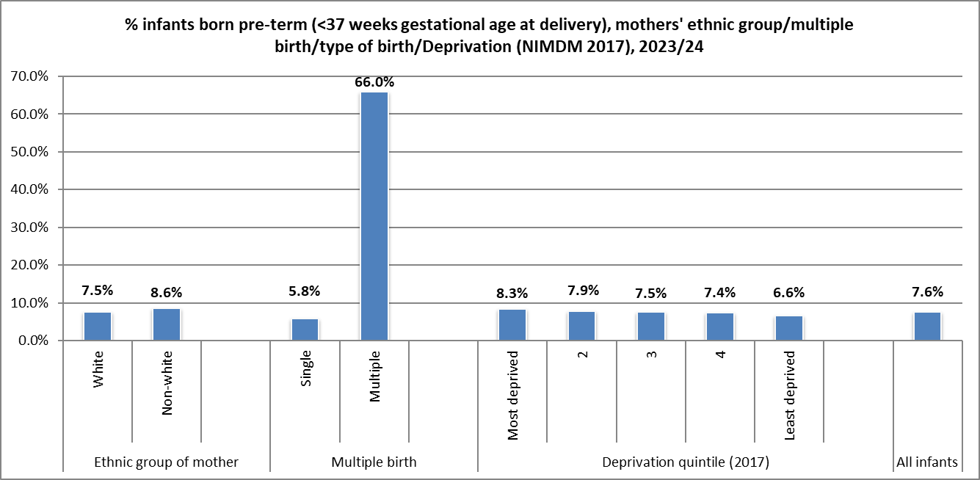
Infant Gestation - Delivery
2023/24:
Higher proportion of infants born still or as part of a multiple birth born pre-term.
Slight differences by deprivation quintile – slightly higher proportion of infants born pre-term to those mothers living in the most deprived areas (8.3%) compared to those in areas with less deprivation (6.6%).
Data table 5.5
Source: NI Maternity System and EPIC
Source: Northern Ireland Statistics and Research Agency, NI Multiple Deprivation Measure 2017
https://www.nisra.gov.uk/statistics/deprivation/northern-ireland-multiple-deprivation-measure-2017-nimdm2017

Slide 15
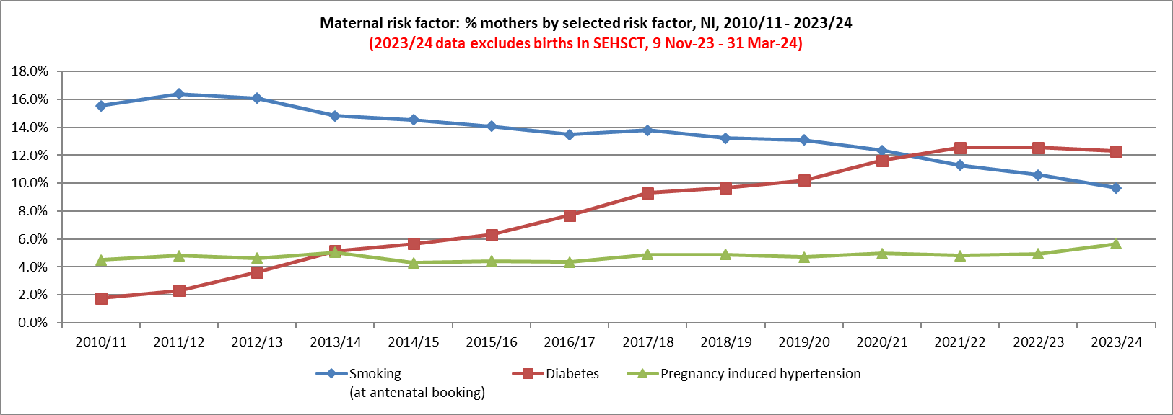
Maternal risk factors
In 2023/24, 9.7% of mothers smoked (2010/11 = 15.5%)
In 2023/24, 5.7% had pregnancy induced hypertension (2010/11 = 4.5%)
In 2023/24, 12.3% of mothers had diabetes (2010/11 = 1.8%)
Data table 6.1
Source: Child Health System (2010/11 - 2016/17), NI Maternity System (2017/18 onwards)
DIABETES - During 2022 and 2023, a validation exercise was completed on data being recorded on NIMATS for women with diabetes. As a result, data sourced from NIMATS has been amended and so will differ from previously published data.

Slide 16
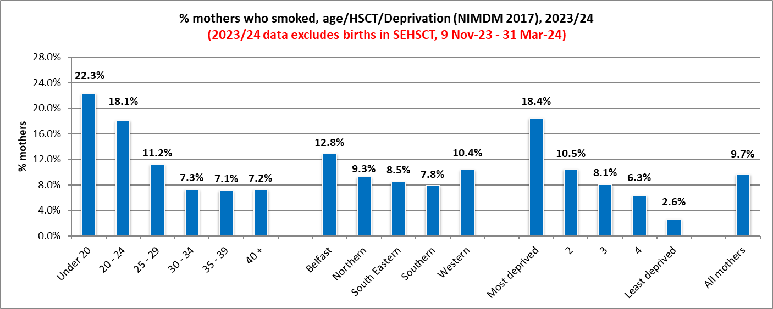
Maternal risk factors - Smoking
2023/24:
Percentage mothers who smoked at booking decreased with age.
A smaller proportion of first time mothers smoked (6.9%), compared to those who were pregnant before (10.8%).
12.8% of mothers living in Belfast Health and Social Care Trust area smoked, compared to 7.8% of those living in Southern HSCT (NI=9.7%).
In the most deprived areas, 18.4% of mothers smoked, compared to 2.6% in the least deprived areas.
Data table 6.2
Source: NI Maternity System
Source: NISRA, NI Multiple Deprivation Measure 2017 https://www.nisra.gov.uk/statistics/deprivation/northern-ireland-multiple-deprivation-measure-2017-nimdm2017

Slide 17
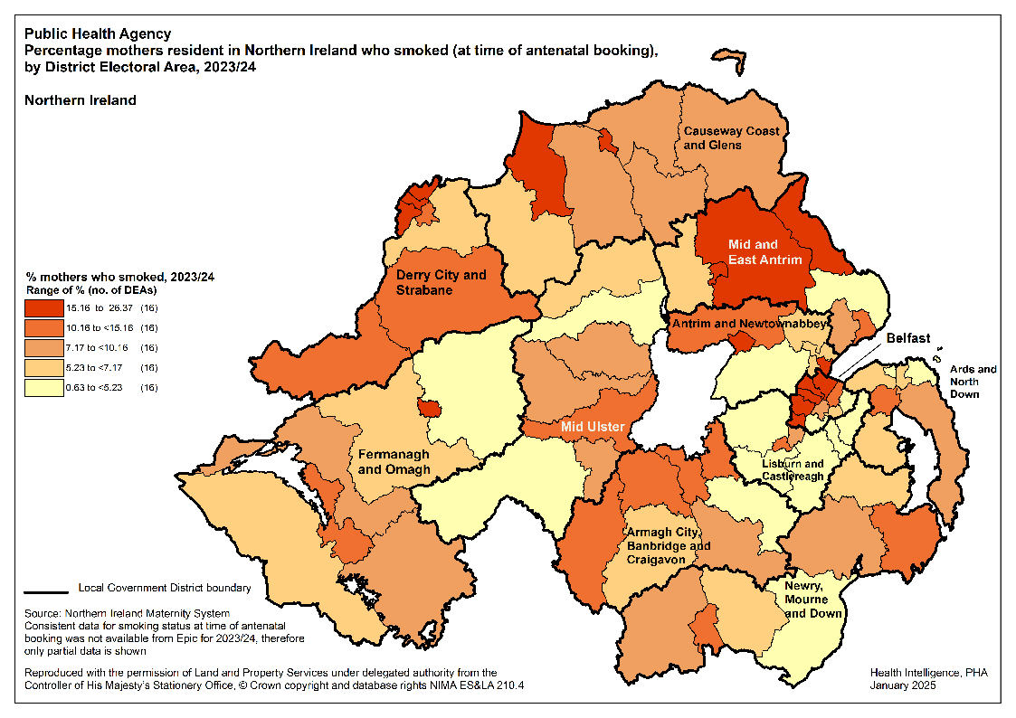
Maternal risk factors - Smoking

Slide 18
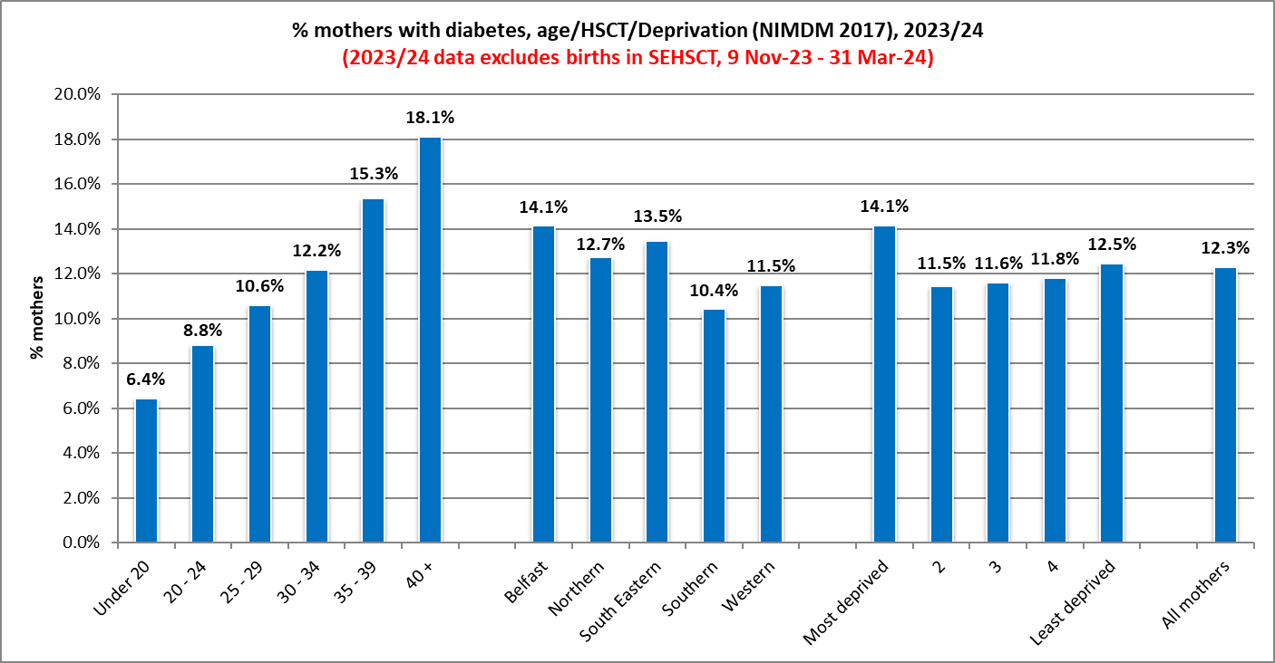
Maternal risk factors - Diabetes
2023/24:
% mothers with diabetes increased with age – 6.4% of those aged less than 20 years, rising to 18.1% of those aged 40+. (All mothers = 12.3%).
Slightly higher proportion of mothers with diabetes living in more deprived areas of Northern Ireland (14.1%). Least deprived = 12.5% (NIMDM 2017).
Data table 6.3
Source: NI Maternity System
Source: Northern Ireland Statistics and Research Agency, NI Multiple Deprivation Measure 2017 https://www.nisra.gov.uk/statistics/deprivation/northern-ireland-multiple-deprivation-measure-2017-nimdm2017

Slide 19
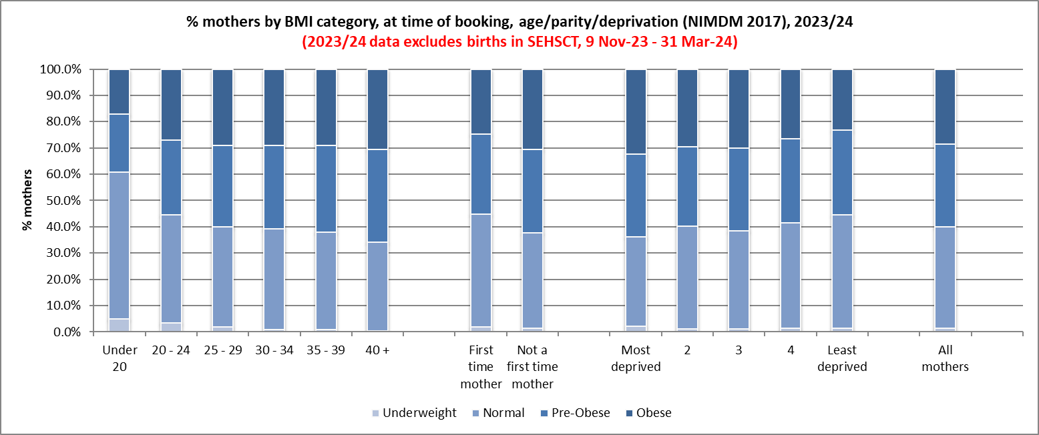
Maternal Body Mass Index (BMI)
2023/24 (at antenatal booking appointment):
60.0% of mothers giving birth were measured as pre-obese (overweight) or obese. 31.4% pre-obese, 28.6% obese.
32.3% of mothers from most deprived areas were classified as obese, 23.2% from least deprived areas.
Data table 7.2
Source: NI Maternity System
Source: Northern Ireland Statistics and Research Agency, NI Multiple Deprivation Measure 2017
https://www.nisra.gov.uk/statistics/deprivation/northern-ireland-multiple-deprivation-measure-2017-nimdm2017

Slide 20
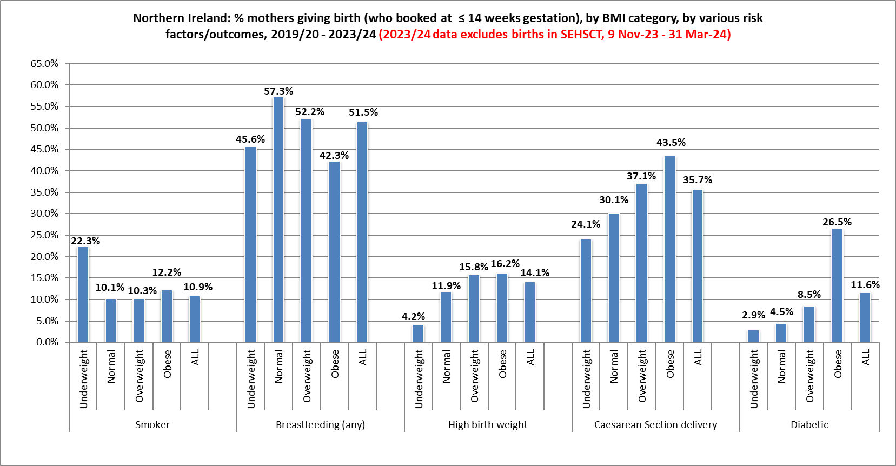
Maternal Body Mass Index (BMI)
2019/20 – 2023/24:
Figures show that a larger proportion of women (who booked at ≤ 14 weeks gestation) with a higher BMI; were more likely to have a larger baby, deliver by Caesarean Section and were less likely to breastfeed.
A higher proportion of women who smoke were more likely to be underweight.
Data table 7.4
Source: NI Maternity System

Slide 21
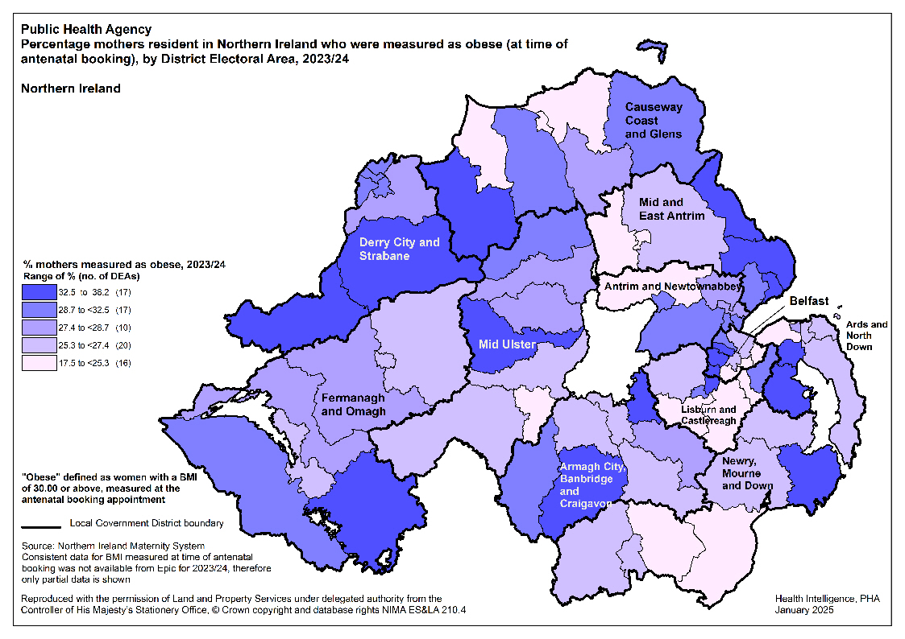
Maternal Body Mass Index (BMI)

Slide 22
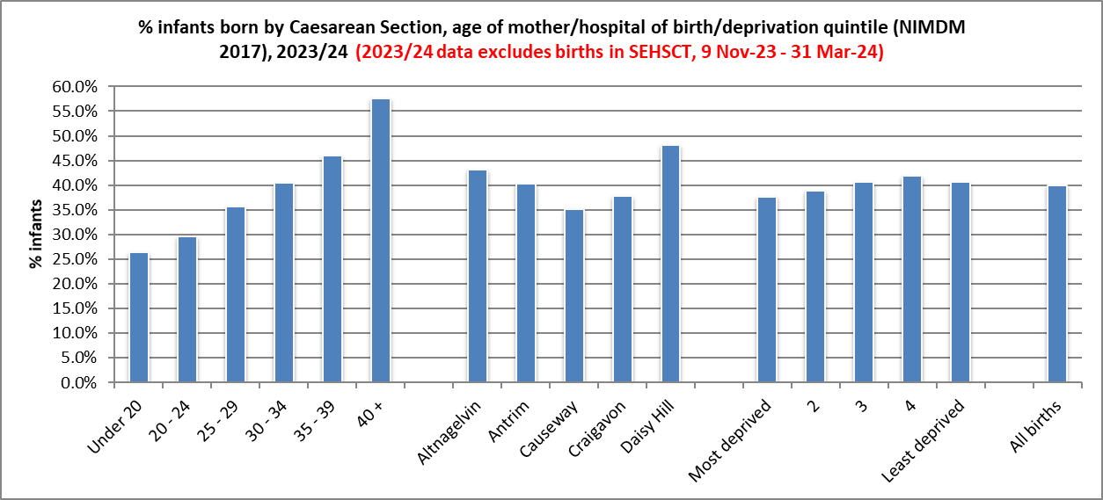
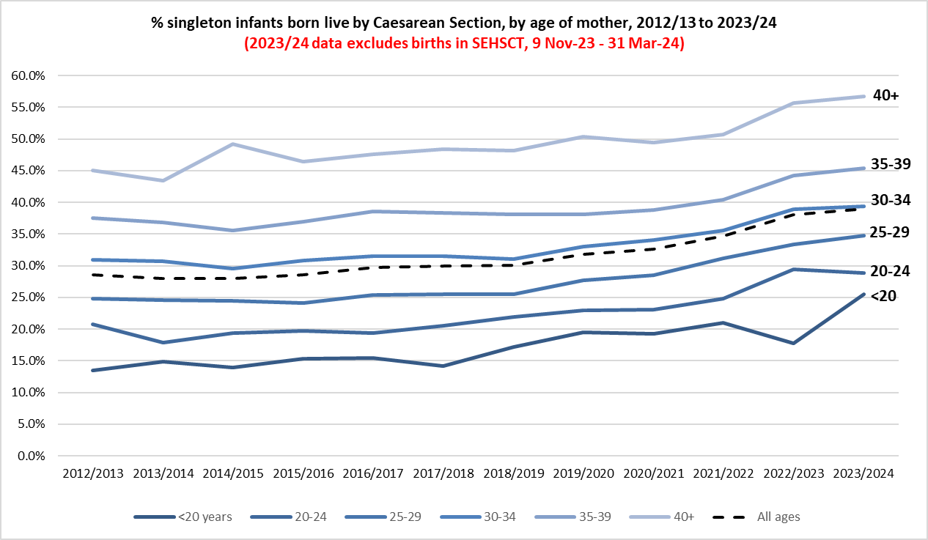
Method of Delivery
2023/24:
39.9% of infants born by Caesarean Section (CS), 47.8% had a normal delivery, 12.3% had another type of delivery e.g. breech, forceps.
Daisy Hill Hospital continues to have a much higher proportion of CS (48.2%).
Slight difference in proportion of infants born by CS, by deprivation quintile. 37.7% of those born to mothers from the most deprived quintile, compared to 40.7% of those born to mothers from the least deprived quintile.
2023/24:
% infants (single, live) born by Caesarean Section increased with age of mother from 25.5% of those aged under 20 years to 56.8% of those aged 40+.
Data tables 8.2 and 8.3
Source: NI Maternity System
Source: Northern Ireland Statistics and Research Agency, NI Multiple Deprivation Measure 2017 https://www.nisra.gov.uk/statistics/deprivation/northern-ireland-multiple-deprivation-measure-2017-nimdm2017

Slide 23
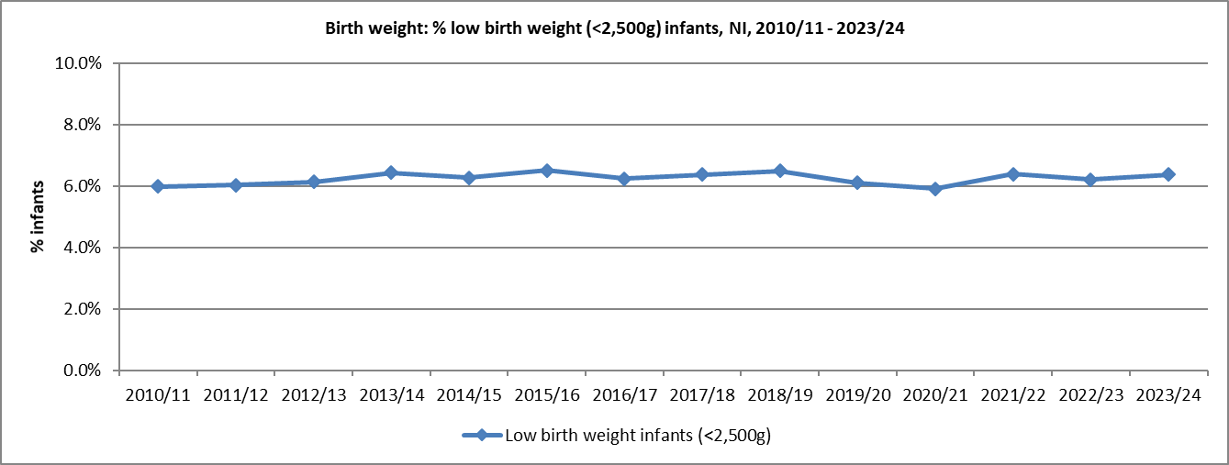
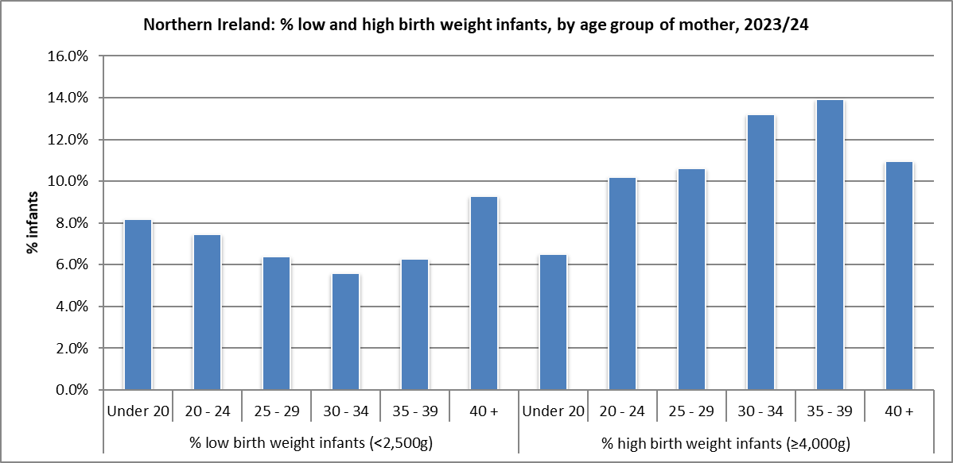
Infant Birth Weight
2023/24:
6.4% of all births were of a low birth weight (6.2% live, 73.1% still).
12.2% of live infants were born with a higher birth weight (4,000g+) and of these, 1.4% with a birth weight of 4,500g+.
Mothers from a ‘white’ ethnic group were more likely to have a baby born with a high birth weight (4,000g+) (12.6%). Those mothers of a ‘non-white’ ethnic group = 5.6%.
Data tables 9.1 and 9.2
Source: Child Health System and NI Maternity System

Slide 24
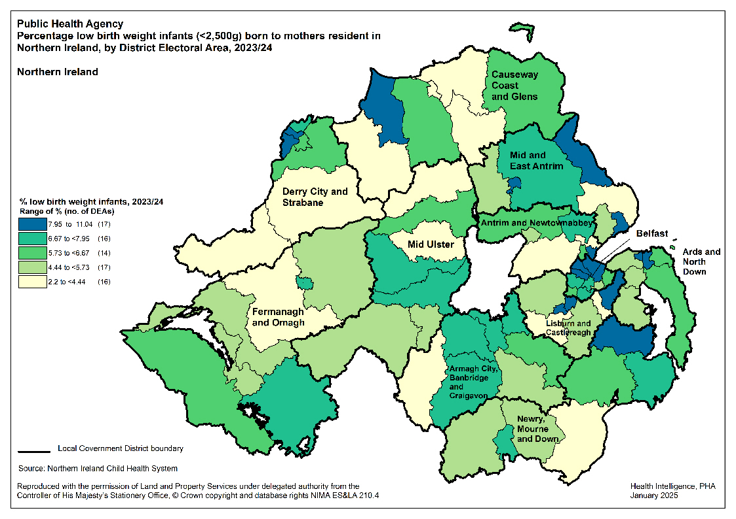
Infant Birth Weight

Slide 25
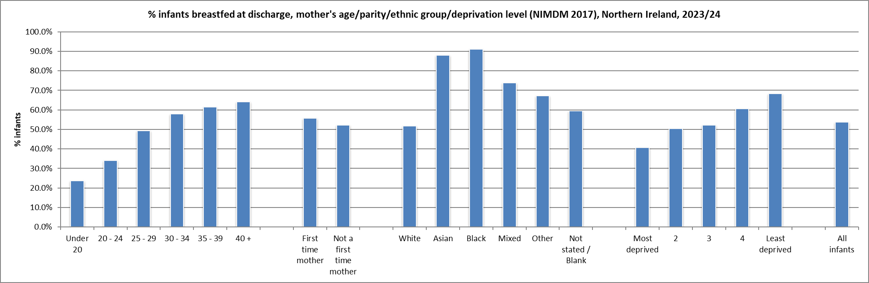
Breastfeeding (total/partial) – at discharge
2023/24:
53.6% of live infants breastfed at discharge.
Increases with age of mother: aged <20 = 23.7%, 40+ = 64.1%.
Much higher rates in infants born to mothers whose ethnic origin was not ‘white’.
By Council area, % breastfed ranges from 45.7% in Derry City & Strabane to 61.9% in Lisburn & Castlereagh.
Noticeably lower in more deprived areas (40.6%). Least deprived = 68.4%.
Data table 10.2
Source: Child Health System and NI Maternity System
Source: Northern Ireland Statistics and Research Agency, NI Multiple Deprivation Measure 2017
https://www.nisra.gov.uk/statistics/deprivation/northern-ireland-multiple-deprivation-measure-2017-nimdm2017

Slide 26
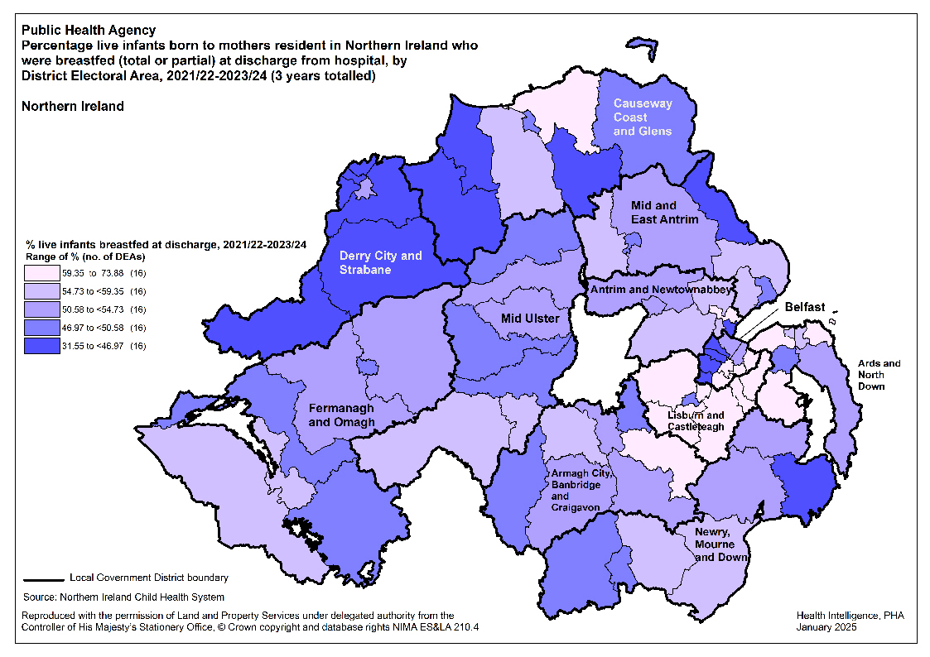
Breastfeeding (total/partial) – at discharge

Slide 27
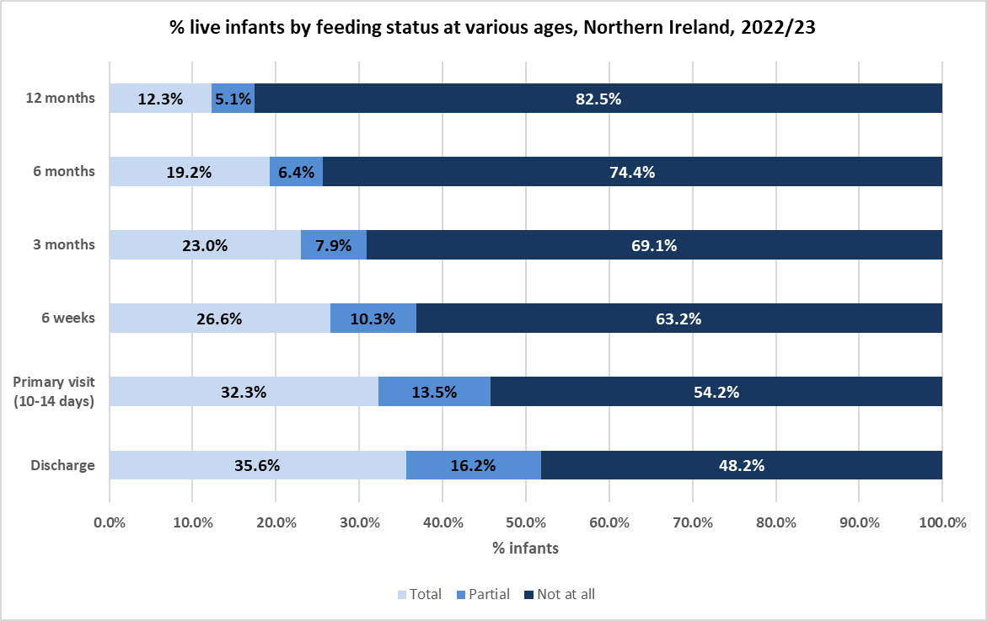
Breastfeeding – prevalence
Infants born in 2022/23:
Chart shows considerable decrease in proportion of infants breastfed “totally” - from 35.6% at time of discharge from hospital to 12.3% at 12 months old.
“Totally” or “partially” represented 51.8% of infants at discharge, but fell to 17.5% at 12 months.
Data table 10.6
Source: Child Health System
Infants whose feeding status was not known have been excluded above

Slide 28
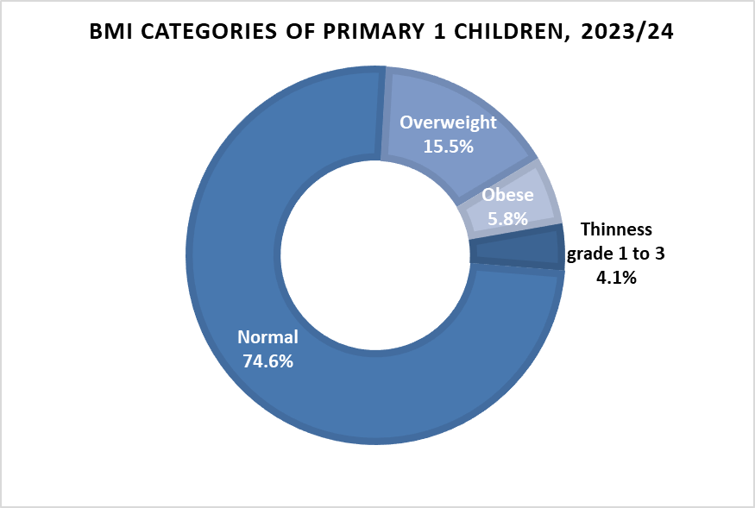
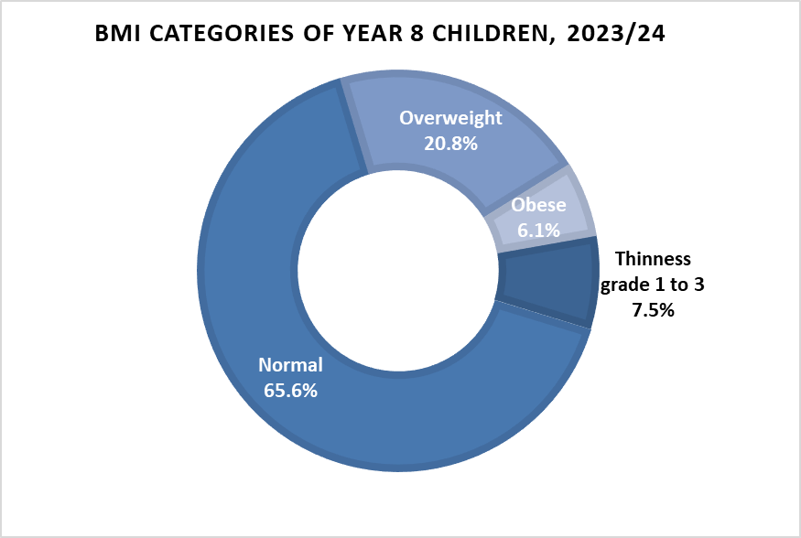
Body Mass Index – Primary 1 and Year 8
Data tables 12.1 and 12.4
Source: Child Health System
Year refers to school year (2 July 2023 - 1 July 2024)
Age range: Primary 1 - children measured are typically between 4½ and 5½ years of age. Year 8 - children measured are typically between 11½ and 12½ years of age
Figures above are categorised using International Obesity TaskForce measures

Slide 29
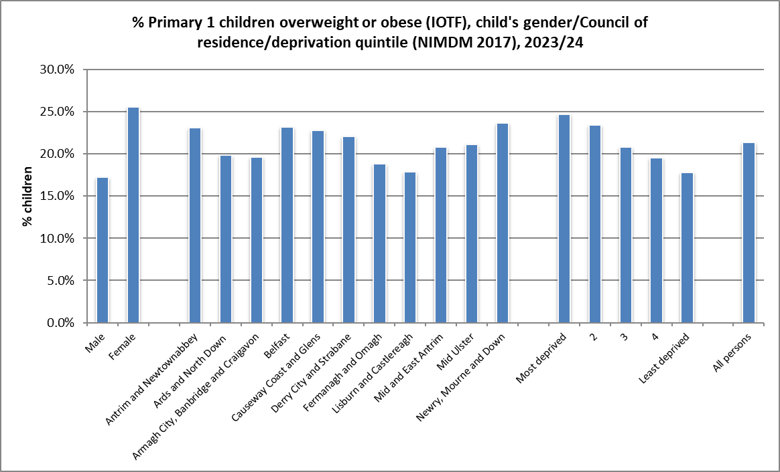
Body Mass Index – Primary 1
2023/24 (IOTF):
Higher proportion of girls were overweight/obese (25.6%) compared to boys (17.2%). All children in NI = 21.3%.
Newry, Mourne and Down LGD had the highest proportion of children overweight/obese (23.6%).
24.7% of children living in the most deprived areas were overweight/obese, compared to 17.8% of children from the least deprived areas.
Data table 12.2
Source: Child Health System
Source: Northern Ireland Statistics and Research Agency, NI Multiple Deprivation Measure 2017 https://www.nisra.gov.uk/statistics/deprivation/northern-ireland-multiple-deprivation-measure-2017-nimdm2017

Slide 30
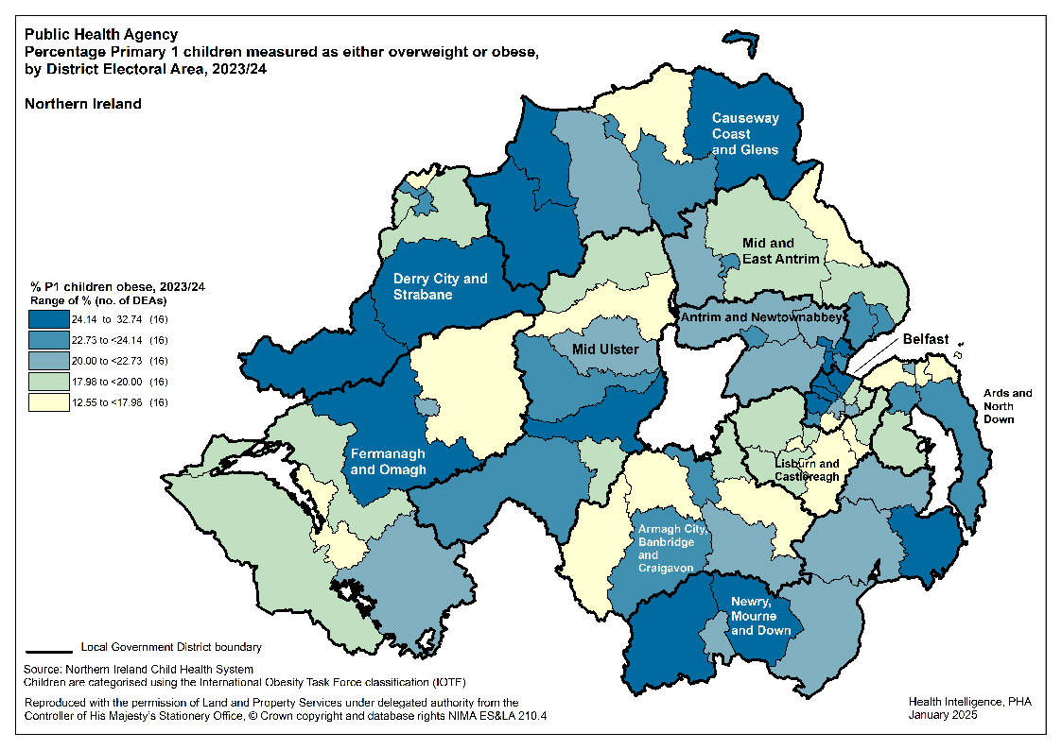
Body Mass Index – Primary 1

Slide 31
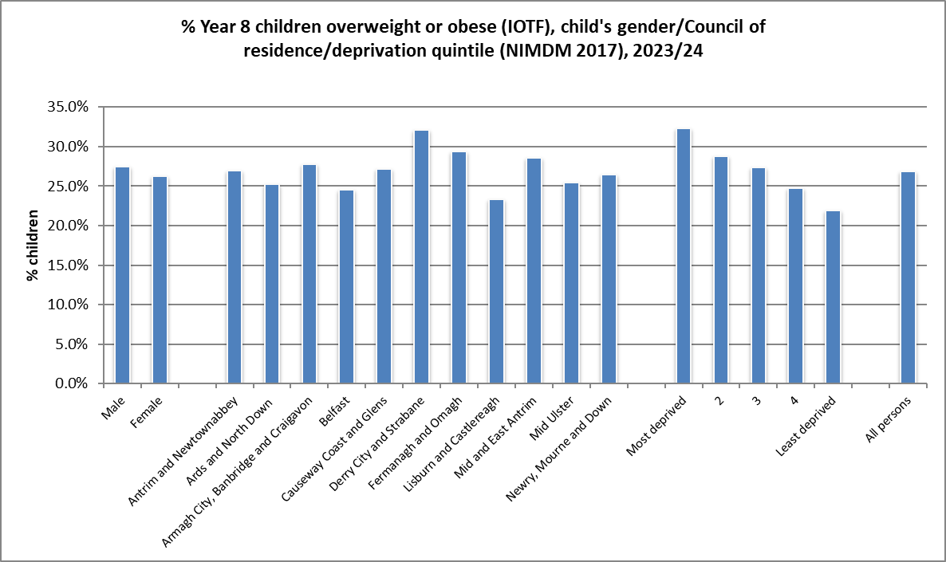
Body Mass Index – Year 8
2023/24 (IOTF):
26.9% of children measured as overweight/obese.
Little difference in the proportion overweight/obese between the two genders (27.4% male, 26.3% female).
Derry City and Strabane LGD had the highest proportion of children measured as overweight/obese (32.1%).
Larger proportion of children from more deprived areas were measured as overweight/obese (32.3%), compared to those living in the least deprived areas (22.0%).
Data table 12.5
Source: Child Health System
Source: Northern Ireland Statistics and Research Agency, NI Multiple Deprivation Measure 2017 https://www.nisra.gov.uk/statistics/deprivation/northern-ireland-multiple-deprivation-measure-2017-nimdm2017

Slide 32
Children’s Health in
Northern Ireland
Produced by Public Health Agency
Health Intelligence Unit
www.publichealth.hscni.net
April 2025

