Slide 1
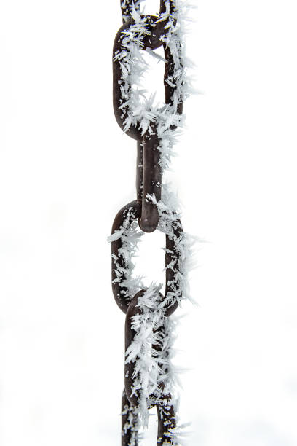
Vaccine Handling and Storage Guidance

Slide 2
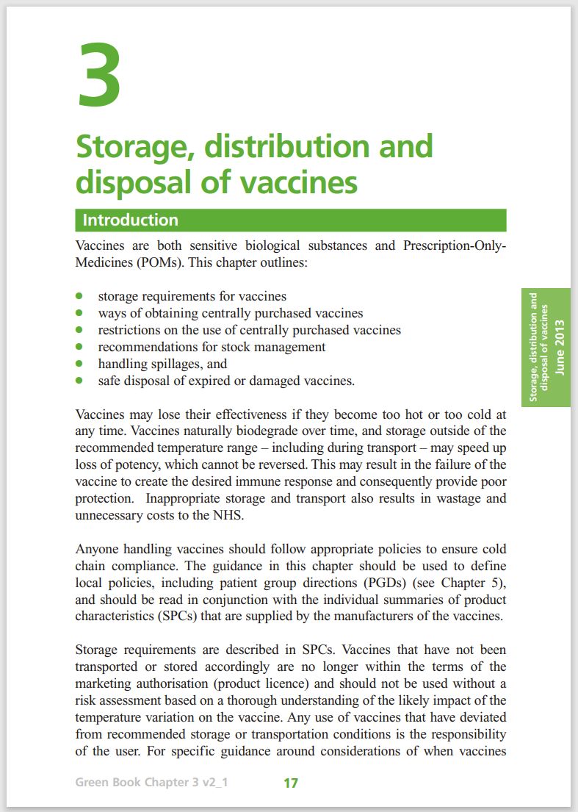
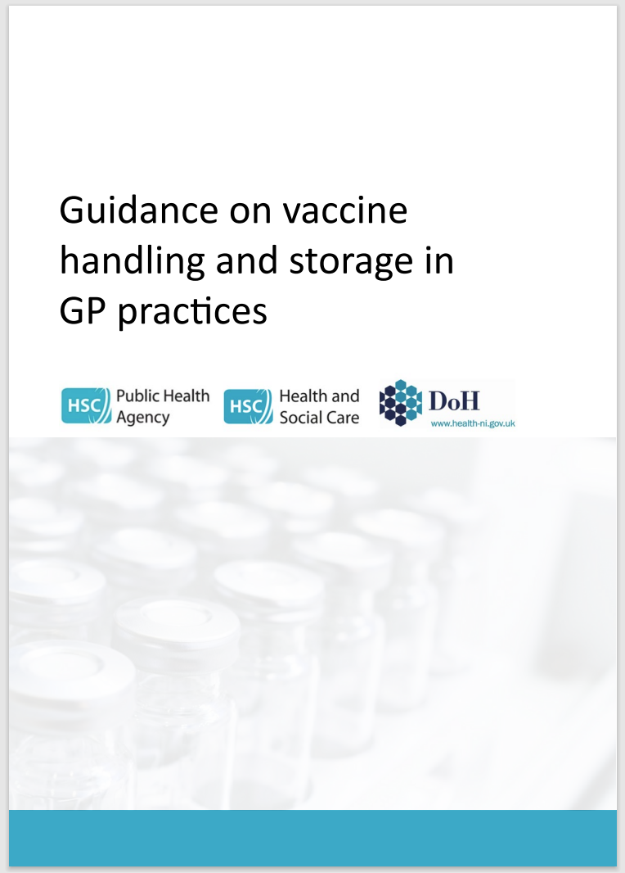
Key Message
Vaccines should be stored between 2 - 8°C
Appropriate action must be taken if there is a significant breach in cold-chain
Notes:
Significant Cold Chain Breach = temperatures outside (either side of) +2 and +8°C lasting longer than 20 minutes.
Resources:
MUST READ: PHA and SPPG / DoH guidance for GP Practices – link provided in slide later in PowerPoint.
Additional resource: Green book chapter 3 produced by UKHSA (UK Health Security Agency)

Slide 3
Contents
The importance of cold chain
The effects of temperature (heat/freezing) and exposure to light on vaccine potency and efficacy
The requirements for correct ordering, delivery and storage of vaccines in the workplace
The management of cold chain breaches, where to dispose of damaged vaccines, who to inform and what action to take.
Audit management of cold chain within your area of practice
Helpful resources and contact information

Slide 4
What is the Cold-Chain?
The cold chain refers to the system of storing and transporting vaccines within the recommended safe temperature range of 2 - 8°Celsius.
Notes:
Significant Cold Chain Breach = temperatures outside (either side of) +2 and +8°C lasting longer than 20 minutes.
Remember to STRIVE FOR FIVE (degrees)

Slide 5
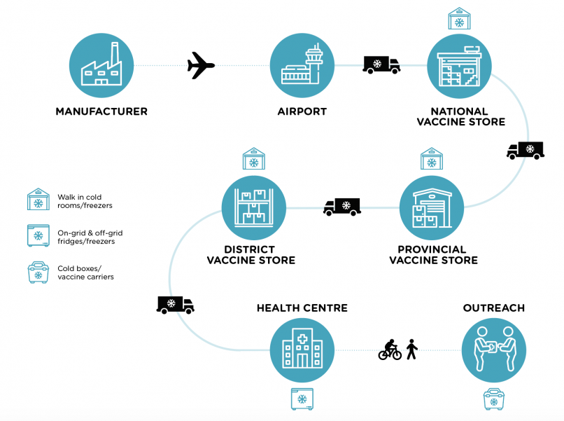
The Cold Chain
From the manufacturer to the patient
Notes:
Image for illustrative purposes only:
UK licensed stock comes from mainland UK via Ferry
EU licensed stock may come from ROI
(Source: Analytics 2020).

Slide 6
Cold Chain
“Anyone handling vaccines should follow appropriate procedures to ensure cold-chain compliance”
Vaccines are licensed products. In some circumstances when vaccines have been temporarily stored outside the manufacturer’s recommended temperature range, it may still be used, this is regarded as being used off-label.
Medicines Information will be able to provide recommendations on whether vaccines may be safely used off-label or should not be used and discarded.
Notes:
Contact details for Medicines Information will be provided later in the presentation.
Medicines Information will ask for specific information regarding a cold chain breach e.g. temperature log data, date and times of cold chain breach, how long the vaccine has been stored outside of 2-8 degrees Celsius. MI will check the manufacture’s vaccine stability data to determine if the vaccine is still valid for use, according to the storage information provided. However, it is the final professional decision of the vaccinator if they wish to administer an off-label vaccine.
UKHSA Guidance on the use of vaccines that have been temporarily stored outside the recommended temperature range:
https://www.gov.uk/government/publications/vaccines-stored-outside-the-recommended-temperature-range-leaflet/the-use-of-vaccines-that-have-been-temporarily-stored-outside-the-recommended-temperature-range

Slide 7
It is important to maintain the cold chain because…
Vaccines are sensitive biological substances:
Effectiveness may be reduced if not stored correctly
Desired immune response may not be achieved leading to poor protection and increased risk of infections
Loss of vaccines:
Cost to the health service
Poor public confidence in the service and leads to reduction in vaccination uptake due to lack of trust

Slide 8
Policies are essential because…
It may not be possible to determine by examination if a vaccine has been stored appropriately
Policy should be followed to ensure cold-chain has been maintained and provides evidence of compliance
Unless specific advice states otherwise, if vaccines are not stored / distributed properly, they should not be used.
Each GP practice should nominate a lead person (known as the Vaccine Controller) and a deputy to manage vaccine ordering, storage and management.

Slide 9
Sensitivity to heat, cold and light…
Most vaccines should be kept between 2 - 8°C unless otherwise stated in the manufacturers summary of product characteristics (SmPC).
Freezing may cause increased reactogenicity and loss of potency, may crack glass leading to contamination.
Most vaccines are less sensitive to heat but potency cannot be guaranteed if stored above 8°C.
Vaccines are also very sensitive to strong light therefore must always be protected against light and stored in original packaging until point of use.

Slide 10
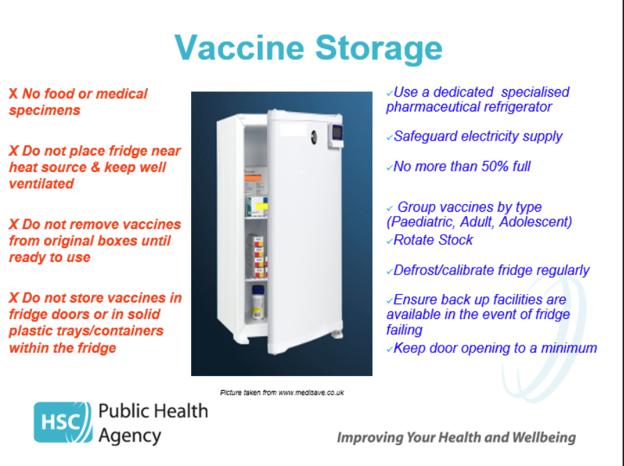

Slide 11
Vaccine Refrigerator
Specialised refrigerators are available for the storage of pharmaceutical products and must be used for vaccines and diluents
There should be a maintenance contract in place that allows for at least yearly servicing of fridges and calibration of temperature gauge. Records should be kept of this
Ice should not be allowed to build up. Records should be kept of servicing, defrosting and cleaning
Approved cool box or alternative fridge should be used when defrosting (temp monitored)-vaccines only replaced when fridge is at correct temperature
Vaccines are POMs and should be stored under locked conditions

Slide 12
Vaccine Refrigerator Temperatures
Temperature readings should be continually monitored with a minimum-maximum thermometer
All fridges should ideally have two thermometers, one of which is independent of mains power
Strongly recommend use of data-loggers
Annual calibration / consider replacement of thermometer
Care should be taken that the thermometer probe cable does not interfere with the door seal
Opening and closing the refrigerator door should be kept to a minimum in order to maintain a constant temperature

Slide 13
Temperature Monitoring
Observe the 4 Rs:
Read Record Reset React
Do make sure that the person making the recording
Records it at the same time every day during the week and signs the sheet
Records it in a standard fashion and on a standard form
Acts if temperature is outside of +2-+8°C
Resets the thermometer after every reading
Remember if stored outside of 2 - 8°C as per licensing conditions is “off-label” and cannot be administered under PGD

Slide 14
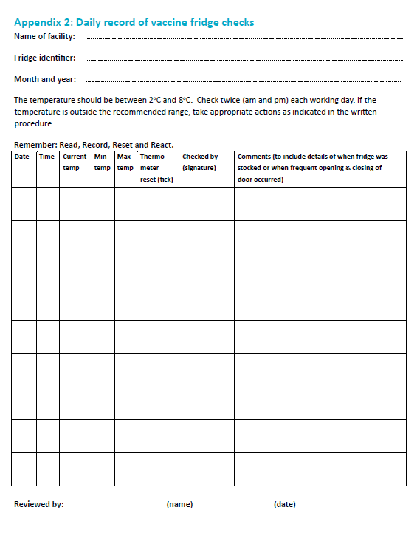
Temperature Records
A sample refrigerator temperature record chart:

Slide 15
Data Loggers
The standard recommends the use of “Data Loggers”
Continually measure temperature of fridge and record every 5 minutes / more frequently
When plugged into computer allow continuous reading display since last read
Can tell how long has been outside of temperature range
Should be calibrated annually

Slide 16
Storage Temperature
Should never exceed +8°C or fall below +2°C
Aim for 5°C
Aim to maintain vaccine fridge as close as possible to 5°C as this gives a safety margin of + or – 3 °C

Slide 17
Cold Chain Incidents
<+2°C Temperature >+8°C Less than 20 minutes | Cold-Chain Breach
Action | One off temperature fluctuation No action required, document in temperature log. If concerned, contact PHA Duty Room for advice.

Slide 18
Cold Chain Incidents
<+2°C Temperature >+8°C More than 20 minutes | Significant Cold-Chain Breach
Action | Do not dispose of vaccine stock affected. Contact local HSCT Trust Medicines Information (MI) team Quarantine and refrigerate stock until advice provided by MI. If MI response is delayed, and stock is urgently required consider using alternative stock or obtain new stock. Report the incident to the PHA Duty Room Contact your SPPG Practice Support Manager for support and advice on how to mitigate future occurrences.

Slide 19
Cold Chain Incidents
Cold chain breached vaccines administered to patients
Action | Report to PHA Duty Room for risk assessment, support and advice regarding the need for revaccination Telephone: 0300 555 0119 Email: pha.immunization@hscni.net

Slide 20
Ordering and Monitoring Stock
Vaccine stocks should be monitored by designated person to avoid over-ordering, order duplication, or stockpiling
There should be no more than 2 weeks supply ordered in advance of a clinic.
If planning for a large vaccination clinic, contact PHA Immunisation team to confirm.
Stock should be rotated so those with shorter expiry dates are used first
Out of date stock should be removed from fridge, and correctly disposed of
Vaccines must never be used past their expiry date unless advised otherwise by Manufacturer or PHA

Slide 21
Excess stock may…
Increase risk of vaccination with out-of-date vaccines
Increase dangers of over-packed fridge leading to poor airflow, potential freezing and poor stock rotation
Delay introduction of new vaccines until local stocks are used
Increase pressure on clinic fridges during period of high demand – e.g. during flu vaccine season
Lead to major vaccine losses if there is a cold chain breach occurrence, vaccine stock is limited and can lead to an unintentional shortage if replacement stock is required.

Slide 22
Vaccine Storage
Must be kept in original packing
Must not be stored in door, bottom drawers or next to freezer plate – areas where temperatures most likely to go out of range
Allow enough space for air to circulate freely

Slide 23
Vaccine not used at Clinic
All reconstituted vaccines and opened single and multi-dose vials must be used within manufacturers recommended time – and should be disposed of correctly.
Unopened vaccines, kept in cool box, can be returned to fridge, but should be labelled and used first next time.

Slide 24
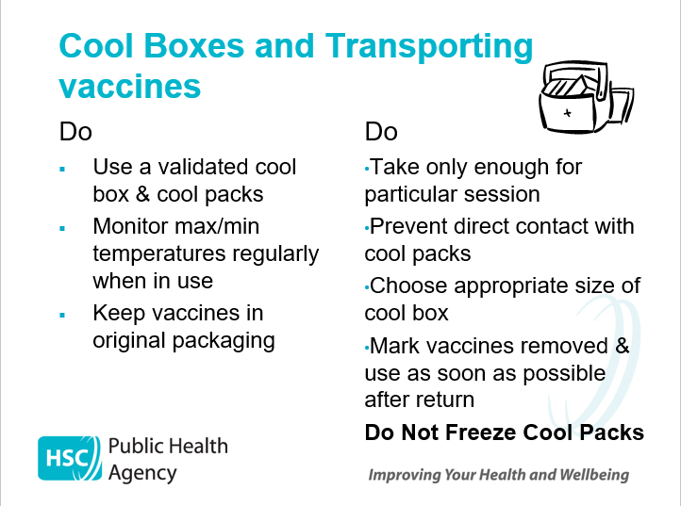

Slide 25
Audit Management of Cold Chain
It is recommended that the Vaccine Controller carries out weekly reviews of temperature readings using the data logger.
In addition to this an annual audit of cold chain procedures should be completed and areas for improvement should be discussed at team meetings (including training needs of staff involved in cold chain maintenance).
An example of an audit template can be found in the PHA Guidance.

Slide 26
Scenarios and Q&A

Slide 27
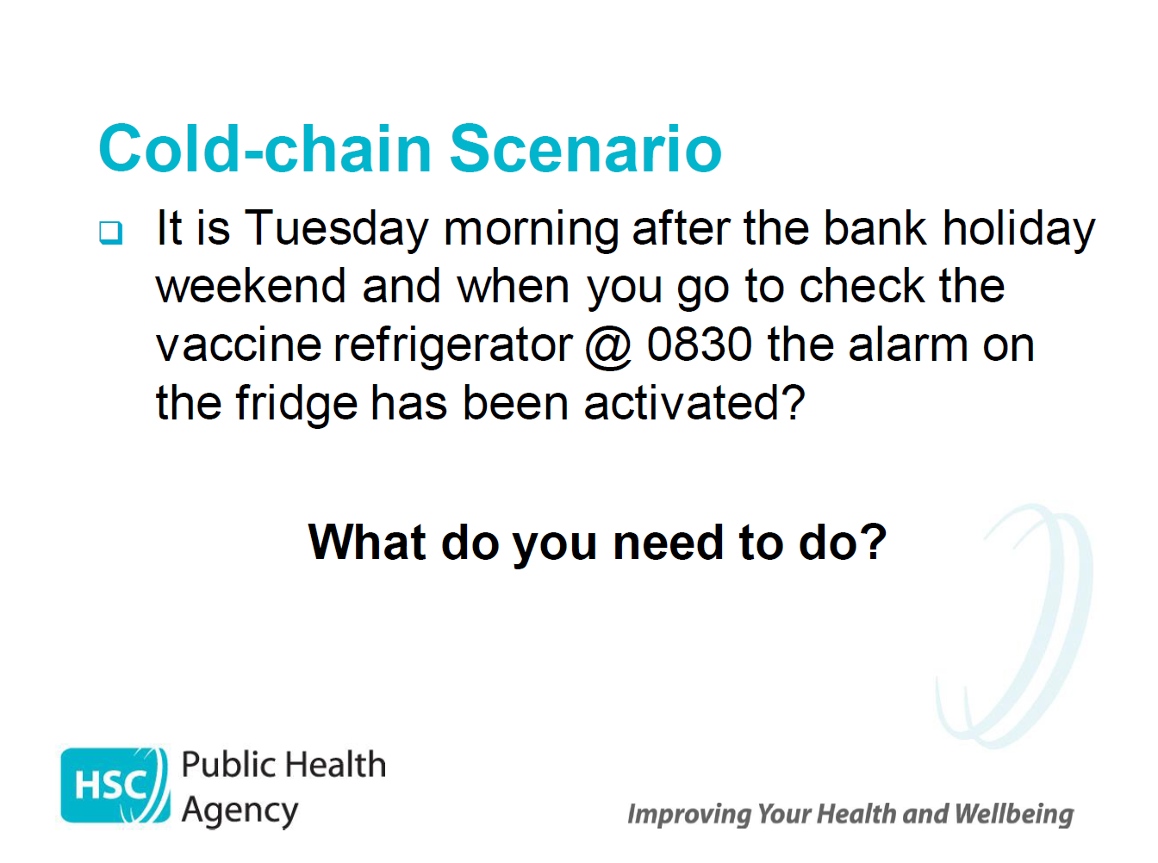

Slide 28
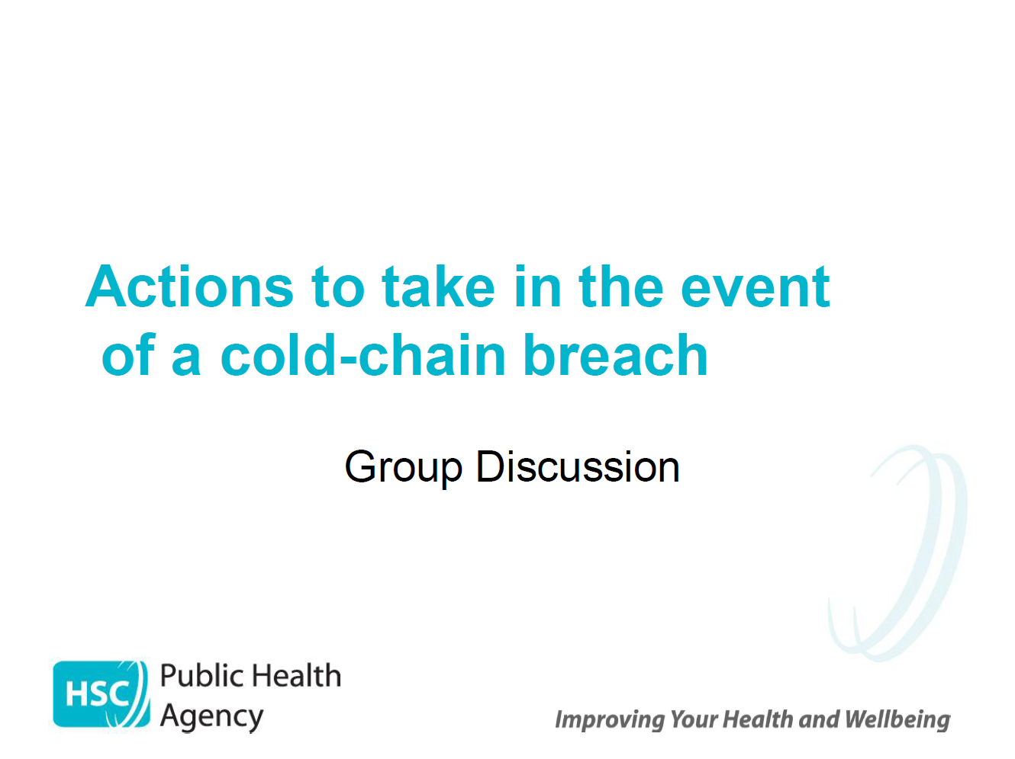

Slide 29
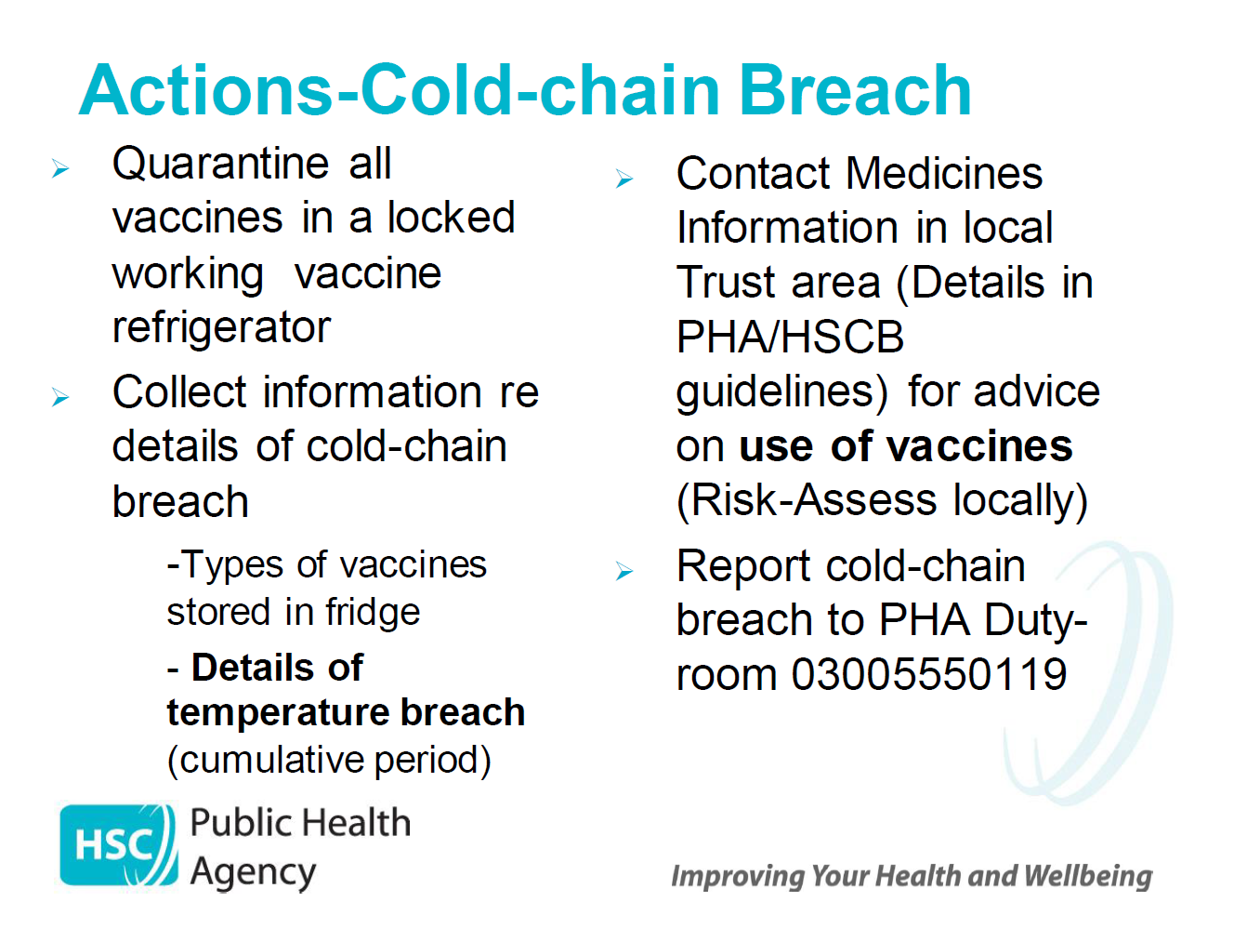
/SPPG

Slide 30
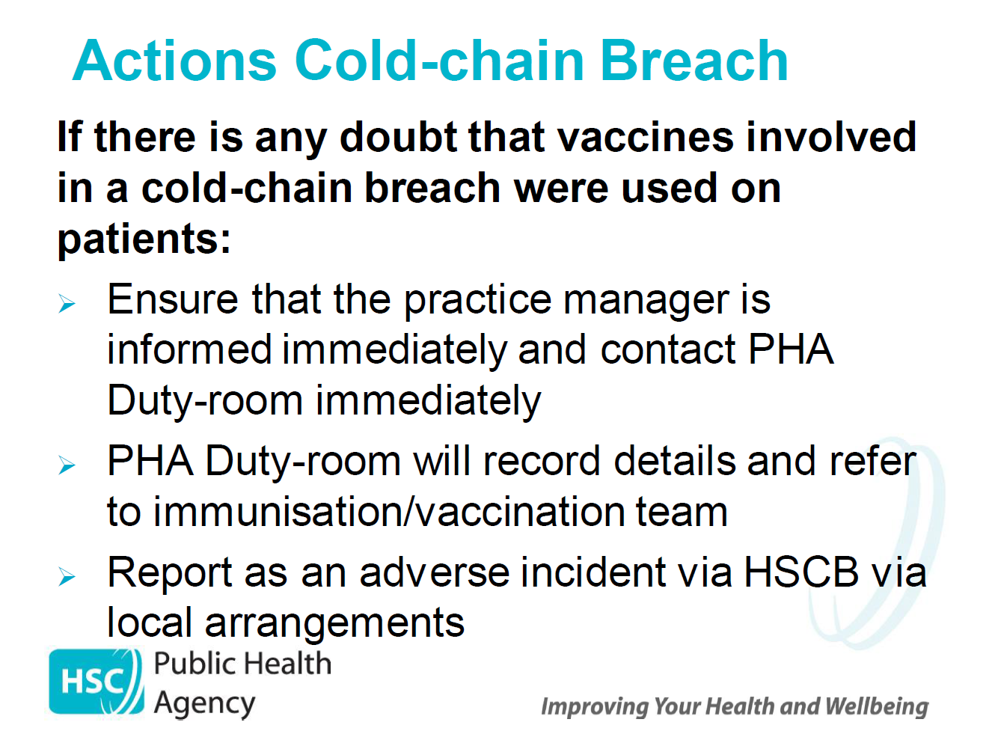
SPPG

Slide 31
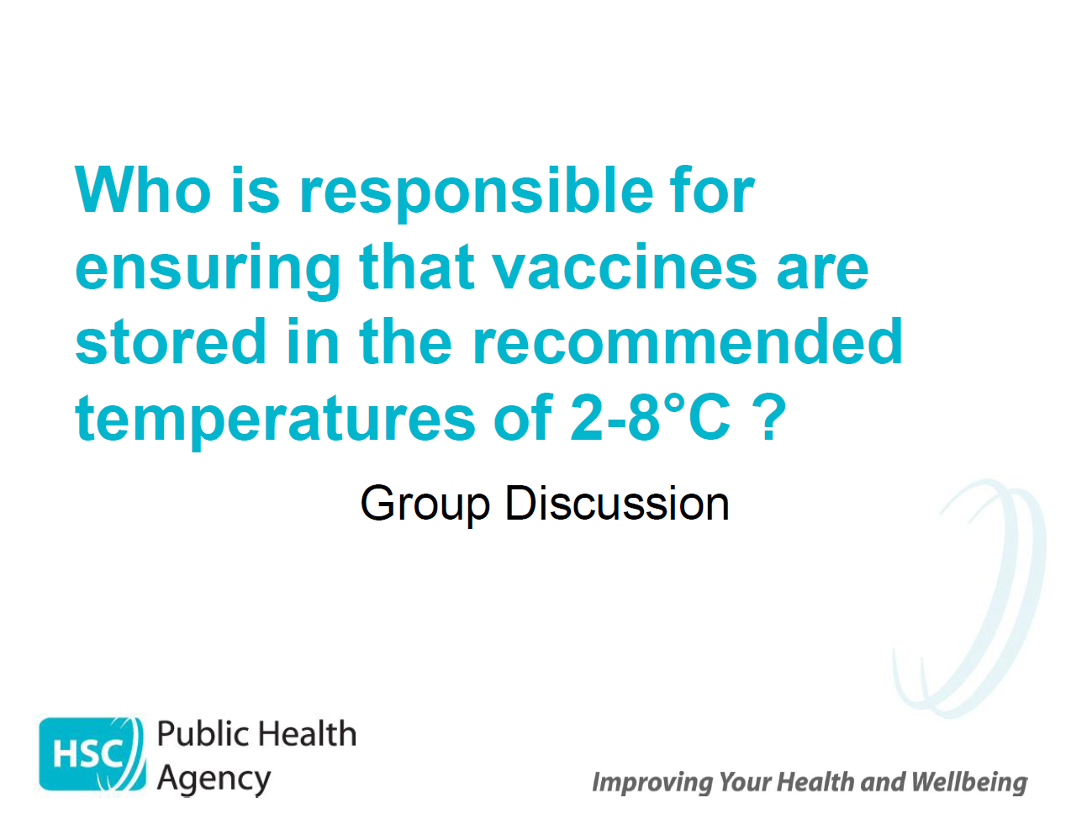

Slide 32
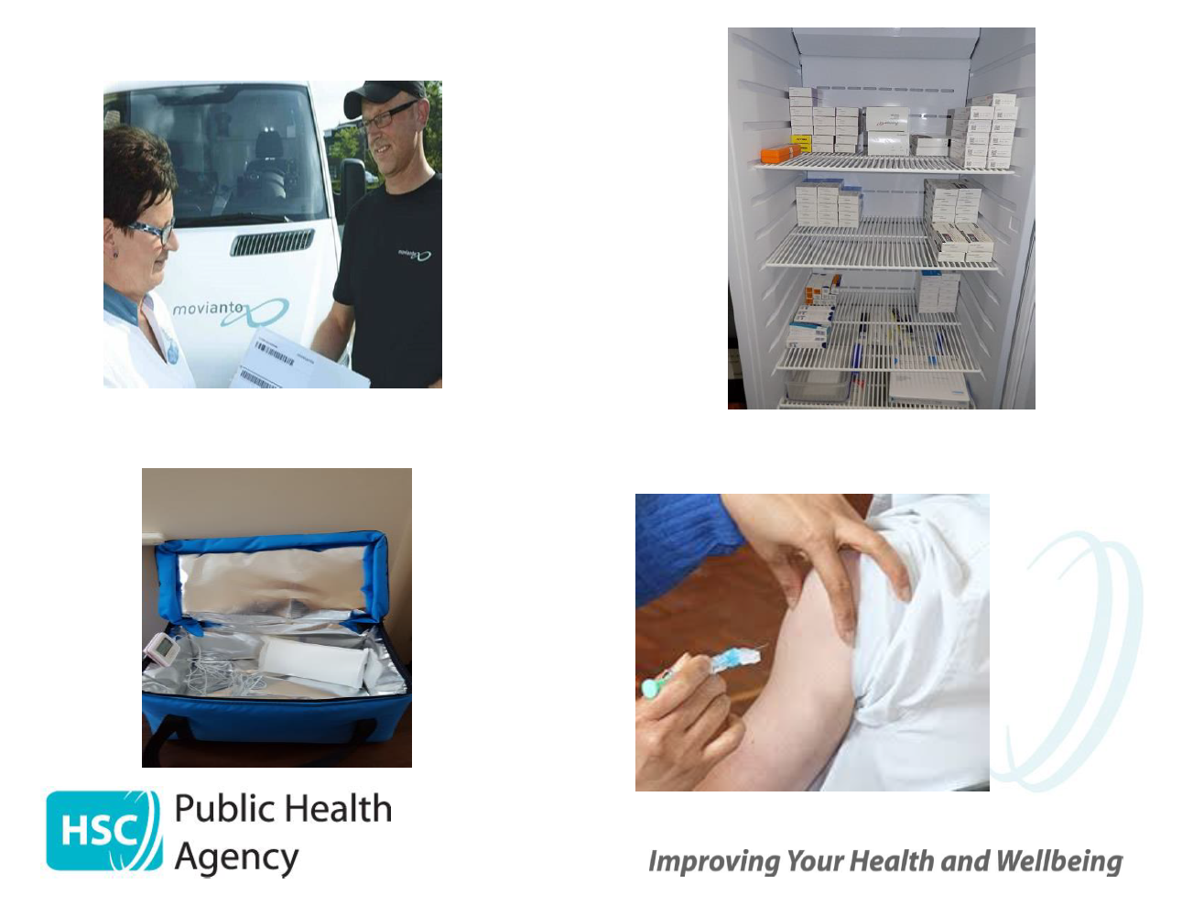

Slide 33
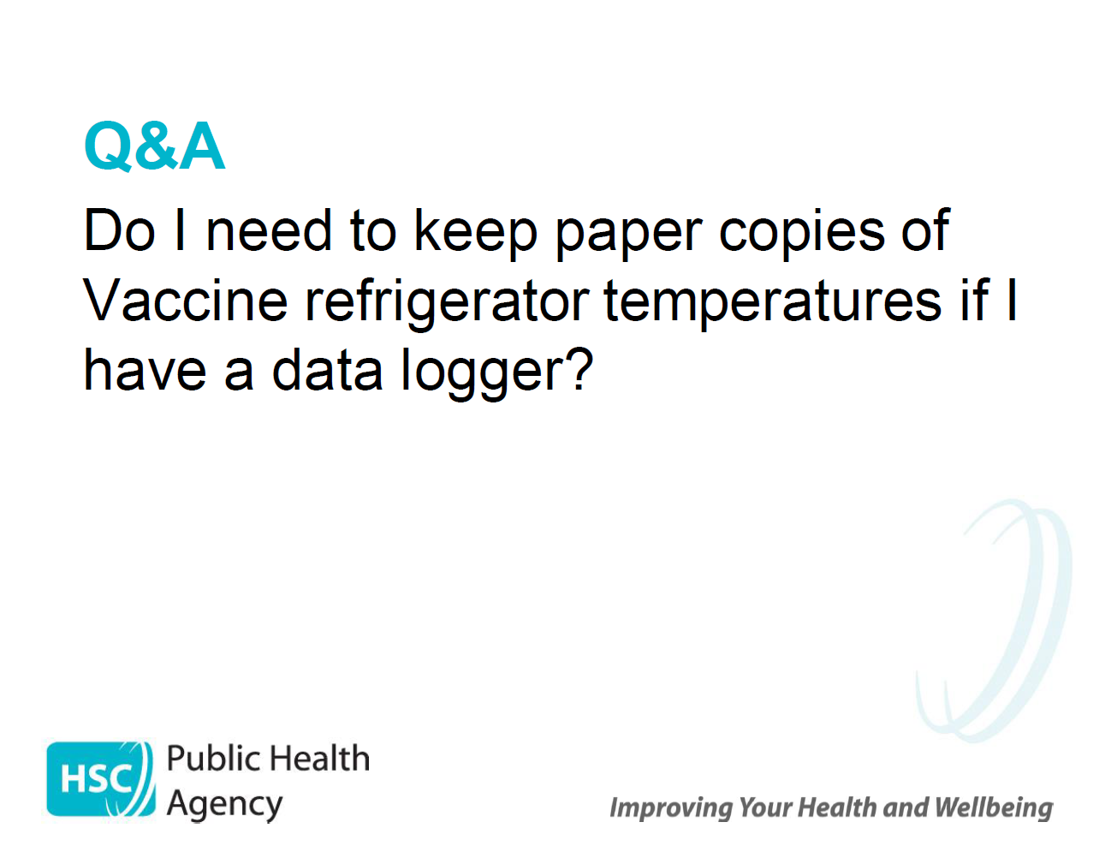

Slide 34
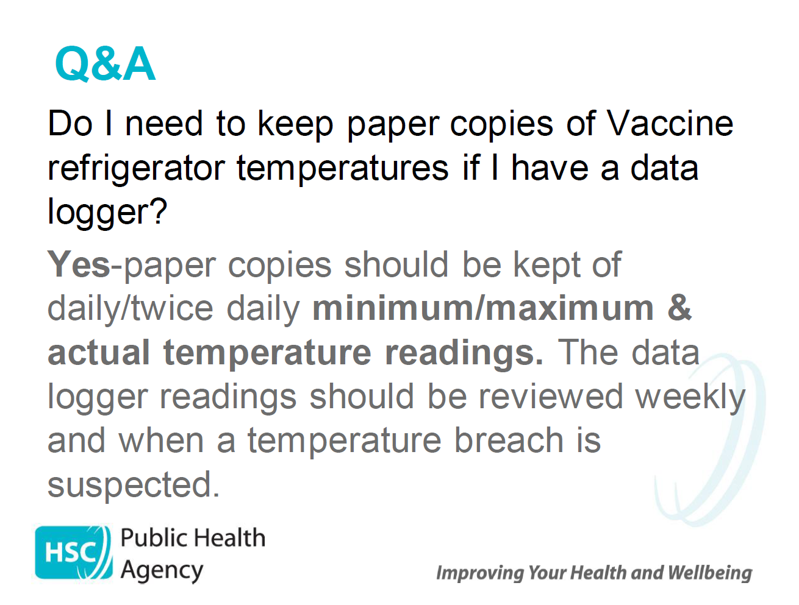

Slide 35
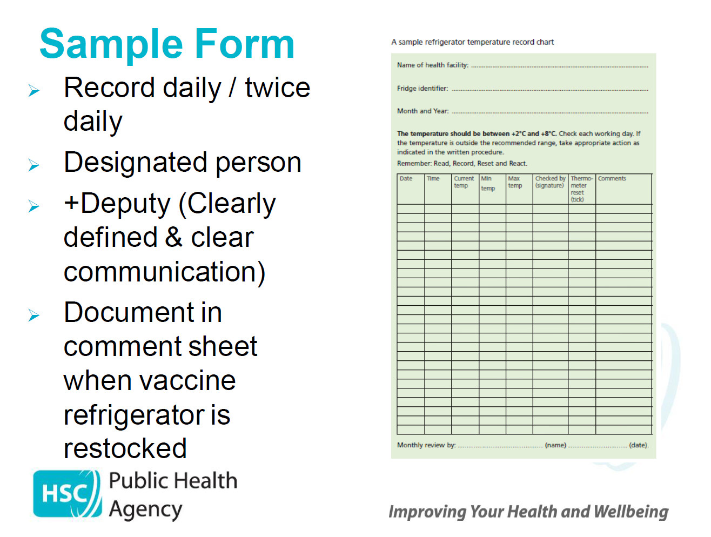

Slide 36
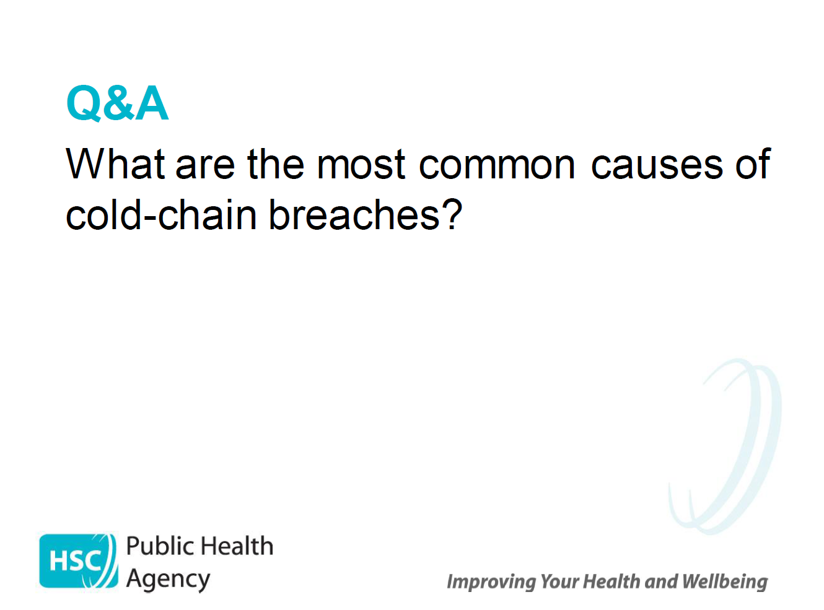

Slide 37
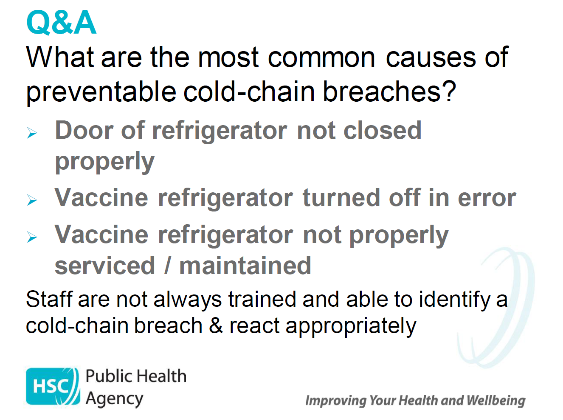
Notes:
Good practice tip: GP practices should document what new interventions they have taken to prevent reoccurrences
e.g. fridge electrical outlet is now wired into building mains electricity to prevent accidental switch off or plug removal.
All staff now receive training and made ware of cold chain procedures. Etc.

Slide 38
Useful Contacts and Resources

Slide 39
PHA Contacts
PHA Immunisation and Vaccinations Team:
pha.immunisation@hscni.net
PHA Duty Room:
pha.dutyroom@hscni.net
0300 555 0119

Slide 40
Northern Ireland Medicines Advice Services (NIMIS)
Monday to Friday 9.00am - 5.00pm
Trust | Email Address | Phone Number
Belfast Trust Local Service & Regional Service | Medicineinfo@belfasttrust.hscni.net | 028 95040558
South Eastern Trust Local Service | medicines.information@setrust.hscni.net | 028 90561445 028 90484511 ext.10220
Western Trust Local Service | altnagelvin.medinfo@westerntrust.hscni.net | 028 71611462 028 71345171 ext. 213756
Northern Trust Local Service | 1st contact Specialist Vaccine Services Technician: Alternative contact: medicines.info@northerntrust.hscni.net | 028 79366755 028 94424556 028 94424556 ext. 4763
Southern Trust Local Service | medicinesinfo.cah@southerntrust.hscni.net | 028 3756 3893 028 3756 3890
Where a vaccine is recommended off-label, including following a cold chain breach, consider, as part of the consent process, informing the individual/carer that the vaccine is being offered in accordance with national guidance but that this is outside the product licence. Please refer to the relevant PGD.

Slide 41
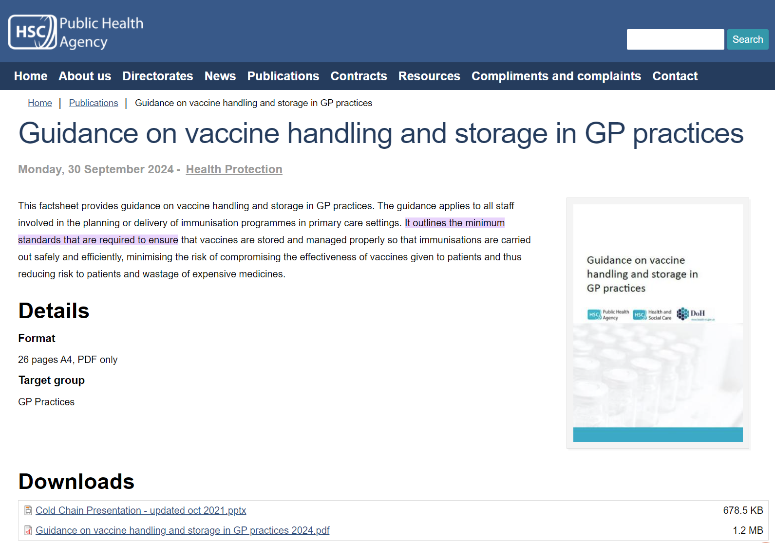

Download the Full Guidance Document:
For more detailed information including best practice guidance, audit templates and action cards for managing cold chain breaches, please download a copy of the Guidance document:
https://www.publichealth.hscni.net/

Slide 42
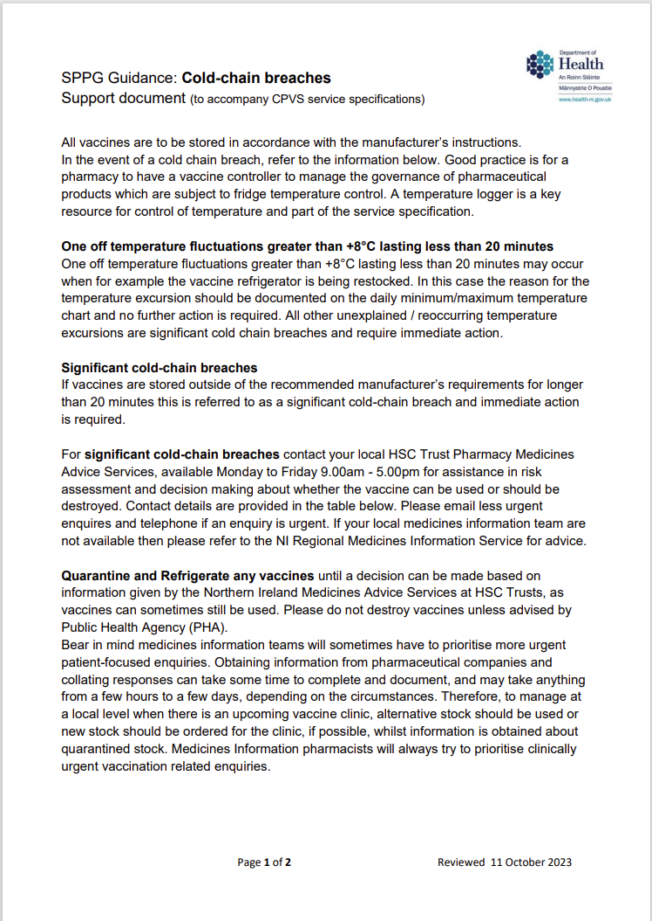
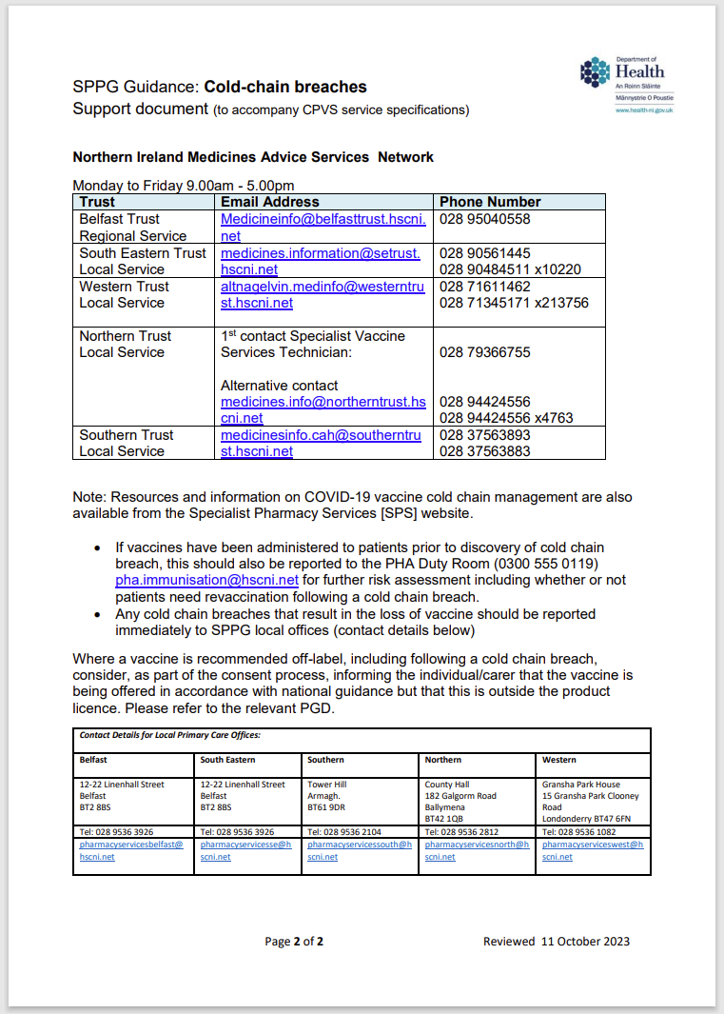
Community Pharmacy Specific Guidance on cold chain breaches
is provided by the SPPG Community Pharmacy Vaccination Service and can be accessed via the BSO website.

Slide 43
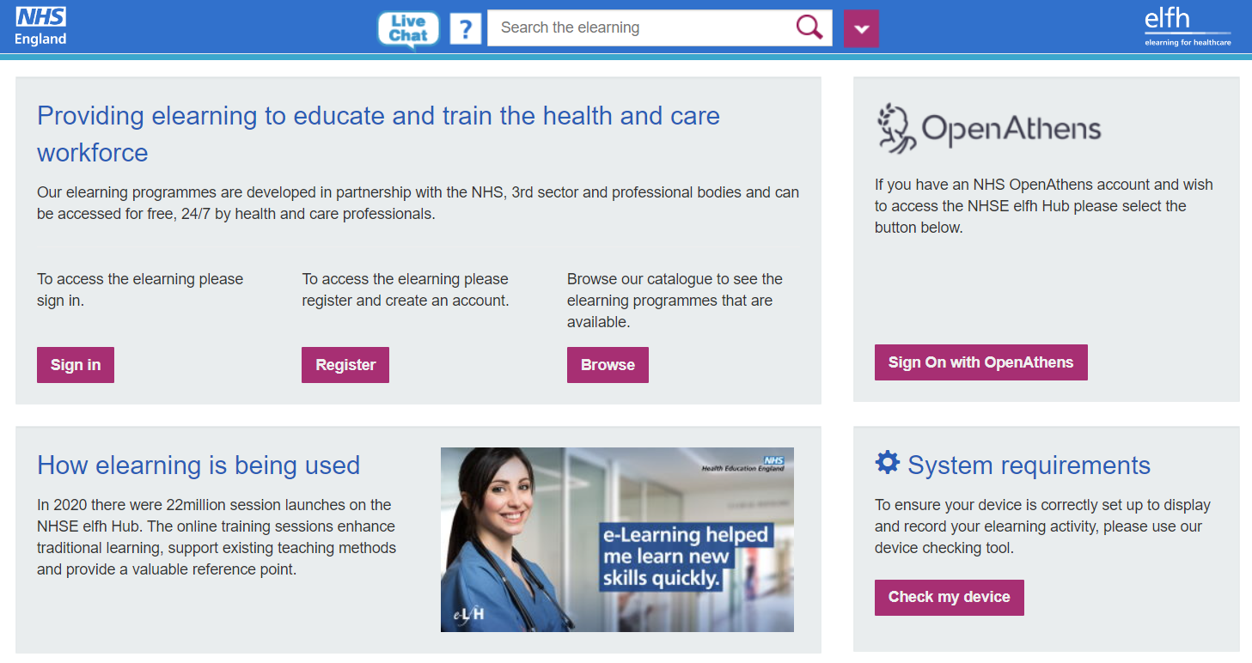
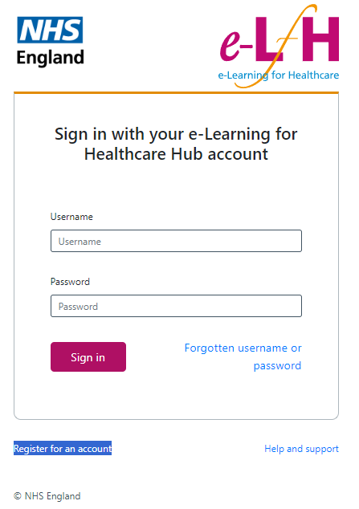
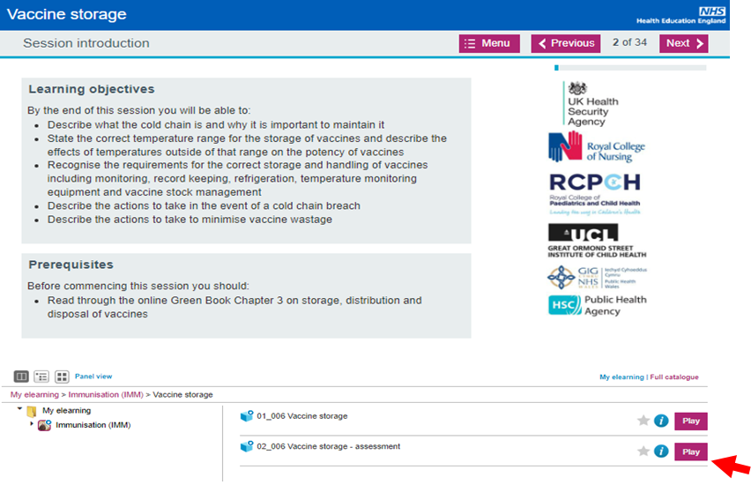
eLearning and Training
https://portal.e-lfh.org.uk/
Notes:
Anyone can access the eLearning for Vaccine Storage training – register using a professional email address.
There will be a how to register guide available on the PHA website.

Slide 44
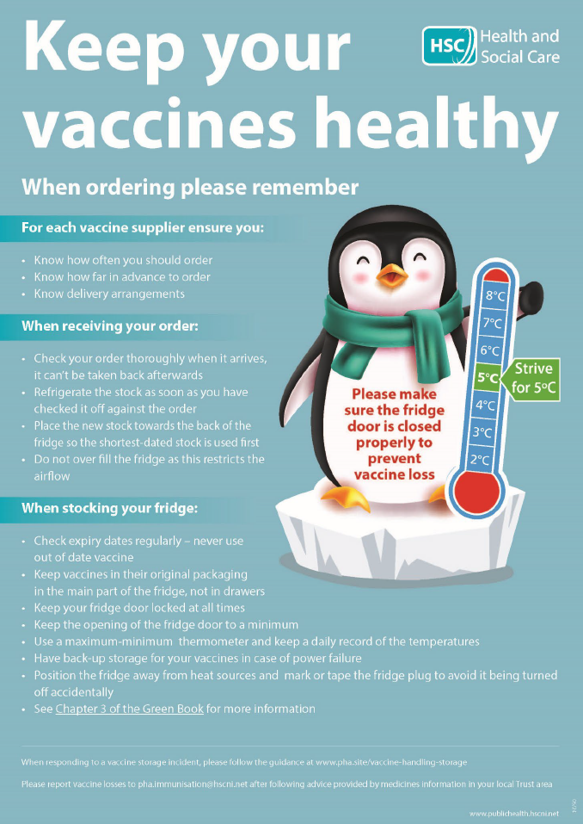
Thank you for your attention and remember to…

Slide 45
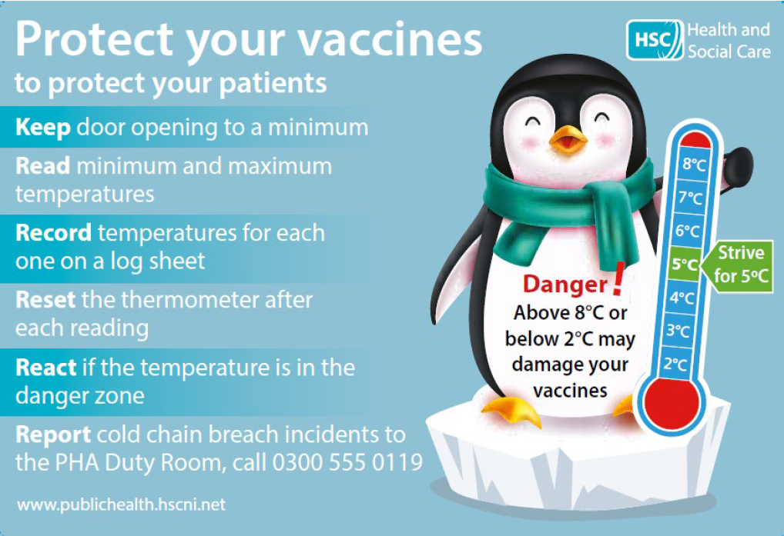
Fridge Magnet:
Notes:
Fridge magnets and posters are available via the PHA – please contact the Immunisation team for more info.

