Slide 1
Children’s Health in
Northern Ireland
Summary
2022/23

Slide 2
COVID-19
Please note that some data within this presentation will be
impacted by the COVID-19 pandemic
and should be interpreted with a degree of caution.

Slide 3


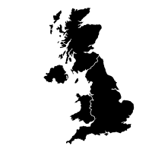




Mothers – Summary
Highest live birth rate (10.9) in United Kingdom, 2022
2.1% of births to teenage mums, 2022/23
2010/11: 15.5%
Women who smoke (antenatal booking)
4.7% of births to older mums (40+), 2022/23
2022/23: 10.6%
2022/23: 12.6%
Highest fertility rate across UK (1.71, 2022)
Women with diabetes
Over 1 in 4 women obese at antenatal booking (28.1%), 2022/23
2010/11: 1.8%
Graphics downloaded from: thenounproject.com

Slide 4





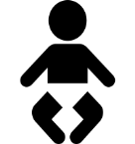

Children – Summary
Almost 39% of infants born by Caesarean Section, 2022/23
5.6% of singleton infants born pre-term (<37 weeks gestation), 2022/23
3.1% of infants born as a multiple, 2022/23
6.2% low birth weight (<2,500g, live infants), 2022/23
51.8% of infants breastfed (partial/total), 2022/23
12.8% high birth weight (≥4,000g, live infants), 2022/23
Overweight & obese (IOTF), 2022/23:
24% of P1 girls
16% of P1 boys
Graphics downloaded from: thenounproject.com

Slide 5
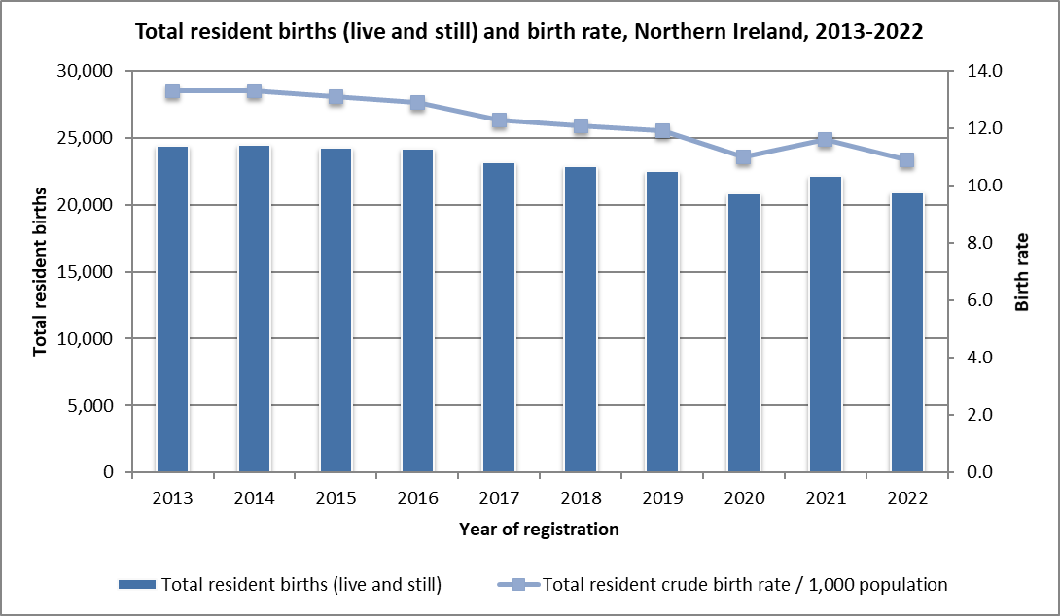
Trends in births
2022:
20,908 registered births to NI residents (total births).
Birth rate of 10.9 per 1,000 population (total births).
Live birth rate (10.9) is the highest across the four UK countries, but lower than Republic of Ireland (11.3).
71 registered stillbirths.
18.5% of live births to mothers whose country of birth was not NI.
Report – Tables 1.1 and 1.2
Source: Northern Ireland Statistics and Research Agency, Office for National Statistics (other UK) and Central Statistics Office (RoI)
https://www.nisra.gov.uk/statistics/births-deaths-and-marriages/births
https://www.ons.gov.uk/peoplepopulationandcommunity/populationandmigration/populationestimates/datasets/vitalstatisticspopulationandhealthreferencetables
https://data.cso.ie/

Slide 6
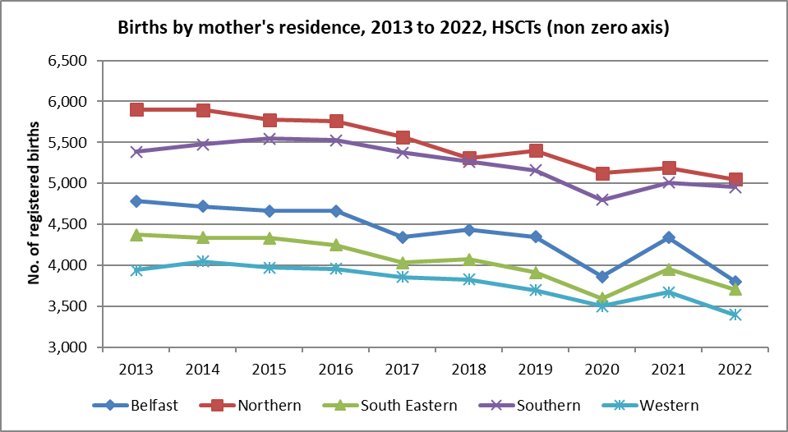
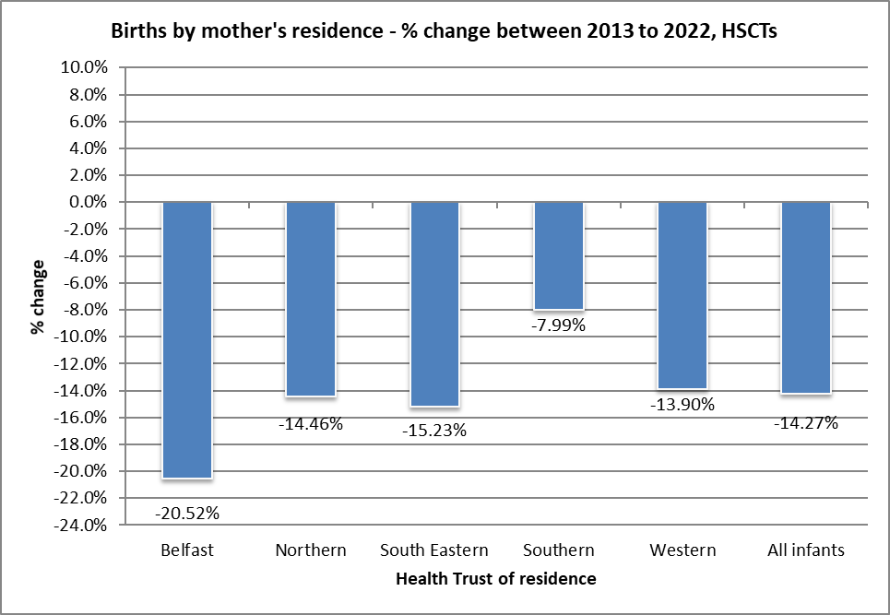
Trends in births – Health Trusts
2022:
Largest number of registered births recorded to NHSCT residents (5,048), with the lowest number in the WHSCT (3,394).
Percentage share of births by Health Trust:
  BHSCT = 18.2%
  NHSCT = 24.1%
  SEHSCT = 17.7%
  SHSCT = 23.7%
  WHSCT = 16.2%
Report – Table 1.2
Source: Northern Ireland Statistics and Research Agency https://www.nisra.gov.uk/statistics/births-deaths-and-marriages/births

Slide 7
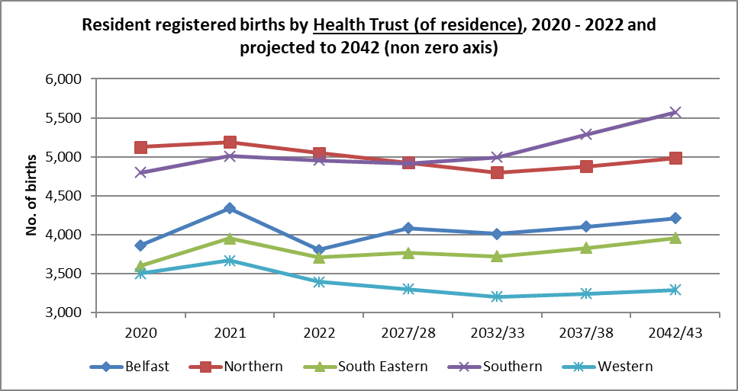
Trends - Projected Births
In the next 20 years (2022 to 2042), the number of births is projected to increase in Southern (12.5%), Belfast (10.7%) and South Eastern (6.7%) Trust areas, but projected to decrease in Northern (-1.3%) and Western (-3.0%) Trusts.
Report – Table 1.3
Source: Northern Ireland Statistics and Research Agency https://www.nisra.gov.uk/statistics/births-deaths-and-marriages/births

Slide 8
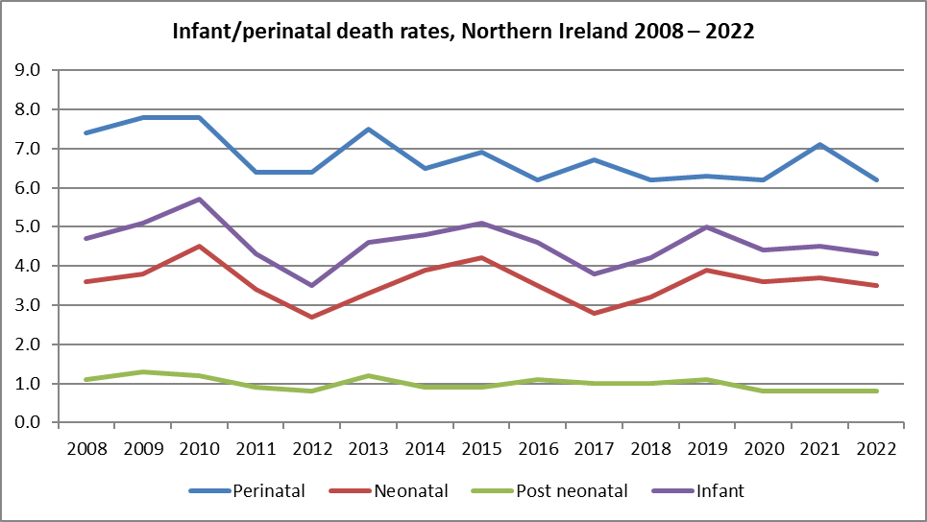
Trends - Infant Mortality
Infant mortality is considered a key indicator of the health of a population. In the last ten years, although fluctuating, mortality rates for children less than one year old in NI, have seen small overall decreases. Risk factors for infant mortality include younger mothers, smoking during pregnancy and not breastfeeding. (Report Sections 3, 6 and 10)
Perinatal deaths continue to have the highest rate of death in children aged less than one year (130 deaths in 2022).
Source: Northern Ireland Statistics and Research Agency
https://www.nisra.gov.uk/statistics/births-deaths-and-marriages
Perinatal mortality rate: Number of stillbirths and deaths in the first week of life per 1,000 live and stillbirths per annum.
Neonatal mortality rate: Number of deaths in the first four weeks of life per 1,000 live births per annum.
Post neonatal mortality rate: Number of deaths after the first four weeks but before the end of the first year per 1,000 live births per annum.
Infant mortality rate: Number of deaths in the first year of life per 1,000 live births per annum.
Rates include non Northern Ireland residents.

Slide 9
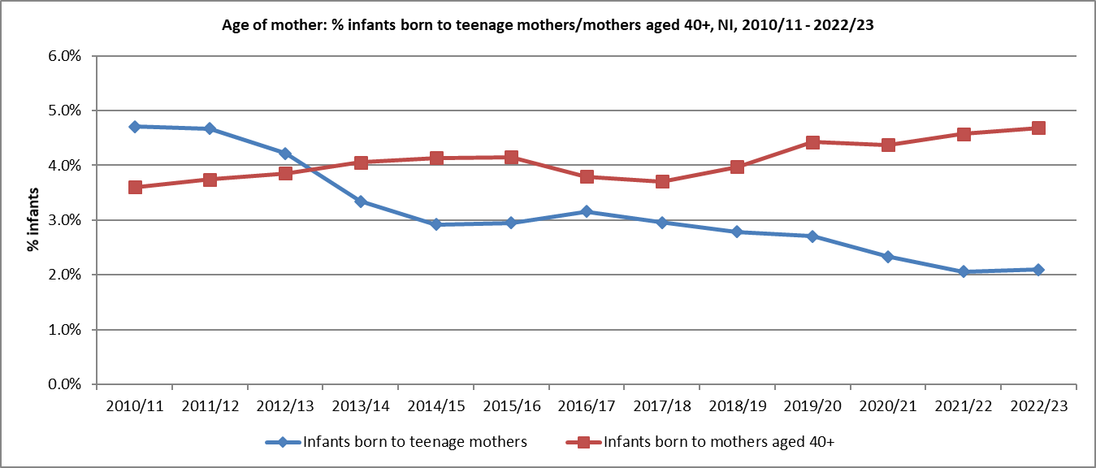
Age of mother
2022/23
Teenage mothers (<20 years):
Number of births to teenage mothers in 2022/23 = 428
2.1% of all births were to teenage mothers.
3.9% of births in the most deprived areas, 0.8% in the least deprived areas (NIMDM 2017).
Older mothers (aged 40+):
Overall % births increasing since 2018/19 (% births in 2022/23 = 4.7%).
3.9% in the most deprived areas, 5.7% in the least deprived areas (NIMDM 2017).
Report – Table 3.1 and 3.2
Source: Child Health System
Source: Northern Ireland Statistics and Research Agency, NI Multiple Deprivation Measure 2017 https://www.nisra.gov.uk/statistics/deprivation/northern-ireland-multiple-deprivation-measure-2017-nimdm2017

Slide 10
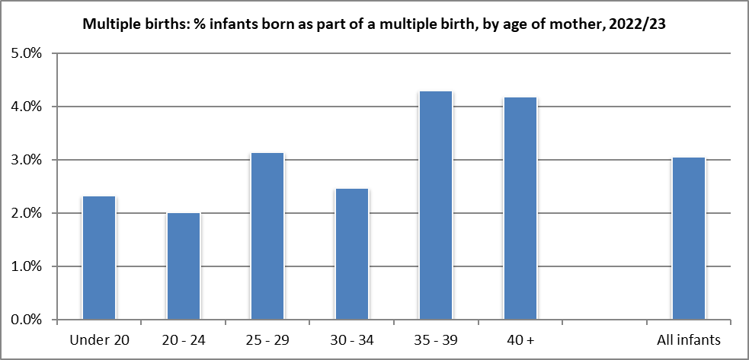
Multiple Births
2022/23:
The proportion of infants born as part of a multiple birth pregnancy increased in general with mother’s age (2.3% of those aged under 20 years who gave birth in 2022/23, compared to 4.2% of those aged 40+ years)
There was little difference in the proportion of infants born as a multiple when considering ethnic group of mother, Trust of residence of mother or deprivation status (NIMDM 2017).
Report – Table 4.2
Source: Child Health System
Source: Northern Ireland Statistics and Research Agency, NI Multiple Deprivation Measure 2017 https://www.nisra.gov.uk/statistics/deprivation/northern-ireland-multiple-deprivation-measure-2017-nimdm2017

Slide 11
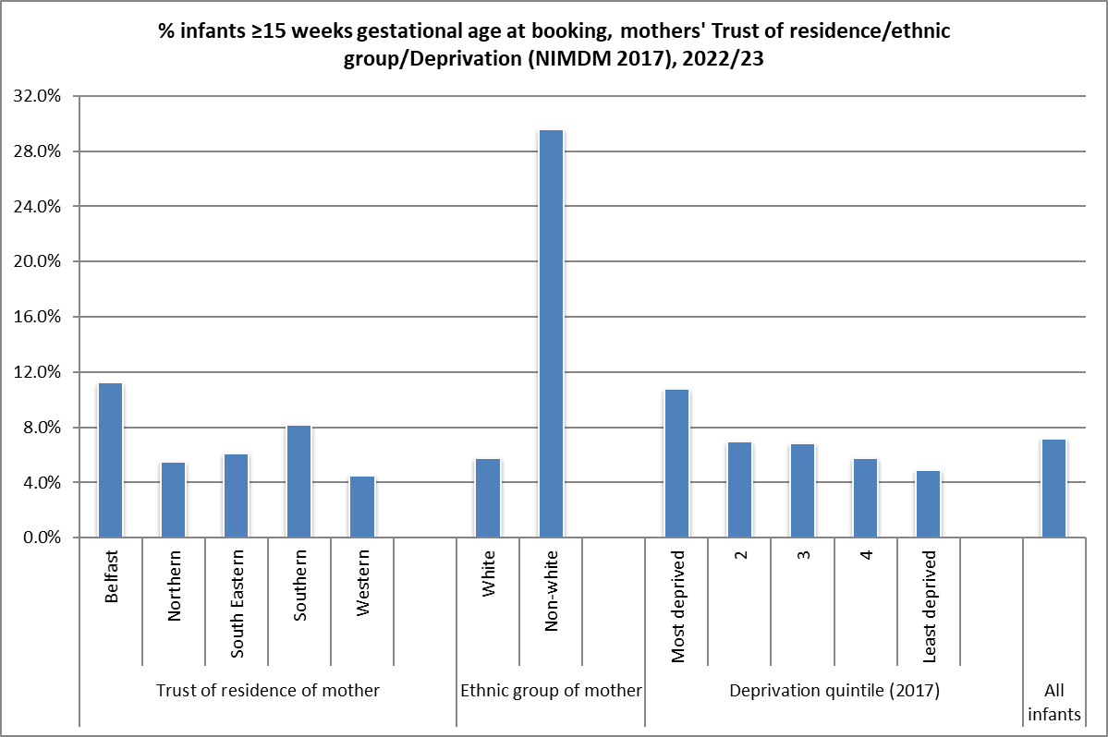
Infant Gestation - Booking
2022/23:
The proportion of infants born to mothers booking for antenatal care at 15 or more weeks varies by Health Trust, ranging from 4.5% of mothers living in Western Trust to 11.3% of mothers in Belfast Trust.
There are substantial differences in the timescales of when mothers book by ethnic group.
Report – Table 5.2
Source: NI Maternity System
Source: Northern Ireland Statistics and Research Agency, NI Multiple Deprivation Measure 2017
https://www.nisra.gov.uk/statistics/deprivation/northern-ireland-multiple-deprivation-measure-2017-nimdm2017

Slide 12
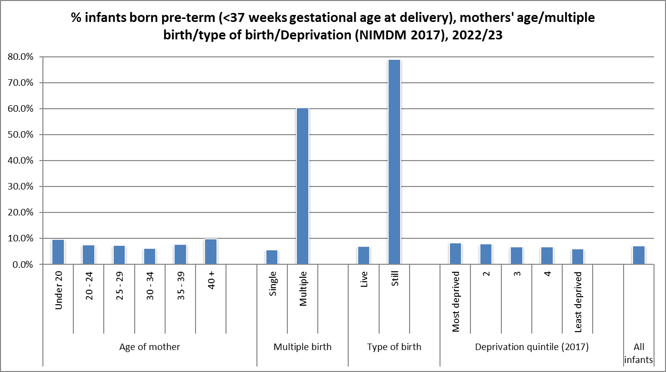
Infant Gestation - Delivery
2022/23:
Higher proportion of infants born still or as part of a multiple birth born pre-term.
Slight differences by deprivation quintile – slightly higher proportion of infants born pre-term to those mothers living in the most deprived areas (8.4%) compared to those in areas with less deprivation (6.1%).
Report – Table 5.4
Source: NI Maternity System
Source: Northern Ireland Statistics and Research Agency, NI Multiple Deprivation Measure 2017
https://www.nisra.gov.uk/statistics/deprivation/northern-ireland-multiple-deprivation-measure-2017-nimdm2017

Slide 13
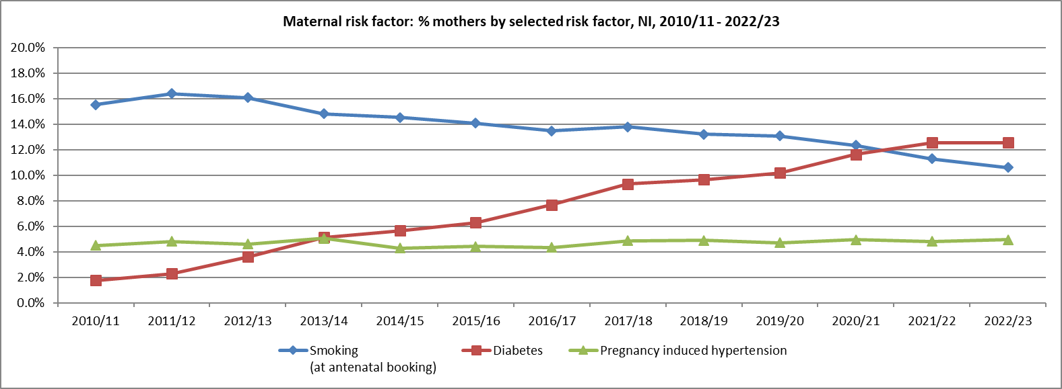
Maternal risk factors
In 2022/23, 10.6% of mothers smoked (2010/11 = 15.5%)
In 2022/23, 4.9% had pregnancy induced hypertension (2010/11 = 4.5%)
In 2022/23, 12.6% of mothers had diabetes (2010/11 = 1.8%)
Report – Table 6.1
Source: Child Health System (2010/11 - 2016/17), NI Maternity System (2017/18 onwards)
DIABETES - During 2022 and 2023, a validation exercise was completed on data being recorded on NIMATS for women with diabetes. As a result, data sourced from NIMATS has been amended and is still considered provisional at this time.

Slide 14
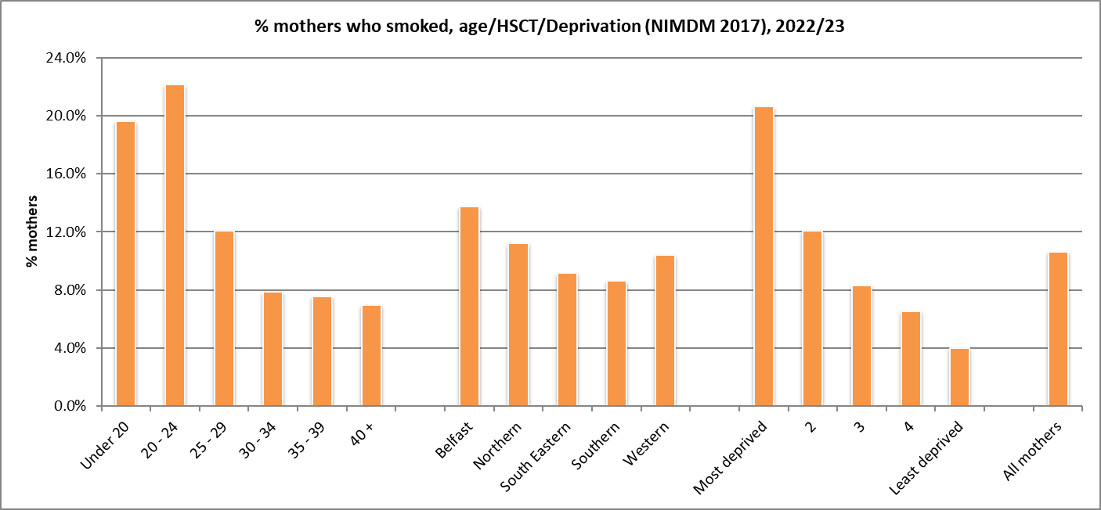
Maternal risk factors - Smoking
2022/23:
% mothers who smoked at booking decreased in general with age.
A smaller proportion of first time mothers smoked (7.9%), compared to those who were pregnant before (11.8%).
Almost 14% of mothers living in Belfast Health and Social Care Trust area smoked, compared to just less than 9% of those living in Southern HSCT (NI=10.6%).
In the most deprived areas (NIMDM 2017), 20.7% of mothers smoked, compared to 4.0% in the least deprived areas.
Report – Table 6.2
Source: NI Maternity System
Source: NISRA, NI Multiple Deprivation Measure 2017 https://www.nisra.gov.uk/statistics/deprivation/northern-ireland-multiple-deprivation-measure-2017-nimdm2017

Slide 15
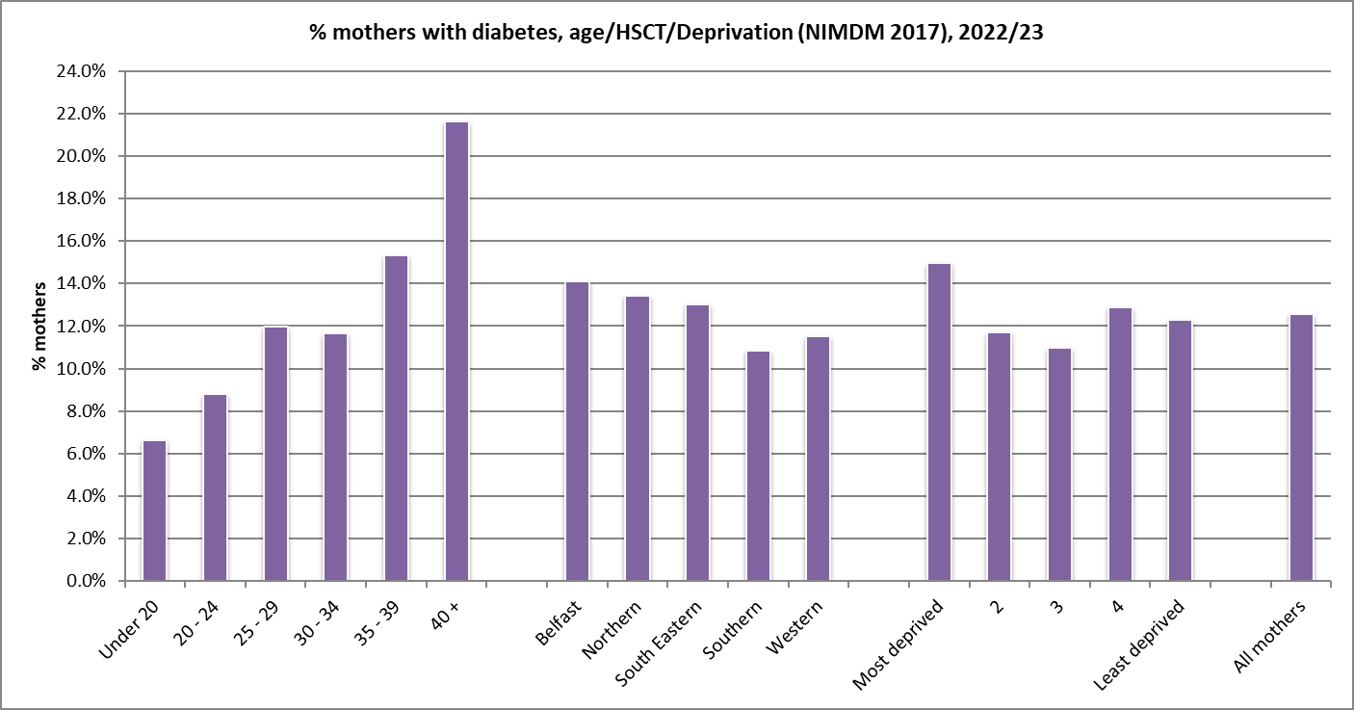
Maternal risk factors - Diabetes
2022/23:
% mothers with diabetes increased with age – 6.6% of those aged less than 20 years, rising to 21.6% of those aged 40+. (All mothers = 12.6%).
Slightly higher proportion of mothers with diabetes living in more deprived areas of Northern Ireland (15.0%). Least deprived = 12.3% (NIMDM 2017).
Report – Table 6.3
Source: NI Maternity System
DIABETES - During 2022 and 2023, a validation exercise was completed on data being recorded on NIMATS for women with diabetes. As a result, data sourced from NIMATS has been amended and is still considered provisional at this time.
Source: Northern Ireland Statistics and Research Agency, NI Multiple Deprivation Measure 2017 https://www.nisra.gov.uk/statistics/deprivation/northern-ireland-multiple-deprivation-measure-2017-nimdm2017

Slide 16
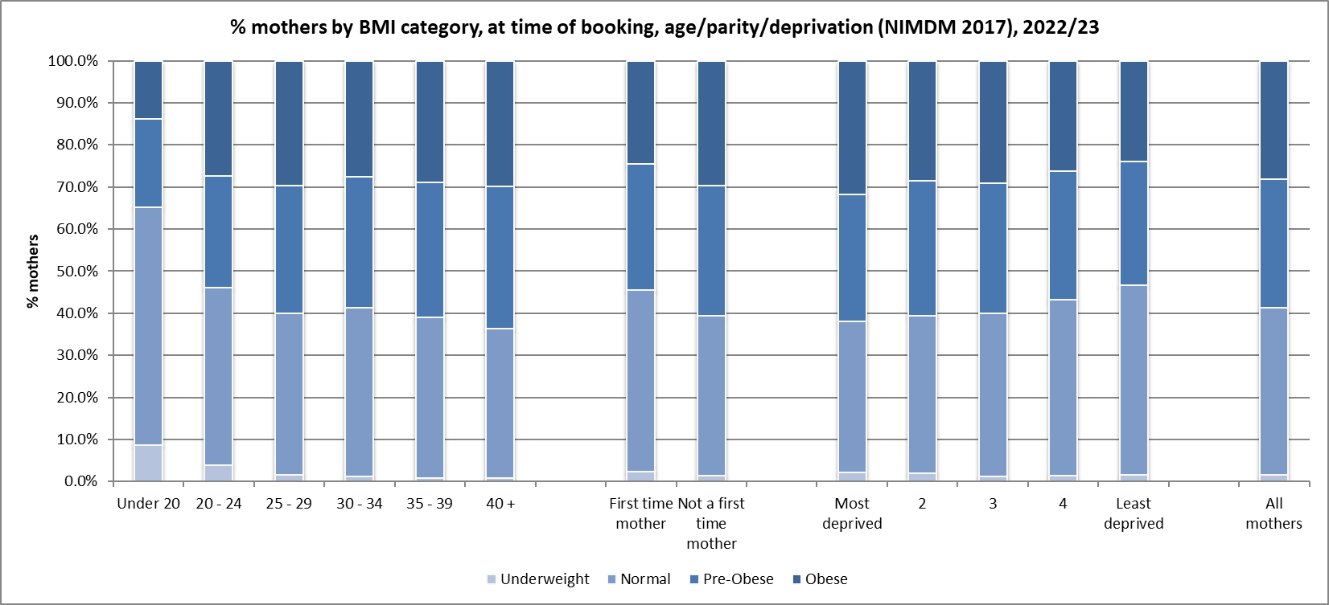
Maternal Body Mass Index (BMI)
2022/23 (at antenatal booking appointment):
58.7% of mothers giving birth were measured as pre-obese (overweight) or obese. 30.6% pre-obese, 28.1% obese.
31.8% of mothers from most deprived areas were classified as obese, 23.9% from least deprived areas.
Report – Tables 7.1 and 7.2
Source: NI Maternity System
Source: Northern Ireland Statistics and Research Agency, NI Multiple Deprivation Measure 2017
https://www.nisra.gov.uk/statistics/deprivation/northern-ireland-multiple-deprivation-measure-2017-nimdm2017

Slide 17
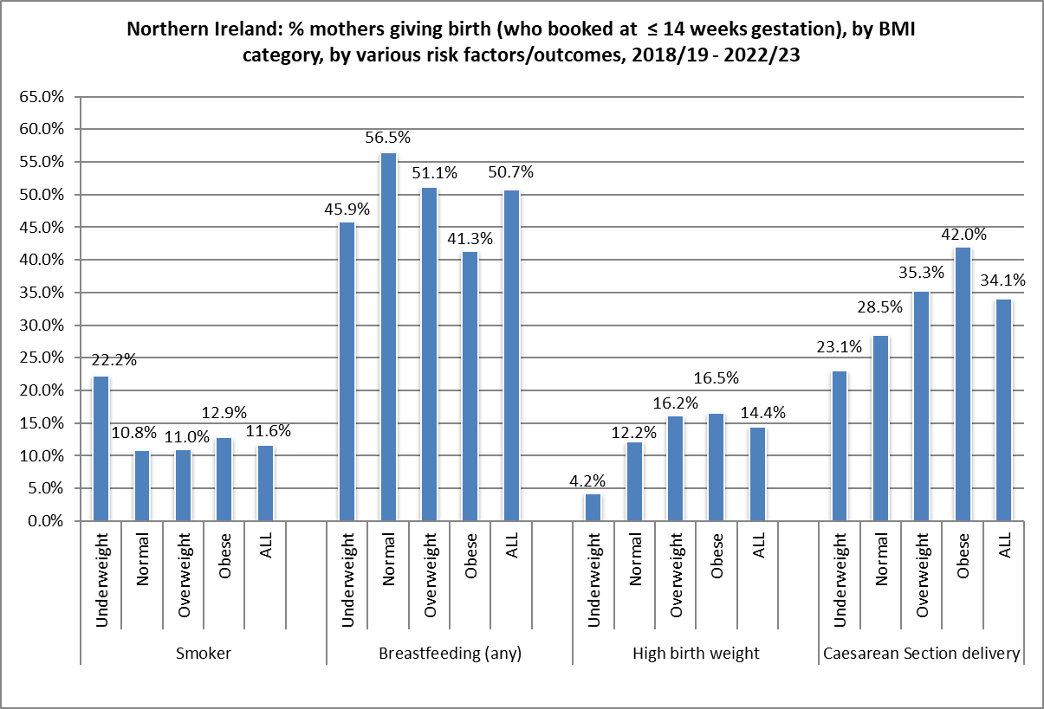
Maternal Body Mass Index (BMI)
2018/19 – 2022/23:
Figures show that a larger proportion of women (who booked at ≤ 14 weeks gestation) with a higher BMI; were more likely to have a larger baby, deliver by Caesarean Section and were less likely to breastfeed.
A higher proportion of women who smoke were more likely to be underweight.
Report – Table 7.4
Source: NI Maternity System

Slide 18
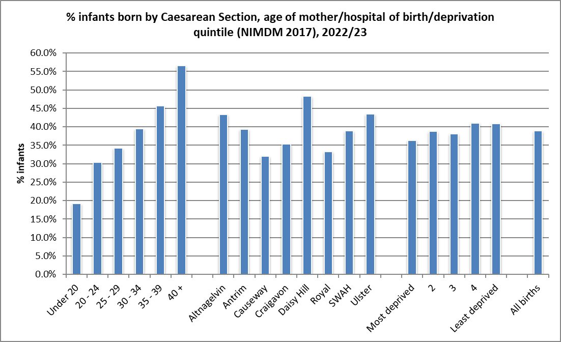
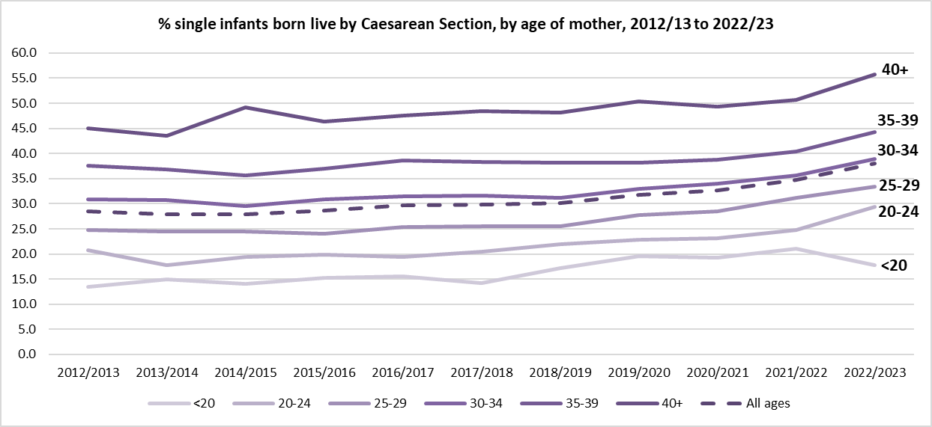
Method of Delivery
2022/23:
38.9% of infants born by Caesarean Section (CS), 49.3% had a normal delivery, 11.8% had another type of delivery e.g. breech, forceps.
Daisy Hill Hospital continues to have a much higher proportion of CS (48.3%).
Slight difference in proportion of infants born by CS, by deprivation quintile. 36.3% of those born to mothers from the most deprived quintile, compared to 40.9% of those born to mothers from the least deprived quintile.
2022/23:
% infants (single, live) born by CS increased with age of mother from 17.8% of those aged under 20 years to 55.7% of those aged 40+.
Report – Table 8.2
Source: NI Maternity System
Source: Northern Ireland Statistics and Research Agency, NI Multiple Deprivation Measure 2017 https://www.nisra.gov.uk/statistics/deprivation/northern-ireland-multiple-deprivation-measure-2017-nimdm2017

Slide 19
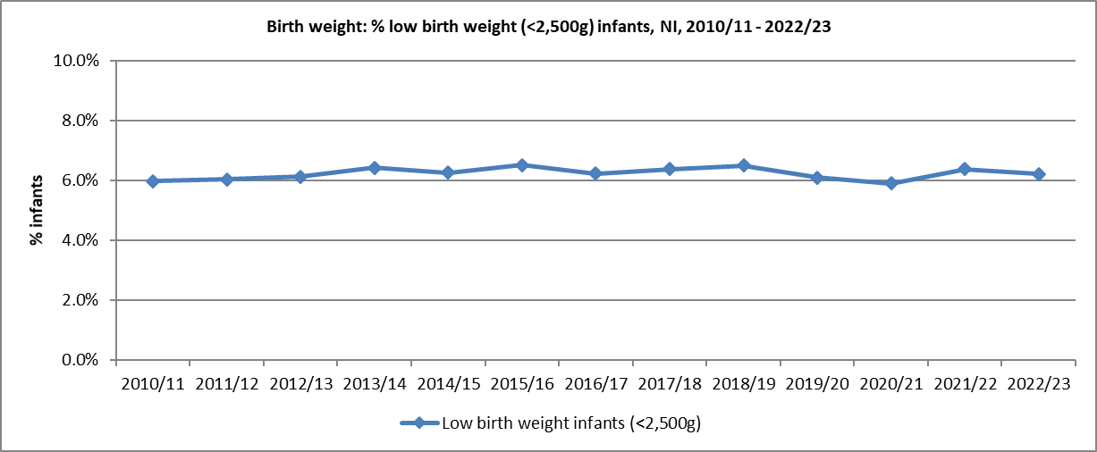
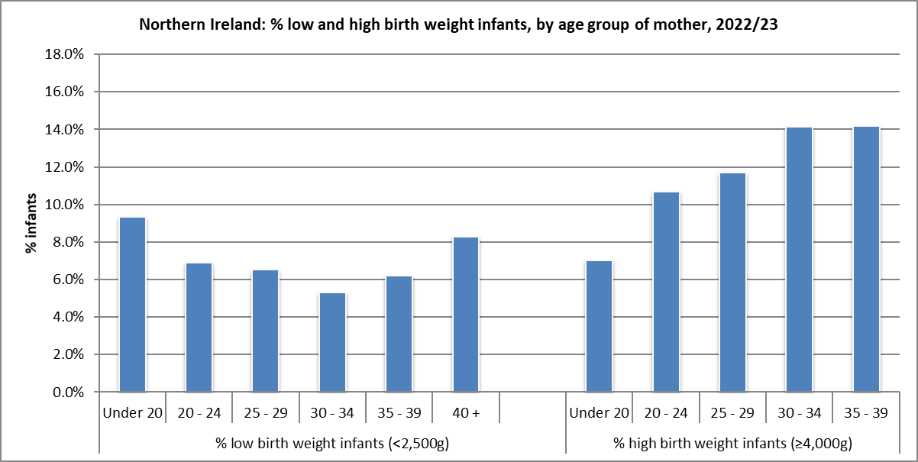
Infant Birth Weight
2022/23:
6.2% of all births were of a low birth weight (6.0% live, 68.5% still).
% low birth weight slightly higher in those mothers aged under 20 years (9.4%). All ages = 6.2%.
12.9% of live infants were born with a higher birth weight (4,000g+) and of these, 1.5% with a birth weight of 4,500g+.
Mothers from a ‘white’ ethnic group were more likely to have a baby born with a high birth weight (4,000g+) (13.3%). Those mothers of a ‘non-white’ ethnic group = 6.4%.
Report – Tables 9.1 and 9.2
Source: Child Health System and NI Maternity System

Slide 20
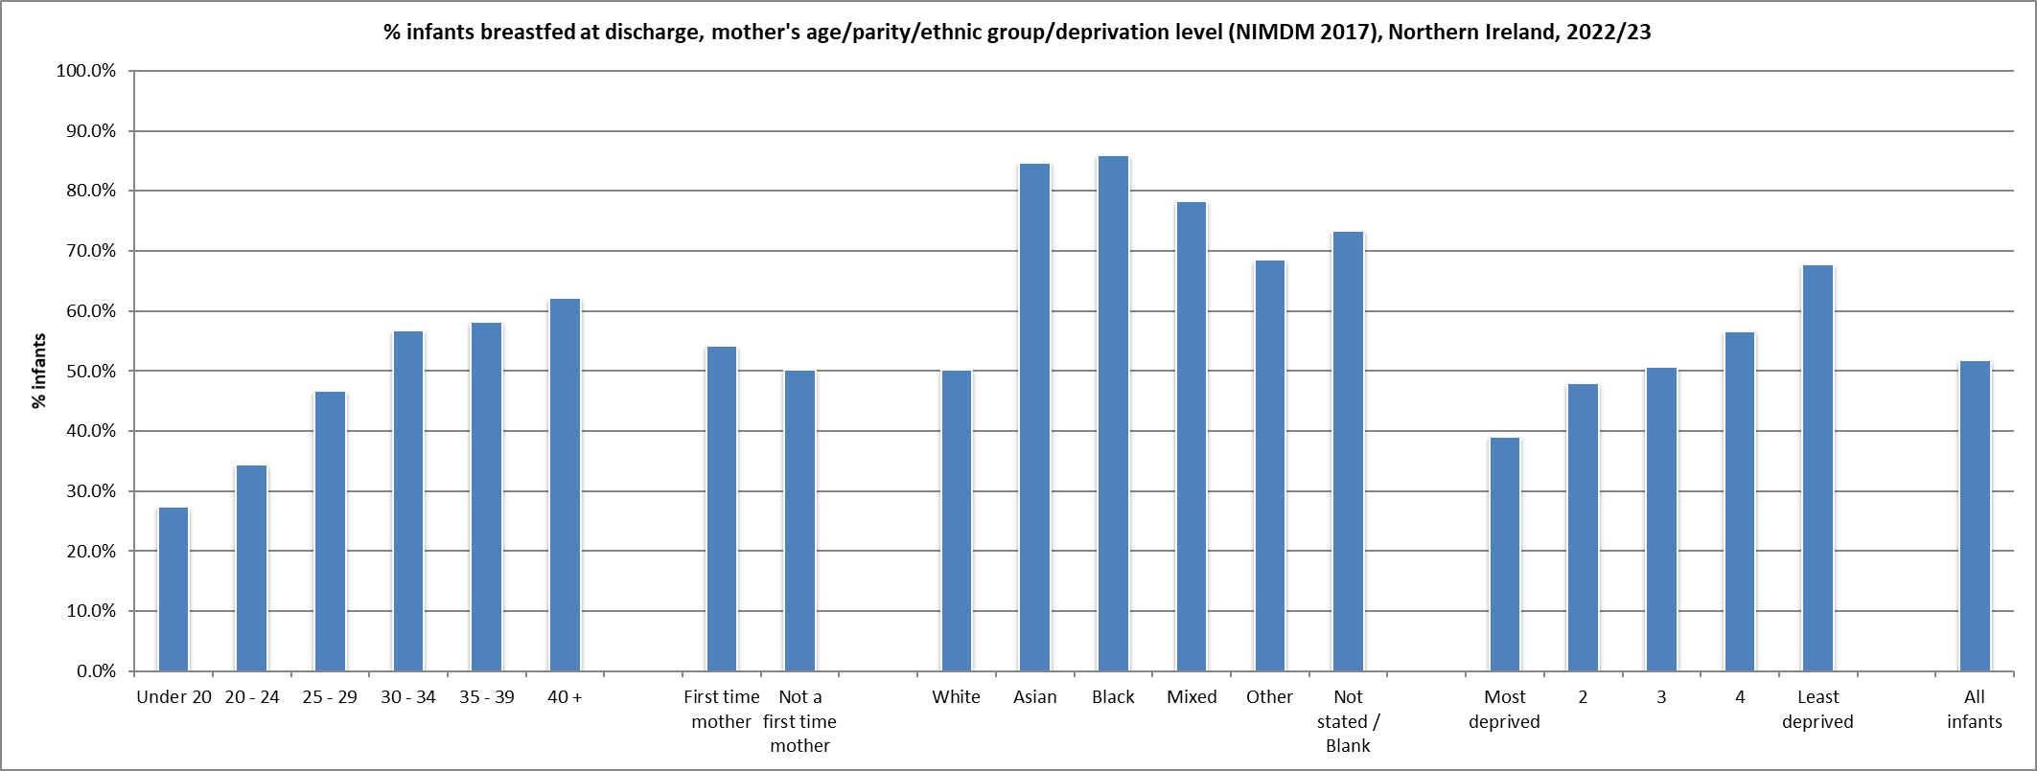
Breastfeeding (total/partial) – at discharge
2022/23:
51.8% of live infants breastfed at discharge.
Increases with age of mother: aged <20 = 27.4%, 40+ = 62.2%.
Much higher rates in infants born to mothers whose ethnic origin was not ‘white’.
By Council area, % breastfed ranges from 42.6% in Derry City & Strabane to 63.8% in Lisburn & Castlereagh.
Noticeably lower in more deprived areas (39.1%). Least deprived = 67.8%.
Report – Table 10.2
Source: Child Health System and NI Maternity System
Source: Northern Ireland Statistics and Research Agency, NI Multiple Deprivation Measure 2017
https://www.nisra.gov.uk/statistics/deprivation/northern-ireland-multiple-deprivation-measure-2017-nimdm2017

Slide 21
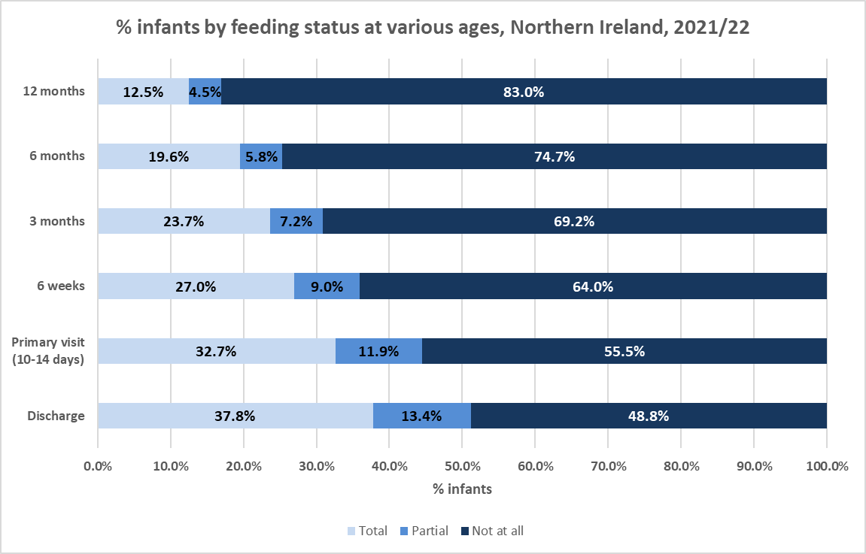
Breastfeeding – prevalence
Infants born in 2021/22:
Chart shows considerable decrease in proportion of infants breastfed “totally” - from 37.8% at time of discharge from hospital to 12.5% at 12 months old.
“Totally” or “partially” represented 51.2% of infants at discharge, but fell to 17.0% at 12 months.
Report – Table 10.5
Source: Child Health System
Infants whose feeding status was not known have been excluded above

Slide 22
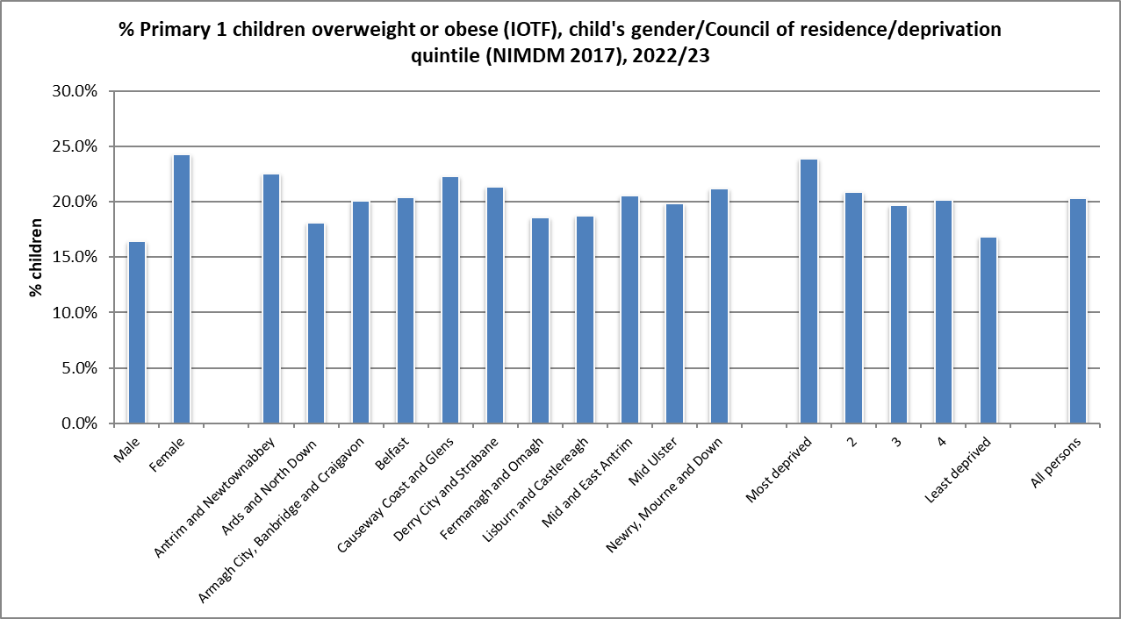
Body Mass Index – Primary 1
2022/23 (IOTF):
Note that coverage of children measured in 2022/23 was lower compared to previous years and so caution is advised.
Higher proportion of girls were overweight/obese (24.3%) compared to boys (16.5%). All children in NI = 20.4%.
Antrim and Newtownabbey LGD had the highest proportion of children overweight/obese (22.5%).
23.9% of children living in the most deprived areas were overweight/obese, compared to 16.9% of children from the least deprived areas.
Report – Table 12.2
Source: Child Health System
Source: Northern Ireland Statistics and Research Agency, NI Multiple Deprivation Measure 2017 https://www.nisra.gov.uk/statistics/deprivation/northern-ireland-multiple-deprivation-measure-2017-nimdm2017

Slide 23
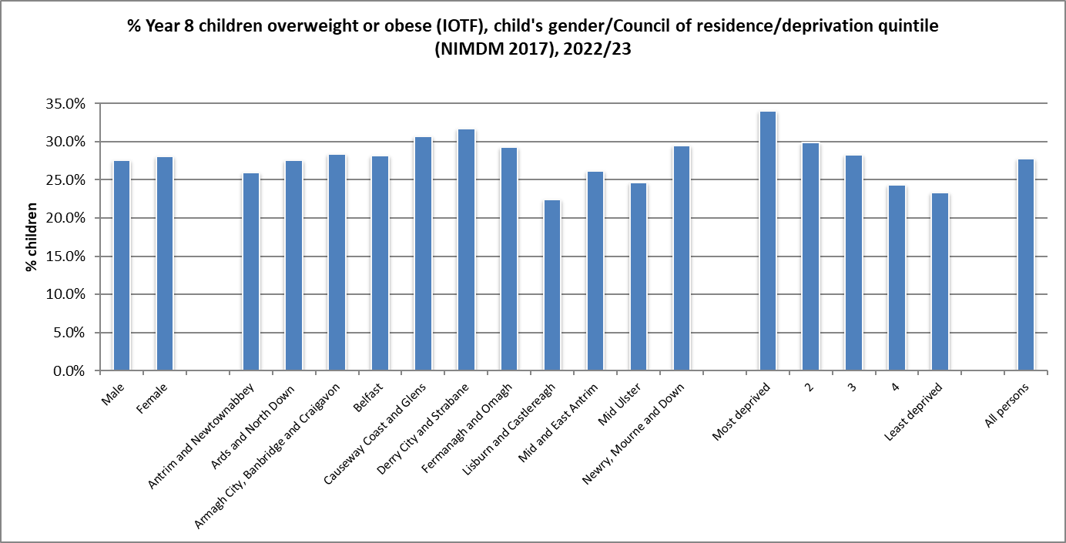
Body Mass Index – Year 8
2022/23 (IOTF):
Note that coverage of children measured in 2022/23 was lower compared to previous years and so caution is advised.
27.8% of children measured as overweight/obese.
Little difference in the proportion overweight/obese between the two genders (27.5% male, 28.1% female).
Derry City and Strabane LGD had the highest proportion of children measured as overweight/obese (31.7%).
Larger proportion of children from more deprived areas were measured as overweight/obese (34.0%), compared to those living in the least deprived areas (23.4%).
Report – Table 12.5
Source: Child Health System
Source: Northern Ireland Statistics and Research Agency, NI Multiple Deprivation Measure 2017 https://www.nisra.gov.uk/statistics/deprivation/northern-ireland-multiple-deprivation-measure-2017-nimdm2017

Slide 24
Children’s Health in
Northern Ireland
Produced by Public Health Agency
Health Intelligence Unit
www.publichealth.hscni.net
17 May 2024

