Slide 1
Shingles (Herpes Zoster)
September 2023

Slide 2
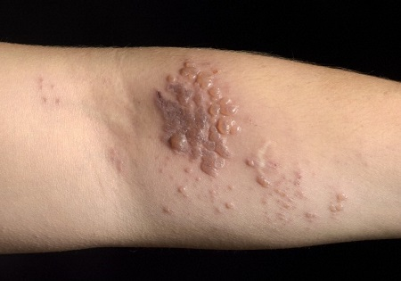
Shingles (Herpes Zoster)
is an infection of the nerve & the skin around it
is caused by reactivation of a latent varicella zoster virus infection
Notes:
The first infection with the varicella zoster virus results in chickenpox. Primary infection results in latent infection. Many decades later a person who has had chickenpox may develop shingles (known also as Herpes Zoster) and this is an infection of the nerve and the skin around it. Shingles is caused by reactivation of the virus, which has lain dormant in their spinal cord. The virus can be reactivated with age, or anything else that reduces how well the immune system works.

Slide 3
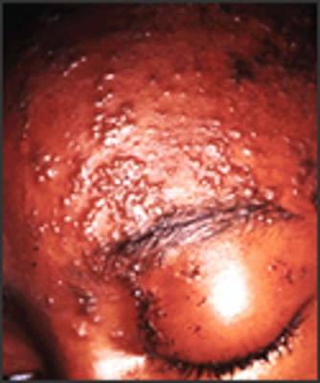
Shingles (Herpes Zoster)
Abnormal skin sensation & pain in affected area of skin (dermatone)
Headache, photophobia, malaise and occasionally fever
Unilateral vesicular rash
Image courtesy of CDC
Notes:
Reactivation of the latent virus leads to the clinical manifestations of shingles and is associated with immunosuppression, HIV infection, malignancy / increasing age. The risk and severity of shingles increases with age.
The first signs of shingles begin most commonly with abnormal skin sensations and pain in the affected area (dermatone). Headache, photophobia, malaise and less commonly fever may occur as part of the period between the initial symptoms and the development of the rash.
Within days / weeks a unilateral vesicular (fluid filled blisters) rash typically appears in dermatomal distribution (the area of the skin supplied by afferent nerve fibres by a single posterior spinal root). The rash may involve multiple dermatomes in an individual who is immunocompromised. The rash which may be extremely painful with tingling, pricking or numbness of the skin can also be itchy and typically lasts between two and four weeks.

Slide 4
Possible complications of shingles
The most common complications are:
Secondary bacterial skin infections
Post herpetic neuralgia (PHN)
Other less common complications can include:
Ophthalmic Zoster
Peripheral motor neuropathy
Severe cases can lead to hospitalisation and death
Notes:
Shingles can cause a number of secondary complications and the severity of these can be dependent on how weak the individual’s immune system is.
Complications are more likely in adults aged over 50 years, with the severity of the illness increasing with age.
Most commonly reported complications in the older age groups include secondary bacterial infections at the site of the rash (that may require antibiotic therapy) and post herpetic neuralgia.
Other less common complications can include ophthalmic shingles and peripheral motor neuropathy. Ophthalmic shingles affects the facial nerve (trigeminal) and can cause ulceration and scarring of the eye and uveitis (inflammation of the inner eye). Ophthalmic shingles can also cause loss of vision if untreated and is often associated with long term pain. Studies have estimated ophthalmic zoster to occur in 10-20% of shingles cases (Opstelten et al., 2002) with around 4% of the cases resulting in long-term sequelae, including pain (Bowsher,1999). Chapter 28a The Green Book (Zoster)
Peripheral motor neuropathy is more common in the elderly population and results in temporary nerve damage (peripheral motor nerve) that controls movement of limbs such as the arm or leg, causing paralysis in the associated limb. This effect is temporary and individuals can make a good recovery.
Severe cases of Shingles can lead to hospitalisation and rare complications of Shingles include: Encephalitis / disseminated zoster in immunocompromised individuals leading to virus dissemination in the lungs, liver and CNS.

Slide 5
Transmission
Shingles cannot be caught from someone else, whether they have chickenpox or shingles.
However, the virus can be found in the vesicles of someone with shingles and can be transmitted by direct contact with the rash, causing chickenpox in a susceptible recipient.
Notes:
Shingles cannot be caught from someone else, whether they have chickenpox or shingles.
However, the virus can be found in the vesicles of someone with shingles (active lesions) and can be transmitted by direct contact with the rash, causing chickenpox in a susceptible recipient – someone who has never had chickenpox before.
There is no evidence that shingles can be acquired from someone who has chickenpox.

Slide 6
Why vaccinate older adults against shingles?

Slide 7
Epidemiology of shingles
An estimated 50,000 cases of shingles occur in people aged over 70 years each year in England & Wales
Of these, 14,000 develop Post Herpetic Neuralgia
1,400 cases of shingles result in hospitalisation
1 in 1,000 cases of shingles are estimated to result in death
In Northern Ireland this corresponds to 900-1000 cases of shingles in people in their 70s and 250 cases of PHN each year
Notes:
An estimated 50,000 cases of shingles occur in people aged over 70 years each year in England & Wales. Of these, 14,000 develop Post Herpetic Neuralgia. 1,400 cases of shingles result in hospitalisation and 1 in 1,000 cases of shingles are estimated to result in death.
In Northern Ireland this corresponds to 900-1000 cases of shingles in people in their 70s and 250 cases of PHN each year.

Slide 8
Why vaccinate older adults and those immunosuppressed against shingles?
Increased risk of developing shingles
Increased risk of developing a more severe form of the disease including PHN and increased hospital admissions
Notes:
Individuals over 70 years of age are not only at an increased risk of developing shingles, but they also suffer a more severe form of the illness resulting in complications such as PHN and an increased rate of hospital admissions.
Vaccination for individuals over the age of 80 years is not recommended due to the decreased efficacy of the vaccine in this age group. Economic analysis suggested that the vaccine would not be cost effective in individuals over the age of 80 years.

Slide 9
National programme for adults aged 60-79
The JCVI recommended that:
Shingrix should replace Zostavax® in the routine programme
should be offered at 60 years of age.
For this immunocompetent cohort:
the eligible age for immunocompetent individuals will change from 70 to 60 years of age for the routine cohort, in a phased implementation over a 10 year period
This will be completed in 2 stages during that period
Notes:
The choice of age group was based on evidence that the greatest number of cases would be prevented by administering the vaccine at this age.

Slide 10
National programme for adults aged 60-79 years (2)
During Stage 1 (1st September 2023 to 31st August 2028) Shingrix® will be offered to those who are aged 70 and 65 years of age on 1 September 2023(and each year up to 2028).
During Stage 2 (1 September 2028 to 31 August 2033) Shingrix® will be offered to those aged 65 and 60 years of age on 1 September 2028 (and each year up to 2033).
From 1 September 2033 and thereafter, Shingrix® will be offered routinely at age 60 years
Those who have been previously eligible (i.e. in stages 1 and 2) will remain eligible until their 80th birthday. Where an individual has turned 80 years of age following their first dose of Shingrix, a second dose should be provided before the individual’s 81st birthday to complete the course
Notes:
The routine offer will move from 70 to 60 years of age in 2 stages over a 10 year period as above.

Slide 11
Immunosuppressed individuals aged 50 years and over
From September 2021,
Shingrix® made available to immuno-suppressed individuals aged 70 to 79 years, who are contraindicated to receive Zostavax®, as part of the NHS shingles vaccination programme.
From 1 September 2023
eligibility will be expanded to all immunosuppressed individuals aged 50 years and over (with no upper age limit) who should be offered two doses of Shingrix.

Slide 12
Immunosuppressed individuals aged 50 years and over (2)
Immunosuppressed individuals represent the highest priority for vaccination given their risk of severe disease, and therefore the programme aims to catch up all eligible individuals aged 50 years and over in the first year of programme implementation.
Individuals who should be offered Shingrix® amongst this cohort are summarised:
Box: Definition of severe immunosuppression
p7 Chapter 28a Green Book

Slide 13
National Shingles Vaccination Programme
From 1st September 2023
Eligible Cohorts:
1. Those aged 65 and 70 years old on 1st September 2023
(i.e. those born between- 02/09/1957 to 01/09/1958 and 02/9/1952 to 01/09/1953)
2. Those aged 50 years and above who are immunosuppressed
3. Those aged 71 to 79 years of age who have not previously received a Shingles vaccine
Notes:
The National Shingles Vaccination Programme began on 1st September 2013 and included both routine and catch-up cohorts.

Slide 14
National Shingles Vaccination Programme cont.
The 2023/24 vaccination programme continues until 31 August 2024
GPs should continue to ensure patients who meet the eligibility criteria for the 2023/24 programme, irrespective of their age now, are offered the vaccine, particularly those who will become ineligible due to being aged 80 or older on 1 September 2024.

Slide 15
National Shingles Vaccination Programme cont.
From Autumn 2023 GP’s should offer Shingrix vaccine to eligible patients aged 65 or 70 years of age on 1 September 2023 and those over the age of 50 and are immunosuppressed.
A limited quantity of Zostavax vaccine will still be available until January 2024 (or central stocks deplete)
Zostavax should only be offered to those aged 71-79 who are previously eligible while supply remains, unless contraindicated e.g. immunosuppressed.
After this date they should be offered Shingrix if remain eligible.

Slide 16
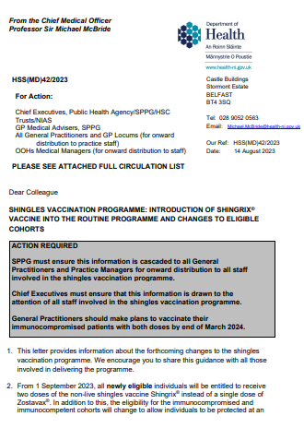
Notes:
The CMO Letter about the Shingles programme issues 1st September 2023. This provides updated guidance regarding the introduction of Shingrix® into the programme.
The link to the CMO letter can be found on the last slide of this presentation.

Slide 17
Shingles Vaccine

Slide 18
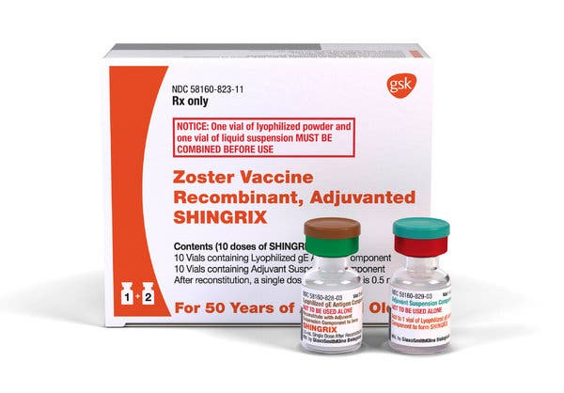
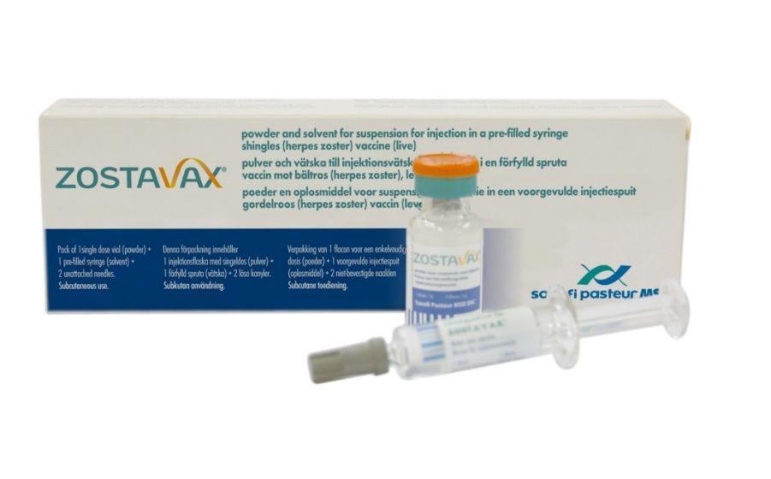
Shingles vaccine
Shingrix® and Zostavax® are the current vaccines recommended for the prevention of shingles and shingles-related PHN
Notes:
Shingrix is a recombinant (non-live) shingles vaccine and is replacing Zostavax in the routine immunisation programme from September 2023.
Zostavax® is recommended for the prevention of shingles infection and shingles related PHN only. Zostavax® should not be used for the treatment of PHN.
Zostavax® contains a significantly higher antigen level of varicella zoster virus than the routine varicella (chickenpox) vaccine and is not recommended for the prevention of chickenpox infection
It is important immunisers familiarise themselves with the vaccine and its product information to avoid administration errors. Zostavax contains significantly higher dose of virus than chickenpox vaccine so do not confuse the two.

Slide 19
Shingrix
Shingrix® is a recombinant vaccine and contains varicella zoster virus glycoprotein E antigen produced by recombinant DNA technology, adjuvanted with AS01B.
Shingrix® is available as a white powder for reconstitution with diluent and is injected as a suspension. After reconstitution, the suspension is an opalescent colourless to pale brownish liquid.
Shingrix® is available in a pack size of 1 vial of powder plus 1 vial of suspension or in a pack size of 10 vials of powder plus 10 vials of suspension. The reconstituted vaccine should be inspected visually for any foreign particulate matter and/or variation of appearance. If either is observed, the vaccine should not be administered.
After reconstitution, the vaccine should be used promptly; if this is not possible, the vaccine should be stored in a refrigerator (2°C – 8°C). If not used within 6 hours it should be discarded.

Slide 20
Shingrix®
Administration:
Adults should receive two doses of 0.5ml of Shingrix® a minimum of 2 months apart
Shingrix® should be given by intramuscular injection
Subcutaneous administration is not recommended
Shingrix® should be given with caution to individuals with thrombocytopenia or any coagulation disorder since bleeding may occur following intramuscular administration.
Notes:
Shingrix should not be administered intravascularly or intradermally.
Maladministration via the subcutaneous route may lead to an increase in transient local reactions. (https://www.medicines.org.uk/emc/product/12054/smpc)

Slide 21
Shingrix Schedule- Northern Ireland
Immunocompetent cohort:
Administer 2 doses, 6-12 months apart
Immunosuppressed cohort:
Administer 2 doses, 2-6 months apart
Notes:
Shingrix licensed dosing schedule is 8 weeks separating doses, with flexibility of up to 6 months after the first dose if necessary.
The recommendation in the HSS letter to administer the second dose 6 – 12 months apart advocates for off-label use and is supported within the Shingles vaccine patient group direction (PGD) .
While Shingrix licencing allows the second dose to be given 8 weeks after the first dose, funding has only been secured for one dose for the immunocompetent cohort in the 23/24 financial year, therefore the second dose should be given between 6-12 months after the first dose,(i.e between April and September 2024) as referenced in the Green Book.

Slide 22
Co-administration- Shingrix®
Shingrix® can be given concomitantly with inactivated influenza vaccine
Interim data from the US on co-administration of Shingrix® with adjuvanted influenza vaccine is reassuring, therefore these 2 vaccines can be given together if required
As COVID vaccines are considered inactivated, Shingrix® vaccine can be co-administered to individuals in an eligible cohort
Where more than one vaccine is offered, patients should be informed about the likely timing of potential adverse events relating to each vaccine
Notes:
In line with general advice about co-administration of inactivated or non-live vaccines, Shingrix® can be given concomitantly with inactivated influenza vaccine.
Initially, a seven day interval was recommended between Shingrix® and adjuvanted influenza vaccine because the potential reactogenicity from two adjuvanted vaccines may reduce tolerability in those being vaccinated. Interim data from a US study on co-administration of Shingrix with adjuvanted seasonal influenza vaccine is reassuring. Therefore, an appointment for administration of the seasonal influenza vaccine can be an opportunity to also provide shingles vaccine, although the latter should be offered all year round, rather than purely as a seasonal programme“
As Shingrix® is a non-live vaccine, where individuals in an eligible cohort present having recently received another inactivated or live vaccine (such as Covid-19), Shingrix® vaccination should still be offered.
A 7 day gap between administration of Shingrix® and COVID-19 vaccine is no longer required. In most cases, vaccination should proceed to avoid any further delay in protection and to avoid the risk of the patient not returning for a later appointment. In such circumstances, patients should be informed about the likely timing of potential adverse events relating to each vaccine.
Source: Shingles: the green book chapter 28a (from 1 September 2023)

Slide 23
Contraindications- Shingrix®
Shingrix® should not be administered to an individual with a confirmed anaphylactic reaction to any component of the vaccine.

Slide 24
Precautions
Delay if:
Acutely unwell
Individuals with shingles / PHN
Notes:
Immunisation of individuals who are acutely unwell should be postponed until they have fully recovered to avoid confusing diagnosis of any acute illness by wrongly contributing any signs & symptoms to the adverse effects of the vaccine.
Shingrix® vaccination is not recommended for the treatment of shingles or post herpetic neuralgia (PHN). Individuals who have shingles should wait until symptoms have ceased before being considered for shingles immunisation. The natural boosting that occurs following an episode of shingles, however, makes the benefit of offering zoster vaccine immediately following recovery unclear. Patients who have two or more episodes of shingles in one year should have immunological investigation prior to vaccination. Clinicians may wish to discuss such cases with local specialist teams.
In contrast to Zostavax, anti-virals such as acyclovir can be prescribed with Shingrix concurrently.
Concurrent administration of Shingrix® and anti-viral medications known to be effective against VZV has not been evaluated, but drugs such as aciclovir are unlikely to reduce vaccine response as the vaccine is a recombinant vaccine.

Slide 25
Inadvertent administration-
Shingrix®
Inadvertent vaccination in individuals under 18 years of age
Shingrix® is licensed for use in individuals over 18 years of age
Most children aged >10 are likely to be immune to varicella and therefore inadvertent vaccination is highly unlikely to result in serious adverse reactions
Vaccination of varicella naïve children also unlikely to result in serious adverse reactions and should count as a valid dose of varicella vaccine
Inadvertent vaccination with Shingrix® during pregnancy
No known risk associated with giving inactivated, recombinant viral or bacterial vaccines or toxoids during pregnancy or whilst breast-feeding.
If indicated, Shingrix® can be considered in pregnancy after full discussion of the risks and benefits of vaccination with the recipient
Notes:
Inadvertent vaccination in individuals under 18 years of age
Shingrix® is licensed for use in individuals over 18 years of age. However, most children above the age of 10 are likely to be immune to varicella and therefore inadvertent vaccination with Shingrix® is highly unlikely to result in serious adverse reactions. As the vaccine is a recombinant sub-unit vaccine inadvertent vaccination with Shingrix® in varicella naïve children of any age is unlikely to result in serious adverse reactions and would count as a valid dose of varicella vaccine. In this instance, children eligible for chickenpox vaccination may be offered a second dose, a minimum of 4 weeks later, to complete the course.
Inadvertent vaccination with Shingrix® during pregnancy
There is no known risk associated with giving inactivated, recombinant viral or bacterial vaccines or toxoids during pregnancy or whilst breast-feeding (Kroger et al., 2013). If indicated, Shingrix® can be considered in pregnancy after full discussion of the risks and benefits of vaccination with the recipient. All incidents of inadvertent administration of Shingrix ® during pregnancy should also be reported to UK Health Security Agency (UKHSA) using the vaccine administered in pregnancy reporting form (ViP). https://www.gov.uk/vaccination-in-pregnancy-vip

Slide 26
Possible adverse reactions- Shingrix®
Most frequently reported side effects were:
Pain at injection site
Myalgia
Fatigue
Notes:
A full list of side effects can be found in the Shingrix® summary of product characteristics. (https://www.medicines.org.uk/emc/product/12054/smpc)

Slide 27
Efficacy
Shingrix:
Clinical trials of 15,411 participants: Vaccine efficacy in the 7,695 immunocompetent adults ≥ 50 years and 6,950 ≥70 years, administered with two doses of Shingrix® 2 months apart was estimated at 97.2% and 91.2% respectively
US study of adults ≥65 years, two dose vaccine effectiveness against postherpetic neuralgia was 76.0%
In immunocompetent adults ≥70, Shingrix® immunity remained high throughout 7 years following vaccination
Notes:
Cases of shingles have declined by approximately 35% in England since the vaccine programme was introduced in 2013. Between 2013 and 2016, approximately 17 000 GP visits for shingles and 3300 consultations for PHN have been avoided.
Shingrix:
In the phase 3 randomized placebo controlled clinical trials of 15,411 participants, vaccine efficacy in the 7,695 immunocompetent adults ≥ 50 years and 6,950 ≥70 years, administered with two doses of Shingrix® 2 months apart was estimated at 97.2% and 91.2% respectively (Lal et al 2015),
In a phase 3 clinical trial in autologous haemopoietic stem cell transplant recipients aged 18 years and above who received two doses of Shingrix® 1-2 months apart, robust humoral and cellular responses persisted at 1 year after vaccination. (Dagnew et al, 2019) Post hoc efficacy analysis revealed a vaccine efficacy of 87.2% against herpes zoster in immunocompromised patients which included non-Hodgkin B-cell lymphoma and chronic lymphocytic leukaemia.
One and two dose real world vaccine effectiveness of Shingrix® was estimated at 56.9% and 70.1% respectively in a US study of adults aged >65 years (Izurieta et al, 2021). Two dose vaccine effectiveness against postherpetic neuralgia was 76.0% (95% CI, 68.4-81.8). The two-dose vaccine effectiveness was not significantly lower for adults 80+ years, for second doses received at ≥180 days, or for individuals with autoimmune conditions
Source: The Green Book Chapter 28a (Zoster)
Shingles Vaccination: What Everyone Should Know | CDC

Slide 28
Zostavax®
Please note from September 2023, this vaccine is only available for patients previously eligible (i.e. those aged 71 -79) and only until January 2024 or when stock is depleted (whichever occurs first)
Administration:
a single dose of 0.65ml should be given I.M. unless the patient has a bleeding disorder
if more than one vaccine is given during the same visit give in separate limbs / leave 2.5 cm space between injection sites & record site of injection in patient’s notes
Notes:
A single dose of 0.65ml should be given I.M. unless the patient has a bleeding disorder. If more than one vaccine is given during the same visit give in separate limbs / leave 2.5 cm space between injection sites & record site of injection in patient’s notes.
Zostavax® can be given at the same time as inactivated influenza vaccination / PPV. It is preferable to give the vaccines in separate limbs but if not possible e.g. giving PPV at the same time as flu vaccine, a space of 2.5 cms should be left between injection sites
Zostavax can now be administered at the time as / with any interval before / after MMR vaccine.

Slide 29
Co-administration: Zostavax®
Previously, for ease of administration, Zostavax® has been given to eligible patients at the same time as their flu vaccines.
Though a 7 day gap between administration of Zostavax® and COVID-19 vaccine is preferred, where individuals attend requiring both vaccines and require rapid protection or are considered likely to be lost to follow up, co-administration may still be considered. Patients should be informed about the likely timing of potential adverse events relating to each vaccine.
The shingles vaccine should be offered all year round, rather than purely as a seasonal programme.

Slide 30
Contraindications- Zostavax®
The vaccine should NOT be given to a person who:
has a primary or acquired immunodeficiency (Details provided in The Green Book Chapter 28a / PGD)
Is receiving immunosuppressive or immunomodulating therapy
has had a confirmed anaphylactic reaction to a previous dose of varicella-containing vaccine or any component of the vaccine
is pregnant
Notes:
Zostavax® is a live vaccine and should not be given to anyone who is immunosuppressed.
The decision to administer Zostavax® to immunosuppressed individuals should be based on a clinical risk assessment
If primary healthcare professionals have concerns about the nature of therapies / degree of immunosuppression-seek specialist’s advice
As with other vaccines Shingles vaccine is contra-indicated in anyone who has had a confirmed anaphylactic reaction to a previous dose of varicella containing vaccine / any component of the vaccine. Live vaccines are also contra-indicated in someone who is pregnant but is unlikely that this would be considered because Zostavax is only licensed for individuals > 50 years old.

Slide 31
Precautions
Delay if:
Acutely unwell
Zostavax® should be delayed in individuals treated with oral / I.V. antivirals (48 hrs after completion)
Individuals with shingles / PHN
Notes:
Immunisation should be delayed in individuals who are being treated with either oral or intravenous antivirals until 48 hours after cessation of treatment. This is due to the potential to lower effectiveness of the vaccine as the therapy may reduce response to the vaccine. Note: The use of topical aciclovir is not a contra-indication to the vaccine.
As with Shingrix®, delay vaccination if acutely unwell or active shingles infection.

Slide 32
Precautions
If a vesicular rash develops after Shingles vaccination:
Keep covered when in contact with susceptible person until dry & crusted/if person with rash is immunocompromised they should avoid contact with susceptible people due to higher risk of virus shedding
Vesicle fluid sample should be sent to UKHSA Colindale for analysis to confirm diagnosis
  There are no risks of developing varicella-like rashes following administration of Shingrix®
Notes:
As a precautionary measure any person who develops a vesicular rash after receiving Zostavax should ensure that the rash is kept covered when they are in contact with a susceptible (chickenpox niave) person until the rash is dry and crusted.
If the person who received the vaccine is themselves immunosuppressed, they should avoid contact with susceptible people until the rash is dry and crusted due to the higher risk of virus shredding. Prophylactic aciclovir can be considered in vulnerable patients exposed to a varicella like rash in a recent vaccinee.
Although Zostavax® is no longer in routine use, in the event of a person developing a varicella (widespread) or shingles-like (dermatomal) rash at any time post-Zostavax® or Shingrix a vesicle fluid sample should also be sent for analysis to confirm the diagnosis and determine whether the rash is vaccine associated or wild type. This service is available at the Virus Reference Department (VRD) at the UK Health Security Agency (UKHSA), Colindale (T: 0208 327 6017).

Slide 33
Inadvertent administration-
Zostavax®
Individuals aged less than 50 years:
Individuals < 50 years is unlikely to result in adverse effects but vaccine is not licensed for this use
Varicella naïve children is unlikely to result in serious adverse reactions and should count as a valid dose of varicella vaccine
Immunosuppressed individuals
Immunosuppressed individuals who are inadvertently vaccinated with Zostavax® should be urgently assessed to establish the degree of immunosuppression.
Prophylactic aciclovir may be considered
During pregnancy:
Treat in same way as natural exposure to chickenpox infection & urgently assess susceptibility to chickenpox
If unreliable history of chickenpox, they require an urgent varicella antibody test (VZV IgG) & if negative contact Royal Victoria Hospital Virology Lab
Notes:
Zostavax® is licensed for use in individuals over 50 years of age. However, most adults below the age of 50 years are likely to be immune to varicella and therefore inadvertent vaccination with Zostavax® is unlikely to result in serious adverse reactions
Zostavax is similar to varicella vaccine but it has a significantly higher antigen content. Inadvertent vaccination with Zostavax in varicella naïve children is unlikely to result in serious adverse reactions and should count as a valid dose of varicella vaccine.
Inadvertent vaccination in immunosuppressed individuals
Immunosuppressed individuals who are inadvertently vaccinated with Zostavax® should be urgently assessed to establish the degree of immunosuppression. As all individuals of this age group should be VZV antibody positive, varicella-zoster immunoglobulin is unlikely to be of benefit but prophylactic aciclovir may be considered in those for whom the attenuated vaccine virus poses a significant risk. Immunosuppressed individuals who develop a varicella rash following inadvertent vaccination should be urgently assessed and offered prompt treatment with IV high-dose aciclovir, given the risks and severity of disseminated zoster.
Pregnancy:
Treat in same way as natural exposure to chickenpox infection & urgently assess susceptibility to chickenpox
If unreliable hx chickenpox require urgent varicella antibody test (VZV IgG) & if –ve contact PHE Colindale Duty Doctor to consider VZIG (7-10 days post-vaccination)
Further advice found in the Green book
All incidents of inadvertent administration of Zostavax during pregnancy should also be reported to Public Health England using the vaccine administered in pregnancy reporting form (ViP). . https://www.gov.uk/vaccination-in-pregnancy-vip

Slide 34
Possible adverse reactions- Zostavax®
Most commonly reported (1:10 of people vaccinated)
Erythema (redness), pain, swelling and itching at the injection site
Less commonly reported (1:100 of people vaccinated)
Haematoma, induration and warmth at the injection site, pain in arm, leg / headache
Very rarely reported (1:10,000 of people vaccinated)
Varicella (chickenpox)-like illness reported
Should a pregnant woman be inadvertently vaccinated this should be reported to UKHSA. Please see link for further guidance: https://www.gov.uk/guidance/vaccination-in-pregnancy-vip
Notes:
Healthcare workers should refer to the vaccine manufacturers authorisation holders summary of product characteristics (SPC).

Slide 35
Common Queries
What if an individual does not have a previous history of chickenpox; should they still be offered the vaccine?
Yes these people should be vaccinated
What if an individual presents with a previous hx of shingles; should they still be offered the vaccine?
Yes these people should be vaccinated however wait until fully recovered from active shingles infection
Notes:
What if an individual does not have a previous history of chickenpox; should they still be offered the vaccine?
Previous clinical history of chickenpox infection is not a pre-requisite for receiving Shingles vaccine. Many people who think they haven’t had chickenpox have in fact had a sub-clinical infection. Yes these people should be vaccinated.
What if an individual presents with a previous hx of shingles; should they still be offered the vaccine?
People can get shingles more than once and the vaccine will reduce the risk of further attacks. Yes, the individual should still be offered the vaccine despite presenting with a previous history of shingles infection. However, wait until individual is fully recovered from active shingles infection before considering vaccination.

Slide 36
No. patients aged 70 & 78 years, receiving shingles NI 2016-2022
Please note: The number of patients receiving shingles vaccine and the uptake (%) should be interpreted with caution in 2021-2022. All shingles vaccines are recorded under a generic shingles vaccination code on GP systems, therefore it is not possible to distinguish between Zostavax, Shingrix dose 1 and Shingrix dose 2. Shingles not proactively offered to 78 year olds in 2021-22.

Slide 37
Shingles Vaccine Uptake in patients aged 70 & 78 years, NI 2016-2022
Please note: The number of patients receiving shingles vaccine and the uptake (%) should be interpreted with caution in 2021-2022. All shingles vaccines are recorded under a generic shingles vaccination code on GP systems, therefore it is not possible to distinguish between Zostavax, Shingrix dose 1 and Shingrix dose 2. Shingles not proactively offered to 78 year olds in 2021-22.

Slide 38
Resources
CMO Letter doh-hss-md-42-2023.pdf (health-ni.gov.uk)
Shingles immunisation programme: introduction of Shingrix® letter - GOV.UK (www.gov.uk)
Guidance on viral rash in pregnancy
Revised recommendation for administration of > 1 live vaccine
PGDs and National Protocols – Primary Care Intranet (hscni.net)

Slide 39
Resources (Continued)
Chapter 34 The Green Book ( Varicella)
Chapter 28a The Green Book (Zoster)
Chapter 4 The Green Book (Immunisation Procedures)
Link to immunisation factsheets and patient information leaflets (including Shingles)

