Slide 1
Quick Guide Walk-in Vaccinations & Nursing Homes Vaccination Management URL: https://admin-immunisation.aptvision.com/
Next page

Slide 2
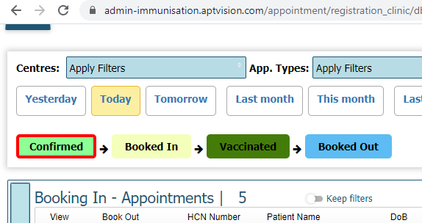
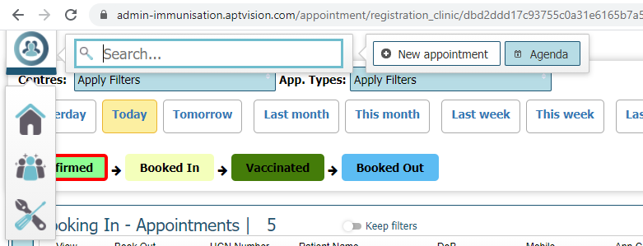
Screen 1 – Patient Arrives (1 of 2)
Hover over top-left bar to open menu
Click “New Appointment” button
Start over
Next page

Slide 3
Screen 1 – Patient Arrives (2 of 2)
In the pop up, select your location details
- Note: If a Nursing Home, select “Care/Nursing Homes”, and make sure to enter the “Home Name” & “RQIA Home Code”
Add appointment time
- Note: it is possible to add these in the past; e.g. if you need to backfill paper forms
Click “Create appointment”
Previous page
Next page

Slide 4
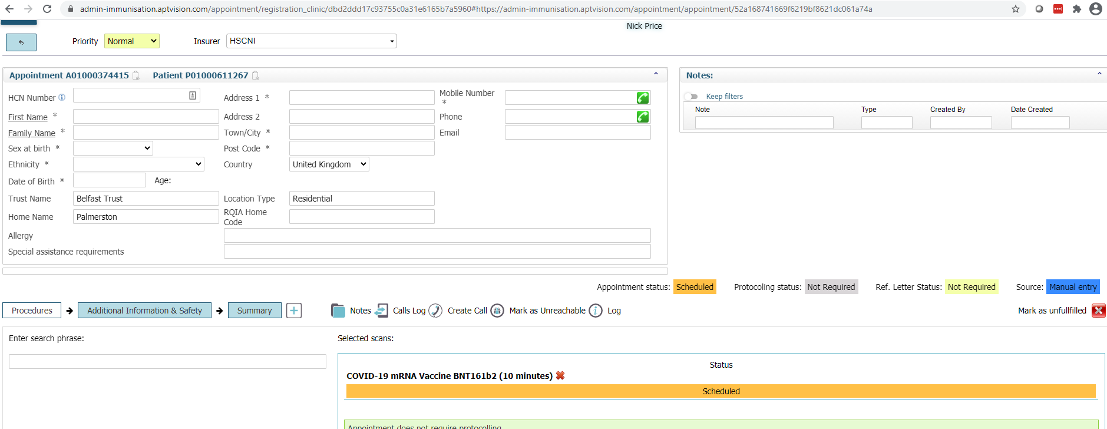
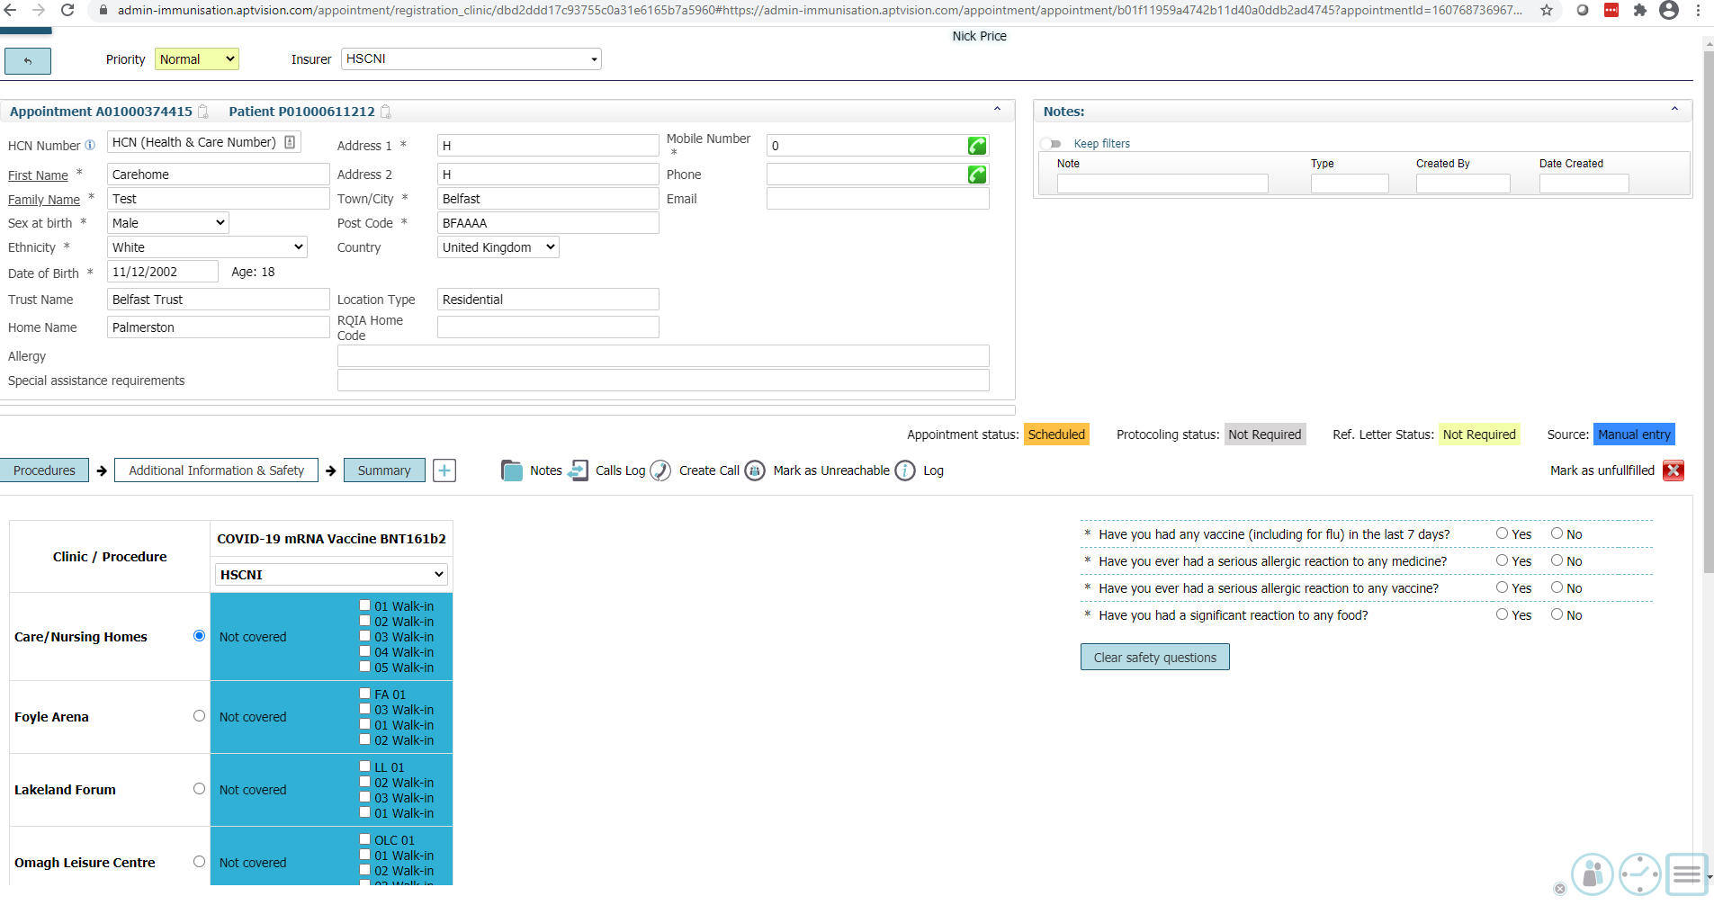
Screen 2 – Check in patient (1 of 3)
Enter patient details
- Note: if patient already exists (e.g. second dose), a popup will appear after typing their names – simply select the patient and it will fill the fields for you
Click “Additional Information & Safety” to go the next step
Complete safety questions
Click “Summary” to go to the next step
Previous page
Next page

Slide 5
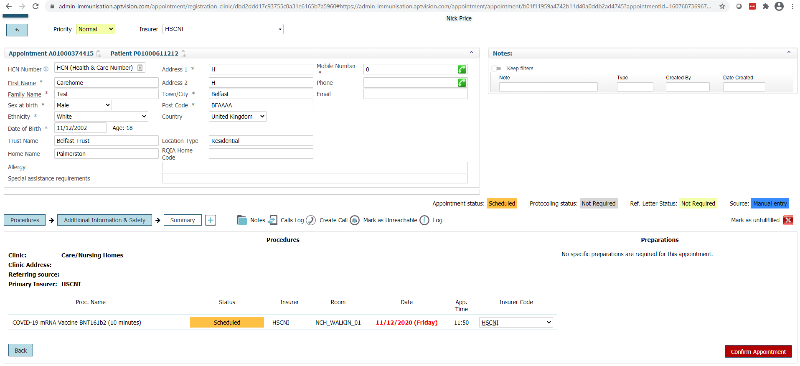
Screen 2 – Check in patient (2 of 3)
Click “Confirm appointment” to proceed to the vaccination screen
Previous page
Next page

Slide 6
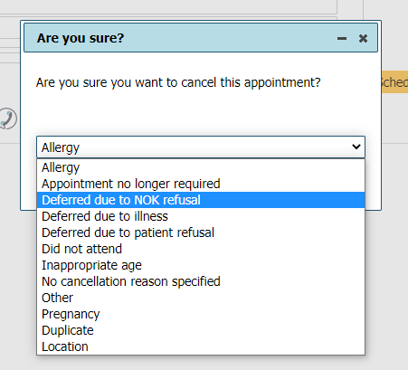
Screen 2 – Check in patient (3 of 3)
OPTIONAL STEP At any time during check-in, if the patient is not proceeding with the vaccination…
Click “Mark as unfulfilled” if the patient is not receiving a vaccination
Select the reason and click “YES” (or click “NO” to continue the appointment)
Previous page
Next page

Slide 7
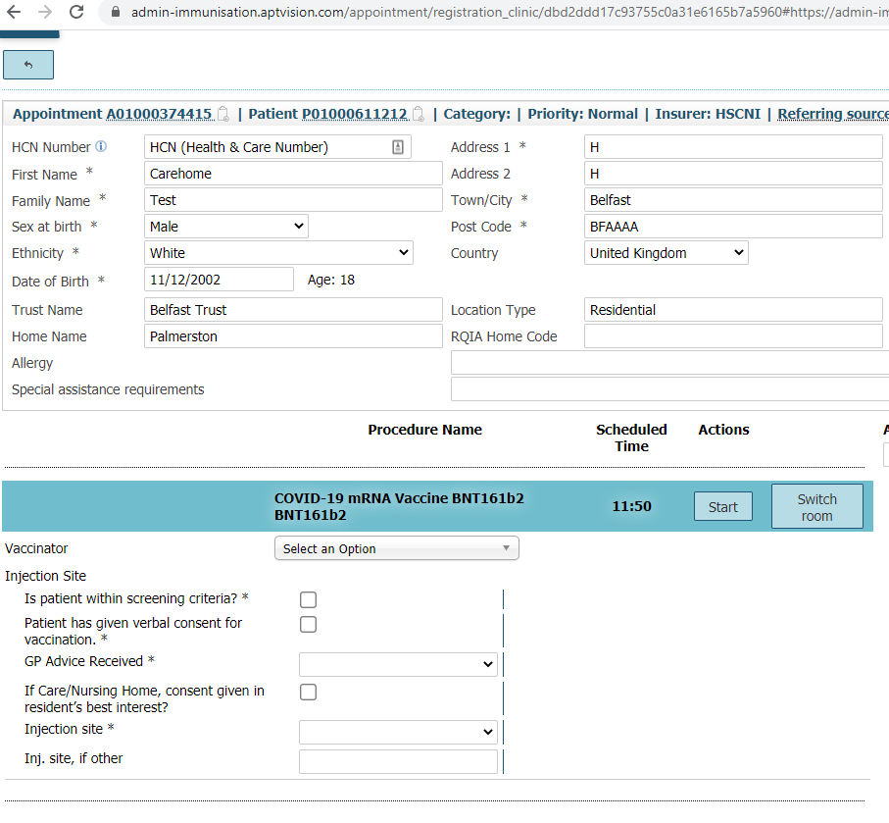
Screen 3 – Vaccination (1 of 2)
Click “Start” (box for Step 14 will appear)
Select the name of vaccinator from the drop-down
- Note: if the vaccinator does not exist, please contact support team
Complete pre-vaccination questions
Enter batch number and expiry date
Previous page
Next page

Slide 8
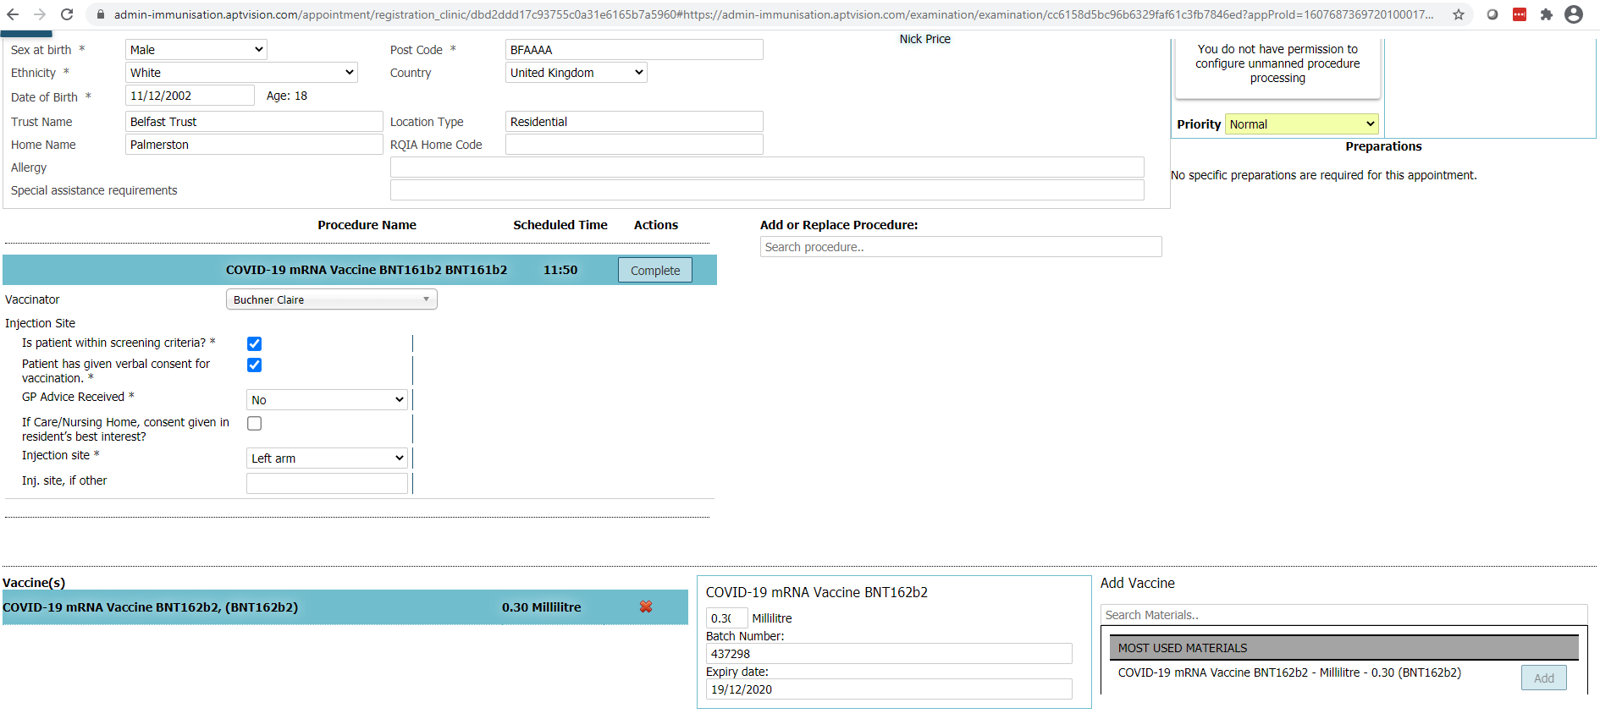
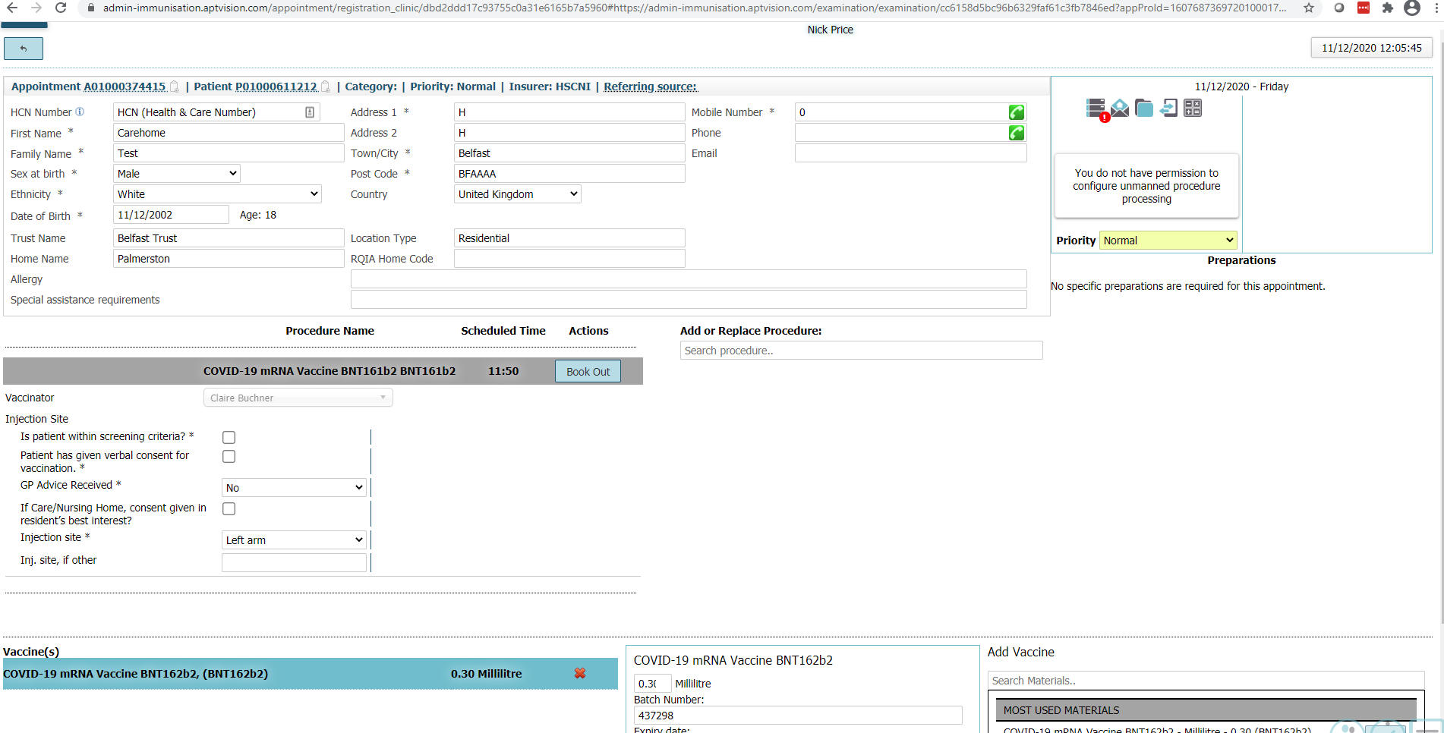
Screen 3 – Vaccination (2 of 2)
Perform vaccination
- Note: non-system step
Click “Complete”
Click “Book out” in the same place “Complete” appeared
OPTIONAL Add any adverse reactions in the notes/comments box
Previous page
Start over

