Slide 1

Admin guide - using the vaccination administration system
User/system admin
  Creating a user
  Reactivating and deactivating a user
  Resetting user passwords
  Amending user profile
    Amending user information
    Changing type of user profile
    Restricting the number of clinics shown to user
  Adding or amending safety questions
Booking admin
  Change appointment slots from Scheduler
  Change appointment slot from Patient view
  Creating additional dates by clinic
  Creating additional dates by modeler

Slide 2
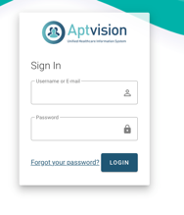
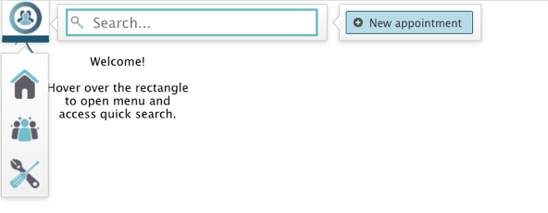

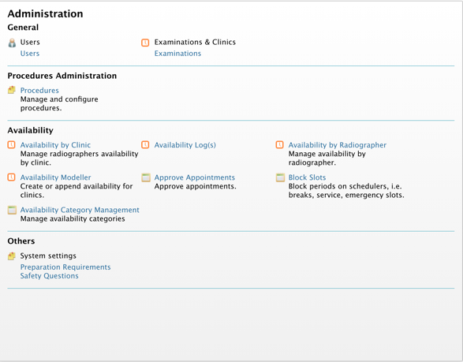
Creating new user 1/2
Log in using your log on credentials
From any screen select the menu top left and select the Administration icon
Select users to proceed to the users screen
Home page
Next page

Slide 3
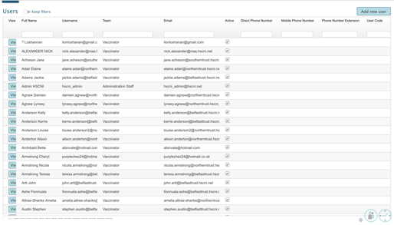
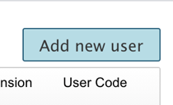
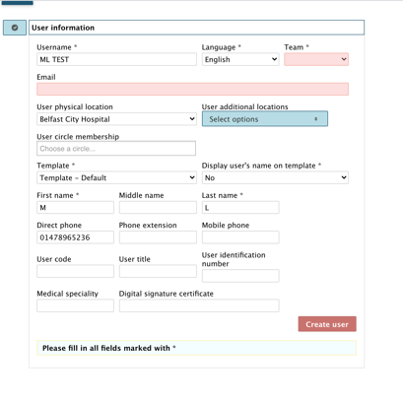
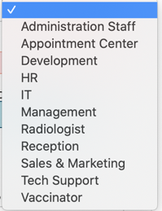



Creating new user 2/2
On the User page select “Add new user” at the top right.
Enter the following information
  Username
  Language
  Team dropdown choose from: Administration Staff/Reception/Vaccinator
  Template (use default)
  Email
  Locations
  Personal information
Select “Create user” to continue
Good to know
Best practice for usernames is to use the full name or email address
Location isn’t mandatory but is good for reporting in future
Home page

Slide 4
Reactivating and deactivating a user 1/2
Log in using your log on credentials
From any screen select the menu top left and select the Administration icon
Select users to proceed to the users' screen
Home page
Next page

Slide 5
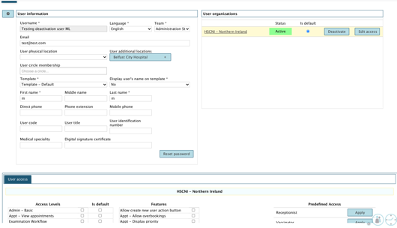

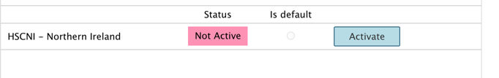
Reactivating and deactivating a user 2/2
On the User page select the user to be reactivated/deactivated.
To deactivate - on the users’ information page select “Deactivate’ top right
To reactivate – on the users’ information page select ‘Activate’ top right
Home page

Slide 6
Resetting user password 1/2
Good to know
Users can easily re-set their own passwords using the forgotten password option on the log in page.
This way can be used if the user has tried to do that and need some additional help.
Log in using your log on credentials
From any screen select the menu top left and select the Administration icon
Select users to proceed to the users' screen
Home page
Next page

Slide 7
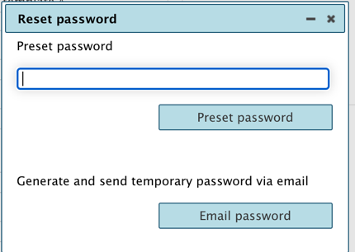
Resetting user password 2/2
On the User page select the user to be reactivated/deactivated.
To deactivate - on the users’ information page select “Deactivate’ top right
To reactivate – on the users’ information page select ‘Activate’ top right
Home page

Slide 8
Amending user profile 1/4
This section covers
  Amending user information
  Changing type of user profile
  Restricting the number of clinics shown to user
Log in using your log on credentials
From any screen select the menu top left and select the Administration icon
Select users to proceed to the users' screen
Home page
Next page

Slide 9

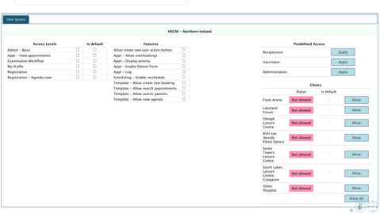

Amending user profile – Amending user information 2/4
On the user profile there are two sections:
  User information
  User access
There is the ability to amend any of the personal user information except for the Username.
Amend the profile and it is auto updated with the changes.
Previous page
Next page

Slide 10
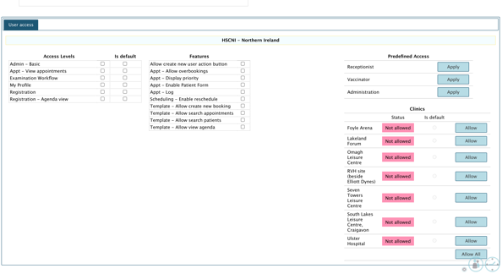
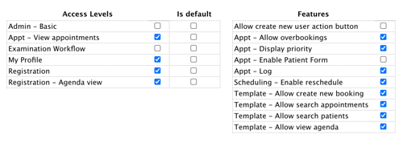
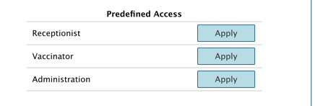
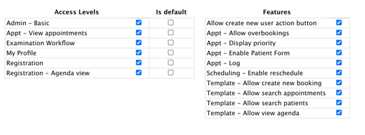
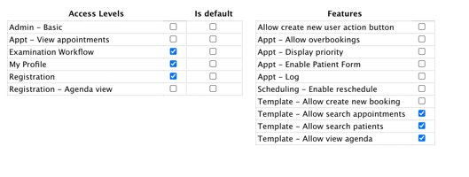
Amending user profile – Changing type of profile 3/4
Scroll down the User profile page to access the User access area
Change the user access type using the Pre-defined Access area choose from: Receptionist/Vaccinator/Administration
Updating the Predefined access will change the access levels automatically. These can also be individually set.
Previous page
Next page

Slide 11
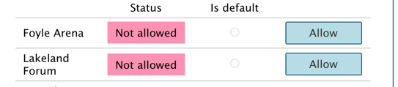
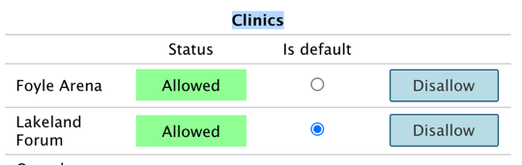
Amending user profile - Restricting view 4/4
To restrict the number of locations that a user can view scroll down the User profile page to access the User access area
Under the clinics section
  Remove access to a clinic select ”Disallow”
  Add access to a clinic select ”Allow”
Good to know
Restricting the view of users can be a useful tool to reduce the number of patients a user can see. Selecting “Allow” for all clinic's, means the user can see all patients in all locations.
Home page

Slide 12
Adding or amending a Safety question 1/3
Log in using your log on credentials
From any screen select the menu top left and select the Administration icon
Select users to proceed to the users screen
Home page
Next page

Slide 13
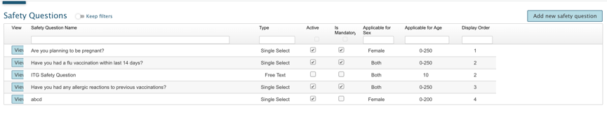
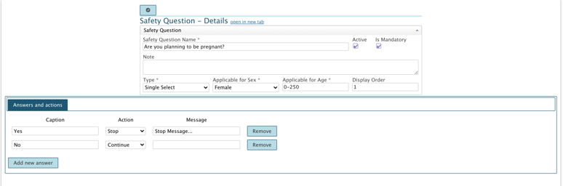

Adding or amending a Safety question 2/3
To view and amend an existing question select the view button.
Change any of the information- ensure that all mandatory fields have relevant information.
To save the changes and close use the button at the top
Previous page
Next page

Slide 14
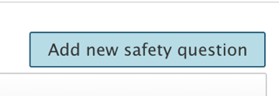
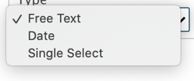
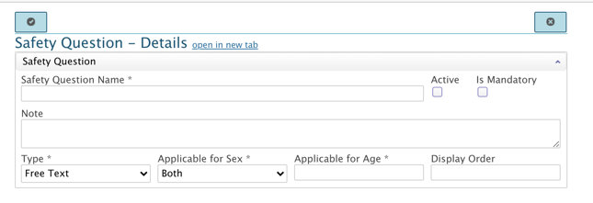
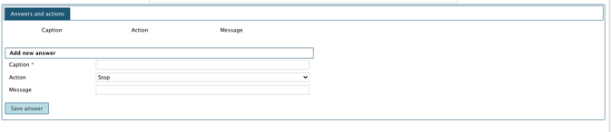


Adding or amending a Safety question 3/3
To add a safety question, select the “Add new safety question” button at the top left of the page/
Step 1 – add the basic question information – Type option has three selections note use Single select for a Yes/No answer.
Step 2 – the answers section is available once the mandatory area has been filled in, add in any answers or if there is hard stop and the user can’t go on to be vaccinated
To save use the button at the top left
Home page

Slide 15
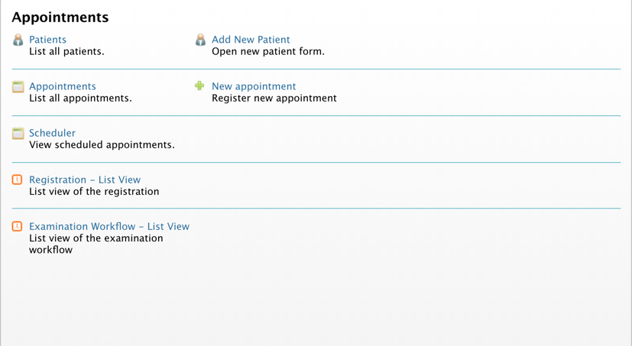

Changing an appointment via Scheduler 1/3
This way is best if you have a vaccinator absence or a reduction in the number of available rooms
Log in using your log on credentials
From any screen select the menu top left and select the Appointment icon
Select users to proceed to Scheduler page
Home page
Next page

Slide 16
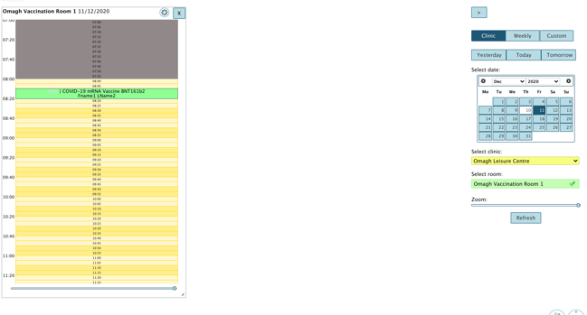
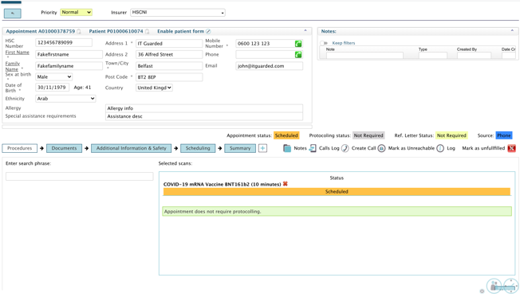
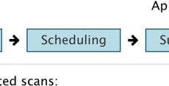
Changing an appointment via Scheduler 2/3
On the Scheduler page select the
  Clinic
  Room
  Date of the appointment you want to change
You should see a list of appointments select the appointment to move and proceed to the patient details page
Click Scheduling to proceed to the patients schedule page to change this patients’ appointment
Previous page
Next page

Slide 17
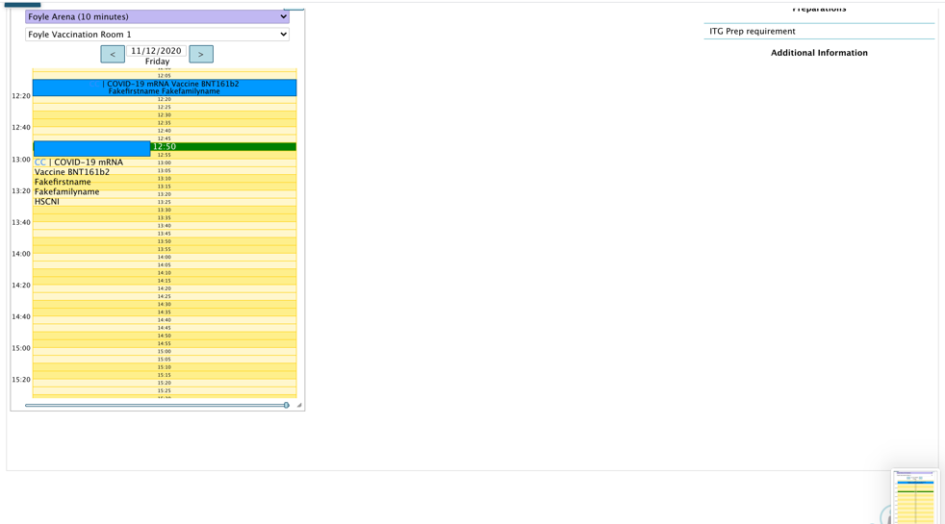
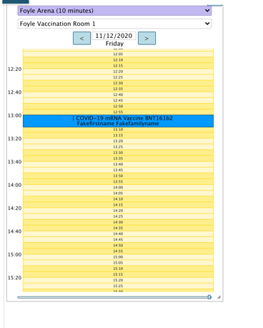
Changing an appointment via Scheduler 3/3
When on the patient scheduler page select the appointment to change and click, hold and drag to a different time
Once you have let go it will move the appointment automatically and notify the patient.
Home page

Slide 18
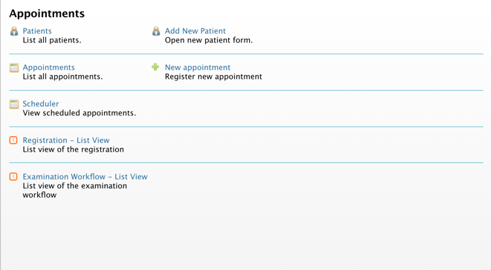
Changing an appointment via patient details 1/3
This way is best if the patient has asked to change the appointment
Log in using your log on credentials
From any screen select the menu top left and select the Appointment icon
Select users to proceed to List all patients
Home page
Next page

Slide 19
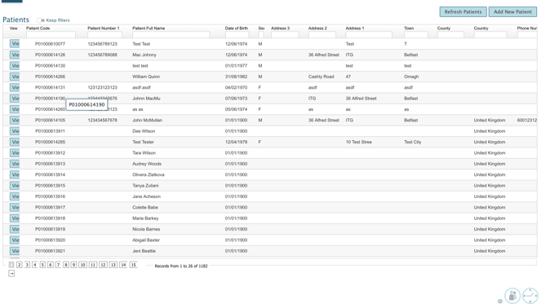
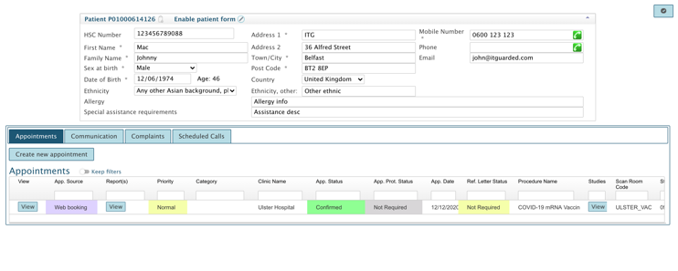
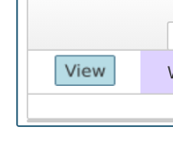

Changing an appointment via patient details 2/3
On the Patient list search for the patient and select “View” to see the patient details and select the ”View” button to see the appointment details
Click “Scheduling” to proceed to the patients schedule page to change the appointment
Previous page
Next page

Slide 20
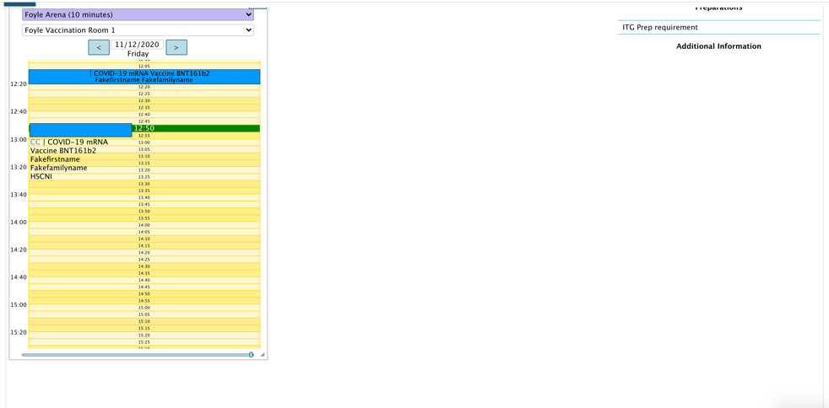
Changing an appointment via patient details 3/3
When on the patient scheduler page select the appointment to change and click, hold and drag to a different time
Once you have let go it will move the appointment automatically and notify the patient.
Home page

Slide 21
Creating/amending dates for testing by clinic 1/2
Log in using your log on credentials
From any screen select the menu top left and select the Administration icon
Select users to proceed to Availability by Clinic
Home page
Next page

Slide 22
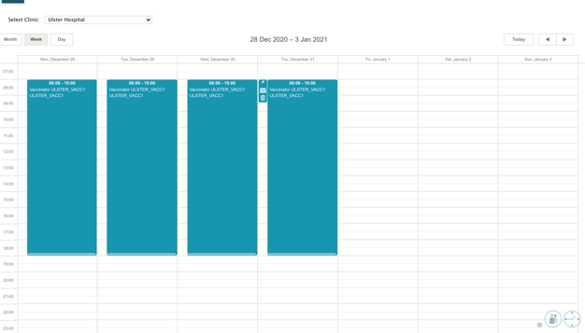
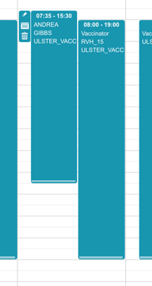
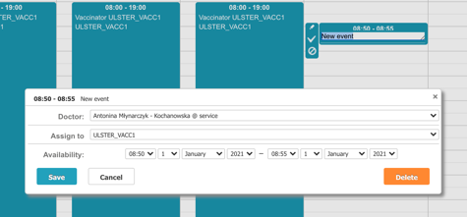
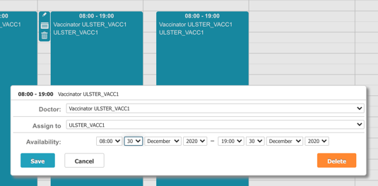
Creating/amending dates for testing by clinic 2/2
At the top of the page use the navigation to view a date that needs appointments creating for or one that needs amending
To add double click on an available day/time and
To amend click and drag the day to the correct time or double click on the day or make multiple appointments
Home page

Slide 23
Creating/amending dates for testing by modeller 1/3
Log in using your log on credentials
From any screen select the menu top left and select the Administration icon
Select users to proceed to “Availability by Modeller”
Home page
Next page

Slide 24
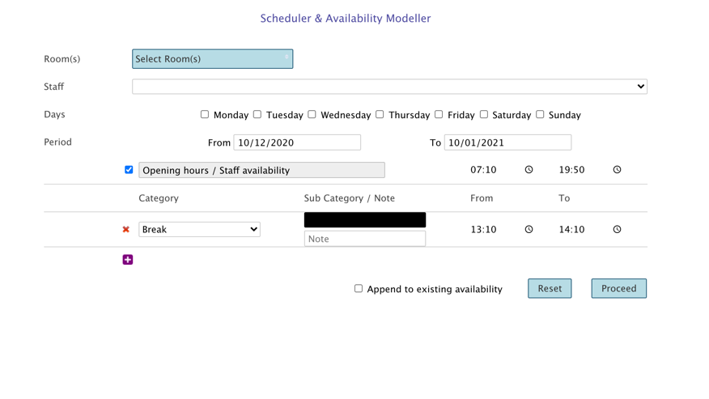
Creating/amending dates for testing by modeller 2/3
To add capacity
Select a room
Select a member of staff
Add their availability then check “Append to existing availability” then click the “Proceed” button to continue
To change or remove capacity
Select a room
Select a member of staff
Amend their availability then check then click the “Proceed” button to continue
Previous page
Next page

Slide 25
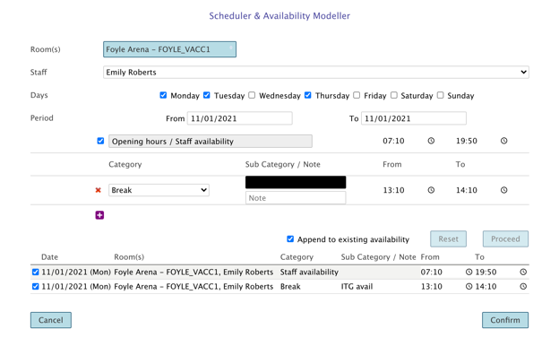
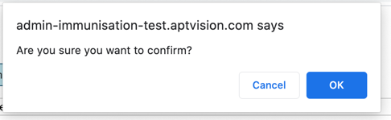
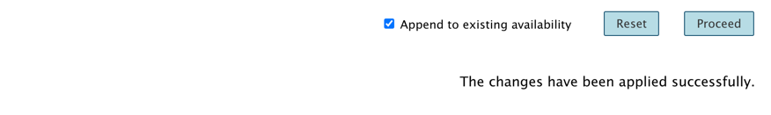
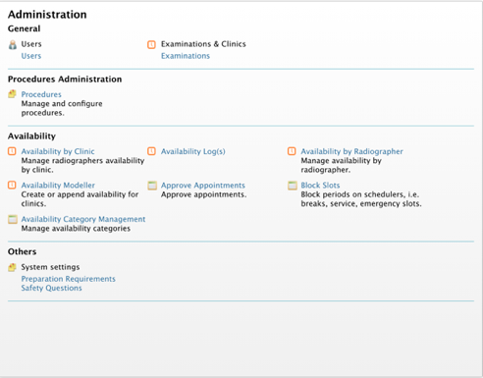
Creating/amending dates for testing by modeller 3/3
Confirm the additional days or the amended details
Select ok on the pop-up ”OK”
The confirmation is displayed under the modified details.
To view modifications, go to menu (top left) select Administration icon
Select Availability by Clinic
Home page

