Slide 1
Antimicrobial Resistance: Challenges and Opportunities, an English Perspective
Diane Ashiru-Oredope
Lead Pharmacist, HCAI & AMR Division, Public Health England
HCAI & AMR Health Protection Symposium 12 March 2019

Slide 2
UK 5-year AMR Strategy 2013-18
The 7 Key Areas for Future Action:
improving infection prevention and control practices
optimising prescribing practice
improving professional education, training and public engagement
developing new drugs, treatments and diagnostics
better access to and use of surveillance data
better identification and prioritisation of AMR research needs
strengthened international collaboration

Slide 3
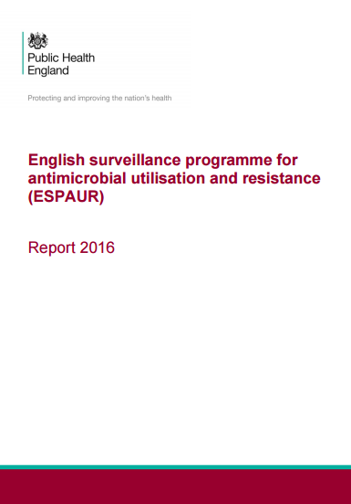
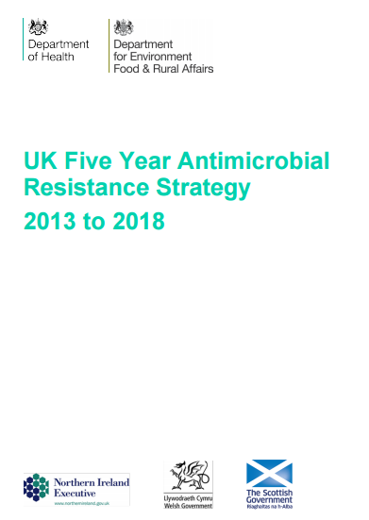
UK AMR strategy - ESPAUR: Introduction of a National Dataset
ESPAUR reports published for the first time in 2014 analysed data from across England, and across healthcare settings on antimicrobial consumption, resistance and stewardship
As well as total consumption data, the reports detail trends in use in specific antibiotics and regional variation across England.
Better access to and use of surveillance data

Slide 4
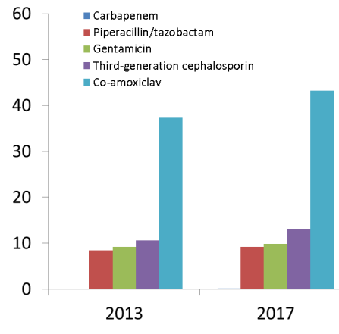
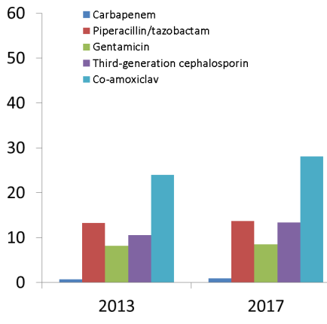
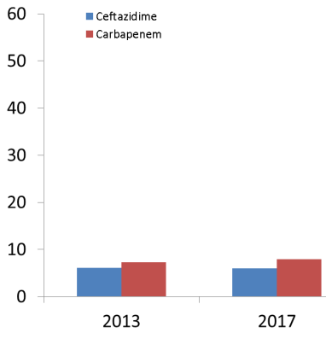
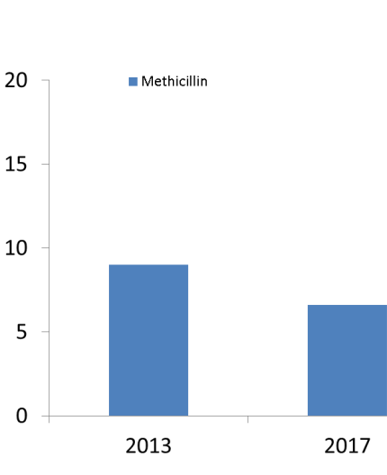
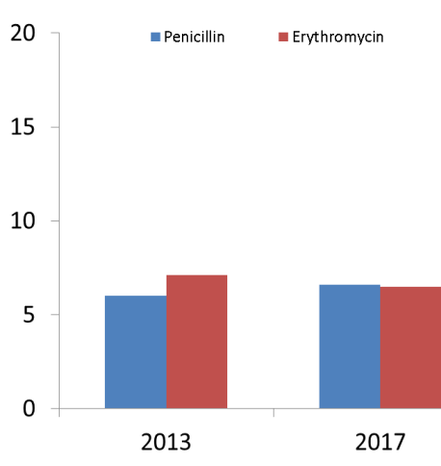
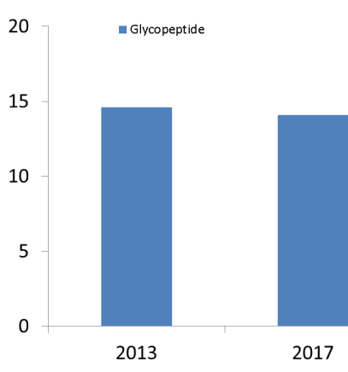
Overview of AMR in BSI from 2013 to 2017
Proportion of bacterial species causing BSIs resistant to key antibiotics has remained broadly stable over the last 5 years, most likely reflecting the impact of antimicrobial stewardship.
% resistant
E. coli
K. pneumoniae
Pseudomonas spp.
% resistant
S. aureus
S. pneumoniae
Enterococcus spp.

Slide 5
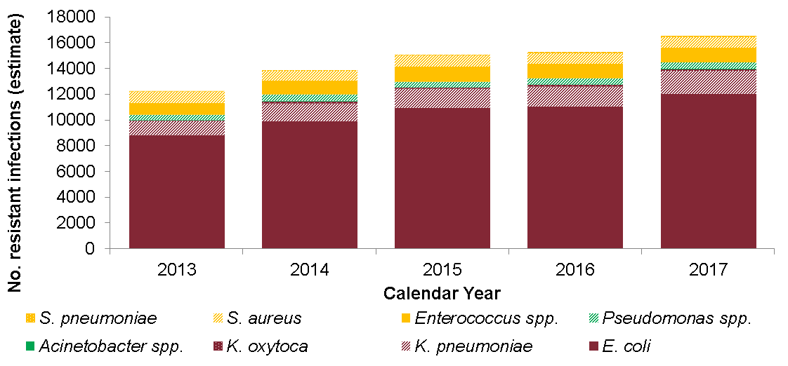
Estimated trends in burden of bloodstream infections due to antibiotic-resistant pathogens in England, 2013 to 2017
HOWEVER, the burden of resistance as measured by total numbers of antibiotic resistant bloodstream infections increased by 35% from 2013 to 2017, predominantly driven by the year on year increased incidence of infections.

Slide 6
Number of confirmed CPE isolates referred to PHE’s AMRHAI Reference Unit, 2008 – 2017
The number of Gram-negative bacteria with a detected carbapenemase increased year-on-year (~3,000 in 2017).
The proportion of isolates from bloodstream infections remained broadly stable ranging from 11.3% in 2014 to 7.2% in 2017.

Slide 7
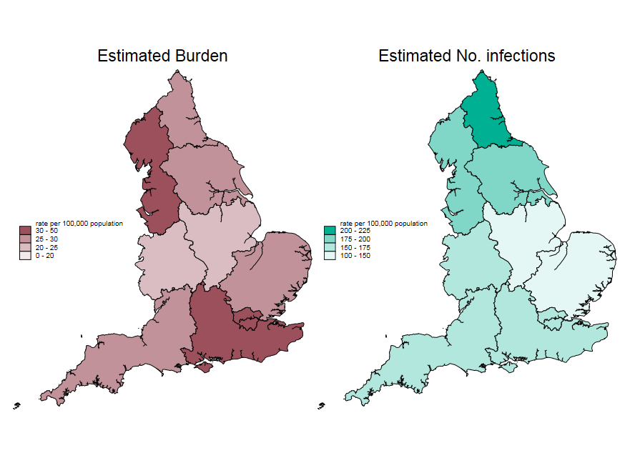
Regional Variation in Incidence and Burden
Substantial regional variation in in both the incidence of bloodstream infections and the burden of resistant BSI across the country.
Hotspots in urban areas possibly related to high density of complex healthcare delivery is evident.

Slide 8
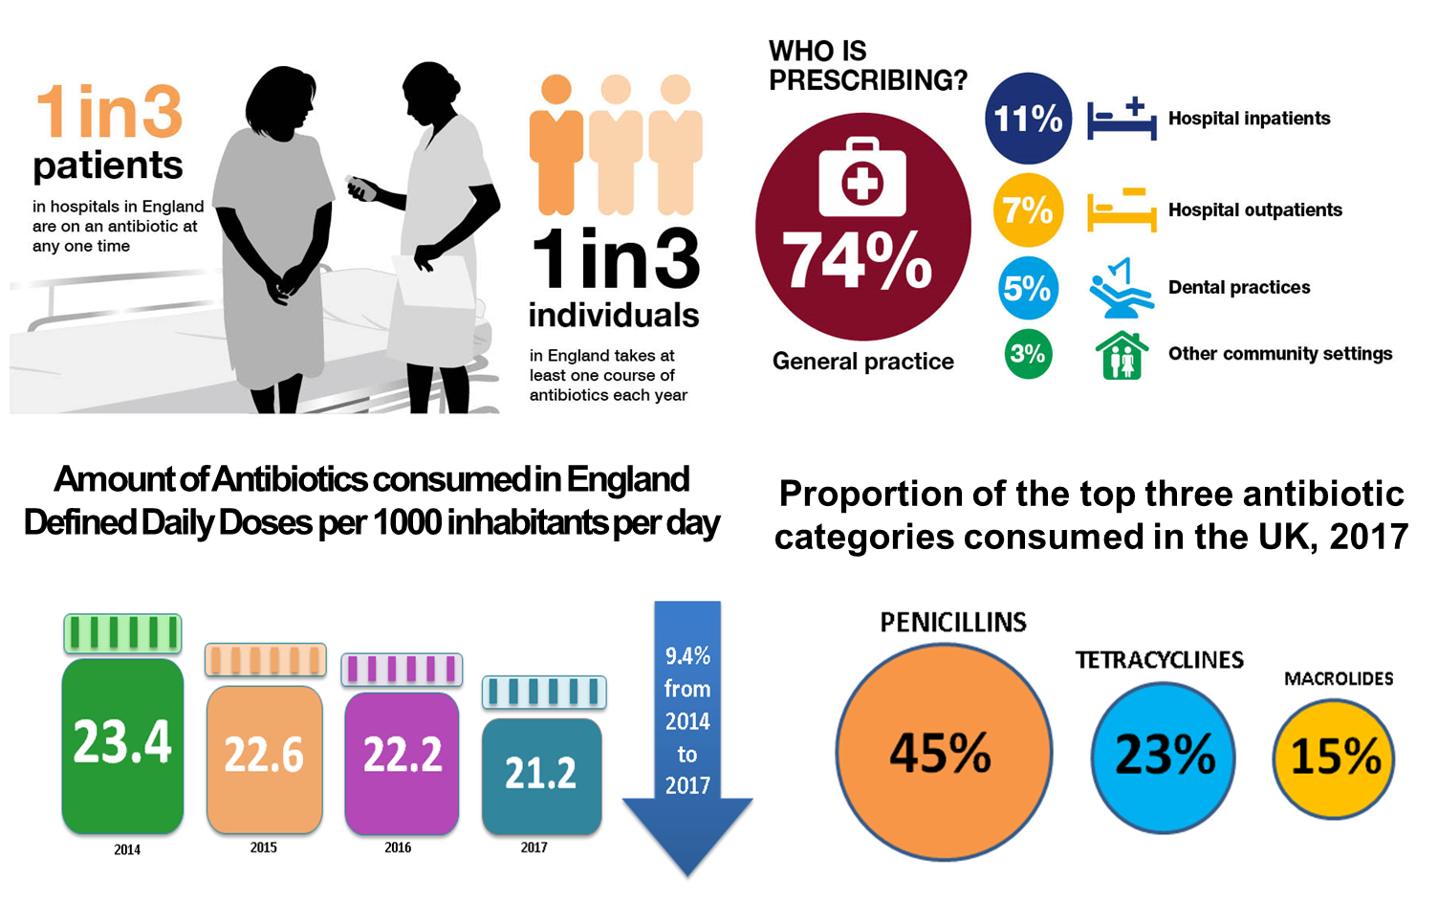
Antibiotic Prescribing

Slide 9
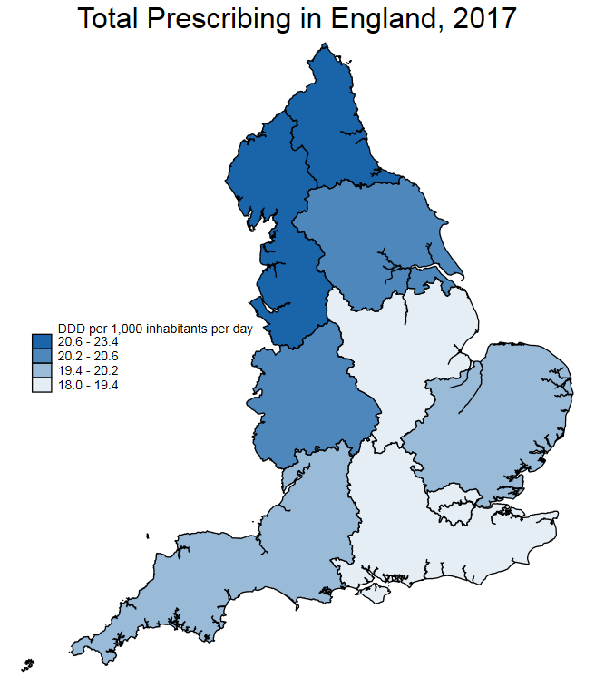
Regional Variation in Antibiotic Use
Substantial regional variation in antibiotic use occurs.
This can be viewed at CCG, GP and Trust level at PHE Fingertips AMR local indicators
https://fingertips.phe.org.uk/profile/amr-local-indicators

Slide 10
Reducing inappropriate prescribing
Estimates/Modelling - 20% of antibiotics are prescribed inappropriately
Patient visit HCP and expects antibiotics
Patient puts pressure on HCP
Patient is prescribed antibiotics
Inappropriate prescribing rates increase
Reinforcement of patients expectations
Acute cough:
41% prescribed vs ideal of 10%
Bronchitis:
82% prescribed vs ideal of 13%
Rhinosinusitis:
88% prescribed vs ideal of 11%
Sore throat:
59% prescribed vs ideal of 13%
Notes:
However, inappropriate prescribing is still an issue…..
And PHE marketing is still crucial to communicating key messages to the public in order to change current behaviours
Our research shows that inappropriate prescribing is a bi-lateral issue – with patient expectation mounting pressure to prescribe which in turn exacerbates the issue
Inappropriate prescription rates:
34% think there is nothing individuals can do to prevent antibiotics becoming less effective at treating diseases
37% think new antibiotics will always be developed to replace those that don't work any more
24% think if there is any doubt about whether an illness needs to be treated with antibiotics it's better to take them just in case
Source: Inappropriate antibiotic prescribing in English primary care. The Journal of Antimicrobial Chemotherapy 2018
Patient expectation:
38% of people expected an antibiotic from a doctor’s surgery, NHS walk-in centre or ‘GP out of hours’ service when they visited with a cough, flu or a throat, ear, sinus or chest infection in 2017*
Source: from Capibus on behalf of Public Health England. Attitudes towards antibiotics. 2017
Reducing this expectation and demand for antibiotics is key as it will help free up HCP time and lessen inappropriate prescribing – ultimately relieving pressure on the NHS whilst helping to delay AMR
The first step to achieving this is to encourage people to take their doctor’s advice and educate them about what antibiotics can and can’t treat. If we can break this cycle and reinforce different behaviours which work, the patient may be more likely to repeat the desired behaviour

Slide 11
AMR UK Strategy 2013-2018: PHE’s role
PHE supported the AMR strategy through multi-disciplinary and multi-sectoral collaboration :
Improved AMR and antibiotic use surveillance
Providing quarterly UK and country specific data for ambitions (GNBSI & Antibiotics)
Supporting local action through development and monthly updated Fingertips indicators
Supporting the provision of behavioural interventions (nudge work)
Developing resources and toolkits for catheter associated UTI, improving diagnosis and treatment of UTI, modelling inappropriate prescribing, healthcare impact of GNBSI, UTI and antimicrobial stewardship toolkits
Expert advice and monitoring of national incentive schemes to reduce antibiotic use
Developing national guidelines (in collaboration with NICE)
Developing educational programmes on AMR - E-Bug health education resource for children aged 4-18; delivering training programmes
Public & professional information related to AMR: the Antibiotic Guardian initiative, Keep Antibiotics Working, the World Antibiotic Awareness Week and European Antibiotic Awareness Day
Contributing to the Global Action Plan and providing UK coordination of surveillance to ECDC and WHO GLASS
One Health surveillance report
PHE Remit Letter objective 2018/2019:
To support the Government’s goal to slow the growth of Antimicrobial Resistance (AMR) by contributing to the human health aspects of the revision of the AMR strategy and supporting NHS Improvement and NHS England in delivering on Gram negative bloodstream infections, reducing inappropriate prescribing and the diagnostic programme respectively

Slide 12
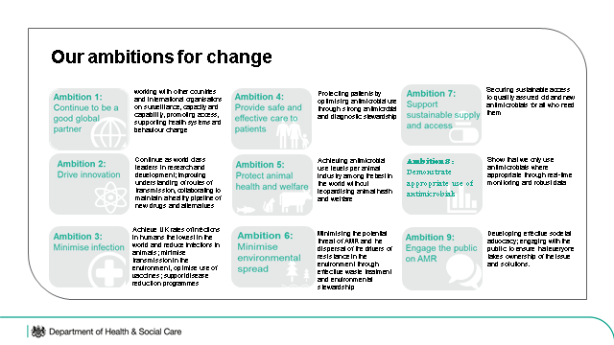
The UK’s vision for AMR by 2040 and five-year national action plan
By 2040, our vision is of a world in which antimicrobial resistance (AMR) is effectively contained, controlled and mitigated.

Slide 13
Ambitions:
1 - working with other countries and international organisations on surveillance, capacity and capability, promoting access, supporting health systems and behaviour change
2 - Continue as world class leaders in research and development; improving understanding of routes of transmission, collaborating to maintain a healthy pipeline of new drugs and alternatives
3 - Achieve UK rates of infections in humans the lowest in the world and reduce infections in animals; minimise transmission in the environment, optimise use of vaccines; support disease reduction programmes
4 - Protecting patients by optimising antimicrobial use through strong antimicrobial and diagnostic stewardship
5 - Achieving antimicrobial use levels per animal industry among the best in the world without jeopardising animal health and welfare
6 - Minimising the potential threat of AMR and the dispersal of the drivers of resistance in the environment through effective waste treatment and environmental stewardship
7 - Securing sustainable access to quality assured old and new antimicrobials for all who need them
8 - Show that we only use antimicrobials where appropriate through real-time monitoring and robust data
9 - Developing effective societal advocacy; engaging with the public to ensure that everyone takes ownership of the issue and solutions.

Slide 14
Measuring success in the first 5 years:
MEASURING SUCCESS
MEASURING SUCCESS
Target: to reduce the incidence of a
specified set of drug resistant
infections in humans in the UK by 10%
by 2025; and halve the number of
healthcare associated Gram-negative
blood stream infections.
Target: to reduce UK antimicrobial use
in humans by 15% by 2024, including:
a 25% reduction in antibiotic use in
the community from the 2013 baseline.
a 10% reduction in use of ‘reserve’ and ‘watch’ antibiotics in hospitals from the 2017 baseline.
MEASURING SUCCESS
MEASURING SUCCESS
Target: to reduce UK antibiotic
use in food-producing animals
by 25% between 2016 and 2020;
and define new objectives for individual
animal sectors by 2021.
Target: to be able to report on the
percentage of prescriptions supported
by use of a diagnostics test or decision
support tool by 2024, with improvement
targets set by 2025.

Slide 15
Challenges

Slide 16
Regional Variation in Incidence and Burden
Substantial regional variation in in both the incidence of bloodstream infections and the burden of resistant BSI across the country.
Hotspots in urban areas possibly related to high density of complex healthcare delivery is evident.

Slide 17
Regional Variation in Antibiotic Use
Substantial regional variation in antibiotic use occurs.
This can be viewed at CCG, GP and Trust level at PHE Fingertips AMR local indicators
https://fingertips.phe.org.uk/profile/amr-local-indicators

Slide 18
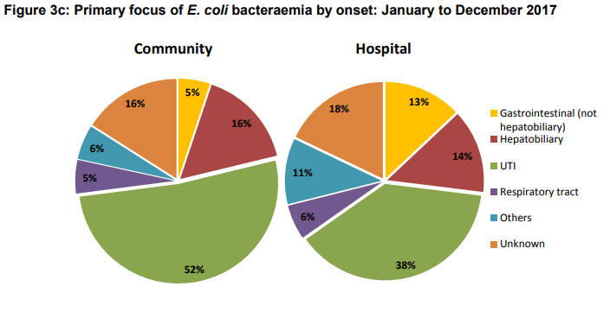
Challenges
Increase in infections occurring in the community
Changes to the structure of the provider / commissioning landscape over the last few years have led to a breakdown in established networks hampering sharing of learning and best practice.
Move of Public Health into local authorities and the consequent rupture of community IPC structures.

Slide 19
Challenges (contd)
Lack of evidence on effective interventions to effect reduction in E. Coli bacteraemias.
NHS - Difficulty recruiting to consultant microbiology posts in many of our acute trusts – resulting in limited AMR leadership
Variation in functionality and expertise in IPC teams in NHS trusts, limited buy-in into national AMR ambitions
Variation in functionality of microbiology networks at PHE Centre level and binding these into centre AMR work

Slide 20
opportunities

Slide 21
Mandatory HCAI Surveillance: Timeline
 | 2001 | 2002 | 2003 | 2004 | 2005 | 2006 | 2007 | 2008 | 2009 | 2010 | 2011 | 2012 | 2013 | 2014 | 2015 | 2016 | 2017 | 2018
S. aureus bacteraemia (aggregate counts)
MRSA bacteraemia (enhanced, real-time)
S. aureus bacteraemia (enhanced, real-time)
Post Infection Review (PIR) for MRSA bacteraemia
C. difficile infection over 65s (quarterly aggregate)
C. difficile infection over 2s (enhanced, real-time)
GRE bacteraemia (quarterly aggregate counts)
Surgical site infection (orthopaedics)
E. coli bacteraemia (enhanced, real-time)
Klebsiella and Pseudomonas aeruginosa bacteraemia
 | 2001 | 2002 | 2003 | 2004 | 2005 | 2006 | 2007 | 2008 | 2009 | 2010 | 2011 | 2012 | 2013 | 2014 | 2015 | 2016 | 2017 | 2018
Notes:
Mandatory HCAI surveillance outputs are used to monitor progress on controlling key health care associated infections and for providing epidemiological evidence to inform action to reduce them. Data are unavailable from any other source and provide unique information on infection levels. Data are used to support the NHS objective of improving the quality and safety of services and promoting patient choice by providing access to information on NHS performance.
Mandatory reporting timelines.
Data are also publically available on fingertips
https://fingertips.phe.org.uk/profile/amr-local-indicators/data#page/0/gid/1938132910/pat/158/par/TE_trust/ati/118/are/RRV

Slide 22
S. aureus
Surveillance, Targets & Interventions
Introduction of national legislation for Infection Prevention and Control – Code of Practice.
Introduction of care for
catheters, cannulae & tubes
Saving Lives bundles
Clean your hands campaign
Towards cleaner hospitals campaign
Enhanced MSSA surveillance
Enhanced MRSA surveillance
Screening of high risk and certain elective pre-operative patients for MRSA
Screening of high risk, all elective & emergency admissions patients for MRSA
Post Infection Review initiated
National MRSA BSI target reduce by 50% ( over 3 years)
CQC inspections
Karen Shaw. PHE
Notes:
National Target for MRSA reduction introduced in 2005 – 50% reduction over 3 years.
National target reduction for the number of incidents of MRSA bloodstream infections by 50% over three-year period (April 2005 – March 2008) compared to the 2003/04 baseline dataix
Key to note in this slide
National target was introduced in 2005 to reduce MRSA BSI by 50% over 3 years. But there were a whole raft of national initiatives that went alongside this target
Care bundles (high impact interventions to reduce infections eg. Vascular access, surgical site infections, catheter associated uti etc, cleaner hospitals)
Clean your hands campaign
Towards cleaner hospitals and lower rates of infections
Board to ward campaign
Introduction of legislation – code of practice on the prevention and control of infections
Screening high risk patients
CQC inspections (regulators of health and social care) – inspecting against the code of practice
Post infection review of all MRSA bsi
Board level CEO sign off – of every MRSA BSI

Slide 23
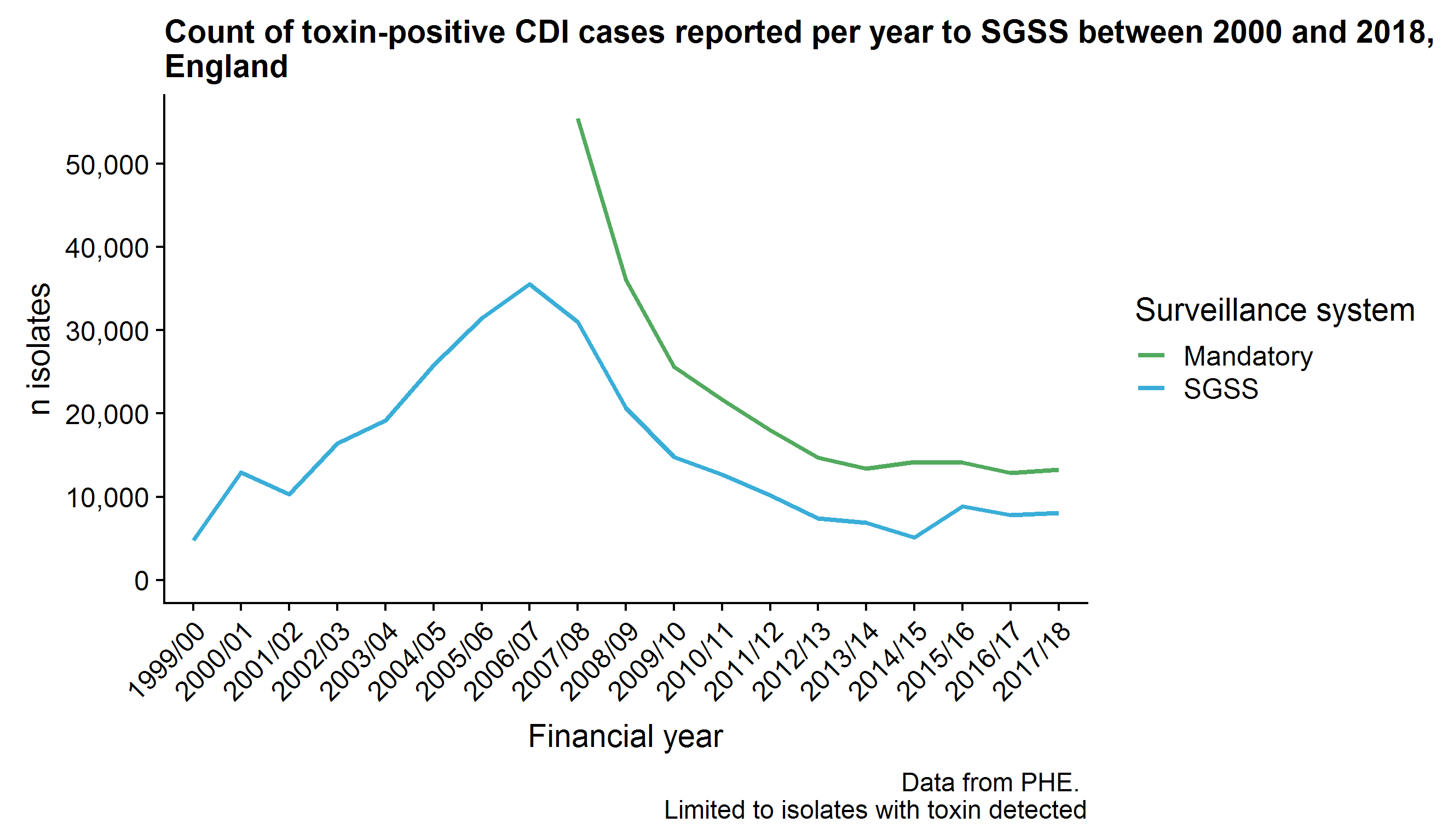
CDI Surveillance, Target and Interventions
National target to reduce CDI by at least 30% by March 2011
CDI guidance updated
CDRN established
Introduction of national IPC legislation (Code of practice)
Karen Shaw. PHE
Notes:
A similar picture with CDI shows the national target being set but there were a number of initiatives at the same time
Code of practice on the prevention and control of infections
CQC inspections
CDI guidelines published
CD ribotyping network establish
Cleaner hospitals and lower rates of infection – national intervention published to encourage cleanliness
Board to ward national initiative to improve the engagement from across all levels from leadership to ward level

Slide 24
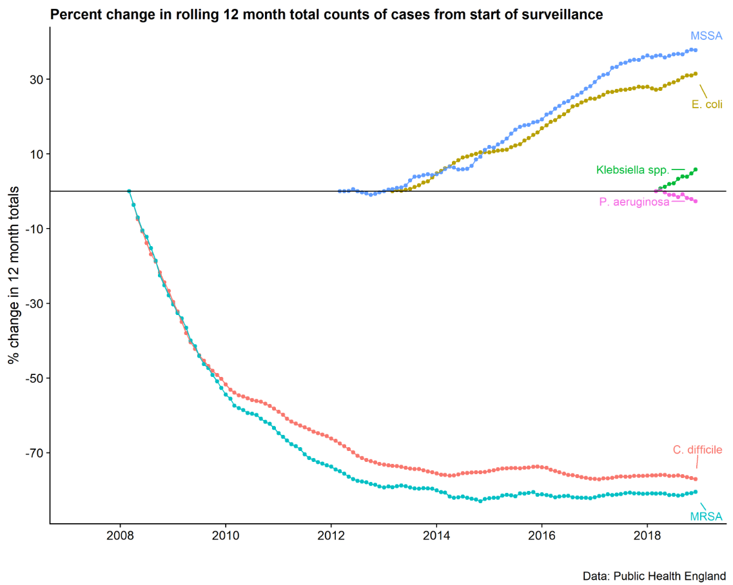
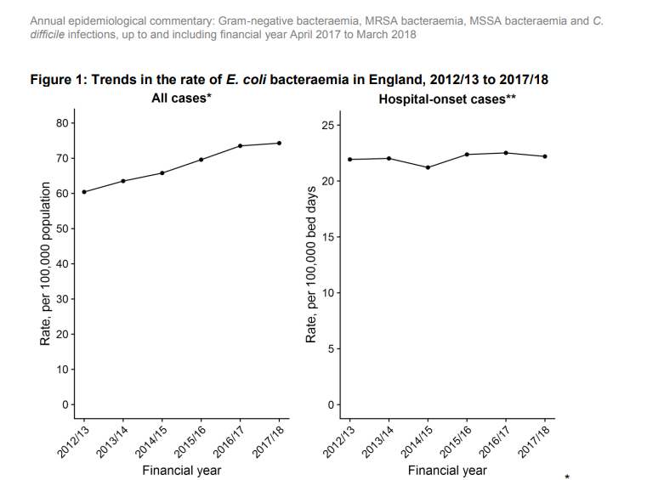
National MRSA BSI target reduce by 50% ( over 3 years)
2005
Ambition to reduce E.coli BSI by 50% by 2020/21
Ambition to reduce HCAI
E.coli BSI by 50% by 2020/21
National target to reduce CDI by at least 30% by March 2011
Notes:
Have asked Simon for this slide to go back to 2004

Slide 25
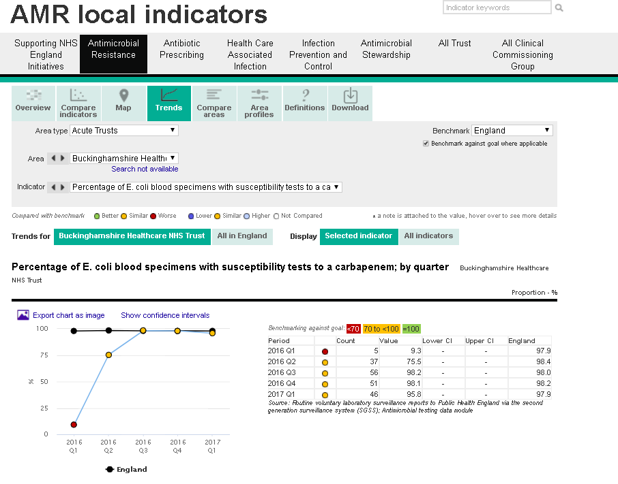
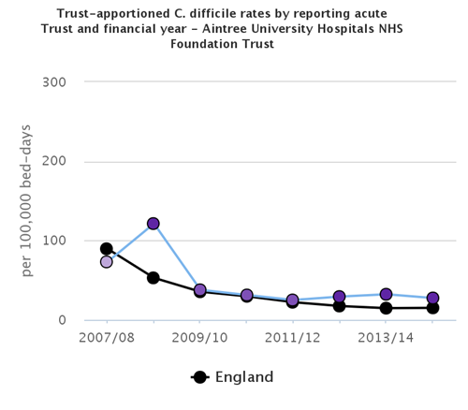
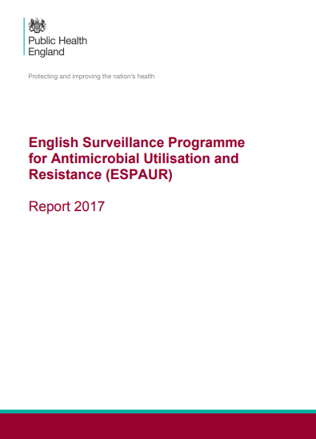
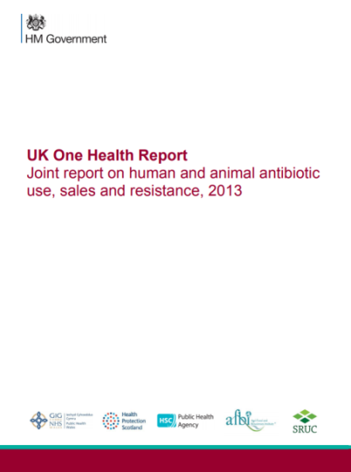
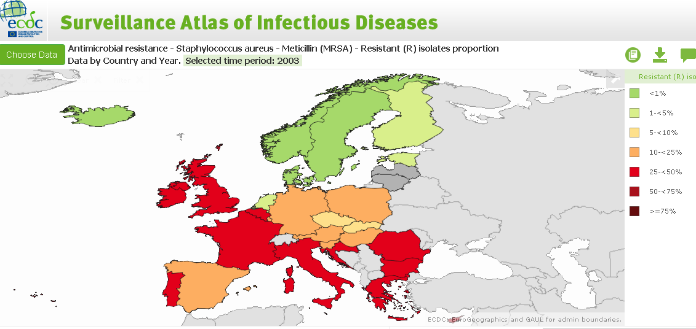
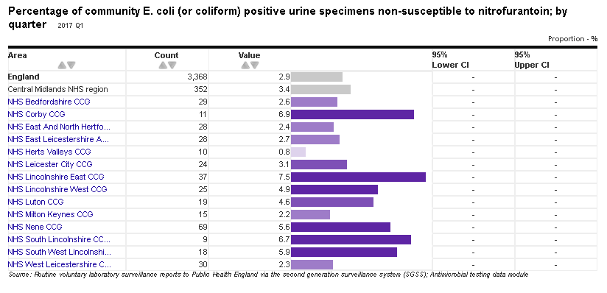
Surveillance Outputs
Notes:
PHE Fingertips (AMR local indicators) enables easy access to key trends and geographical differences while raising awareness of differences in antibiotic prescribing, healthcare associated infections, infection prevention and control and antimicrobial stewardship.
The UK One Health Report 2013 shows UK data on antibiotic resistance in key bacteria that are common to animals and humans. It also includes details on the amount of antibiotics sold for animal health and welfare and antibiotics prescribed to humans.
The ESPAUR report includes national data on antibiotic prescribing and resistance, and hospital antimicrobial stewardship implementation.
There is a need for rapid diagnostic tools to help GPs identify within minutes the strain of bacterial infection present and the antibiotics to which it is resistant or susceptible. The tests most readily available to most GPs are the C reactive protein (CRP) test and urinalysis, which provide an indication that infection may be present. CRP testing has reduced antibiotic prescribing for respiratory tract infections by 25%

Slide 26
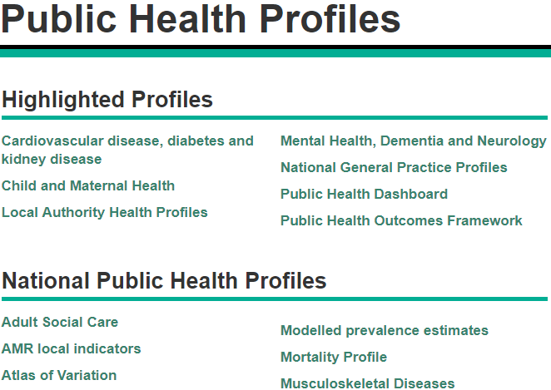
Open access data: AMR local indicators
PHE uses fingertips to display data on a number of different health topics.

Slide 27
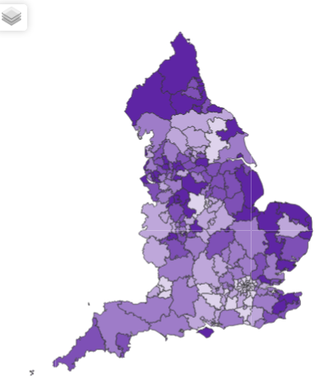
AMR Local Indicators
Since April 2016 146 indicators have been launched across six domains¹:
Supporting NHS England Initiatives
Antimicrobial Resistance (AMR)
Antibiotic Prescribing
Healthcare-Associated Infections (HCAI)
Infection Prevention and Control (IPC)
Antimicrobial stewardship (AMS)
And four geographies:
NHS acute Trust
Clinical Commissioning Group
General Practice
Laboratory
¹ Johnson AP et al. 2017. JAC
Notes:
Started with approx 50 indicators
Have added new indicators almost every month since launch

Slide 28
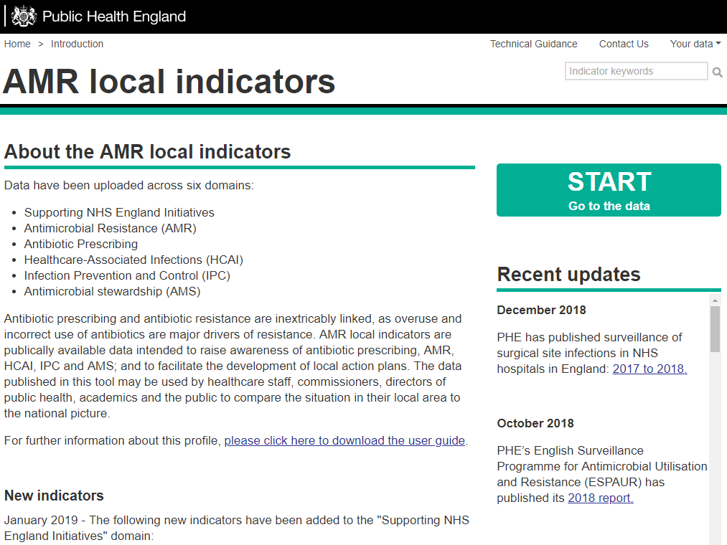
Notes:
The Front page of the AMR local indicators provides a brief summary of the data that can be found on the profile including lists of recently added and recently updated indicators. There’s also a news feed under recent updates which provides information on AMR related publications and activities across government and the NHS.
Data can be accessed by pressing the start button

Slide 29
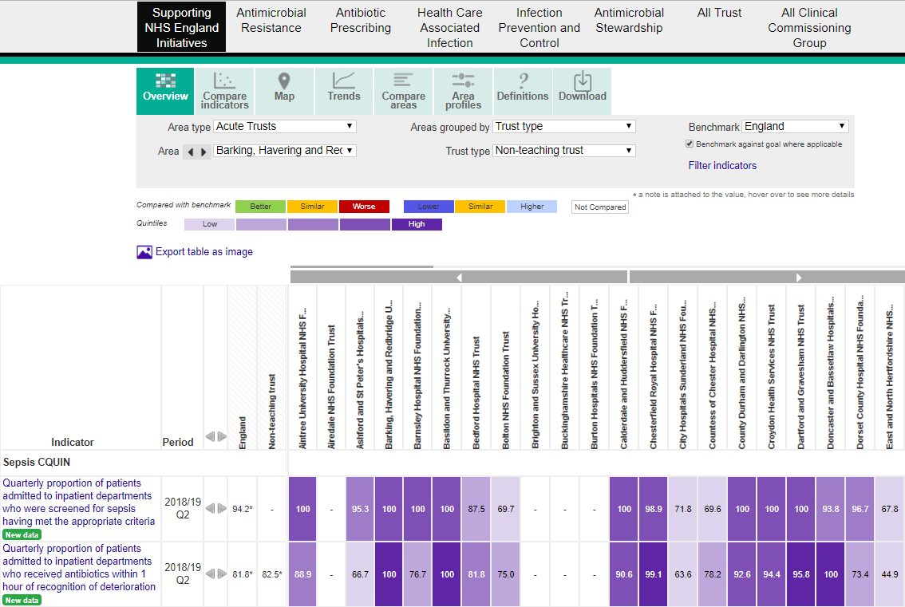
DOMAINS
VIEWS
AREA TYPE
DATA DISPLAY
Notes:
The fingertips display can be described by four key sections: Domains, views, area & benchmarking selection, data display.

Slide 30
NHS improvement schemes & targets on antibiotic consumption: AMR Quality Premium
2014/15
In community settings
Over 3.7 million fewer antibiotic
prescriptions
2017/18
Notes:
QP/CQUIN:
QP: General practices only (Primary care)
Over 3.7 million fewer antibiotics were dispensed in primary care (general practice only) 2017/18 in comparison to 2014/15, following the introduction of the AMR Quality Premiums.
Primary care icon?
CQUIN: Don’t want to advertise the CQUIN. – Nothing noteworthy and picture all skewed due to piptaz shortage

Slide 31
NHS improvement schemes & targets on antibiotic consumption
CCG: Quality Premium
Excellent outcome
Hospital: CQUIN
Modest improvement, albeit challenged by piperacillin/tazobactam shortage

Slide 32
Reducing antibiotic prescribing: interventions
National prescribing toolkit – TARGET 2011
Start Smart then Focus – 2011
Antibiotic Guardian – 2014
NICE Guidelines AMS – 2015
NICE Guidelines – infection – 2017
Quality Premium – 2015 – 2019
CQUIN 2016- 2019
Notes:
England introduced a national improvement scheme in 2015 to reduce inappropriate antibiotic prescribing in primary care. National reduction targets were met and new targets were introduced in 2018 The scheme has successfully delivered a 12% reduction of 4.5 million antibiotic prescriptions in the 3.5 year period April 2015 to October 2018 https://www.england.nhs.uk/ccg-out-tool/qual-prem/
Improvement scheme included use of the NHS England Quality Premium and CCG Improvement Assessment Framework.
Year 1 2015-16 all CCGs had a 1% reduction target for all antibacterial items/STAR-PU and a 10% reduction in broad spectrum antibiotic use unless ≤10% value.
Year 2 2016-17 CCGs had to remain ≤1.161 antibacterial items/STAR-PU or had a 4% stretch targets; similar use of targets for broad spectrum antibiotics
Year 3 2017-18 all CCGs have to meet 2 fixed targets; ≤1.161 antibacterial items/STAR-PU; ≤10% broad spectrum antibiotics
Year 4 2018-19 Introduce lower target ≤0.965 antibacterial items/STAR-PU with weighted reward while also retaining existing 1.161 target to reduce disengagement risk for outlier high CCGs; note CCG IAF adopted single lower target this year
UK AMR national Action Plan will require lowering the target for a third time to deliver the required improvement by 2025

Slide 33
Reducing antibiotic prescribing (secondary care): consumption & stewardship targets
QI scheme to reduce Piperacillian-tazobactam and carbapenems
Notes:
England introduced a national AMR improvement scheme in April 2016 to reduce inappropriate antibiotic prescribing in acute hospitals. It used targets to both reduce consumption, and increase 72 hour review in line with Start Smart then Focus stewardship guidance The AMR improvement scheme was integrated with the Sepsis scheme that improved the identification and timely management of suspected sepsis in April 2017, and both schemes will complete in March 2019
https://www.england.nhs.uk/nhs-standard-contract/cquin/cquin-17-19/
Year 1 2016/17 AMR CQUIN Total consumption; Piperacillin-tazobactam; carbapenems; all reduction targets individualised to Trust from baseline
Year 2 2017/18 AMR + SEPSIS CQUIN 72 hour review focus on sepsis prescriptions only
Year 3 2018/19 AMR + SEPSIS CQUIN Remove Piperacillin-tazobactam and introduce WHO EML AWaRe List; 72 hour review focus on sepsis again
2019-20 CQUIN scheme will consist solely of 2 clinical audits:

Slide 34
CQUIN 2018/19 (parts 2c & d)
Focus on improving diversity of prescribing. No new data submission required for 2d. Update to data collection tool and submission portal – improving clarity
Reduction in antibiotic consumption
Three parts to this indicator:
1. Total antibiotic consumption per 1,000 admissions
2. Total consumption of carbapenem per 1,000 admissions
3. Total consumption of piperacillin-tazobactam per 1,000 admissions
3. An indicator to increase diversity of prescribing
(NO NEW DATA Submission required)
Review of antibiotic prescriptions (Stewardship)
Monthly local audit of a minimum of 10 antibiotic prescriptions for the treatment of sepsis taken from a representative sample across sites and wards.
Update to data collection & submission to improve clarity

Slide 35
2019/2020: quality incentives and contracts on antibiotic prescribing
Secondary care:
CQUIN: Improving antibiotic prophylaxis for colorectal surgery & improving the management of lower UTI in older people
NHS Standard contract: reduction in total consumption (CQUIN target 2017-2019)
Primary Care:
prescribing metrics in use in CCG IAF, GP indicators, CCG Quality Premium

Slide 36
AMR in NHS England Long term plan
Antimicrobial resistance
2.22. “……The health service will continue to support implementation and delivery of the government’s new five-year action plan on Antimicrobial Resistance. We will continue to optimise use, reduce the need for and unintentional exposure to antibiotics, as well as supporting the development of new antimicrobials. We will ensure access to old and new treatments, preventative measures (including vaccines) and appropriate tools (including diagnostics and electronic prescribing in both hospitals and community settings). And we will continue to support system-wide improvement, surveillance, infection prevention and control practice, and antimicrobial stewardship, ensuring resources are available for clinical expertise and senior leadership at all levels.”

Slide 37
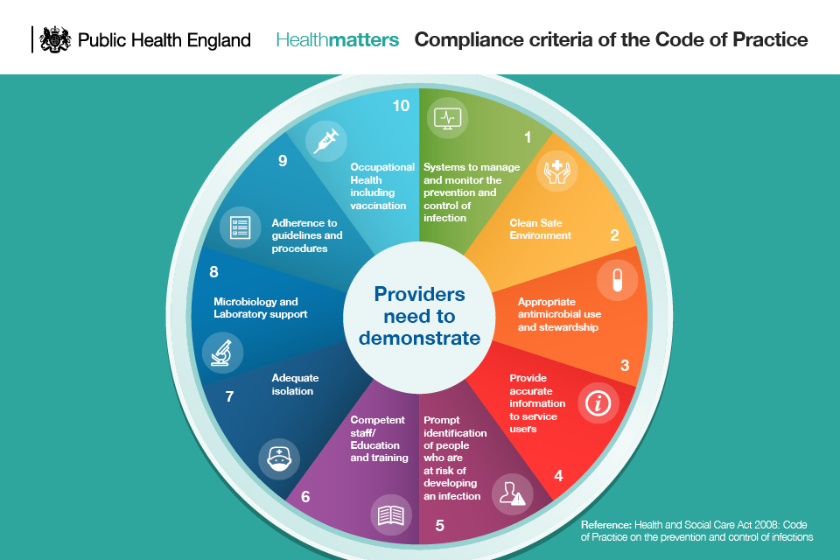
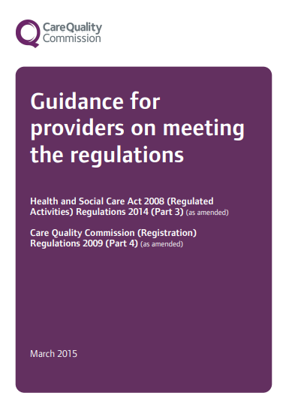
NHS I working with CQC to support inspections

Slide 38
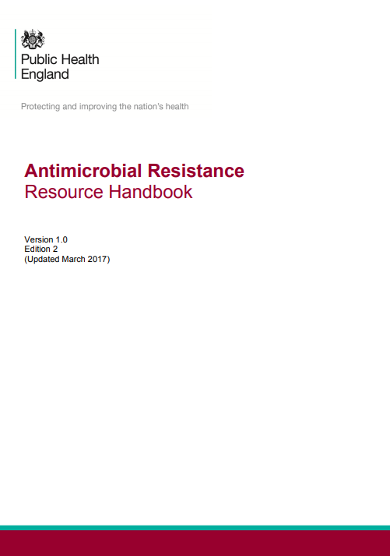
Interventions, toolkits and resources:
Notes:
The ‘Keep Antibiotics Working’ campaign was supported by a wide range of partners to whom materials including leaflets and posters were distributed. In addition, specially designed self-care prescription pads were sent to General Practitioners (GPs), providing a tangible intervention to satisfy patient concerns and help alleviate pressure to prescribe. The Antibiotic Guardian pledge system helps people feel that they have taken concrete personal and collective action to help keep antibiotics active. This may in turn act as a catalyst for behaviour change that is measured through follow up.
The Treat Antibiotics Responsibly, Guidance, Education, Tools (TARGET) Antibiotics toolkit, developed by PHE with the Royal College of General Practitioners (RCGP) aims to influence patients’ behaviour around antibiotic use through health care professionals. The toolkit includes posters and videos for waiting and consulting rooms, and leaflets to share with the patient in the consultation.
e-Bug, a PHE educational programme targeted at children and young people, is an innovative and multidisciplinary resource that provides lesson plans, interactive activities and educational media for schools and communities on infections, hygiene and antimicrobial resistance. The e-Bug resources are currently available in 23 different languages.

Slide 39
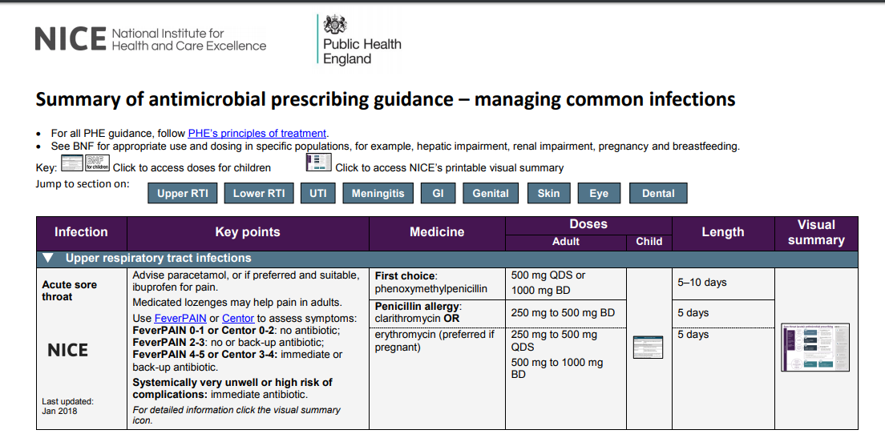
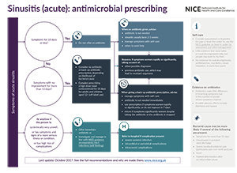
NICE & PHE antimicrobial prescribing guidance
https://www.nice.org.uk/Media/Default/About/what-we-do/NICE-guidance/antimicrobial%20guidance/summary-antimicrobial-prescribing-guidance.pdf

Slide 40
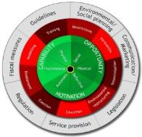
PHE Behavioural Insights coordination with scientific input
Behavioural analyses to inform strategic decisions about interventions
Understanding and changing behaviours related to preventing catheter associated urinary tract infections in primary, secondary and community care and nursing homes.
A Behaviour Change Wheel classification of AMS interventions for self-limiting RTIs in primary care patients, prescribers, providers, CCGs and pharmacies.
Interventions
Annual feedback letters to GPs from the CMO based on behavioural insights
to top 20% of practices (2017 – results imminent)
to practices with prescribing increased by >4% (2018 – results in 2019)
Testing TARGET in pharmacies and care homes
Optimising intervention content (OPIC) in CAUTI and AMS: Implementation of findings from the two behavioural analyses

Slide 41
Public campaign

Slide 44
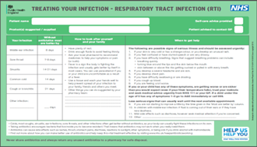
National to local and local to national
Embedding AMR in STPs and ICSs
Stronger and extended membership local networks /forums
Consolidation of work undertaken by national AMR teams, enabling local teams to prioritise implementation of outputs from the national teams work plan.
Examples of National/Local Collaboration
AMR lead in South West worked with National lead pharmacist to implement TARGET leaflet into local pharmacies and then as national resource for Help Us Help You campaign
PHE Centres are actively involved in NHS England’s Regional Medicines Optimisation Committees (RMOC).
The National Marketing campaign was piloted in the North West where local leadership galvanised the healthcare system in support of the effort
The National dental AMS toolkit developed from initiative by NHS England Cheshire and Merseyside Local Dental Network.
To Dip or Not to Dip developed to improve diagnosis and management of UTIs in nursing homes in Bath and North East Somerset
Notes:
This is an evidence based systematic approach to improve the diagnosis and management of UTIs in residents in all 23 Nursing Homes in Bath and North East Somerset - Residential homes were not included initially

Slide 45
Engaging the community: children, families, students

Slide 46
SCOUTS AS ANTIBIOTIC GUARDIANS
Scouts continue to work towards achieving these badges, raising awareness in children and families. A Scouting Antibiotic Guardian badge was expanded in 2017 across Leicestershire (http://www.leicestershirescouts.org.uk/2017/11/antibiotic-guardian-scheme-leader-training/) following initial development by West Lancashire Scouts and PHE (https://www.westlancsscouts.org.uk/antibiotic-guardians/).
https://twitter.com/mortons72/status/959725456751722501

Slide 47
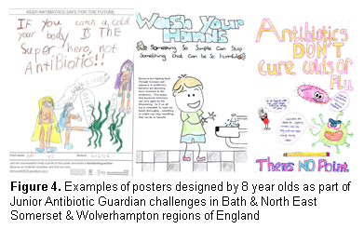
School poster competitions, museums/science centres
Northern Ireland – AG Passport for children

Slide 48
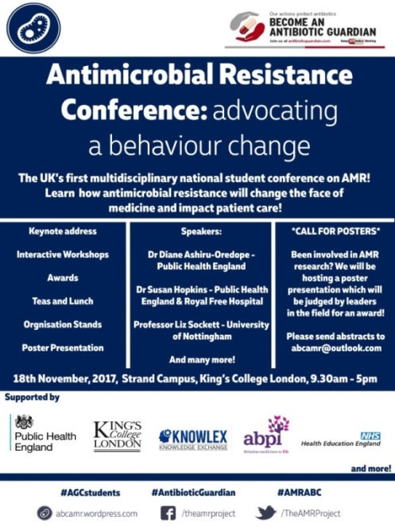
Health students
First and second national AMR student conferences was held on 18th November 2017 and 2018 to engage with healthcare student bodies nationally to promote antibiotic awareness across the UK universities.
One Health conference
Over 200 students registered for both conferences. The presentations from the conference are available via http://antibioticguardian.com/Meetings/students-amr-conference-2017/
AG Champion badges – LinkedIn accounts
Notes:
The first national AMR student conference was held on 18th November 2017 to engage with healthcare student bodies nationally to promote antibiotic awareness across the UK universities.
The conference aimed to promote collaboration amongst all health-related fields through a One Health approach, providing students and young professionals an opportunity to participate in talks and workshops held by key individuals with expertise in this field.
Over 200 students attended the conference. The presentations from the conference are available via http://antibioticguardian.com/Meetings/students-amr-conference-2017/
Health students and pre-registration professionals were invited to earn their AG Champion badges (that could be displayed on LinkedIn accounts) by completing AMR-related tasks and providing a short summary of their activities.

Slide 49
New/forth coming interventions in England:
- national hand hygiene and standard precaution policy being launched at the Chief Nursing Officer conference this week. (NHS Improvement) - national catheter resources (passport, care plan, patient held card) launched and now on the NHS Improvement website. https://improvement.nhs.uk/resources/urinary-catheter-tools/ - CPE Framework of actions - update of the current CPE toolkit for acute and non-acute. In progress. Draft to go out for consultation in May (PHE working with stakeholders to co-produce) - survey of capacity and capability of long term care facilities to deliver IPC and AMS - in progress. Report due in May (PHE) - Resource library of evidence, guidance and examples of practice to reduce GNBSI will be published at the end of March (NHS Improvement)
testing equivalent of CMO letters in secondary care
Working with GP practice pharmacists to reduce inappropriate prescribing

Slide 50
Several challenges but also a range of opportunities available:
National targets for surveillance and reduction of HCAIs & AMR
Quality incentives for reducing antibiotic prescribing (including use of standard contracts)
Open access data
AMR in NHS England long term plan
Strengthening implementation of evidence based multi-modal interventions and evaluation of the interventions
Use of behaviour change strategies when designing interventions
Public media campaign and engaging the community
Code of practice and CQC inspections (with support from NHS Improvement)
Notes:
In terms of the IPC section your top line could be to emphasise the importance of prevention of infection which will generally lower the need for antimicrobials and therefore the potential for resistance to develop. The strategy talks about GNBSI ambitions - you could present how setting targets or ambitions has driven down infections historically but they weren't in isolation. If you have a look at the slides from my presentation at the European Parliament, they nicely show the setting of targets but also the multimodal interventions alongside those targets. We need to strengthen the multimodal - cross organisational interventions where we are all working together to prevent infections . We know that a lot of these infections are occurring in the community therefore we can't just focus on hospitals. We all need to work together. There are systematic reviews showing that bundle/multi modal approaches prevent infections. You could mention CQC and the code and how NHS Improvement are working with CQC inspectors to support them in their inspections. Interventions in England that are new - national hand hygiene and standard precaution policy being launched at the Chief Nursing Officer conference this week. (NHS Improvement) - national catheter resources (passport, care plan, patient held card) launched and now on the NHS Improvement website. https://improvement.nhs.uk/resources/urinary-catheter-tools/ - CPE Framework of actions - update of the current CPE toolkit for acute and non-acute. In progress. Draft to go out for consultation in May (PHE working with stakeholders to co-produce) - survey of capacity and capability of long term care facilities to deliver IPC and AMS - in progress. Report due in May (PHE) - Resource library of evidence, guidance and examples of practice to reduce GNBSI will be published at the end of March (NHS Improvement)

Slide 51
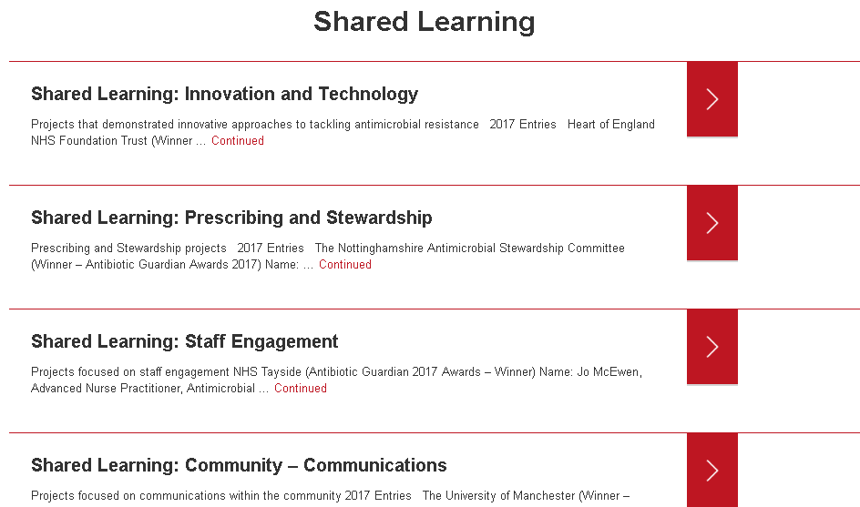
Shared Learning pages http://antibioticguardian.com/shared-learning/

Slide 52
ANTIBIOTIC GUARDIAN AWARDS 2019
Categories include:
Agriculture and Food: How has your organisation promoted antibiotic stewardship in the agriculture and food sector?
Community Communications: How has your organisation worked within the community to highlight Antibiotic Guardian or stewardship?
Diagnostic stewardship: Tell us how you have demonstrated effective use of diagnostics to reduce prescribing.
Infection Prevention and control: Tell us how you have demonstrated improvements in infection prevention and control practices to address Antimicrobial Resistance.
Other categories: Prescribing and stewardship; Public engagement; Innovation and Technology; Health Student of the Year; Children and Family; Research
The Das Pillay Antimicrobial Stewardship Memorial Award: This award is to recognise innovation the field of antimicrobial stewardship at a junior level.
To view 2018 winners and shortlisted go to: http://antibioticguardian.com/antibiotic-guardian-2018-awards-shortlist/
(Entries close 22 March 2019)

Slide 53
PHE is particularly focused on
Integrating national to local through relationships with
Field service
Centres & Regions
Wider public health system
NHS
Reducing burden of key infections by
Improved understanding (data linkage of pathogens, syndromes, clinical data)
Better future predictions (models, exceedance, automation)
Novel methodologies for detection and surveillance
Excellent outbreak investigation
Excellent science with academic partners
Developing a multidisciplinary workforce to
Deliver data science
Develop evidence base and interventions (including testing)
Provide expert advice and system leadership

Slide 54
PHE HCAI & AMR Division Mission Statement:
To protect people from healthcare-associated and antimicrobial resistant infections, through world-leading public health microbiology, outbreak response, surveillance, research and interventions.

Slide 55
Acknowledgements
Viviana Finserella
Karen Shaw
Elizabeth Beech
Emma Cramp
Susan Hopkins

