Slide 1
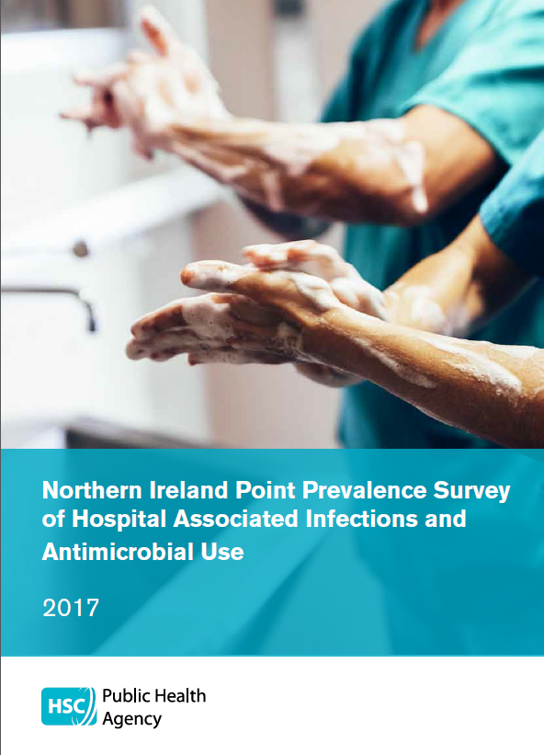


Point prevalence survey (PPS) of healthcare associated infections (HAI) & antimicrobial use (AMU) in acute care
Mark McConaghy, Dr Muhammad Sartaj,
Dr Bronagh Clarke, Dr Tony Crockford
PHA Health protection nurses, Trust PPS coordinators
and local acute teams.
Notes:
1

Slide 2
Context
Risk; >4 million people in Europe get a healthcare-associated infections every year, around 37k die as a direct result of the infection.
Inappropriate antimicrobial use is a key driver of antimicrobial resistance; understanding the indications and adherence to guidelines is important to reduce consumption and respond to targets e.g. O’Neill
Infection means more pressure on the system – extra cost, inpatient days, re-operations, bed availability, activity displacement, morbidity and mortality Badia J.M. et al Impact of surgical site infection on healthcare costs and patient outcomes: a systematic review in six European countries. Journal of Hospital Infection 96 (2017) 1-15

Slide 3

HAI estimate 1 in 16 versus 1 in 24
Comparable rates of hospital acquired infections in Europe and UK
Country | HAI prevalence 2012 | HAI prevalence 2017
Europe – ECDC PPS | 6.2 (6.1 - 6.3) | 5.5 (4.5 -6.7)
England | 6.5 (4.8 - 8.8) | 6.4 (5.4 -7.6)
Scotland | 4.9 (4.4 - 5.4) | 4.5 (4.0 - 5.0)
Wales | 4.3 (3.8 - 4.8) | 5.5 (5.0 - 6.1)
Northern Ireland | 4.2 (3.6 - 4.8) | 6.1 (5.4 - 6.9)
Distribution of infection
Pneumonia (29%),
SSI (17%),
GI (10%) and
BSI (9%)…

Slide 4
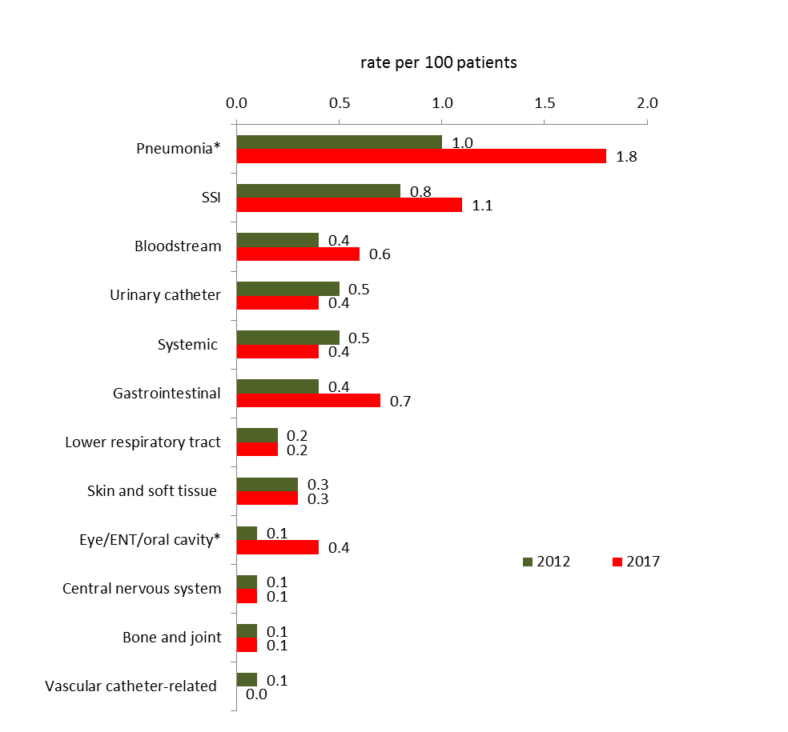
Changes to infection rates
-Pneumonia
-Bloodstream, GI
also
Increased number of SSI (organ/space*) infection types
* Significance <0.05

Slide 5
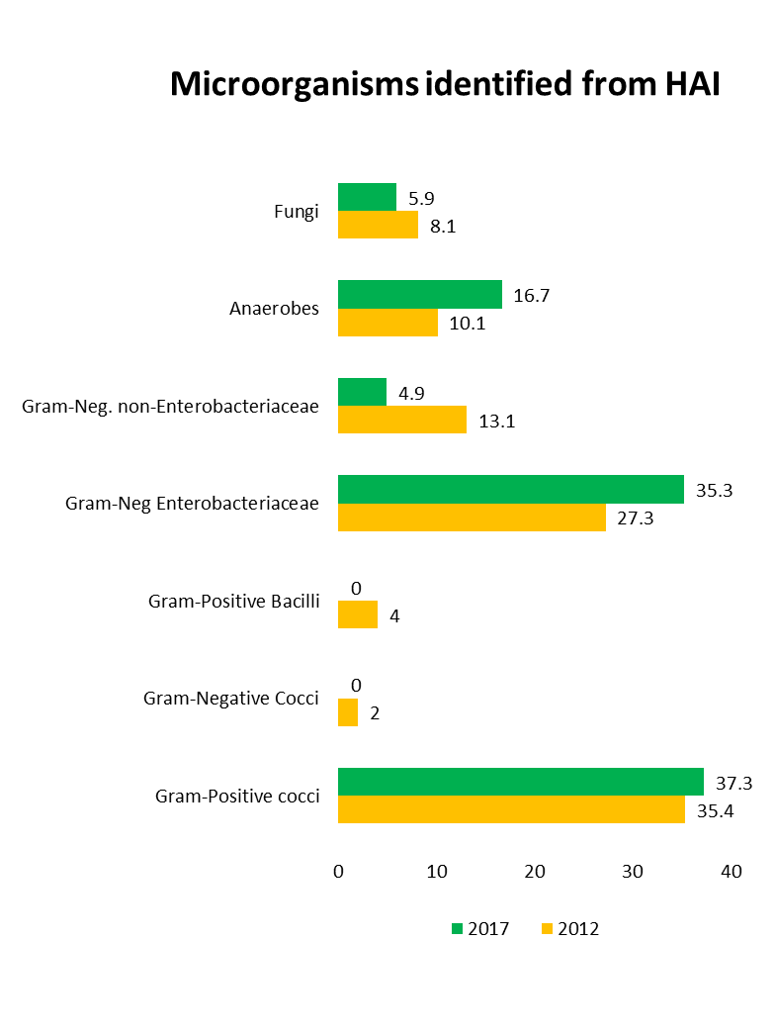
Gram positive (37.3%)
Staph aureus 18.6% [14%]
Enterococcus spp 18.6% [12%]
Gram negative Enterobacteriaceae(35.2%)
e-coli 20.6% [8%]
Anaerobic bacilli (16.7%)
C. diff 12.7% [8%]
…
Fungi (5.9%) & Gram negative non- enterobateriaceae (4.9%)

Slide 6

PPS 2012
AMU prevalence
29.5% (28.1 – 30.9)
6 in 20
PPS 2017
AMU prevalence
36.3% (34.8 – 37.9):
7 in 20
Notes:
Overall figure
Increase over 2012

Slide 7
2017 AMU benchmark figure
Comparable rates of antimicrobial consumption in Europe and UK
Country | AMU prevalence 2012 | AMU prevalence 2017
Europe – ECDC PPS | 32.7 (29.4 – 36.2) | 30.5 (29.2 – 31.9)
England (Acute) | 34.3 (30.1 – 39.2) | 37.4 (35.3 – 39.5)
Scotland (Acute) | 32.3 (30.9 – 33.8) | 35.3 (33.8 – 36.7)
Wales (Acute) | 32.7 (31.6 – 33.9) | 34.2 (33.0 – 35.3)
Northern Ireland | 29.5 (28.1 – 30.9) | 36.3 (34.8 – 37.9)
Notes:
Up in 2017, was low, now in line with rest
7

Slide 8
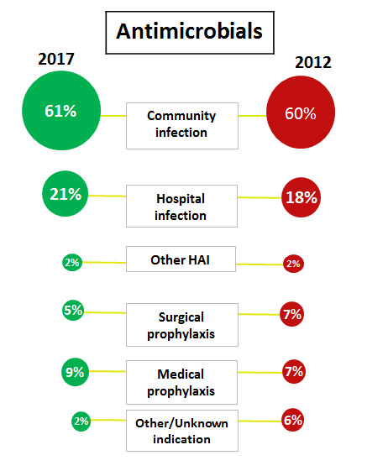
Indication for antimicrobial prescription
Similar distribution 2017 and 2012; majority for community acquired infection,
followed by hospital associated infection and medical and surgical prophylaxis

Slide 9
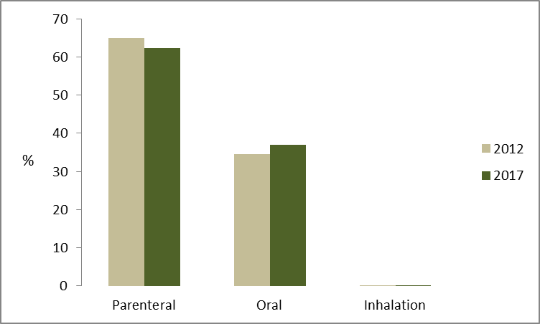
Route of administration
-High proportion of antimicrobials administered paternally; 63%
Comparable figure in Scotland and Wales ~50%
Less IV-oral ‘switching’
Notes:
9

Slide 10
Top 20 antimicrobials 2012 & 2017
Notes:
overall prescribing of AMs has increased
co-amoxiclav shows decrease
Control inappropriate use of:
broad spectrum which increase the risk of HAI e.g. C. dificile
Very broad spectrum which increase the risk of AMR
Antimicrobial stewardship, policy and guidance
------------------------------------------------------------------
Lots of Pip/Taz and co-amoxiclav used
Is Local policy adhered to?
Arrows are 10 most prescribed off-policy

Slide 11
Not assessable – where the antimicrobial is prescribed for medical prophylaxis or
local policy is not available for the specific infection being treated or procedure undergone
Notes:
~ 73% meet local policy
~27% are outside meeting local policy
Some countries setting target of 95% compliance target
Compliance of 73% seems low, but need to understand the underlying factors
Trust variation
Specialty
Antimicrobials in question
Non-compliance runs the risk of increased HAI and AMR

Slide 12
Top ten most commonly off-policy antibiotics
Antibiotic | Not to guidelines | Total No. prescribed | % off guidelines
Co-amoxiclav | 50 | 176 | 28.4
Piperacillin-tazobactam^{W} | 50 | 322 | 15.5
Amoxicillin | 20 | 177 | 11.3
Clarithromycin ^{W} | 16 | 92 | 17.4
Metronidazole (parenteral) | 15 | 105 | 14.3
Doxycycline | 9 | 87 | 10.3
Gentamicin | 9 | 139 | 6.5
Teicoplanin^{W} | 9 | 93 | 9.7
Meropenem^{W} | 8 | 75 | 10.7
Metronidazole (oral- rectal) | 8 | 48 | 16.7
W = watch group
Notes:
Broad spectrum risk of CDI e.g. Co-amoxiclav previously shown decrease in use but 28.4% is off local policy
Very broad spectrum AMR risk e.g.Pip/Taz highest use and 15.5% is off local policy
Understand why and use the knowledge to inform
IPC improvement strategy
Antimicrobial stewardship
Local prescribing policy
And also the implementation of these policies
------------------------------------------------------------------------------------------------------------------
17% of top 10 off policy are CDI risk i.e. more than 1 in 6
Co-amoxiclav (CDI Risk)
Amoxicillin (CDI Risk)
Meropenem (CDI Risk)
Piperacillin-tazobactam (CDI Risk and Critical)
Clarithromycin (?)
Metronidazole (parenteral) (?)
Doxycycline (Tetracycline antibiotics – organisms might have resistance)
Gentamicin (mostly Gram-negative bacteria including Pseudomonas, Proteus, Escherichia coli, Klebsiella pneumoniae, Enterobacter aerogenes, Serratia, and the Gram-positive Staphylococcus.⁾
Teicoplanin (treatment Clostridium difficile and of serious infections caused by Gram-positive bacteria, including methicillin-resistant Staphylococcus aureus and Enterococcus faecalis. It is a semisynthetic glycopeptide antibiotic with a spectrum of activity similar to vancomycin.
Metronidazole (treatment Clostridium difficile colitus)
750 prescribed 128 off-policy (17% off policy i.e. more than 1 in 6)

Slide 13
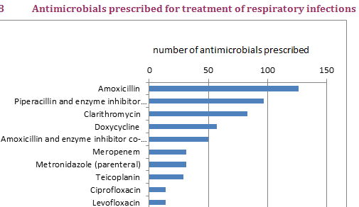
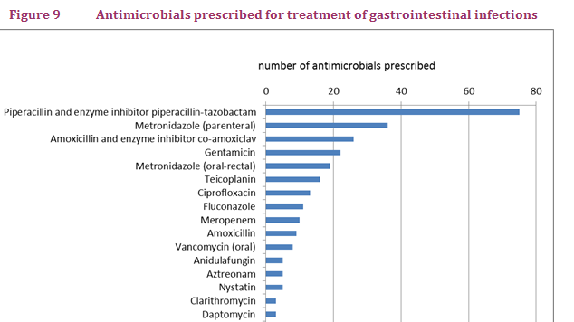
Diagnosis site where AM used
Infection | Number diagnosed | Percent
Respiratory tract (pneumonia/bronchitis) | 614 (506 pneu & 108 bron) | 35.2
Gastro | 288 | 16.5
Systemic infection | 257 | 14.7
Skin/soft tissue/bone/joint | 254 | 14.5
Urinary tract | 201 | 11.5
Eye/ear/nose/throat | 57 | 3.3
Central nervous system | 31 | 1.8
Genito-urinary system | 27 | 1.5
Cardiovascular system | 17 | 1.0
!
!
!
!
!
!
!
!
!
!

Slide 14
Classifying antibiotics in the WHO List of essential medicines for optimal use – be AWaRe
Higher resistance potential. 1st/2nd treatment choice for
limited indications
9% not compliant

Slide 15
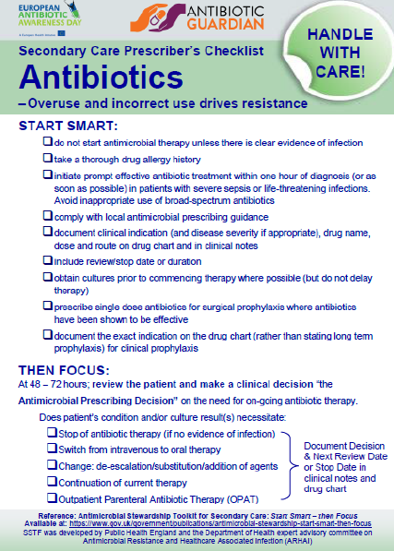
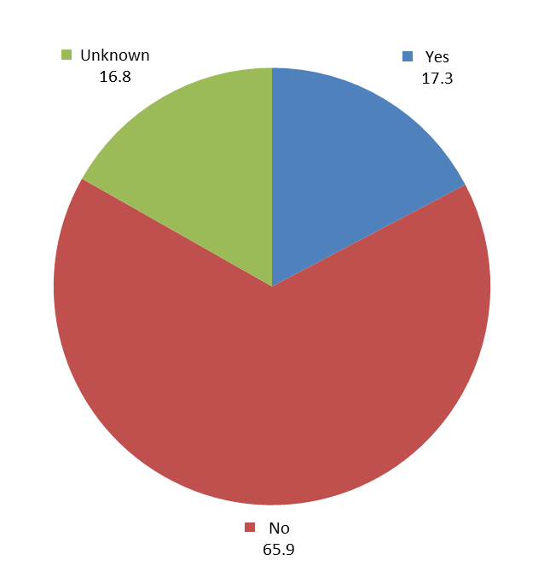
Review of antimicrobial order within 72h at ward level?
Notes:
15

Slide 16
Finally….
  Key priorities for regional actions identified in the final report and included in the work plan of the Regional HCAI & AMR Board
Individual trust level data was shared with the Trust to identify local priorities and develop local action plans
Consideration given to more frequent local PPS style surveys and further development of incidence surveillance systems to strengthen evidence base and monitor change.

Slide 17

Thanks and comments

