Slide 1


Gram Negative Bacteraemia – Challenges & Opportunities in NI
Dr David Farren MB BCh BAO MSc MRCP FRCPath
Consultant in Medical Microbiology / Infection Control Doctor
Northern Health and Social Care Trust

Slide 2
Outline
What are gram negatives?
Why are they important?
How can they be controlled?
What are the challenges?
How do we overcome them?
Summary
Questions

Slide 3
Gram negative bacteria
Gram negative organisms are ubiquitous in the environment and the human body
Resist staining with crystal violet, hence stay pink on Gram’s stain
  Due to having two cell membranes, an outer and an inner
  Inner is similar to gram positive organisms
  Outer membrane conveys resistance to detergents, some antibiotics and lysozyme. Also acts as a toxin when cell is lysed.
Acquired resistance is common and challenging
Image by Jeff Dahl - Own work, CC BY-SA 4.0,
https://commons.wikimedia.org/w/index.php?curid=3647374

Slide 4
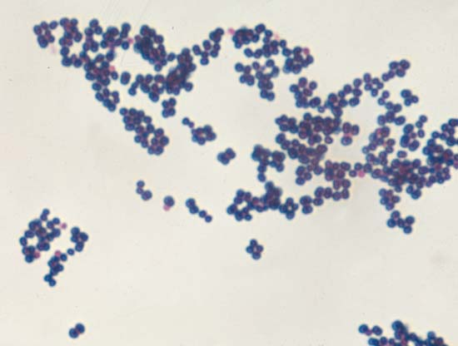
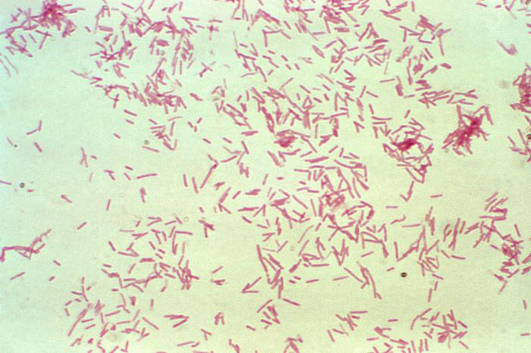

Slide 5
Relevance
Significant morbidity and mortality
E. coli is consistently the most common bloodstream infection in NI
Rising incidence over recent years
  Increasing complexity of healthcare
  Medical devices
  Co-morbidity
  Antimicrobial resistance
  ? Overshadowed by other “alert organisms”/HCAIs

Slide 6
E. coli bloodstream infections 2014-18
* Data from Cosurv and Hisurv (after April 2018), courtesy of PHA surveillance team

Slide 7
Klebsiella spp. bloodstream infections 2014-18
* Data from Cosurv and Hisurv (after April 2018), courtesy of PHA surveillance team

Slide 8
Pseudomonas aeruginosa BSI 2014-18
* Data from Cosurv and Hisurv (after April 2018), courtesy of PHA surveillance team

Slide 9
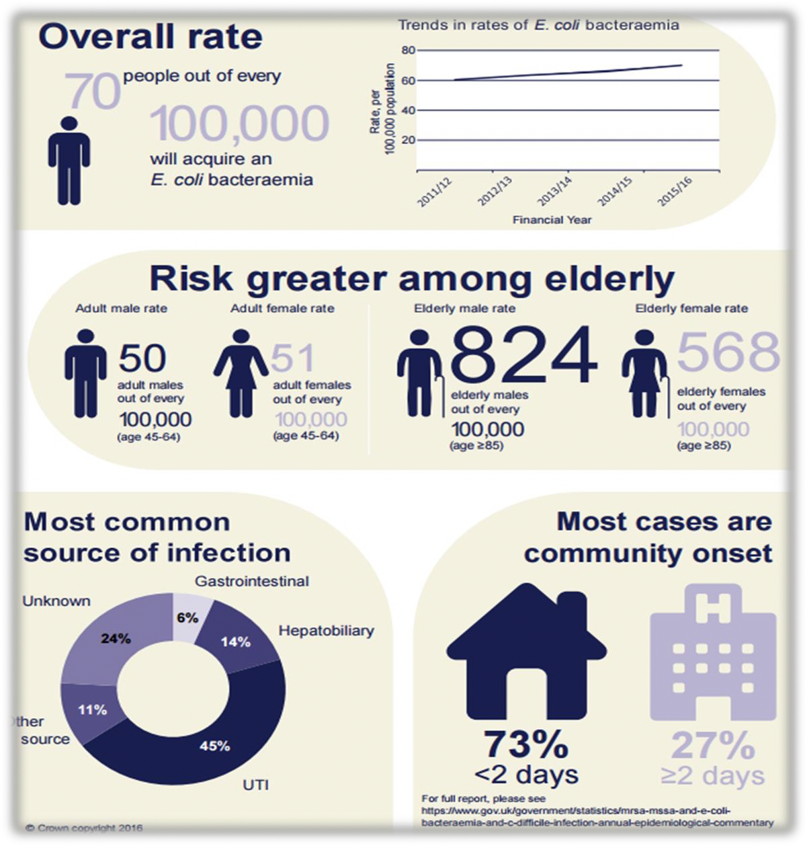

Slide 10
Case fatality rate
Bacterial infection | Overall CFR (95% CI) | Community onset CFR (95% CI) | Hospital onset CFR (95% CI)
MSSA BSI | 20.2 (19.5 – 20.9) | 19.1 (18.3 – 19.9) | 23.2 (21.8 – 24.8)
MRSA BSI | 27.0 (24.0 – 30.2) | 25.6 (21.9 – 29.4) | 30.1 (24.6 – 36.0)
CDI | 15.2 (14.6 – 15.9) | 11.1 (10.5 – 11.8) | 22.6 (21.4 – 23.8)
E. coli BSI | 14.7 (14.3 – 15.0) | 12.9 (12.6 – 13.3) | 22.7 (21.8 – 23.7)
Klebsiella spp. BSI | 20.2 (19.3 – 21.0) | 18.3 (17.4 – 19.3) | 24.4 (22.8 – 26.1)
Pseudomonas aeruginosa BSI | 27.0 (25.6 – 28.3) | 25.2 (23.6 – 26.9) | 29.8 (27.5 – 32.1)
https://assets.publishing.service.gov.uk/government/uploads/system/uploads/attachment_data/file/765014/HCAI_fatality_report_201718_v2.pdf

Slide 11
Approach to Controlling Infections

Slide 12
Controlling infection
Infectious agent
Mode of escape
Mode of transfer
Mode of entry
Susceptible host
Reservoir
Preventing infection usually focuses on addressing specific risk factors and
  Eradicating reservoirs
    Cleaning and disinfection; antimicrobial stewardship
  Preventing escape
    Source control; isolation
  Preventing transfer
    Hand hygiene; cleaning and disinfection
  Preventing entry
    PPE
  Protecting susceptible host
    Prophylaxis; protective isolation

Slide 13
First steps
Reinforce the important of Standard Precautions
  Effective hand hygiene
  Appropriate use of PPE
  Safe disposal of clinical waste, especially bodily fluids
  Robust environmental hygiene in clinical areas
  Augmented care – enhanced hand washing and water safety
Surveillance and screening, as relevant, for resistant organisms
  Isolation and enhanced precautions as relevant
Antimicrobial stewardship
Adherence to EPIC 3 guidance

Slide 14
Specific measures
Most common source is urogenital tract
  Preventative measures
    Self care and hydration
    Urinary catheters (HII; HOUDINI)
    Continence care
    Catheter passports
  Appropriate treatment
    Making correct diagnosis – appropriate sampling
    Surveillance of resistance
    Targeted therapy

Slide 15
Specific measures (cont)
Prevention of surgical site infections (HII; NICE QS49)
Aseptic management of all wounds; draining abscesses
Management of intravascular devices (HII; EPIC 3)
Prevention of chronic wounds in diabetes
  NICE NG19
Reducing risk from immunocompromise
  Protective isolation; use of GCSF; prophylactic antimicrobials
Prevention of VAP and appropriate management of respiratory infections

Slide 16
Challenges

Slide 17
NONE OF THIS IS NEW!

Slide 18
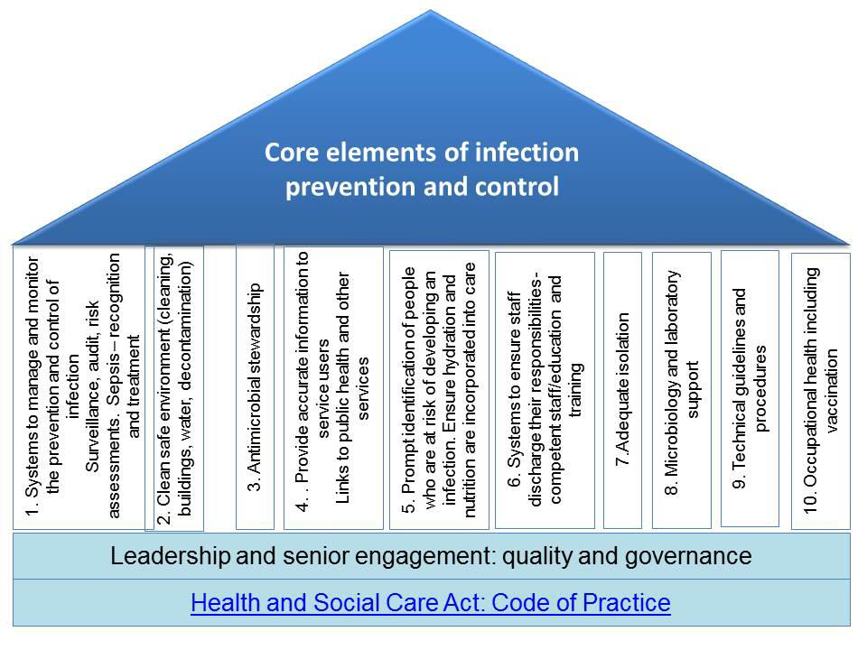

Slide 19
Hisurv +/- “Fingertips”-style outputs?
Staffing on wards? Bank / agency use common
Most hospitals have too few siderooms
Are we doing enough? Culture change needed
Laboratory centralisation and workforce crisis
Policy fatigue
Old hospital fabric, not meeting current guidance
Myth busting and encouragement
Hisurv and dashboards locally?
No formal DIPC role in NI

Slide 20


Slide 21


Slide 22


Slide 23
Opportunities
Putting Patient Safety first can never be the wrong message
Culture changing re: antimicrobials slowly but surely
Global traction of AMR / AMS agenda
Targets now in place for a year, improvements from elsewhere evident
Research promising new approaches

Slide 24


Slide 25
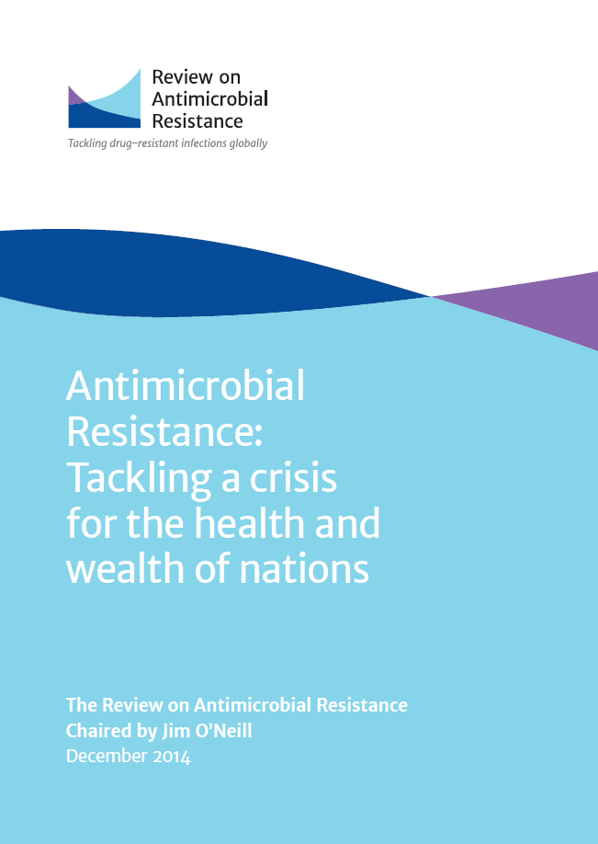
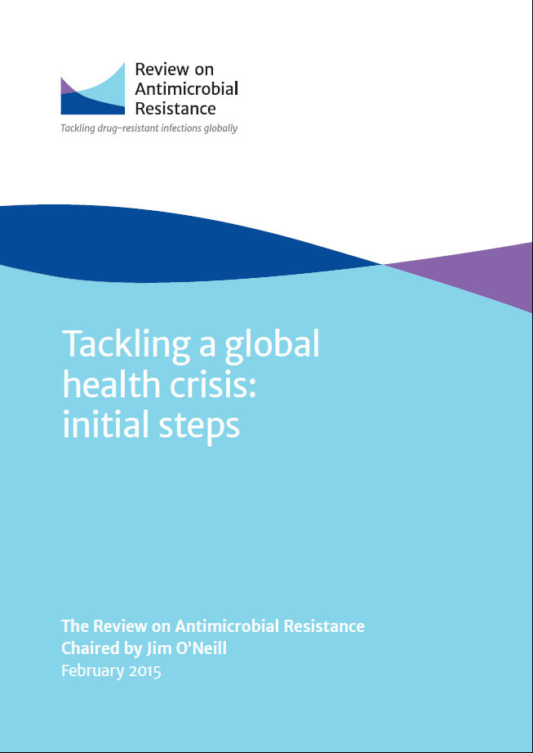
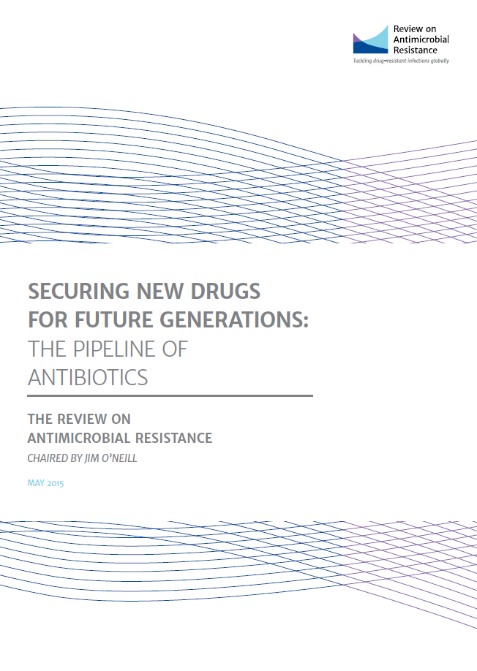
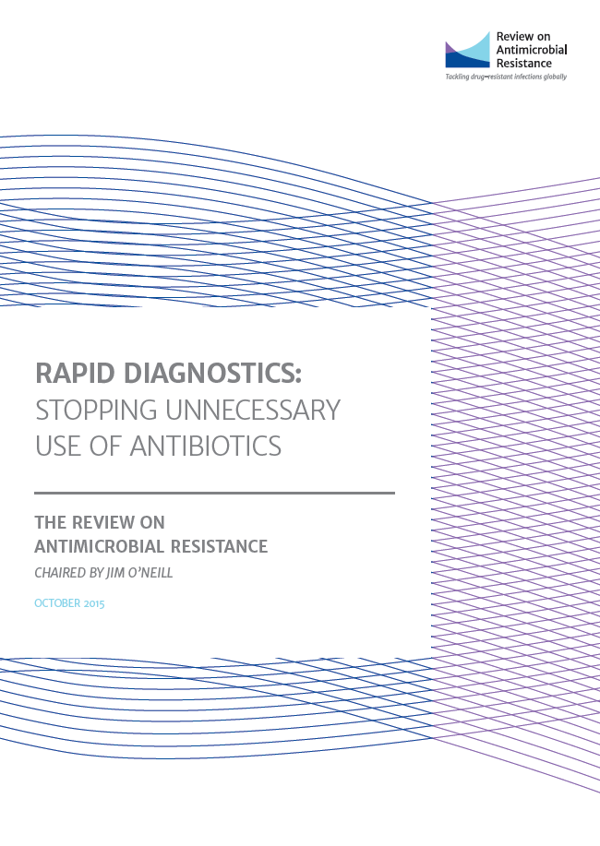
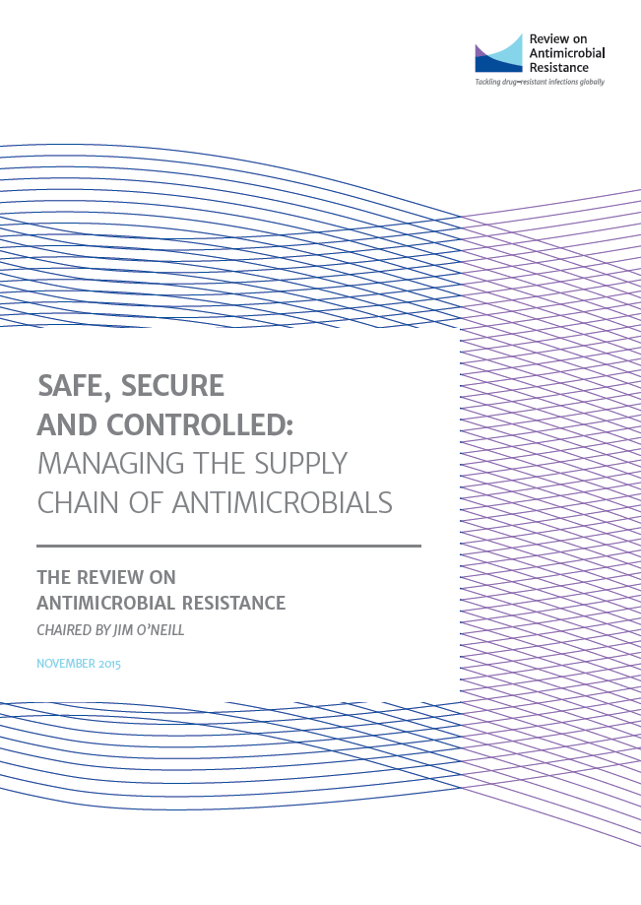
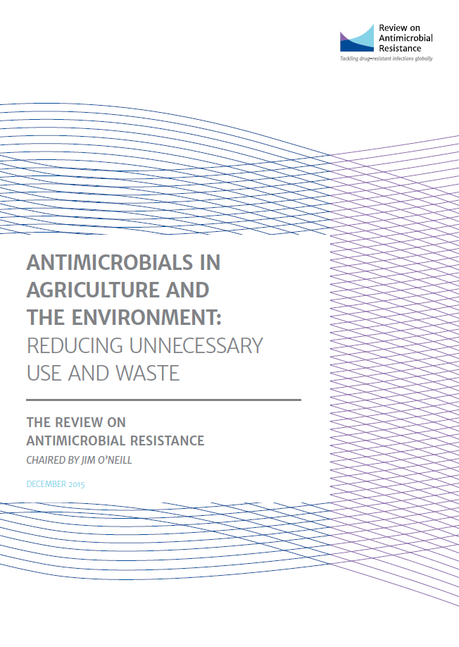
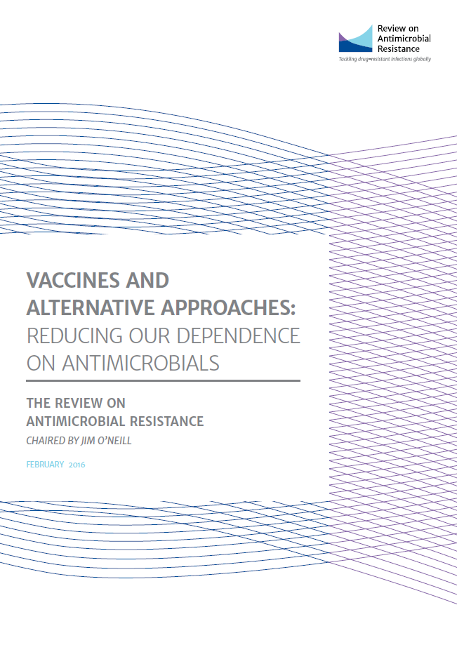
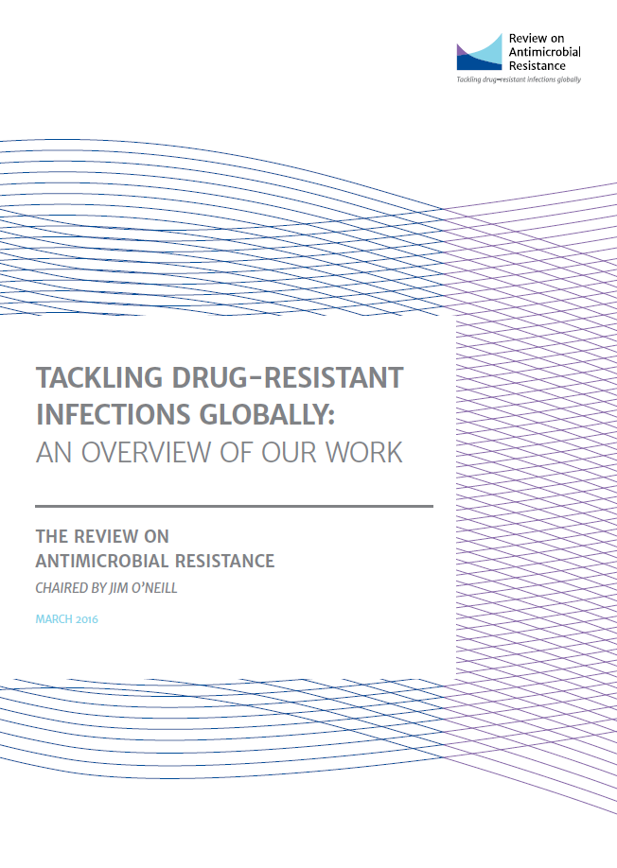
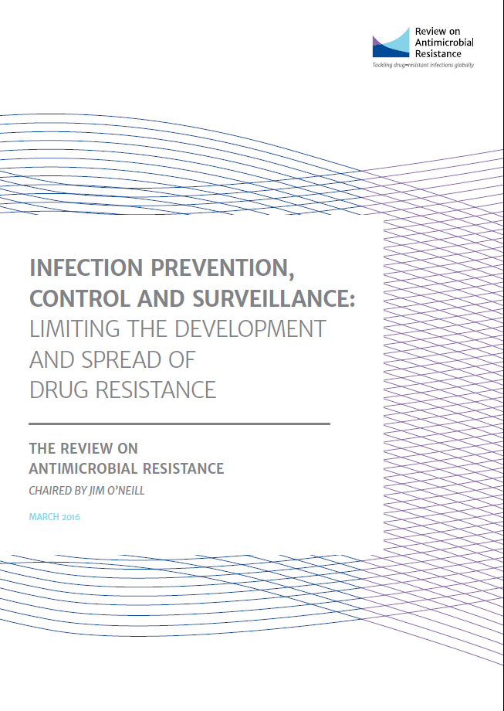
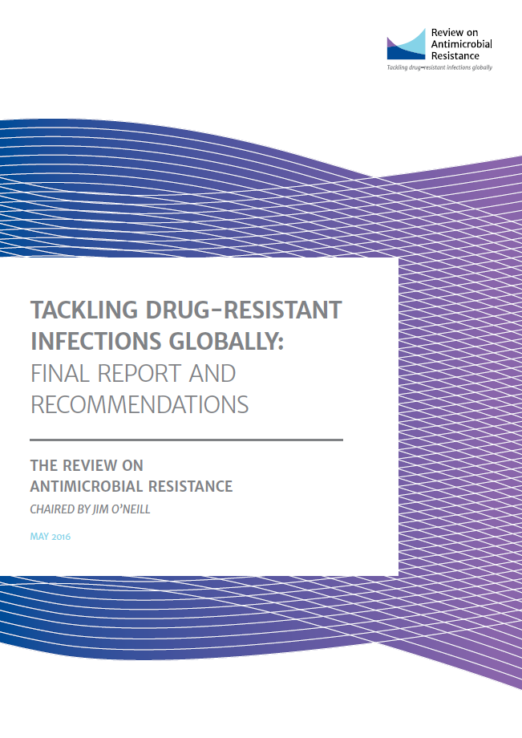

Slide 26
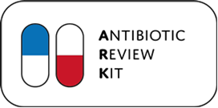


AMR Research

Slide 27
Summary
Gram negative bloodstream infections
  Are a significant proportion of our bloodstream infections
  Rates are increasing year-on-year
  Carry a significant mortality
Targets for reduction to drive improvement
  “Good practice” will control
  Can learn from England as data shows improvement
We need to lead culture change

Slide 28

Questions?

