Slide 1
Surveillance of Healthcare-associated Infections in NI
Rachel Spiers
Senior Epidemiological Scientist, HCAI Team
rachel.spiers@hscni.net
Germs by Vectors Market from the Noun Project

Slide 2
HCAI Surveillance
Detection
Analysis
Timely action
Building Information
Public communication
Surveillance by Rose Alice Design from the Noun Project
Notes:
The Public Health Agency’s Health Protection Surveillance Team is mandated by the
Department of Health to undertake surveillance of healthcare-associated infections (HCAI).
The surveillance of HCAIs has a number of goals:
1. Detection of changes in the temporal, geographic and age distribution of new and
known diseases, or changes in the pattern of diseases and their risk factors
2. Analysis which can determine the exposure, prevalence, burden, morbidity, mortality,
carriage and long term trends of HCAI
3. Timely action to protect the public’s health
4. Building information on the temporal, geographic and population distribution and
epidemiology of new, poorly-understood and well-understood diseases for information
public health decision-making, health service planning, risk management, research
and infection control programmes
5. Informing the public about the risk of communicable diseases
6. Contributing to European and International efforts to protect health

Slide 3
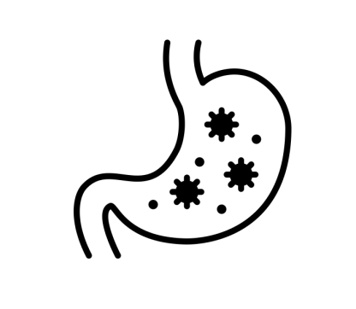
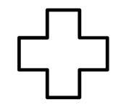
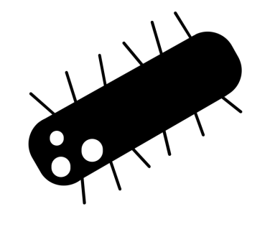
Organisms Under Surveillance 18/19
S. Aureus bacteramias
C. Difficile (age 2 +)
Gram-negative bacteraemias
P. Aeruginosa
Klebsiella spp.
E. coli
Pseudomonas
neonatal settings
augmented care
blood by Aziz Muttaqin from the Noun Project. Stomach by mungang kim from the Noun Project, Germ by Fer Guerrero from the Noun Project, medical sign by Artieady Budiman from the Noun Project, Nurse Holding Newborn by Gan Khoon Lay from the Noun Project
Notes:
Mandatory surveillance for Meticillin-sensitive and Meticillin-resistant Staphylococcus aureus (MSSA and MRSA, respectively) bloodstream infection was introduced in April
2001.
Staphylococcus aureus (S. aureus) is a round shaped bacterium which commonly colonises the nose, respiratory tract, gut mucosa and the skin usually without causing any
problems. It can also cause disease, particularly if there is an opportunity for the bacteria to enter the body, for example through broken skin or a medical procedure (including
operations and intravenous lines). If these bacteria enter the body, illnesses which range from mild to life threatening may develop. These can include skin and wound infections,
abscesses, endocarditis, pneumonia and bacteraemia (blood stream infection).
Mandatory surveillance of Clostridium difficile infection (CDI) in hospitals Northern Ireland was introduced in January 2005, with enhanced surveillance of community-onset CDI
following in 2011. C. difficile is a bacterium that can infect the bowel and cause diarrhoea. The infection most commonly affects people who have recently been treated with antibiotics,
and can spread by spores found within faeces. Infections can occur where many people take antibiotics and are in close contact with each other, such as hospitals and care homes.
The enhanced surveillance programme of Pseudomonas colonisations in neonatal units
commenced in January 2013 following a recommendation [3] arising after outbreaks in
neonatal units.Pseudomonas is an important cause of healthcare-associated infection,
particularly in patients who are very ill or immunocompromised. Individuals may be
colonised on the skin surface, nose and throat, usually without problems. Infections of the
bloodstream are, however, particularly serious.
And also gram-negative bloodstream infections – new for 17/18 to include P. aeruginosa, Klebsiella and E.coli.

Slide 4
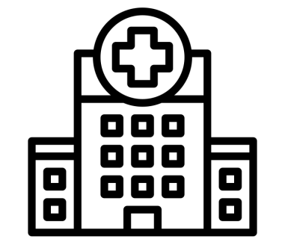
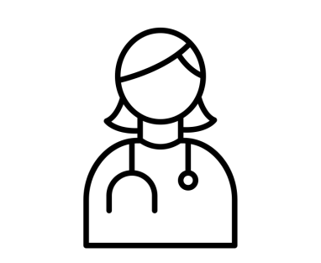
Data Sources
Microscope by Jacopo Bonacci from the Noun Project, Phone by Juliette Design from the Noun Project, Phone by Juliette Design from the Noun Project, dashboard by Xinh Studio from the Noun, dietitian by Made from the Noun Project, Computer by Sergey from the Noun Project, database by Putra Theoo from the Noun Project
Notes:
Some of you will be most familiar with HI-Surv – data entered by infection control
Notifications form duty room – community CDI
Validated by corsurv
Held in database
Reporting – paper/Hi-Surv/PF Dashboard

Slide 5
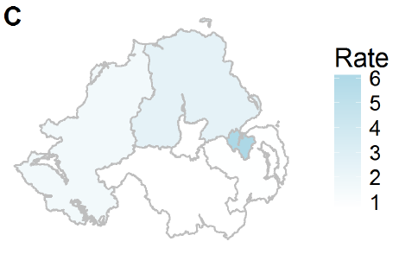
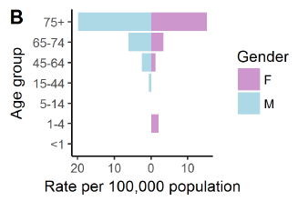
MRSA
blood by Aziz Muttaqin from the Noun Project
Notes:
For 2017, the MRSA rate decreased by 25% to 0.03 per 1000 bed days
in Northern Ireland (45 cases) compared to 2016 - the lowest rate observed in Northern
Ireland since surveillance began.
The highest rates were identified in males over the age
of 75 (rate 19.80, 24% of all MRSA), followed by females over the age of 75 (rate 15.16,
27% of all MRSA). The highest rates per 100,000 population were observed in the Belfast
Trust (6.19), followed by Northern Trust (2.53).

Slide 6
MRSA Targets (NI)
Notes:
Annual Target 34 (2.8 cases per month)
To date we have had… 47 (against target to end Jan 28)

Slide 7
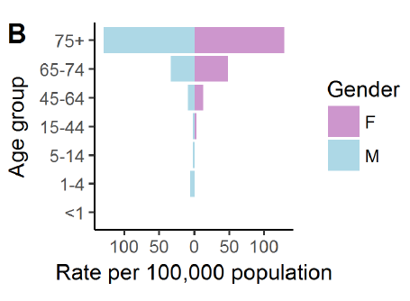
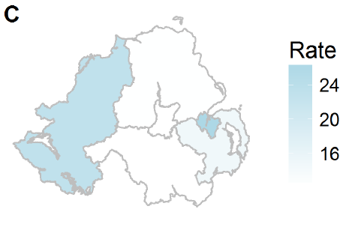
C. Difficile
Notes:
The annual regional rate per 1000 occupied bed days for inpatient CDI between 2010 and
2017 is presented below. Since reporting began there have been significant reductions
in CDI rates for inpatients. For 2017, the inpatient CDI rate (for those over the age of 2)
increased by 3% to 0.21 per 1000 bed days in Northern Ireland compared to 2016.
The highest rates were identified in males over the age of 75 (rate 129.59, 22% of all CDIs),
followed by females over the age of 75 (Rate 128.86, 32% of all CDIs). The highest rates
per 100,0000 population were observed in the Belfast Trust (26.43), followed by Western
Trust (23.22).

Slide 8
C. Difficile Targets (NI)
Notes:
Annual Target 320 (27 cases per month)
To date we have had… 301 (against target to end Jan 267)

Slide 9
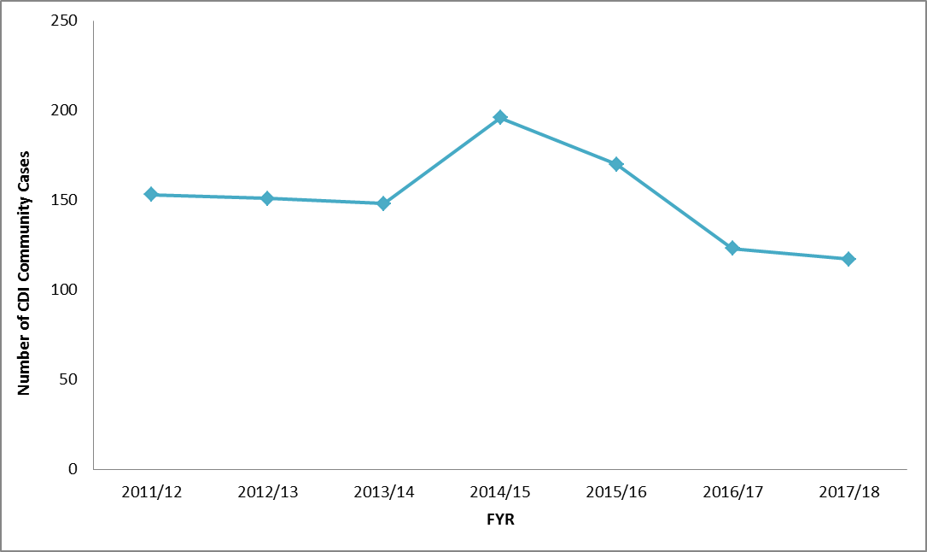
C. Difficile in the Community
Notes:
When directly comparing the 2011/12 and the 2017/18 years, there has been an observed 23.5% reduction in the number of CDI inpatient cases.
The number of cases of community CDI (117) has been at its lowest since reporting began.
Poster – check it out

Slide 10
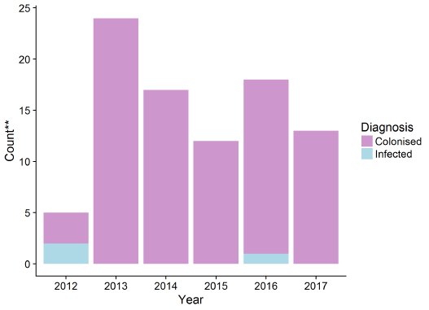
Pseudomonas in Neonatal Units
**Note - illustrates count of isolates only. Patients may have had one colonisation reported.
Nurse Holding Newborn by Gan Khoon Lay from the Noun Project
medical sign by Artieady Budiman from the Noun Project
Notes:
Multiple isolates of a single strain were not detected between patients.
No environmental/water links were reported to
the HCAI Team.

Slide 11
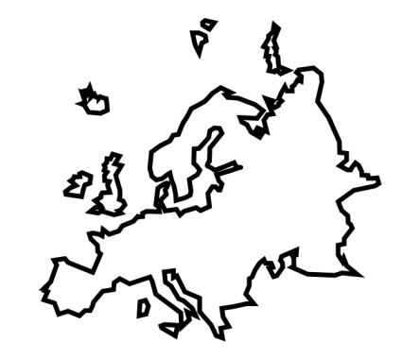
New for 2019/20
Full integration of Community CDI to Hi-Surv, including a Community Dashbaord
Hi-Surv Stakeholder Events
Contribute to ECDC European-wide CDI surveillance
Risk factor analysis for GNB
Community by IOHK Design Department from the Noun Project, Europe by anbileru adaleru from the Noun Project, Stomach by mungang kim from the Noun Project, Germ by Fer Guerrero from the Noun Project, blood by Aziz Muttaqin from the Noun Project

Slide 12
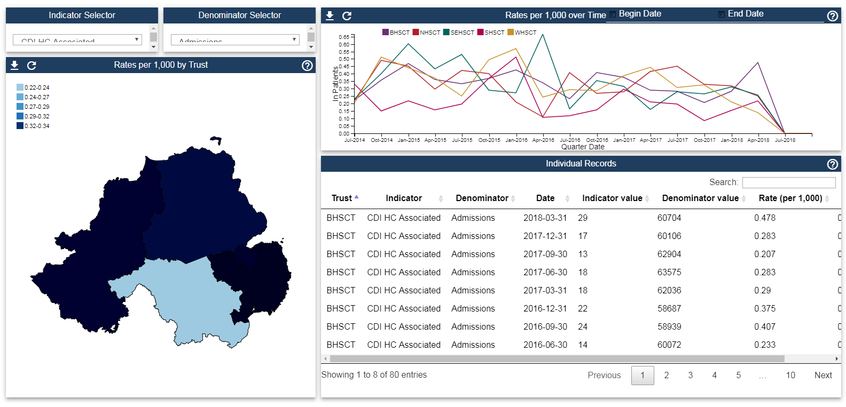
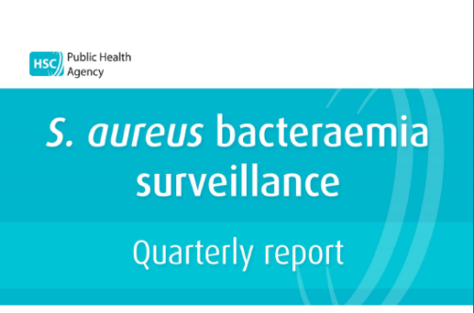
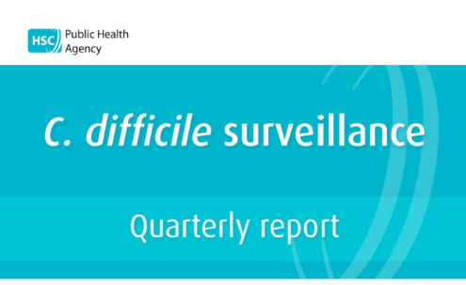
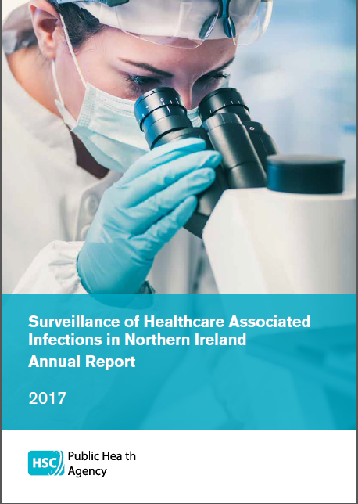
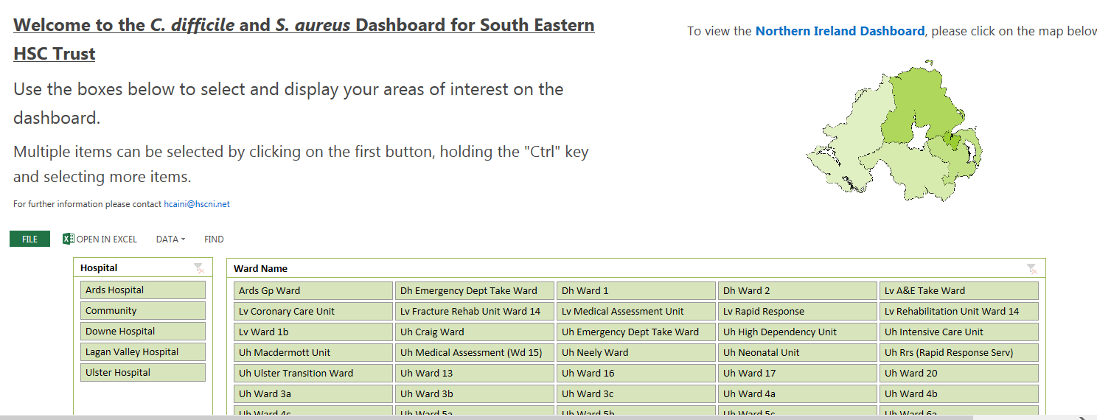
Further Information
Notes:
New public facing dashboard – available soon

Slide 13
Questions? Rachel.spiers@hscni.net

