Slide 1
Point Prevalence Survey of Healthcare-Associated Infections and Antimicrobial Use in Long-term Care Facilities in Northern Ireland (HALT-3):
Nursing Homes 2017
Tony Crockford & Muhammad Sartaj.
Public Health Agency Northern Ireland, Belfast, UK

Slide 2
Background
HALT-3 (“Healthcare Associated Infections and Antimicrobial Use in Long Term Care Facilities” )
The third Europe-wide PPS in LTCFs
The first survey (HALT) was conducted in 2010
PHA led Northern Ireland’s participation in survey
    55 Nursing Homes and 15 Trust-residential homes
    Conducted during Sept –Oct 2017
Notes:
Like to thank all those from PHA and the homes that took part for their input.

Slide 3
Complex project
PHA led team, Local Trust, RQIA & Independent Providers
Partnership with ECDC – Including Internal and External validation teams
Standardised Protocol & Codebook
Training:- Nursing Home Staff, Data Collectors, Data Entry Staff IPCNs,
  Methodology
  Definitions
  Case studies
  IT

Slide 4
Aims and Objectives
Aims & Objectives:
    Establish the burden of Healthcare Associated Infections (HCAI) and Antimicrobial Use (AMU) in Long Term Care facilities (LTCF)
    Describe the related infection prevention & control and antimicrobial stewardship practices and resources in LTCF.
    Identify needs for intervention, training, and/or additional infection and protection & control (IPC) resources
    Identify priorities for national and local intervention and raise awareness

Slide 5
Participation
    257 nursing homes invited to participate
    55 nursing homes submitted data (21% of total)
    Data collected on 2321 eligible residents
    The homes were distributed throughout Northern Ireland
    All homes were privately owned
    93% were run on a “for profit” basis
    Average size of participating nursing homes was similar to NI average (45 versus 47), ranging in size from 19 to 81 beds
    Single rooms per facility varied from 43%-100% (median = 95%)
    In 2013, Single rooms per facility varied from 19.2%-100%

Slide 6
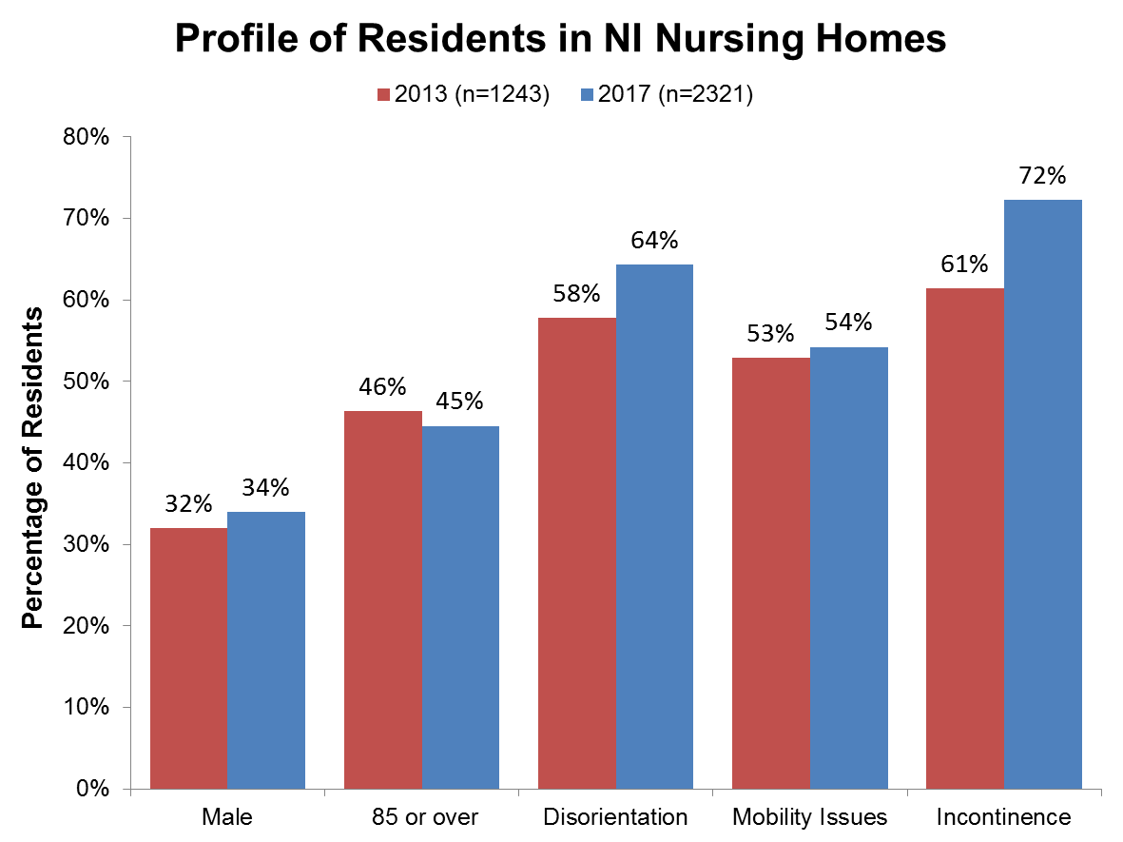
Notes:
Very slight decrease in the proportion of residents 85 or older
But increase in factors that would indicate a “sicker” population

Slide 7
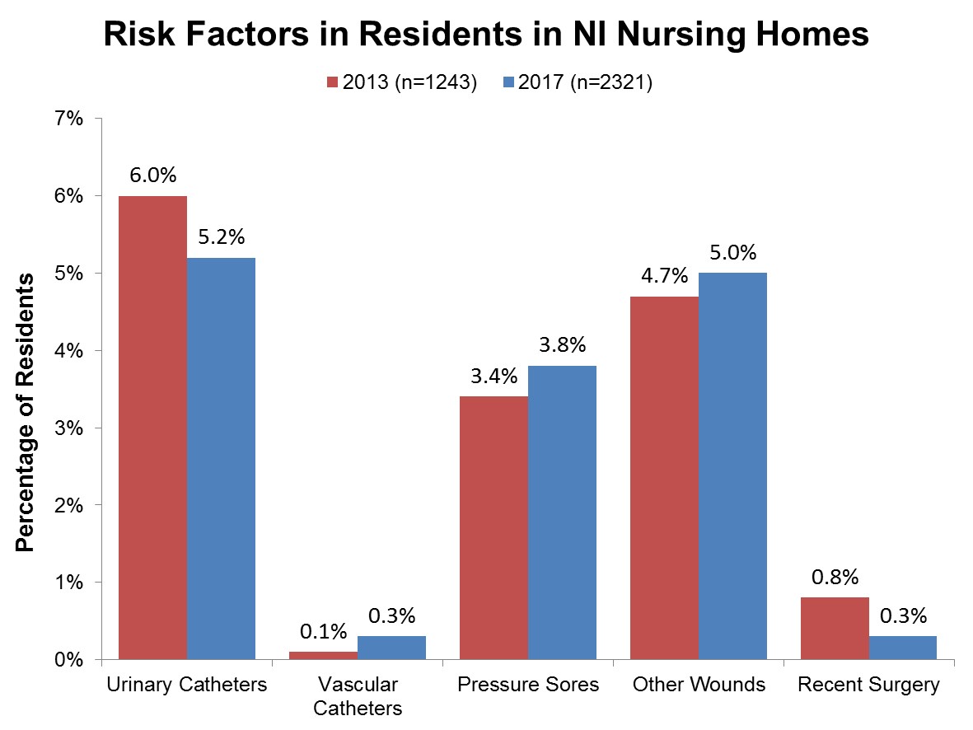
Notes:
Pressure sores showing an increase compared to 2013

Slide 8
HCAI in NI Nursing Homes
  2017
  HCAI prevalence of 3.3% (77 residents, 78 infections )
  HCAI prevalence ranged from 0% to 15.4%
  2013
  HCAI prevalence of 5.5% (68 patients, 75 infections)
  HCAI prevalence ranged from 0% to 25%
Notes:
Substantial decrease in HAI prevalence compared to the 2013 survey

Slide 9
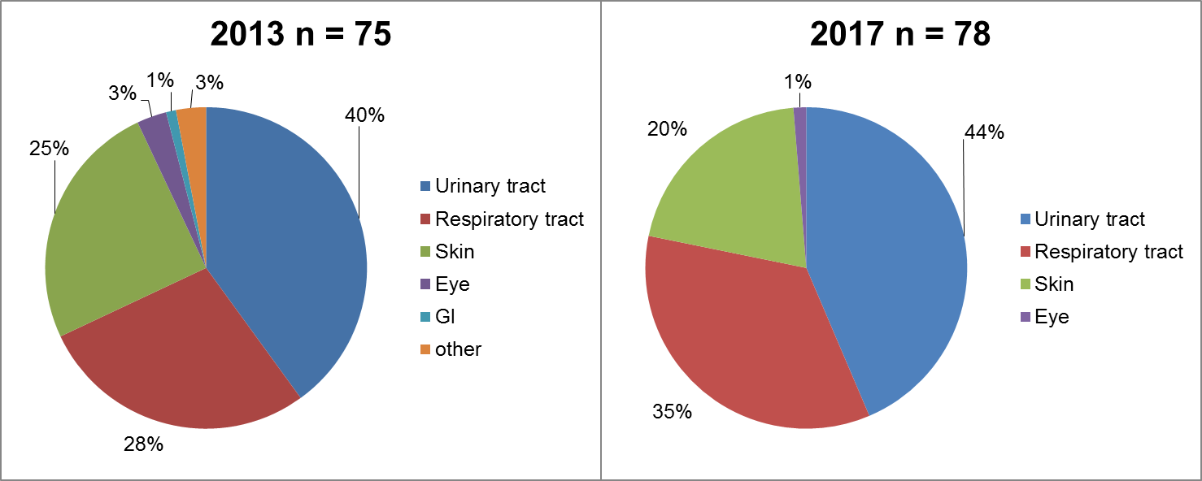
Distribution of HCAI in NI Nursing Home Residents
2017 (n = 2321) and 2013 (n = 1243)
Notes:
Same basic pattern as 2013, UTI, RTI, Skin/soft tissue

Slide 10
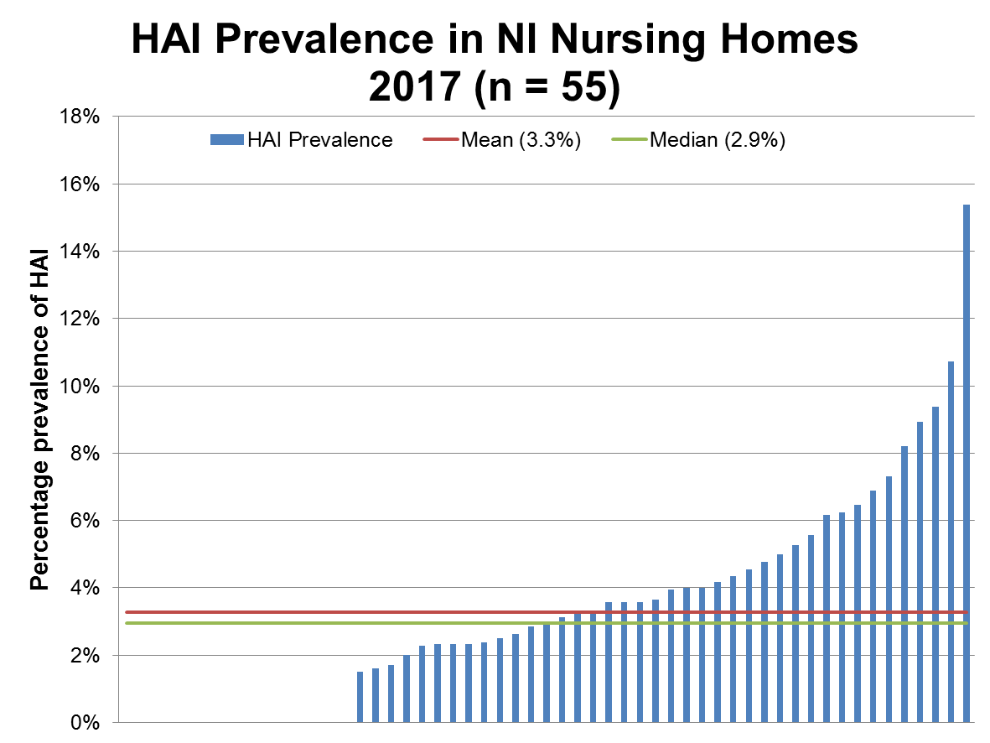
Notes:
Distribution shows how a small number of homes can have a disproportionate affect on the overall prevalence

Slide 11
Antimicrobial Prescribing in
NI Nursing Homes
10.5% prevalence of antimicrobial use
68% of antimicrobials prescribed for UTI
95% of antimicrobial prescribed by a general practitioner
Microbiology results not routinely passed to Nursing homes
Notes:
half of prescriptions (50.4%) were given as prophylaxis and 48.5% were prescribed for therapeutic reasons. Almost half of prescriptions (47.1%) were for uroprophylaxis.

Slide 12
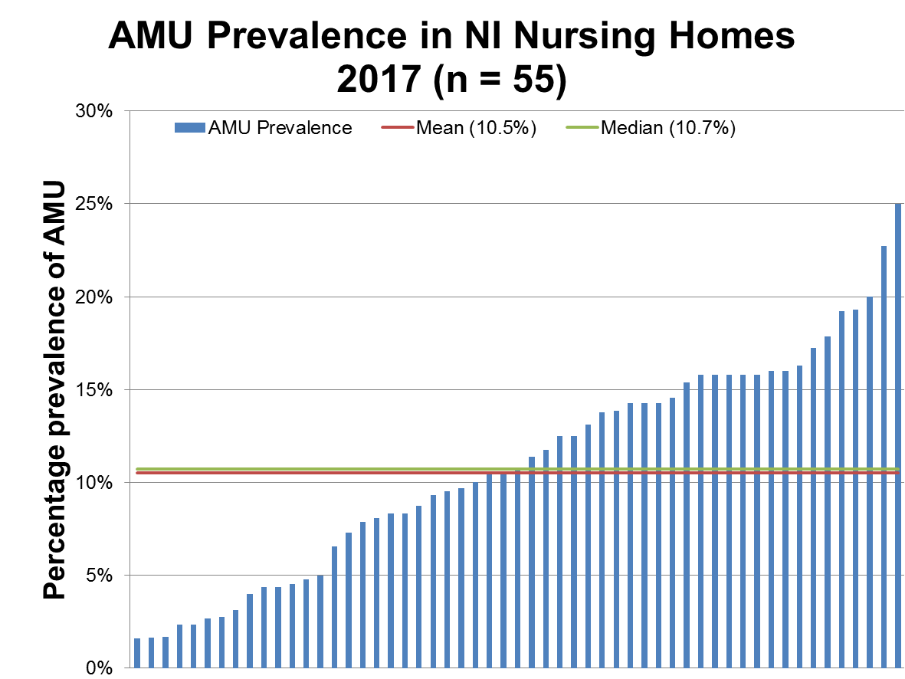

Slide 13
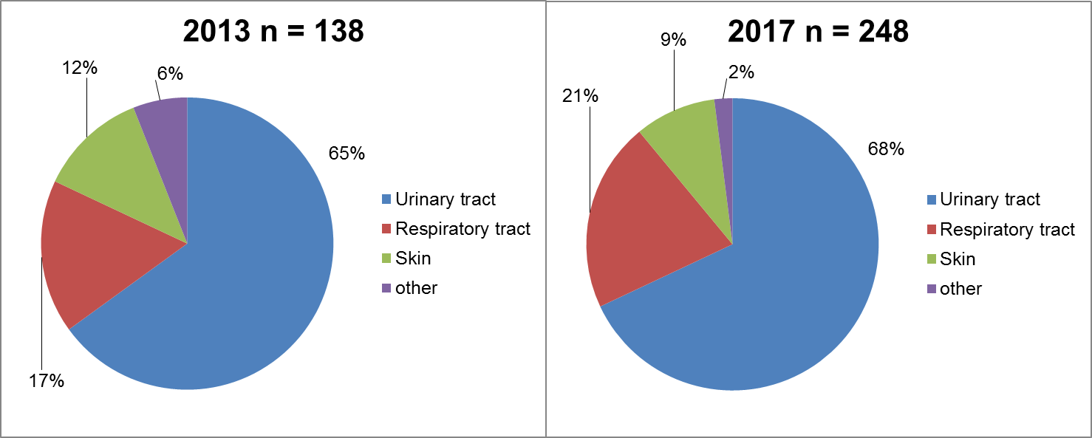
Distribution of AMU in NI Nursing Home Residents
2017 (n = 2321) and 2013 (n = 1243)

Slide 14
Prophylaxis Prescribing in
NI Nursing Homes
    5.1% of all residents were on uroprophylaxis and 2.2% received therapeutic treatment for UTI
68% of antimicrobials prescribed were for UTI (Tx and Px)
69% of antimicrobials prescribed for UTI were for prophylaxis
50.4% of all antimicrobials prescribed were for prophylaxis
    No prophylactic antimicrobials had an end / review date recorded, but all therapeutic antimicrobials had an end / review date recorded

Slide 15
Anti microbial
Site | Prophylactic | Therapeutic | Grand Total
TRIMETHOPRIM | 37 | 22 | 59
Urinary tract | 37 | 22 | 59
CEFALEXIN | 44 | 13 | 57
Urinary tract | 44 | 13 | 57
NITROFURANTOIN | 42 | 13 | 55
Urinary tract | 42 | 13 | 55
AMOXICILLIN / AMOXICILLINE | 1 | 29 | 30
Respiratory tract |  | 27 | 27
Urinary tract | 1 | 2 | 3
FLUCLOXACILLIN / FLUCLOXACILLINE | 1 | 18 | 19
Skin or wound | 1 | 18 | 19
DOXYCYCLINE | 1 | 11 | 12
Skin or wound |  | 4 | 4
Respiratory tract | 1 | 7 | 8
AUGMENTIN | 3 | 7 | 10
Respiratory tract |  | 5 | 5
Urinary tract | 3 | 2 | 5
CO AMOXI | 1 | 6 | 7
Skin or wound |  | 1 | 1
Respiratory tract |  | 3 | 3
Urinary tract | 1 | 2 | 3
CIPROFLOXACIN / CIPROFLOXACINE | 2 | 4 | 6
Skin or wound |  | 1 | 1
Urinary tract | 2 | 3 | 5
Notes:
63% TRIMETHOPRIM
77% CEFALEXIN
76% NITROFURANTOIN*
Nearly 5% CO AMOXI OR CIPROFLOXACIN

Slide 16
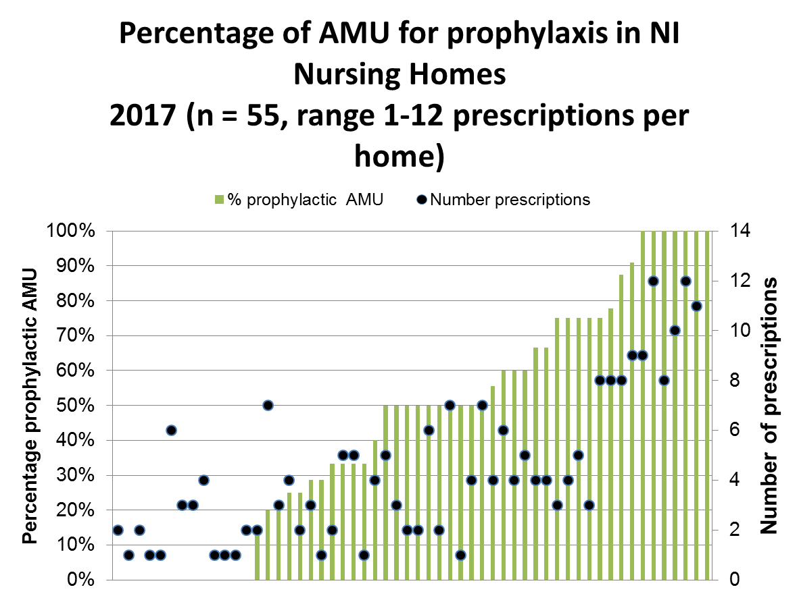

Slide 17
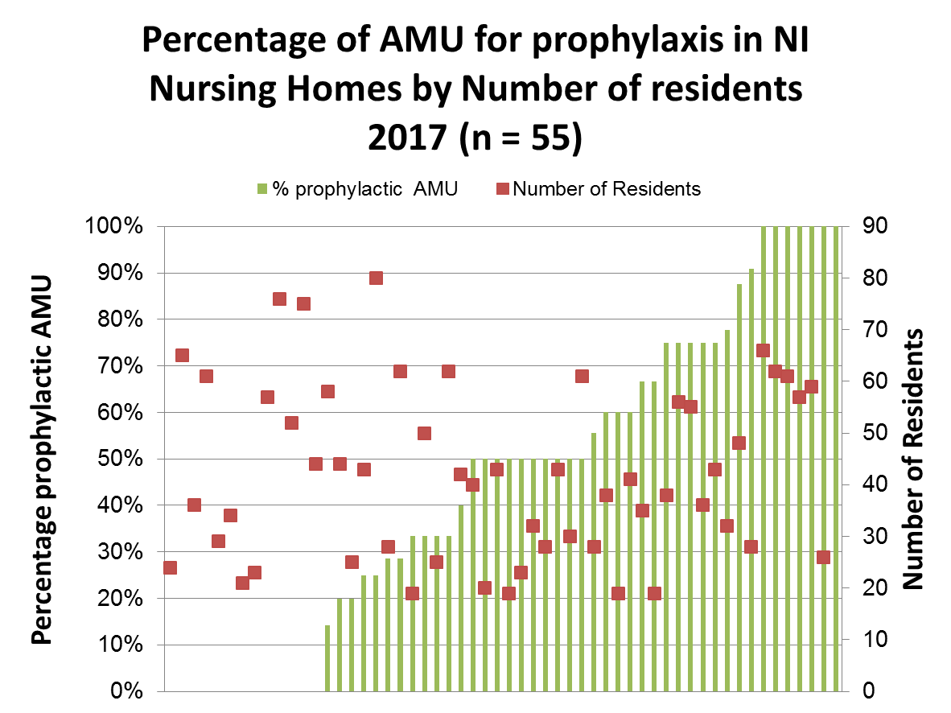

Slide 18
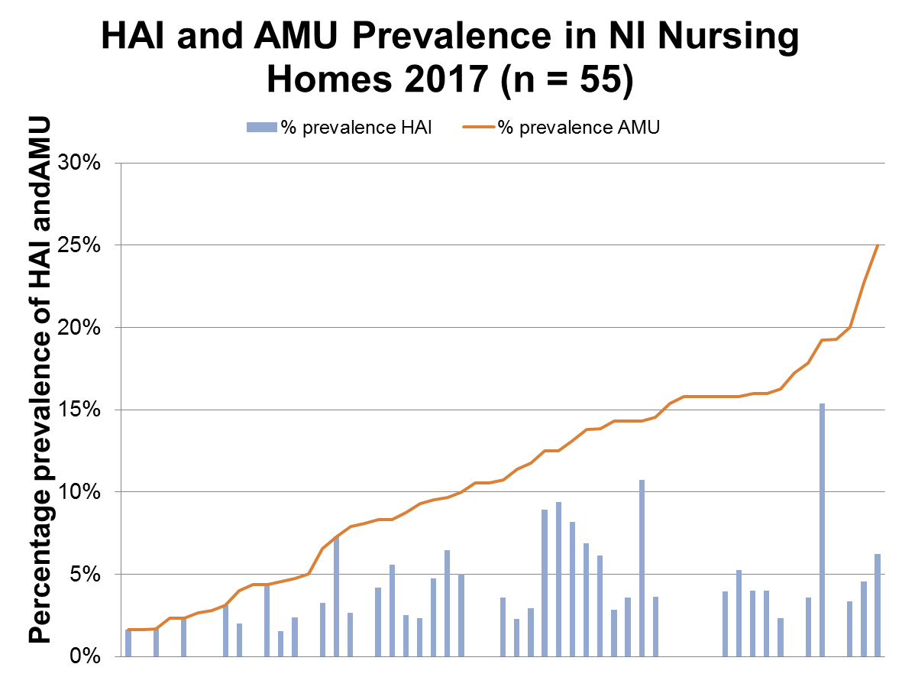

Slide 19
Infection Control
& Antimicrobial Stewardship
Resources
An institutional questionnaire sought information on medical care, infection control practice and antimicrobial policy.
Some of the questions were used to assess seven categories of performance indicators:
    Clinical governance
    Infection control (ICC) indicators
    Hand hygiene (HH) indicators
    Protocols for ICC
    Antimicrobial stewardship indicators
    Infection diagnosis/laboratory support
    Surveillance

Slide 20
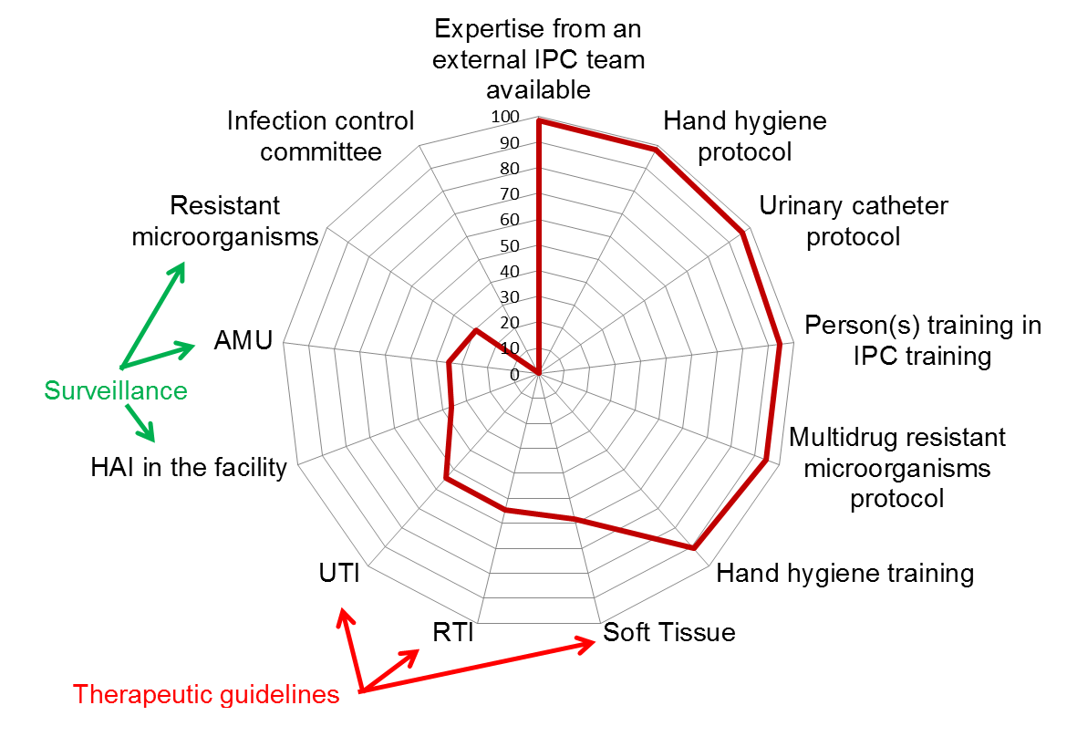
IPC and AMS Resources

Slide 21
Priorities
Explore opportunities for collaboration amongst all GP practices currently providing services to the same LTCF to strengthen and improve the links between LTCF and primary care, particularly with respect to IPC and AMS.
Continue to work with relevant teams to improve diagnosis of infection and prescribing within LTCFs through primary care.
Continue to raise awareness of the availability of formal IPC advice through PHA.
Continue to reduce the HCAI burden by addressing modifiable risk factors through the proper training and the practice of good IPC.

Slide 22
Priorities (cont)
Develop and Implement interventions to reduce the burden of RTIs.
Implement interventions to further reduce the burden of UTIs in LTCFs.
Promote development of pragmatic guidance and protocols on prevention and management of SSTI.
Further improve support and education within LTCFs around antimicrobial prescribing guidance and IP&C policy and guidelines for the prevention or reduction of infections.
Promote active review of residents on antimicrobial therapy in LTCFs.
Undertake five-yearly point prevalence surveys in LTCFs.

Slide 23
Thank You, and Any Questions?

