Slide 1
Reducing Gram-negative bacteraemias:
A Scottish Perspective
A-Lan Banks
Health Protection Scotland
March 2019

Slide 2
Acknowledgements
Gram-negative bacteraemia health protection programme:
Donald Bunyan, Epidemiologist and Programme Manager
Laura Imrie, Nurse Consultant, Infection Control
Stephanie Walsh, Data Manager
Elaine Glass, Data Manager
Controlling antimicrobial resistance in Scotland programme:
Julie Wilson, Epidemiologist and Programme Manager
William Malcolm, Pharmaceutical Advisor
Eleanor Anderson, Consultant in Health Protection
Chris Sullivan, Epidemiologist
Edward McArdle, Data Manager
Dominic Mellor, Veterinary Consultant

Slide 3
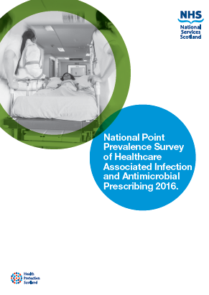
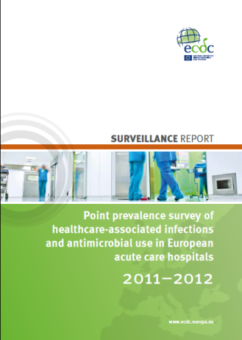
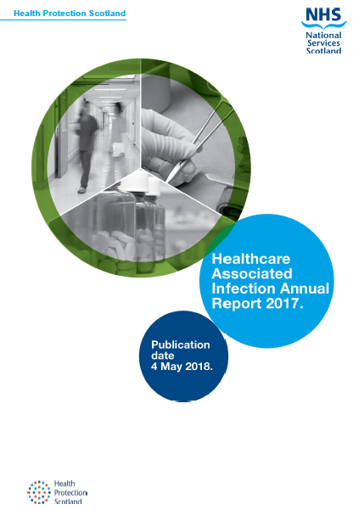
Importance of HCAIs
HCAIs are common:
  4.5% of hospitalised adult patients in Scotland have an HCAI
  (~55 500 HCAIs per year).
  4.5 million HCAIs in hospital patients in EU each year.
HCAIs lead to:
  increased morbidity and mortality.
  additional treatment/antibiotic use.
HCAIs are expensive:
  inpatient cost of HCAIs in Scotland ~£137 million a year.
  estimated economic burden €13-24 billion per year in Europe.
HCAIs are preventable:
  Estimated that 20% of HCAIs are preventable.¹
1. Harbath S et al. The preventable proportion of nococomial infections: an overview of published reports. J Hosp Infect 2003;54:258-66

Slide 4
Importance of HCAIs
HCAIs are common:
  4.5% of hospitalised adult patients in Scotland have an HCAI
  (~55 500 HCAIs per year).
  4.5 million HCAIs in hospital patients in EU each year.
HCAIs lead to:
  increased morbidity and mortality.
  additional treatment/antibiotic use.
HCAIs are expensive:
  inpatient cost of HCAIs in Scotland ~£137 million a year.
  estimated economic burden €13-24 billion per year in Europe.
HCAIs are preventable:
  Estimated that 20% of HCAIs are preventable.¹
1. Harbath S et al. The preventable proportion of nococomial infections: an overview of published reports. J Hosp Infect 2003;54:258-66

Slide 5
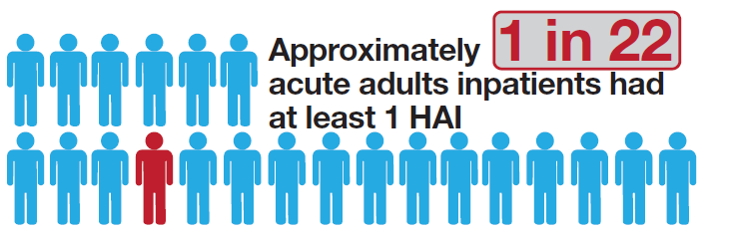
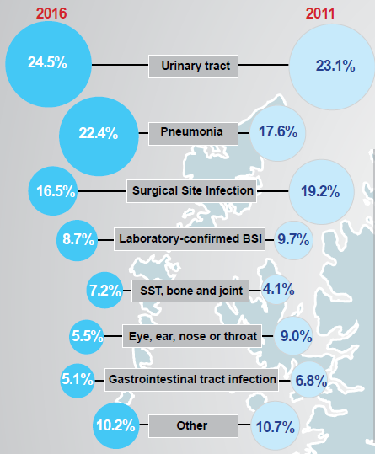
Main types and characteristics of HCAIs in Scotland
UTIs account for almost a quarter of all HCAIs in Scotland.
  Half were catheterised prior to onset.
  Use of SICPs and catheter associated UTI (CAUTI) bundles essential for prevention.
  Catheter passport to ensure appropriate management across care settings.
One fifth of HCAIs are due to pneumonia.
  A quarter associated with intubation (ventilator associated pneumonia (VAP) in ICU/HDU.
  Need for interventions to reduce risk in non-ventilated patients. Good oral care; prevention, early diagnosis, and treatment of aspiration and dysphagia.
One in six HCAIs in acute adults are SSIs.
Bloodstream infections (BSI).
  Quarter associated with use of a vascular catheter.
  Optimal insertion technique and use of evidence based bundles critical.
HPS. National Point Prevalence Survey of HCAI and Antimicrobial Infection 2016. https://www.hps.scot.nhs.uk/resourcedocument.aspx?id=5964

Slide 6
Main types and characteristics of HCAIs in Scotland
UTIs account for almost a quarter of all HCAIs in Scotland.
  Half were catheterised prior to onset.
  Use of SICPs and catheter associated UTI (CAUTI) bundles essential for prevention.
  Catheter passport to ensure appropriate management across care settings.
One fifth of HCAIs are due to pneumonia.
  A quarter associated with intubation (ventilator associated pneumonia (VAP) in ICU/HDU.
  Need for interventions to reduce risk in non-ventilated patients. Good oral care; prevention, early diagnosis, and treatment of aspiration and dysphagia.
One in six HCAIs in acute adults are SSIs.
Bloodstream infections (BSI).
  Quarter associated with use of a vascular catheter.
  Optimal insertion technique and use of evidence based bundles critical.
HPS. National Point Prevalence Survey of HCAI and Antimicrobial Infection 2016. https://www.hps.scot.nhs.uk/resourcedocument.aspx?id=5964

Slide 7
Main types and characteristics of HCAIs in Scotland
UTIs account for almost a quarter of all HCAIs in Scotland.
  Half were catheterised prior to onset.
  Use of SICPs and catheter associated UTI (CAUTI) bundles essential for prevention.
  Catheter passport to ensure appropriate management across care settings.
One fifth of HCAIs are due to pneumonia.
  A quarter associated with intubation (ventilator associated pneumonia (VAP) in ICU/HDU.
  Need for interventions to reduce risk in non-ventilated patients. Good oral care; prevention, early diagnosis, and treatment of aspiration and dysphagia.
One in six HCAIs in acute adults are SSIs.
Bloodstream infections (BSI).
  Quarter associated with use of a vascular catheter.
  Optimal insertion technique and use of evidence based bundles critical.
HPS. National Point Prevalence Survey of HCAI and Antimicrobial Infection 2016. https://www.hps.scot.nhs.uk/resourcedocument.aspx?id=5964

Slide 8
Main types and characteristics of HCAIs in Scotland
UTIs account for almost a quarter of all HCAIs in Scotland.
  Half were catheterised prior to onset.
  Use of SICPs and catheter associated UTI (CAUTI) bundles essential for prevention.
  Catheter passport to ensure appropriate management across care settings.
One fifth of HCAIs are due to pneumonia.
  A quarter associated with intubation (ventilator associated pneumonia (VAP) in ICU/HDU.
  Need for interventions to reduce risk in non-ventilated patients. Good oral care; prevention, early diagnosis, and treatment of aspiration and dysphagia.
One in six HCAIs in acute adults are SSIs.
Bloodstream infections (BSI).
  Quarter associated with use of a vascular catheter.
  Optimal insertion technique and use of evidence based bundles critical.
HPS. National Point Prevalence Survey of HCAI and Antimicrobial Infection 2016. https://www.hps.scot.nhs.uk/resourcedocument.aspx?id=5964

Slide 9
Main types and characteristics of HCAIs in Scotland
UTIs account for almost a quarter of all HCAIs in Scotland.
  Half were catheterised prior to onset.
  Use of SICPs and catheter associated UTI (CAUTI) bundles essential for prevention.
  Catheter passport to ensure appropriate management across care settings.
One fifth of HCAIs are due to pneumonia.
  A quarter associated with intubation (ventilator associated pneumonia (VAP) in ICU/HDU.
  Need for interventions to reduce risk in non-ventilated patients. Good oral care; prevention, early diagnosis, and treatment of aspiration and dysphagia.
One in six HCAIs in acute adults are SSIs.
Bloodstream infections (BSI).
  Quarter associated with use of a vascular catheter.
  Optimal insertion technique and use of evidence based bundles critical.
HPS. National Point Prevalence Survey of HCAI and Antimicrobial Infection 2016. https://www.hps.scot.nhs.uk/resourcedocument.aspx?id=5964

Slide 10
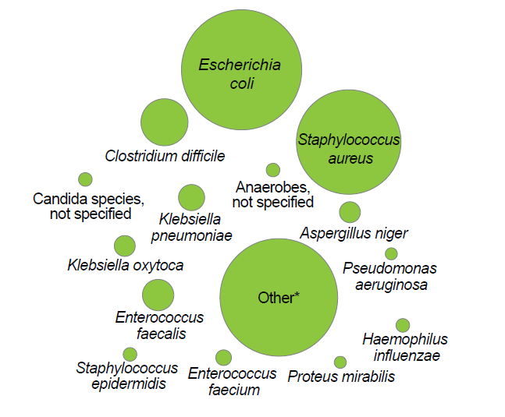
Causative organisms of HCAIs
E. coli (22.7%) was the most commonly reported organism (higher than S. aureus (20.2%)) in acute adult patients.
  Linked to the threat of antimicrobial resistance (AMR).
  Year on year increase in recent years.
HPS. National Point Prevalence Survey of HCAI and Antimicrobial Infection 2016. https://www.hps.scot.nhs.uk/resourcedocument.aspx?id=5964

Slide 11
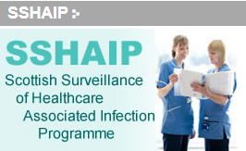
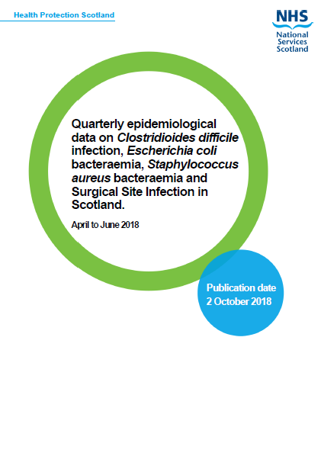
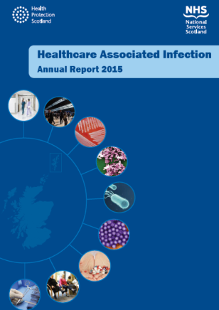
Main national HCAI surveillance systems
C. difficile infection (CDI).
E. coli and other Gram-negative bacteria (bacteraemia surveillance).
Surgical site infection (SSI).
S. aureus bacteraemias (MRSA and MSSA).
https://www.hps.scot.nhs.uk/haiic/sshaip/index.aspx

Slide 12
Gram-negative bacteraemia
Data on Gram-negative bacteraemia has been collected since 2007.
Mandatory surveillance of E. coli bacteraemia data (quarterly and annually) in Scotland since 2016.
Quarterly reporting for other Gram-negative bacteraemias (e.g., Klebsiella spp. and P. aeruginosa) to commence in 2019.
https://www.hps.scot.nhs.uk/haiic/sshaip/index.aspx

Slide 13
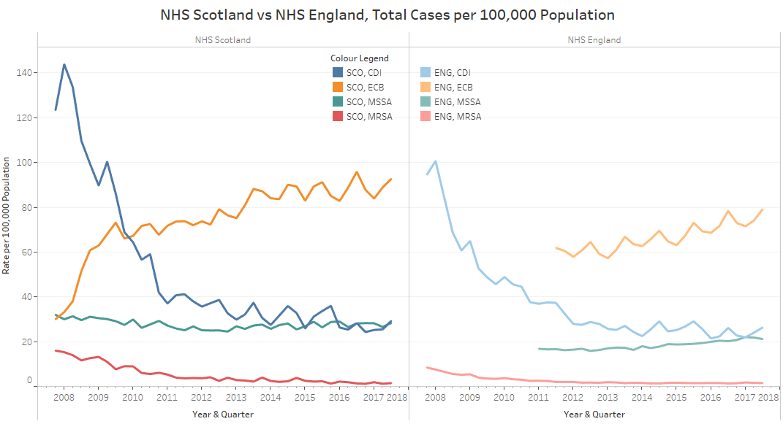
Quarterly incidence rates for ECB, CDI, MSSA and MRSA in Scotland (per 100,000 population)

Slide 15
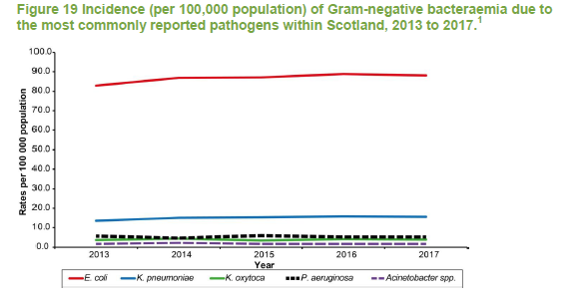
Gram-negative bacteraemia
Gram-negative bacteria are an important cause of serious infections in healthcare and community settings.
The most recent PPS showed that two-fifths of all reports of infection in adult patients in acute healthcare settings (40.4%) and almost all patients in non-acute healthcare settings (94.4%) were caused by Gram-negative bacilli.
E. coli was the most common cause of Gram-negative bacteraemia in Scotland in 2017 followed by K. pneumoniae and P. aeruginosa.
HPS. HCAI Annual Report 2017. https://www.hps.scot.nhs.uk/resourcedocument.aspx?resourceid=3475

Slide 16
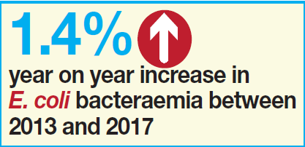
Gram-negative bacteraemia
Gram-negative bacteria are an important cause of serious infections in healthcare and community settings.
The most recent PPS showed that two-fifths of all reports of infection in adult patients in acute healthcare settings (40.4%) and almost all patients in non-acute healthcare settings (94.4%) were caused by Gram-negative bacilli.
E. coli was the most common cause of Gram-negative bacteraemia in Scotland in 2017 followed by K. pneumoniae and P. aeruginosa.
HPS. HCAI Annual Report 2017. https://www.hps.scot.nhs.uk/resourcedocument.aspx?resourceid=3475

Slide 17
Gram-negative bacteraemia
Gram-negative bacteria are an important cause of serious infections in healthcare and community settings.
The most recent PPS showed that two-fifths of all reports of infection in adult patients in acute healthcare settings (40.4%) and almost all patients in non-acute healthcare settings (94.4%) were caused by Gram-negative bacilli.
E. coli was the most common cause of Gram-negative bacteraemia in Scotland in 2017 followed by K. pneumoniae and P. aeruginosa.
HPS. HCAI Annual Report 2017. https://www.hps.scot.nhs.uk/resourcedocument.aspx?resourceid=3475

Slide 18
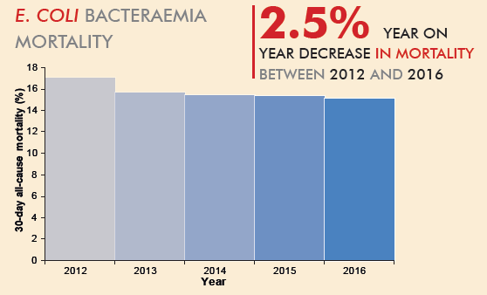
Gram-negative bacteraemia
In 2016, the 30-day all-cause mortality for E. coli bacteraemia (ECB) was 15.2%.
ECB case data reported by HPS between 2012 and 2016 demonstrated a 2.5% decrease in the proportion of people dying within 30 days of acquiring an ECB (p=0.02)
HPS. HCAI Annual Report 2017. https://www.hps.scot.nhs.uk/resourcedocument.aspx?resourceid=3475

Slide 19
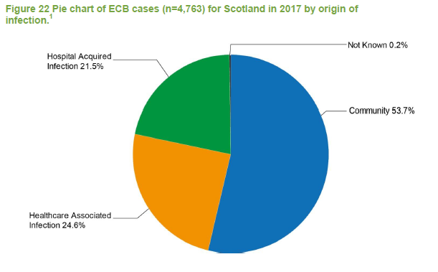
Gram-negative bacteraemia
Enhanced surveillance for E. coli bacteraemia (ECB) became mandatory in 2016.
Detailed clinical information obtained through local case reviews.
Helps identify where the bacteraemia occurred as well as primary infection and/or healthcare procedures that are though to have contributed to the development of bacteraemia.
Around 40% of ECB are HCAI, with the majority occurring in the community.
HPS. HCAI Annual Report 2017. https://www.hps.scot.nhs.uk/resourcedocument.aspx?resourceid=3475

Slide 20
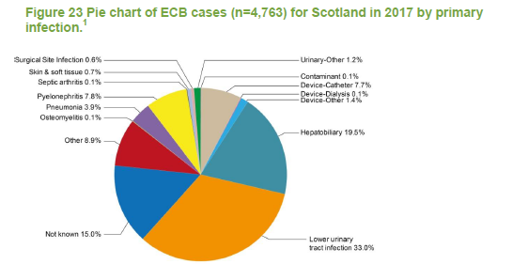
Gram-negative bacteraemia
A third of reported ECB had a lower UTI as their primary infection that may have led to the bacteraemia.
Other common primary infections: hepatobilliary, pyelonephritis, and urinary catheters
HPS. HCAI Annual Report 2017. https://www.hps.scot.nhs.uk/resourcedocument.aspx?resourceid=3475

Slide 21

Enhanced surveillance dashboard now launched on NSS Discovery.
NSS Discovery is an information system that provides users with access to a range of comparative healthcare information to support performance and quality improvement in health boards across Scotland.
NHS boards can identify and investigate exceedances, and focus on particular sources, devices and procedures.

Slide 22
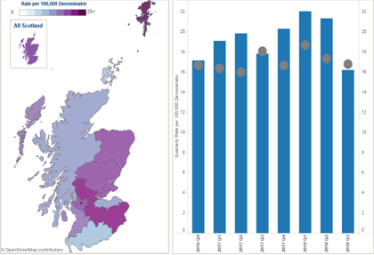
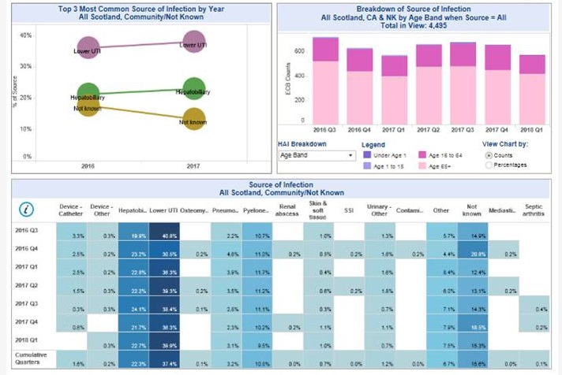

Slide 24
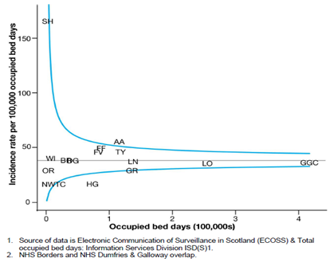

Slide 26
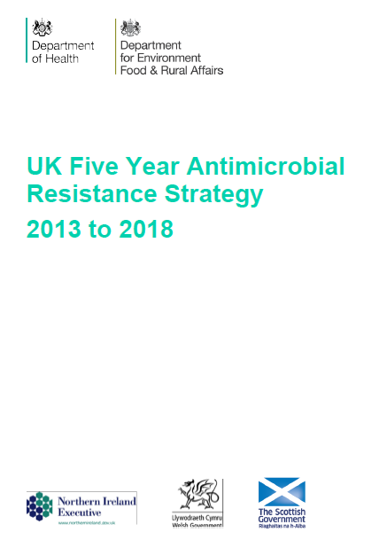
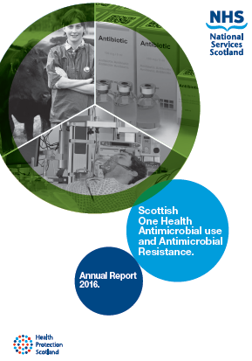
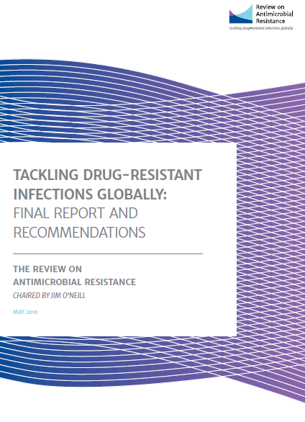
Antimicrobial resistance
Antimicrobial resistance (AMR) has become a global problem as a result of:
  multi-drug resistant infections (especially among Gram-negative bacteria) which are difficult, or in some cases, impossible to treat;
  higher rates of infection, providing a greater opportunity for spread;
  higher healthcare costs (expensive treatments, longer hospital stays); and
  increased risk associated with major surgery, transplants, and chemotherapy.
If action is not taken, an estimated 10 million deaths each year by 2050, at a cost of $100 trillion.
AMR is “everyone’s business”.

Slide 27
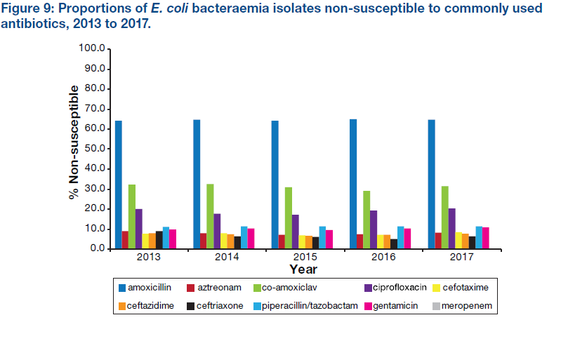
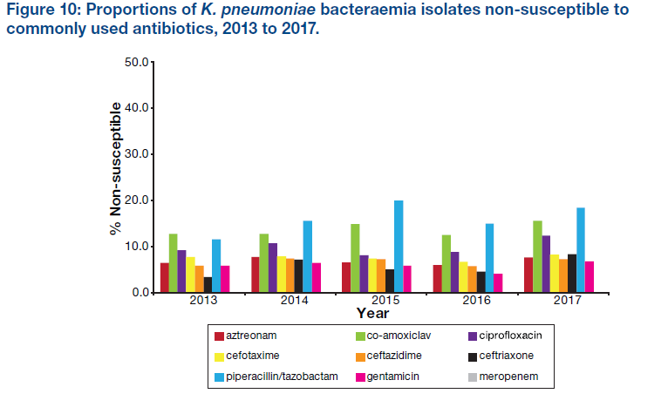
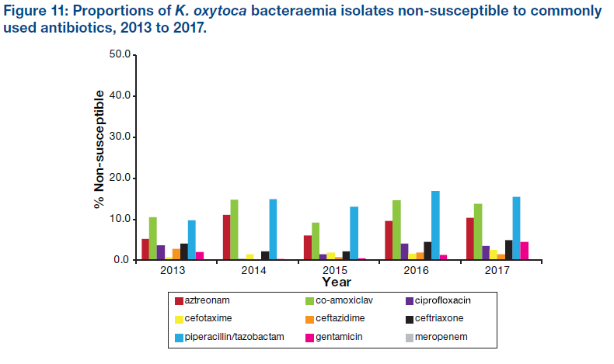
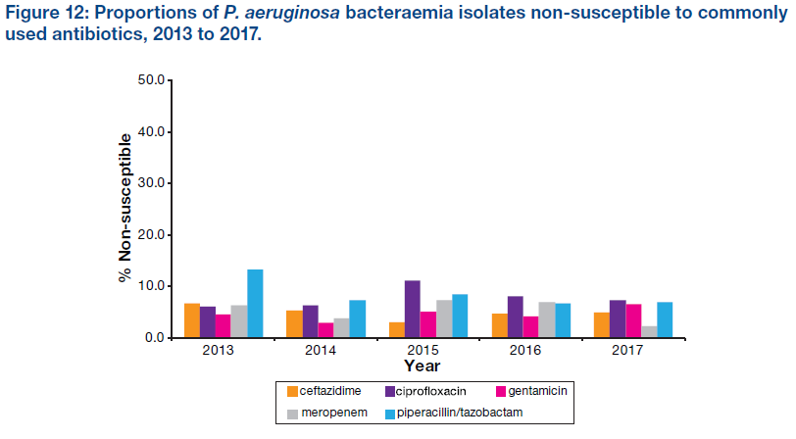
Antimicrobial resistance in Gram-negative bacteria
In many settings, the morbidity and mortality attributable to resistant Gram-negative infections is higher than that associated with Gram-positive infections.
In the UK, the biggest drivers of resistance are a rise in the incidence of infections, particularly Gram-negatives.
HPS. Scottish One Health AMU and AMR Annual Report 2017. https://www.hps.scot.nhs.uk/pubs/detail.aspx?id=3604

Slide 28
Antimicrobial resistance in Gram-negative bacteria
HPS. Scottish One Health AMU and AMR Annual Report 2017. https://www.hps.scot.nhs.uk/pubs/detail.aspx?id=3604

Slide 29
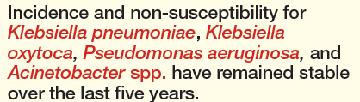
Antimicrobial resistance in Gram-negative bacteria
HPS. Scottish One Health AMU and AMR Annual Report 2017. https://www.hps.scot.nhs.uk/pubs/detail.aspx?id=3604

Slide 30
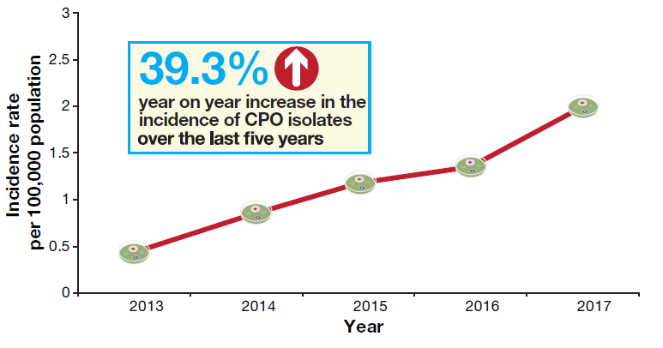
Carbapenemase-producing organisms (CPO)
Carbapenems are very broad-spectrum antibiotics which are used almost exclusively in the hospital setting for the treatment of suspected or confirmed multi-drug resistant Gram-negative infections.
The emergence of CPOs is of particular concern as enzymes produced by these organisms can inactivate carbapenem antibiotics, leaving few therapeutic options for treatment of CPO infections.
CPOs have been reported worldwide in healthcare and community settings, with increased global travel, particularly exposure to healthcare abroad, contributing to their spread.
HPS. Scottish One Health AMU and AMR Annual Report 2017. https://www.hps.scot.nhs.uk/pubs/detail.aspx?id=3604

Slide 31
Carbapenemase-producing organisms (CPO)
Of the CPOs identified in 2017, 93.5% were carbapenemase producing Enterobacteriaceae (CPE).
HPS. Scottish One Health AMU and AMR Annual Report 2017. https://www.hps.scot.nhs.uk/pubs/detail.aspx?id=3604

Slide 32
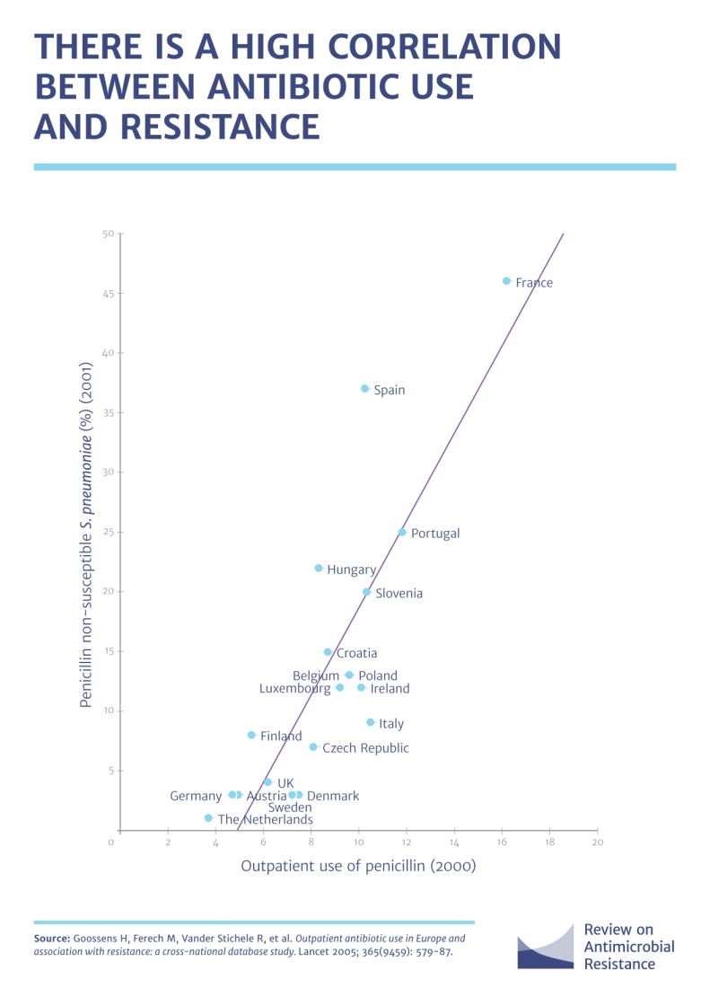
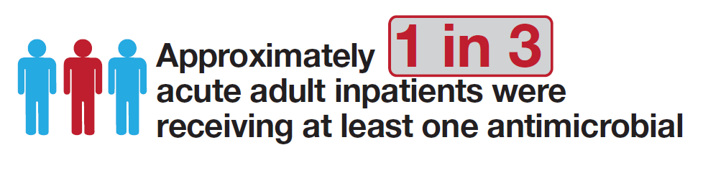
The main driver for the development of resistance is exposure to antibiotics.
Unnecessary and inappropriate use of antibiotics increases the development of resistance.
A ‘One Health’ approach is required to tackle AMR and its drivers across all settings (humans, animals and the environment).
O’Neill J. 2016 Review on Antimicrobial Resistance. https://amr-review.org/
HPS. National Point Prevalence Survey of HCAI and Antimicrobial Infection 2016. https://www.hps.scot.nhs.uk/resourcedocument.aspx?id=5964

Slide 33
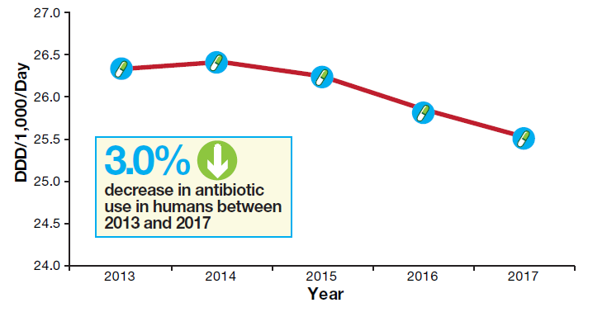
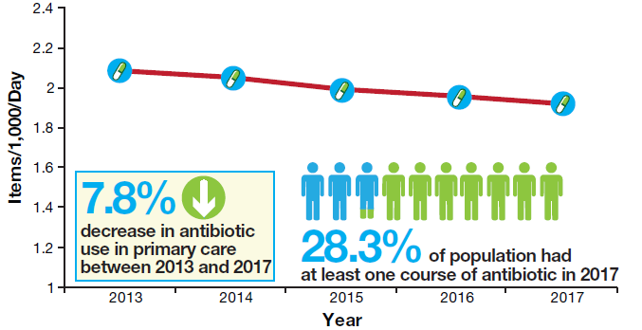
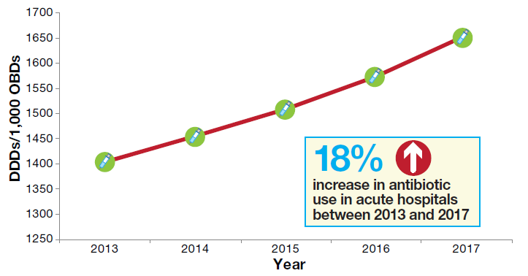
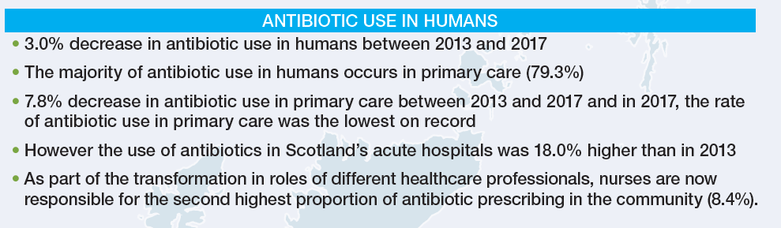
Antibiotic use in Scotland
HPS. Scottish One Health AMU and AMR Annual Report 2017. https://www.hps.scot.nhs.uk/pubs/detail.aspx?id=3604

Slide 34
Antibiotic use in Scotland
HPS. Scottish One Health AMU and AMR Annual Report 2017. https://www.hps.scot.nhs.uk/pubs/detail.aspx?id=3604

Slide 35
Antibiotic use in Scotland
HPS. Scottish One Health AMU and AMR Annual Report 2017. https://www.hps.scot.nhs.uk/pubs/detail.aspx?id=3604

Slide 36
Antibiotic use in Scotland
HPS. Scottish One Health AMU and AMR Annual Report 2017. https://www.hps.scot.nhs.uk/pubs/detail.aspx?id=3604

Slide 37
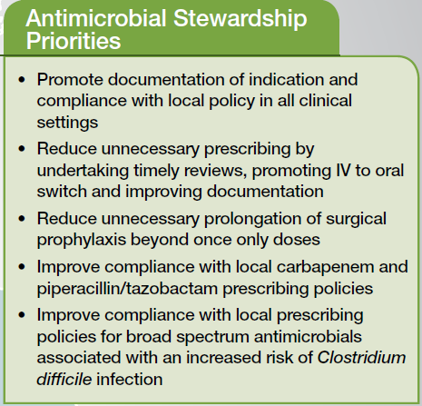
O’Neill J. 2016 Review on Antimicrobial Resistance. https://amr-review.org/
HPS. National Point Prevalence Survey of HCAI and Antimicrobial Infection 2016. https://www.hps.scot.nhs.uk/resourcedocument.aspx?id=5964

Slide 38
O’Neill J. 2016 Review on Antimicrobial Resistance. https://amr-review.org/
HPS. National Point Prevalence Survey of HCAI and Antimicrobial Infection 2016. https://www.hps.scot.nhs.uk/resourcedocument.aspx?id=5964

Slide 39
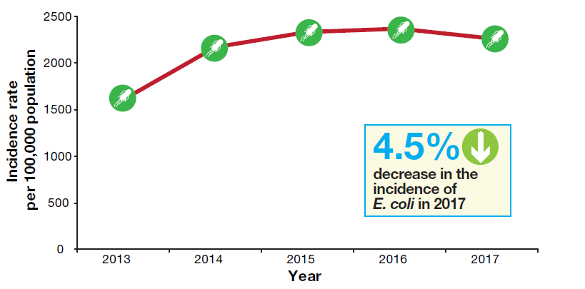
Urinary tract infections
An important aspect of reducing the incidence of Gram-negative bacteraemia is the prevention and management of primary infections, including urinary tract infections (UTIs).
The majority of UTIs in Scotland are caused by E. coli.
The annual incidence of E. coli urinary isolates in 2017 was 2,259 per 100,000 population, a 4.5% decrease on the previous year (p<0.001).
HPS. Scottish One Health AMU and AMR Annual Report 2017. https://www.hps.scot.nhs.uk/pubs/detail.aspx?id=3604

Slide 40
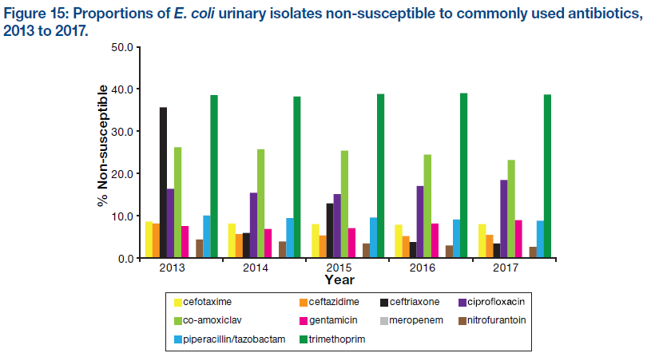
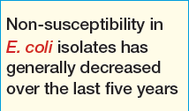
HPS. Scottish One Health AMU and AMR Annual Report 2017. https://www.hps.scot.nhs.uk/pubs/detail.aspx?id=3604

Slide 41
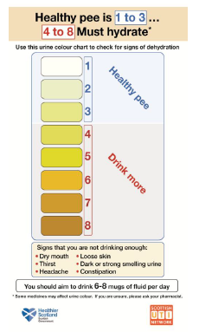


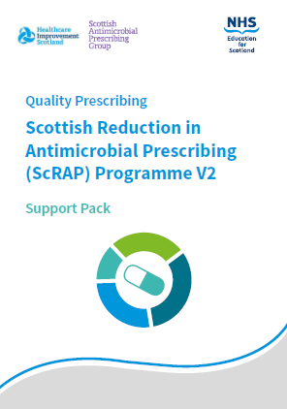
Urinary tract infections
Partnership with the Scottish UTI Network (SUTIN) and Scottish Antimicrobial Prescribing Group (SAPG) to improve prevention and management of UTIs.
https://www.hps.scot.nhs.uk/haiic/sutin.aspx

Slide 42
Urinary tract infections
Hydration campaign launched to convey to the public health benefits of good hydration in terms of UTI prevention.
Includes stakeholders such as NES, Care Inspectorate, Scottish Care, NHS24, SAPG and the Scottish Government.
Posters, leaflets and record charts tailored for the acute setting, care at home and care home setting.
https://www.hps.scot.nhs.uk/haiic/sutin.aspx

Slide 43
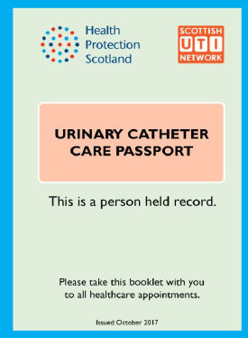
Urinary tract infections
National catheter passport to facilitate the provision of seamless care for people with urinary catheters as they move through the various healthcare settings.
Encourages self-management of the catheter in a way which will reduce the risk of complications such as CAUTI.
The booklet provides essential information regarding:
  Reason for catheter insertion
  Catheter care: hand hygiene, care of leg bag
  Troubleshooting information
  Expected removal date/trial without catheter
  Clinical care details, including catheter maintenance
https://www.hps.scot.nhs.uk/haiic/sutin.aspx

Slide 44


Urinary tract infections
Scottish Reduction of Antibiotic Prescribing (ScRAP) Programme provides educational materials to support facilitated quality improvement sessions for primary care prescribers to further reduce unnecessary use of antibiotics for respiratory tract infections (RTI) and to optimise management of UTIs.
ScRAP supports a key area of the Strategy: ‘Improving professional education, training and public engagement to improve clinical practice and promote wider understanding of the need for more sustainable use of antibiotics’.
https://www.nes.scot.nhs.uk/media/4081795/scrap_support_pack_-_feb_2018.pdf

Slide 45
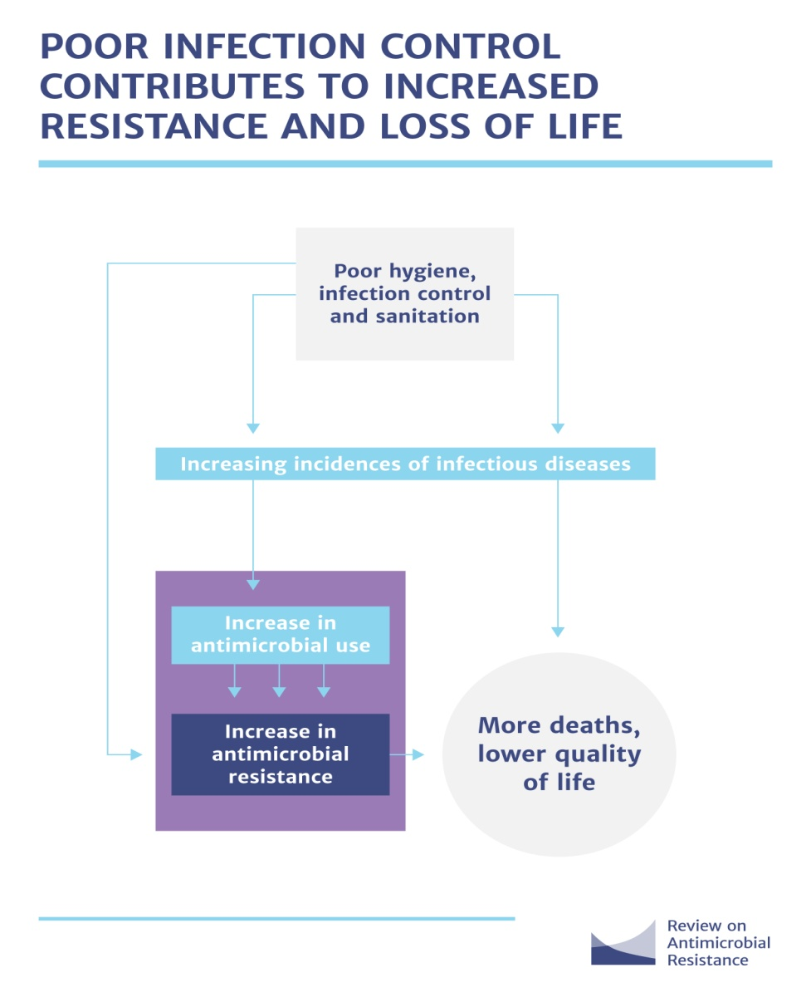
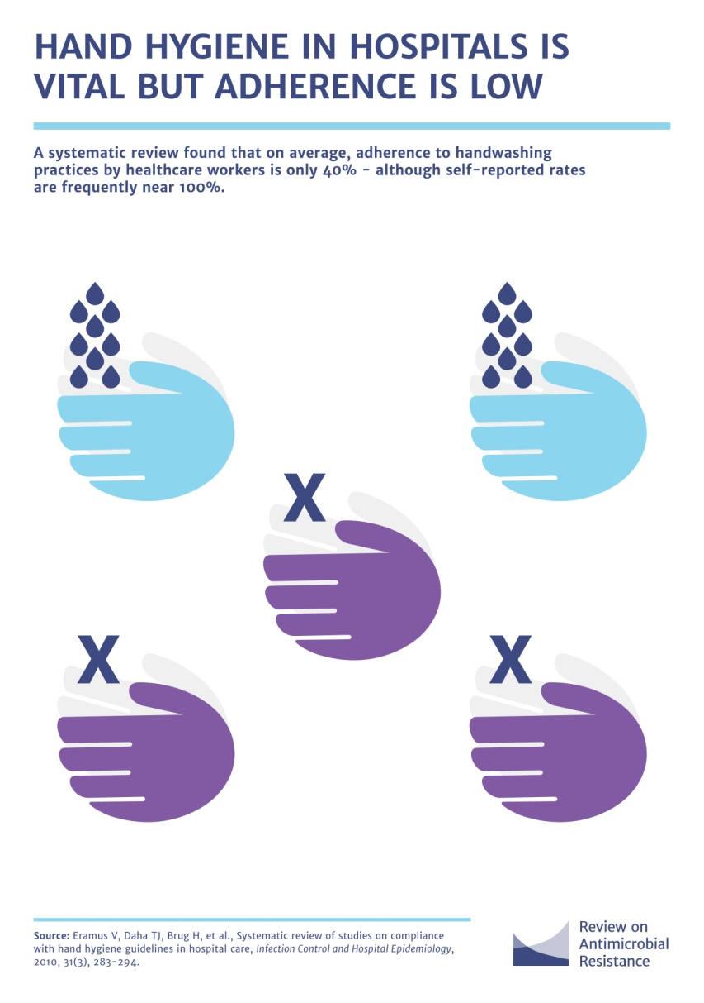
O’Neill J. 2016 Review on Antimicrobial Resistance. https://amr-review.org/

Slide 46
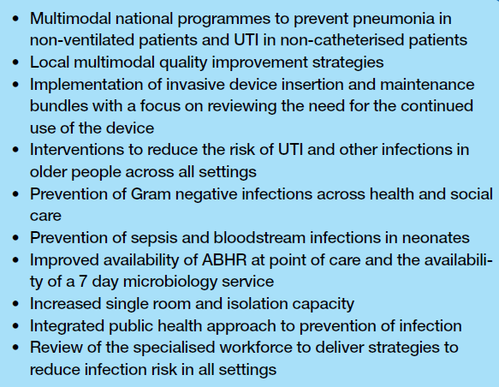
Infection Prevention and Control Priorities
“Multimodal is described as a cultural approach to IPC taking account of local context and conditions, surveillance, training/education, bundles and guidance developed and owned by local interdisciplinary teams.”
HPS, PPS 2016.
HPS. National Point Prevalence Survey of HCAI and Antimicrobial Infection 2016. https://www.hps.scot.nhs.uk/resourcedocument.aspx?id=5964

Slide 47


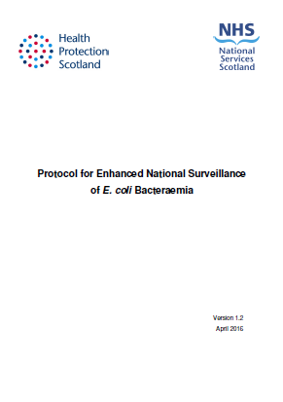


Quality improvement measures to reduce Gram-negative bacteraemias

Slide 48


A Scotland where we live in vibrant, healthy and safe places and communities;
A Scotland where we flourish in our early years;
A Scotland where we have good mental wellbeing;
A Scotland where we reduce the use of and harm from alcohol, tobacco and other drugs;
A Scotland where we have a sustainable, inclusive economy with equality of outcomes for all; and
A Scotland where we eat well, have a healthy weight and are physically active.
The priorities are not a statement of all that needs to be done to contribute to health in Scotland

Slide 49






Public health reform principles

Slide 50
Summary
Gram-negative bacteraemia and associated AMR represents a considerable threat to patient safety in Scotland and globally.
Prevention and control of infections as well as antimicrobial stewardship are key to contain the spread of Gram-negative bacteria and resistant organisms.
A multimodal approach is required.
It is important to manage and prevent infection risk in all areas of care delivery, especially with the integration of health and social care services. A public health system-wide approach is needed to reduce the need for hospitalisation for infections and reduce prescribing.
A robust and current evidence base that is specific to Scottish healthcare settings is necessary to inform the development of local and national strategies to reduce Gram-negative bacteraemias and contain AMR.

Slide 51

Thank You

