Slide 1




HUMAN ANTIMICROBIAL STEWARDSHIP:
PRESERVING CURRENT AND FUTURE ANTIMICROBIALS ni hcai & amr symposium
BELFAST
2018
Dilip Nathwani

Slide 2
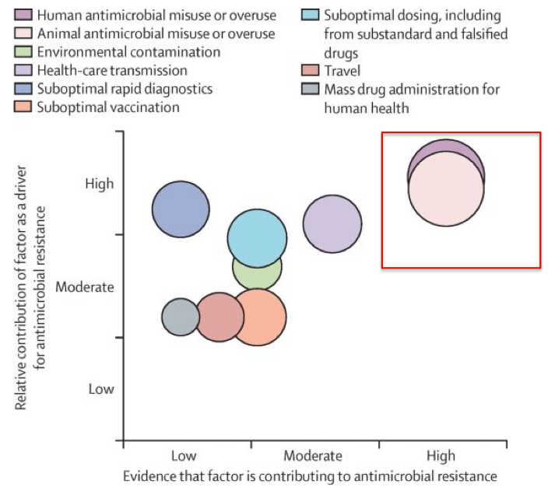



Why are we targeting antimicrobial prescribing ?
“Antimicrobial use is the key driver of resistance. This selective pressure comes from a combination of overuse… and also from misuse”
-WHO Global Strategy for Containment of AMR 2000
Human Stewardship

Slide 3
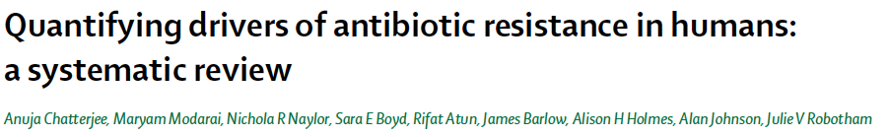
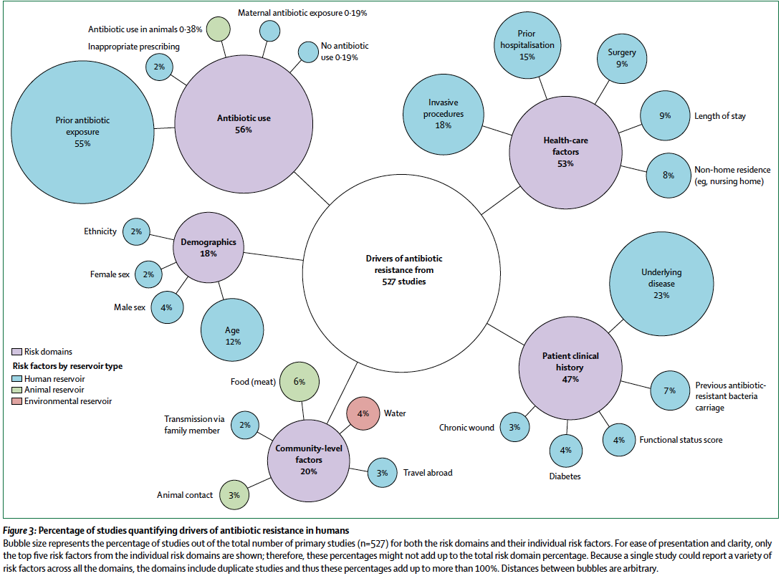
OR 2-4

Slide 4
ANTIMICROBIAL STEWARDSHIP
The term ‘antimicrobial stewardship’ is defined as ‘an organisational or healthcare-system-wide approach to promoting and monitoring judicious use of antimicrobials to preserve their future effectiveness’.
Antimicrobial stewardship has been defined as “the optimal selection, dosage, and duration of antimicrobial treatment that results in the best clinical outcome for the treatment or prevention of infection, with minimal toxicity to the patient and minimal impact on subsequent resistance.”

Slide 5


A Sense of Perspective
WHERE USED
TYPES OF USE
Questionable use
20%
20-50%
hospital
50%
80%
unnecessary
Community
AMS
~ 80% IN HOSPITALS
20% IN COMMUNITY
HUMAN
EU SURVEY
50%
20%
40-80%
therapeutic
80%
Highly
questionable
ANIMAL
Prophylaxis/
growth
promotion
Wise et al. BMJ 1999; 317: 609-610

Slide 6
EVIDENCE FOR ams EFFECTIVENESS

Slide 7
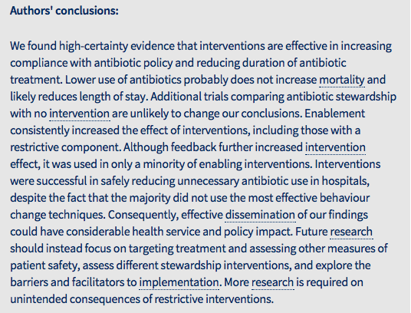

INTERVENTIONS TO IMPROVE ANTIBIOTIC PRESCRIBING PRACTICES FOR HOSPITAL INPATIENTS
Less antibiotics
No increase in
mortality
Reduced LOS

Slide 8
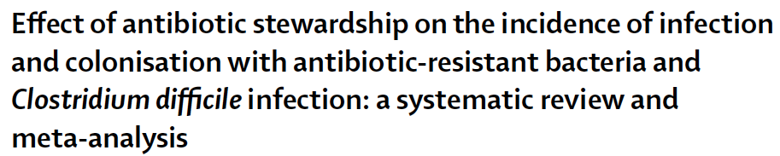
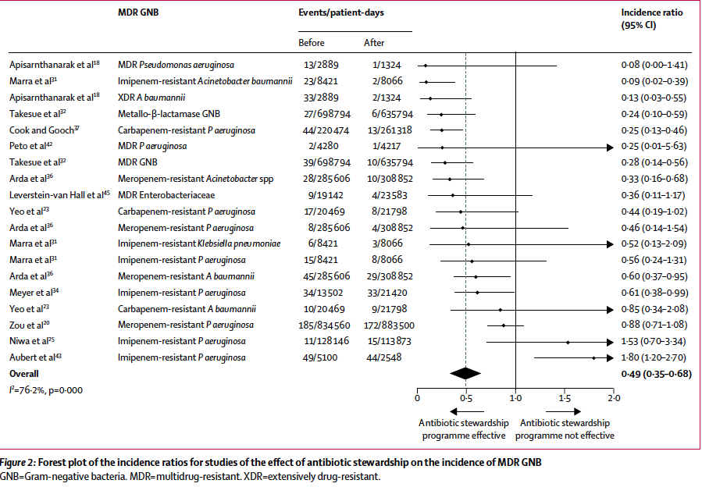
What about impact on resistance & C.difficile?
Positive impact on MDR-GNB infections

Slide 9
SYSTEMATIC REVIEW AND META-ANALYSIS:
IMPACT OF KEY TECHNICAL INTERVENTIONS
Adherence to local guidelines
  Mortality: RRR 35% [RR 0.65, 95% CI 0.54–0.8; P<0.0001]
Culture driven de-escalation
  Mortality: RRR 65% [RR 0.44, 95% CI 0.3–0.66; P<0.0001]
S.aureus bacteraemia clinical review
  Mortality: RRR 66% [RR 0.34, 95% CI 0.25–075; P<0.008]
IVOST No difference in mortality? Reduced LOS
Restriction of antibiotics decreased consumption and in many studies resistance to the drug-bug profile
TDM decreased nephrotoxicity
CI, confidence interval; IVOST, intravenous to oral switch therapy; LOS, length of stay; RR, relative risk; RRR, relative risk reduction; TDM, therapeutic drug monitoring Schuts EC, et al. Lancet Infect Dis. 2016 Mar 2. pii: S1473-3099(16)00065-7.

Slide 10
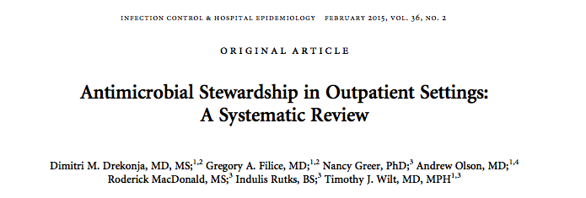
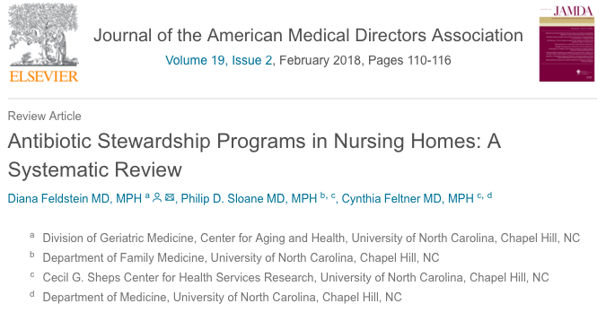
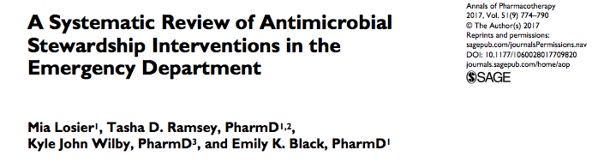
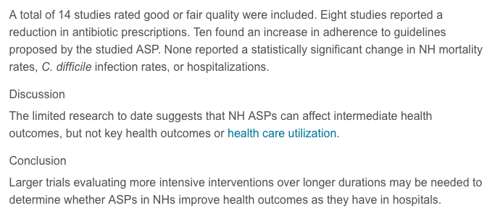
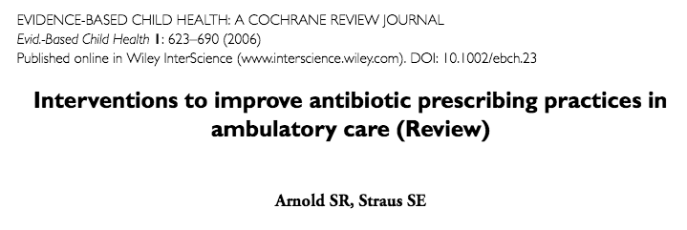
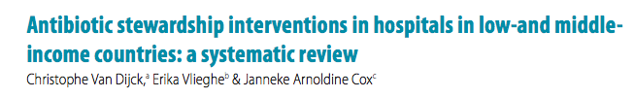
Growing evidence
from all sectors

Slide 11
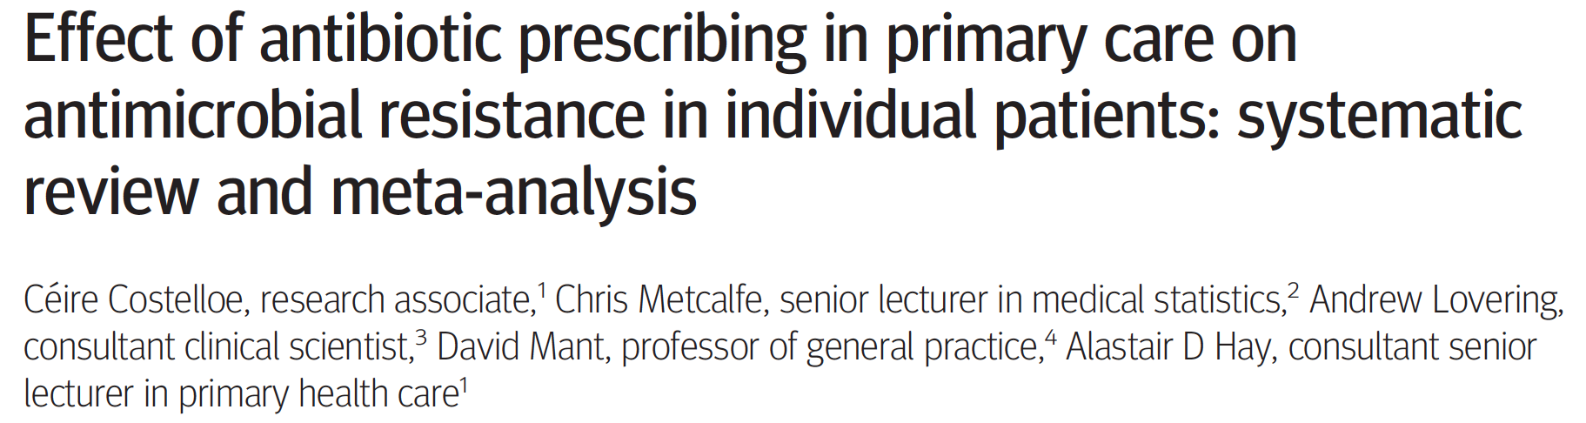

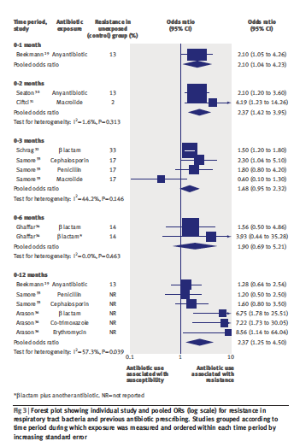
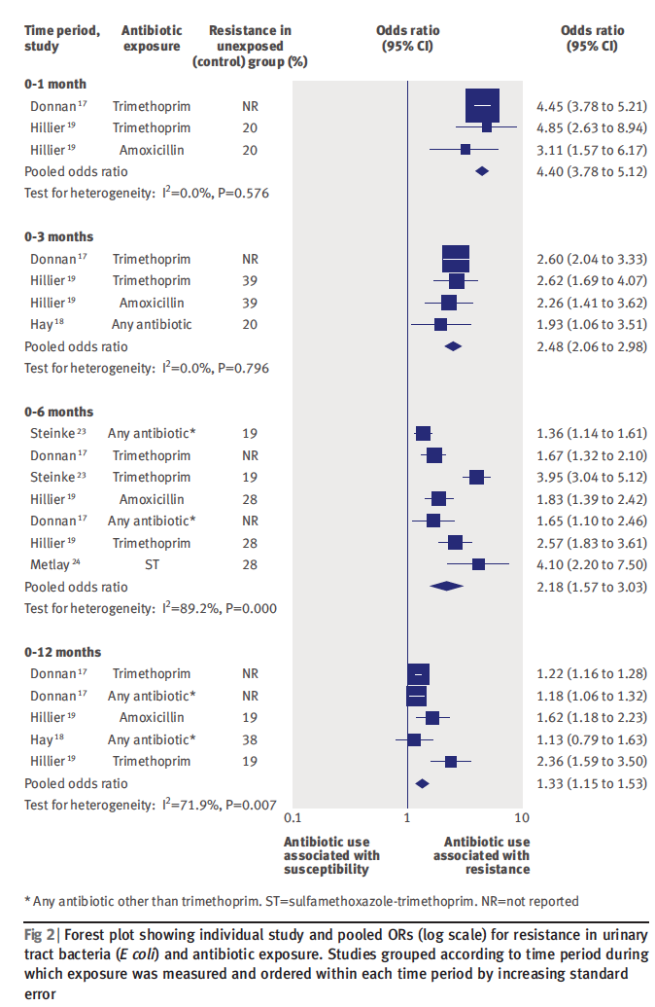

Slide 12
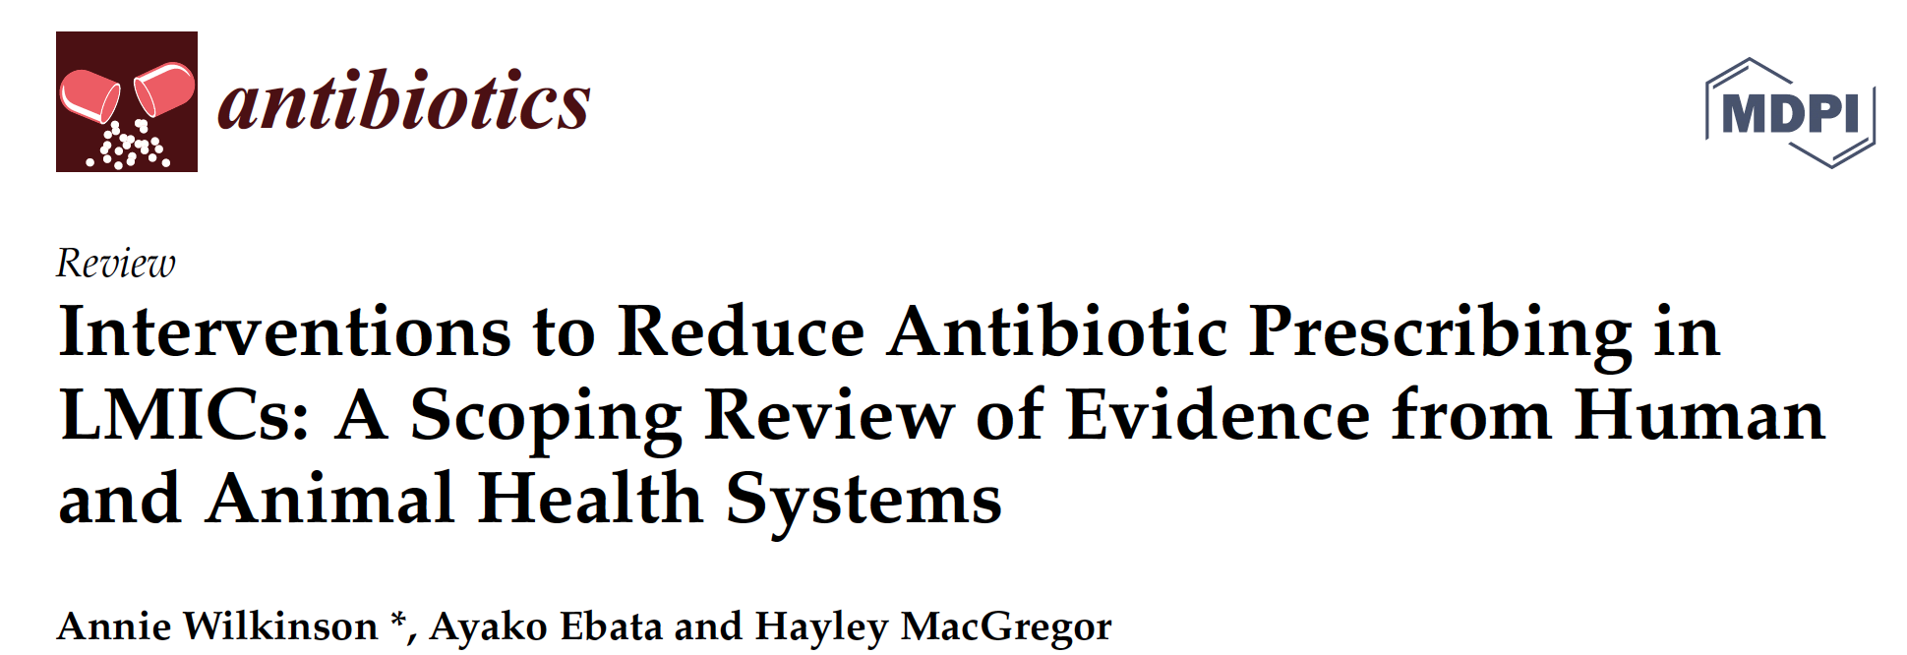
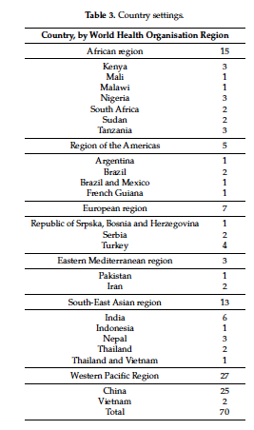
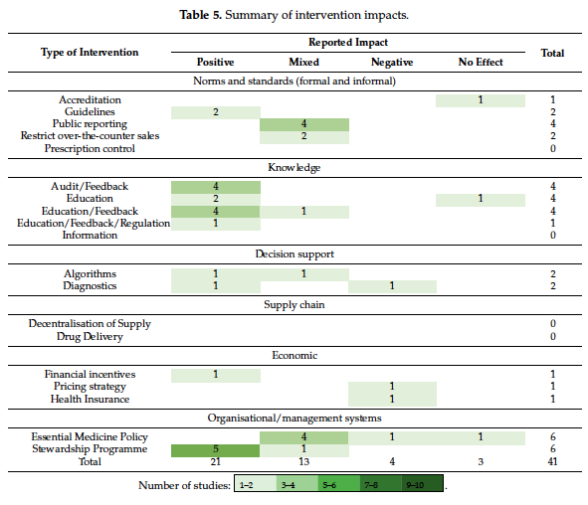

Slide 13

What is being implemented- human ams ?

Slide 14
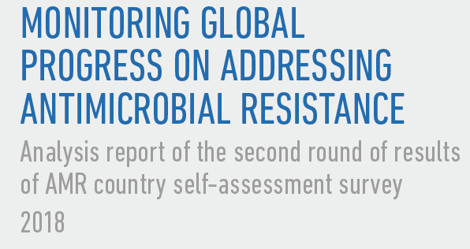
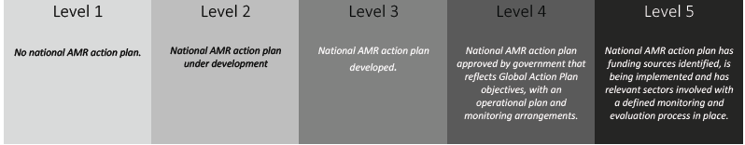

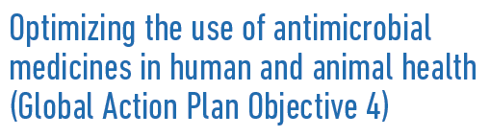
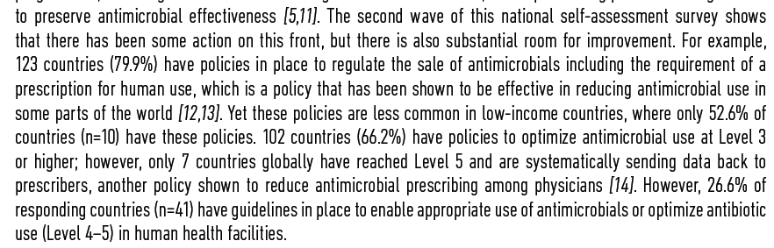

Slide 15

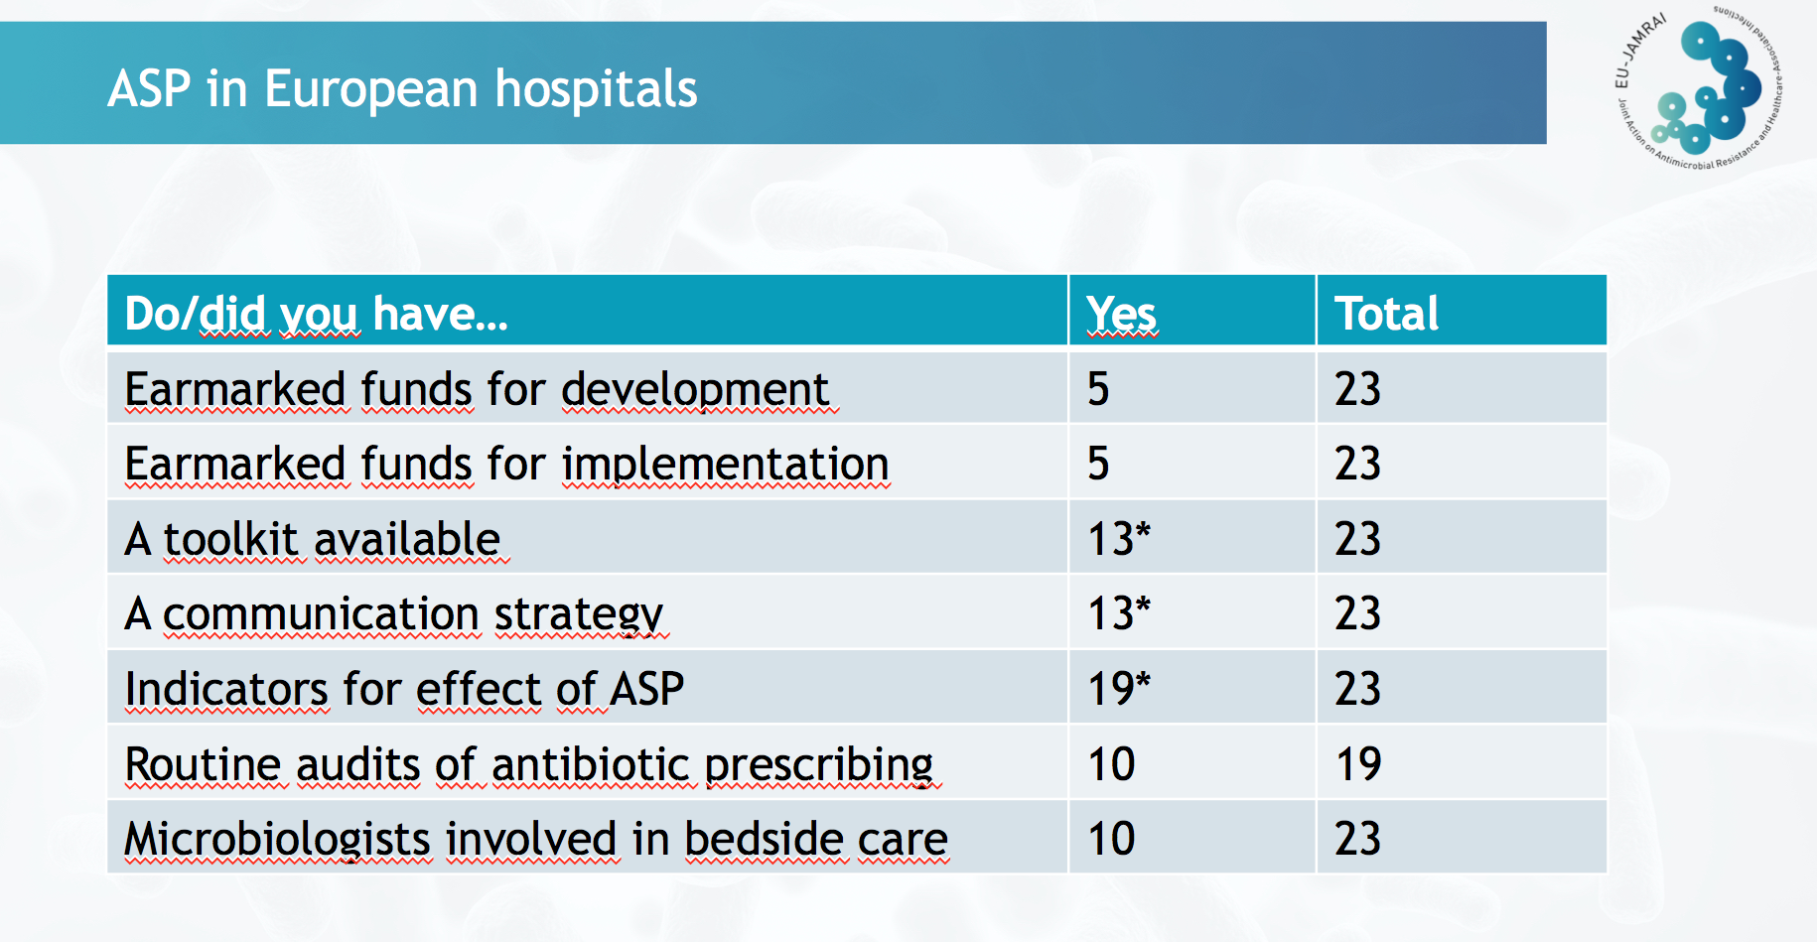
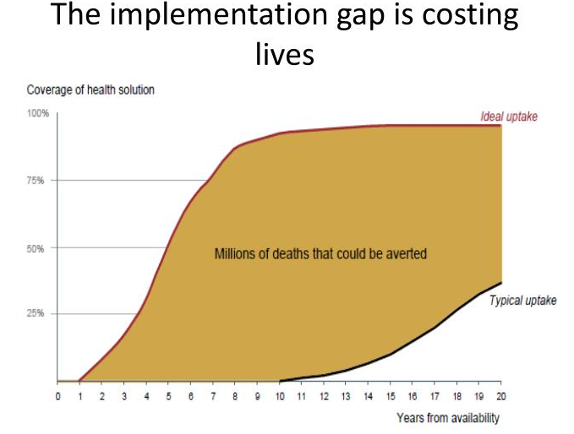
We have just heard similar results from european survey – kACELNIK ET AL
WKP 7
Vienna 11/18

Slide 16
AMS IN HUMAN IS A WHOLE SYSTEMS APPROACH: Doing AMS IN ISOLATION IN ONE COMPONENT OF THE SYSTEM WILL NOT BE SUCCESSFUL IN THE LONG TERM

Slide 17
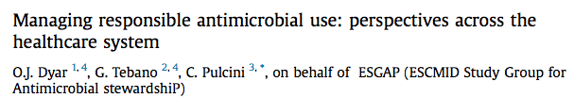
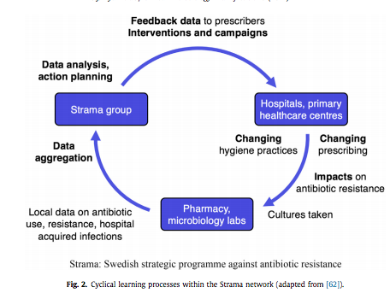
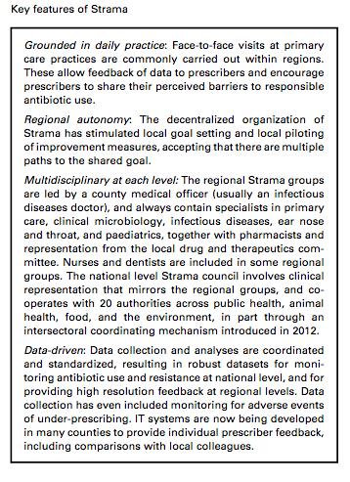
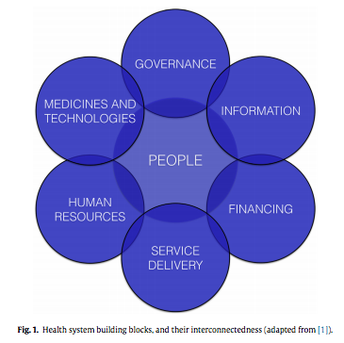

Hospital
LTCF
Primary care
Others
Example of
One system
Approach

Slide 18
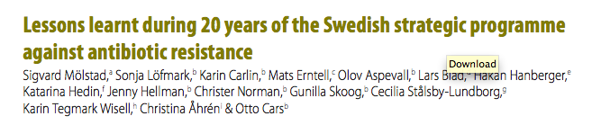
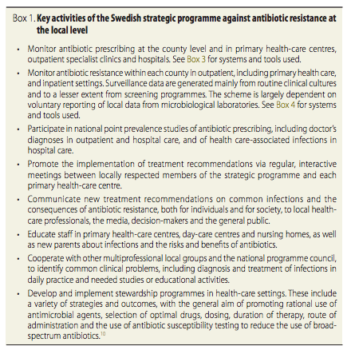
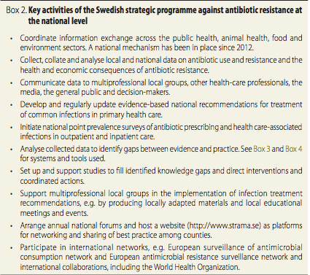
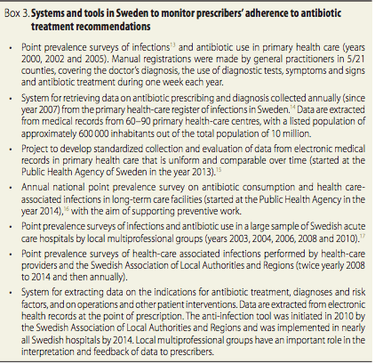

Slide 19
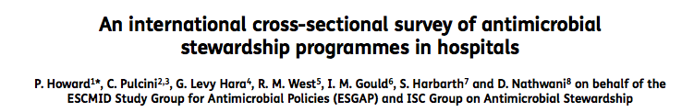
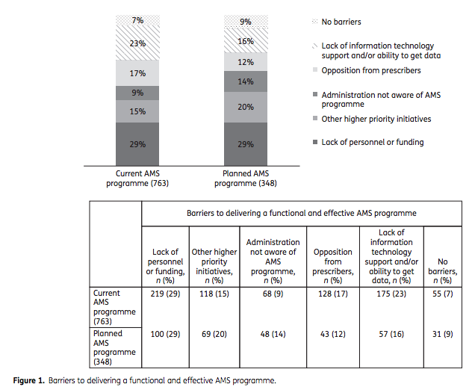


Slide 20
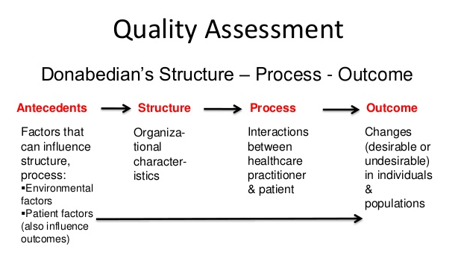
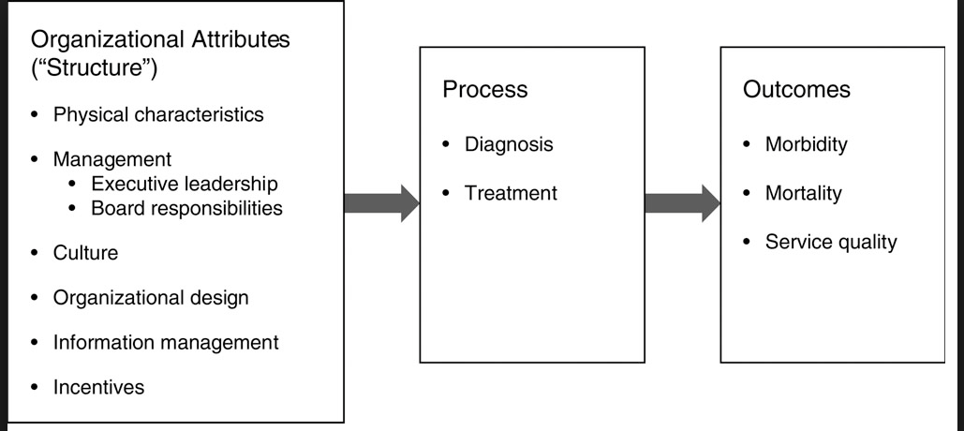

Slide 21

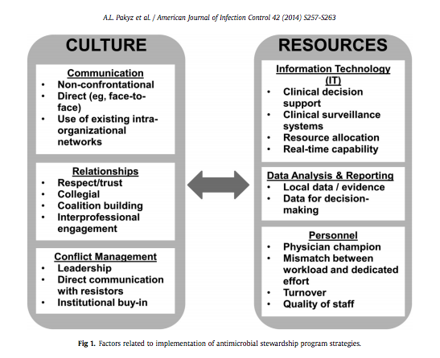

Slide 22
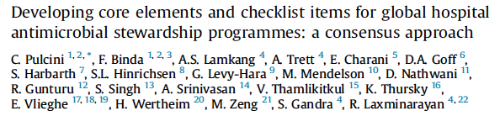
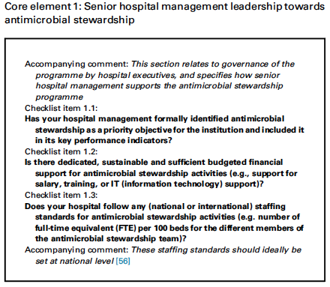
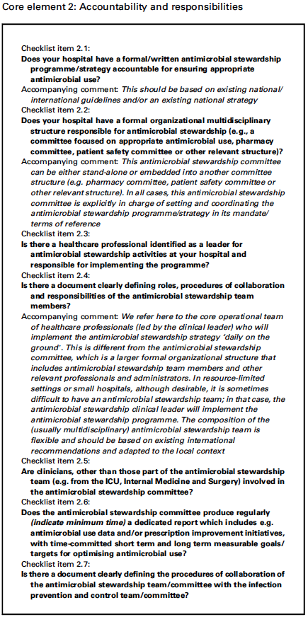
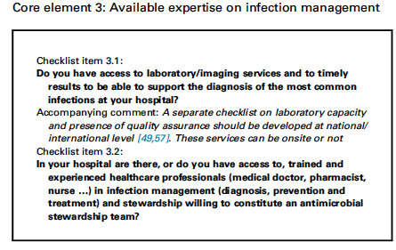
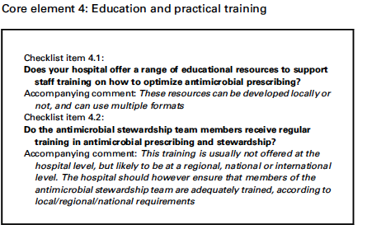
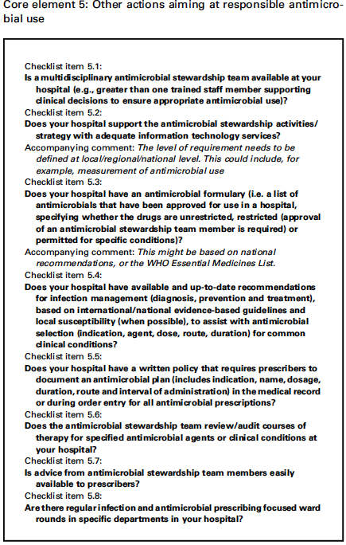
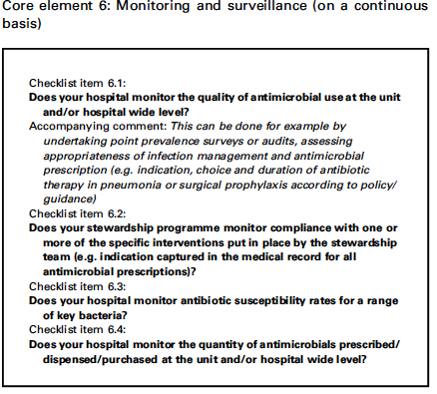
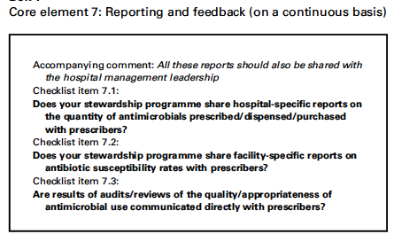
AMS: Structure + Process = Outcomes
Core elements:
Senior hospital management leadership towards AMS
Accountabilities and responsibilities
Available expertise on infection management
Education and practical training
Other actions aiming at responsible antimicrobial use
Monitoring and surveillance (on a continuous basis)
Reporting and feedback (on a continuous basis)

Slide 23
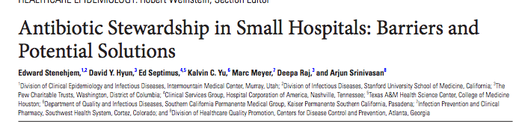
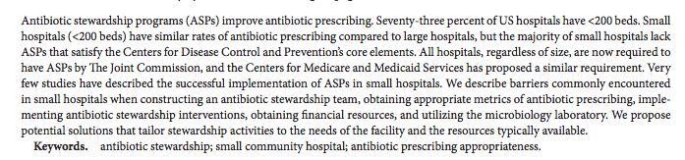
Using local resource, with flexible & novel skills
Leadership / multi-disciplinary
Networks
Tele-health
Use of non ID clinicians
Allignment to other AMS relate activity – QI, patient safety etc
Data

Slide 24
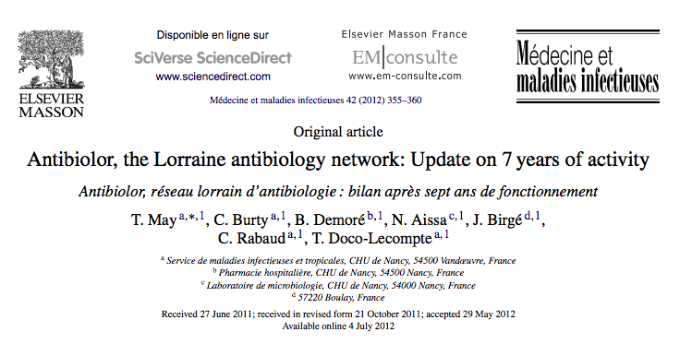

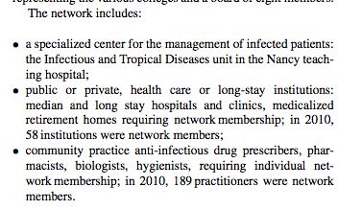




Slide 25
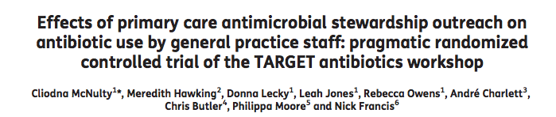


Slide 26




Slide 27



NEW
LAUNCHED
11/18
Focus on
Care home
Education
Key nursing activities include:
Triage, and initial infection control precautions
Medication allergy assessment and reconciliation
Timely ordering and administration of antibiotics
Early and appropriate collection and submission of specimens for culture
Antibiotic timeout and de-escalation
Implementation of quality and safety bundle measures
Central communicator among prescribers, pharmacy, lab, discharge planners and consultants
Olans RN et.al, The critical role of the staff nurse in antimicrobial stewardship—unrecognized but already there.
Clin Infect Dis 2016;62(1):84-89. http://cid.oxfordjournals.org/content/62/1/84.full.pdf+html

Slide 28




THE GROWING CHALLENGE

Slide 29





Slide 30


LOTS OF GOOD PRACTICE
NEED TO TAKE A NOVEL SYSTEMS AND
HUMAN FACTORS APPROACH TO
IMPLEMENTING STEWARDSHIP

Slide 31

From: Implementing Antimicrobial Stewardship in Long-term Care Settings: An Integrative Review Using a Human Factors Approach
Clin Infect Dis. 2017;65(11):1943-1951. doi:10.1093/cid/cix566
Clin Infect Dis | © The Author 2017. Published by Oxford University Press for the Infectious Diseases Society of America. All rights reserved. For permissions, e-mail: journals.permissions@oup.com.
Notes:
Figure 1. Adaptation of the work system from the Systems Engineering Initiative for Patient Safety (SEIPS) model to antimicrobial stewardship interventions in long-term care. Italicized text indicates the working definition used for each human factor. Bulleted text details specific interventions used in the studies reviewed here; bolded text indicates specific approaches that supported a quantifiable change in antibiotic use in accordance with principles of antibiotic stewardship. As detailed in the text, several of the interventions incorporated 2 or more human factors. Abbreviations: EMR, electronic medical record; ID, infectious disease; LTACH, long-term acute care hospital; VA, Veterans Affairs.
31

Slide 32


Measure – Success & Failures

Slide 33
ANTIBIOTIC PRESCRIBING
INDICATORS/METRICS
Process measures
Outcome measures
[we use trends and time series analysis]
Antibiotic Consumption rates
CDI rates
SSI rates
Surveillance of resistant pathogens
Mortality [SMR’s]
Cost of pharmaceuticals
LOS
Mortality
SSI’s
Readmissions to hospital within 30 days of discharge
Admissions to ICU
Rate of complications
Treatment related toxicity e.g aminoglycoside related toxicity
Amount of antibiotic in DDD/100 bed days
  Promoted antibiotic
  Restricted antibiotics
  Days or length of therapy
  Compliance with acute empiric guidance
    documentation in notes and compliance with policy
  Compliance with surgical prophylaxis
    < 60 min from incision, < 24 hours and compliance with local policy
  Compliance with “other bundles”
Balancing measures

Slide 34



NHS Scotland: Use of antibiotics in primary care
items/1000/day 2006-2015

Slide 35





High risk antibiotic [HRA] use in hospital
Medicine
33% reduction in HRA
24% reduction in CDI
No change in mortality

Slide 36




Desirable outcome :

Slide 37





Slide 38




= P
Phase 1 decrease of 21.3DDD/100,000pop, p=0.001
Phase 2 decrease of 12.3 DDD/100000 pop, p=0.05

Slide 39




NHSS
NHST

Slide 40



Slide 41


Range of process & outcome measures
For primary and secondary care

Slide 42





Slide 43
Does more timely treatment with antibiotics offers reduced mortality in sepsis & septic shock ?
N = ~85000, hospitalized, US retrospective data base [1,2]
Only beneficial difference in mortality in patients with septic shock
N=2018, pre-hospital v EM, Netherlands, >95% of patients no septic shock [3]
96 mins median earlier time to administration of antibiotics
No difference is mortality in those without septic shock
  1. Seymout CW et al NEJM 2017; 376: 2235-2244; 2. Liu VX et al Am J Resp Crit Care Med 2017; 196(7): 856-863
  3. Alam N et al. Lancet Resp Med 2018; 6(1): 40-50
  ANTIBIOTIC MAY BEING USED WITHOUT CARE AND CAUSING HARM

Slide 44



Slide 45



2018

Slide 46




Implementation

Slide 47



Martin C Gulliford et al. BMJ 2019;364:bmj.l236
©2019 by British Medical Journal Publishing Group

Slide 48







> 50000 participants
Since 2015

Slide 49
ARE WE WINNING ?

Slide 50





Slide 51
CURRENT STRATEGIES AT BEST 20-30% REDUCTION IN ANTIBIOTIC CONSUMPTION
WHAT WILL GET US TO THE NEXT LEVEL ?

Slide 52

Creating, supporting and Implementing antimicrobial stewardship

Slide 53

“Society’s huge investment in technological
innovations that only modestly improve efficacy,
by consuming resources needed for improved delivery of
care, may cost more lives than it saves.”
“Health, economic, and moral arguments make the case
for spending less on technological advances and more
on improving systems for delivering care.”

Slide 54








Stuck around 20-30% mean
Of reducing antibitoic consumption

Slide 55



Slide 56







Slide 57


